Slide 1
Wednesday 5th December until this morning
06:59 Stable beams fill #3375, L ~ 6.8e33 cm-2s-1.
10:40 Beam dump, trip of RD2.R5. Integrated L 72 pb-1 in 3h39m.
Access for TED TI2 repair:
17:00 TED back in access chain. Pre-cycling.
END OF SPECIAL ACCESS PROCEDURES
B1V tune trimmed flat in squeeze. B2H+V trimmed -5e-3 after 700 s in the squeeze.
19:00 Injecting.
20:30 Beam dumped on flat top, RF trip M1B2.
22:59 Stable beams fill #3378, L = 7.1e33 cm-2s-1
01:31 Beam dumped due to trip of RB.A81.Integrated 55 pb-1 in 2h31m
An access (to both UJ87 and UJ14) was required as the quench loop couldn't be closed remotely. We also gave an access to UW25 to change a CV supervision card. The MAD of UJ87 and UJ14 did not work properly and long time (many attempts) was needed to get the bikes in (to enter UJ14 bike have been finally folded and brought through the PAD!!!)...the issue must be followed up!
08:30: UJ14 still open – cannot close the machine, RB not repaired yet

Slide 2
Fill #3377
Different tune shift at the end of the squeeze
B1V tune trimmed flat in squeeze.
B2H+V trimmed -5e-3 after 700 s, about 1 m, in the squeeze.
Different extraction bump in the PS
Filling with losses, steering could not improve
Average level of losses of 35% on beam 1 and 60-70% on beam 2
Not very good, but not clearly worse than the day before…
Enhanced satellites are on
Dumped at flat top due to RF trip

Slide 3
RF – what happened to RF B2?
Tuesday evening 22:25 RF trip B2
Trip of ACSLine1B2 ACSLine3B2 ACSLine2B2
Complicated access procedure o-night due to TI2 TED
Wednesday when coming back at 17:57, no beam
Trip of ACSLine8B2 ACSLine5B2 ACSLine6B2 ACSLine7B2
Wednesday evening at end of ramp at 20:24
Trip of ACSLine1B2 ACSLine4B2 ACSLine3B2 ACSLine2B2
Trip of the module due to noise on current reading, but back to stable value after the trip. RF piquet changed a threshold value. If trips again, reset and restart as the intervention would require HV intervention with second specialist….

Slide 4
Fill #3378
As on previous fill
Different tune shift at the end of the squeeze
Different extraction bump in the PS
Injection still bad
Vacuum spikes on the ramp Q6.R5
Initial lumi did not reach any records
But happy to be in stable beams again!

Slide 5
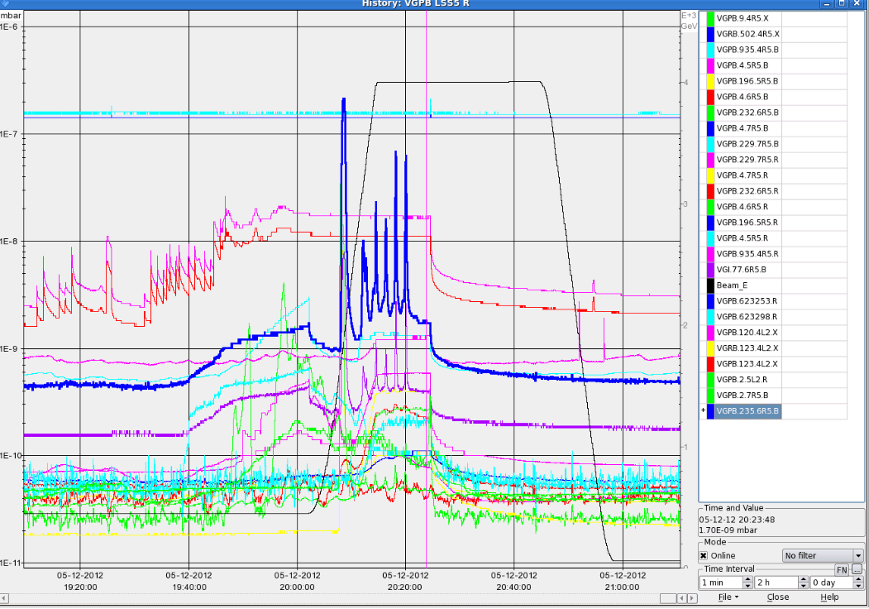
Vacuum over the ramp: Q6R5
1e-6
1e-7

Slide 6
25 ns Programme I
Coordination: GG² G. Arduini, G. Rumolo, G. Iadarola

Slide 7
25 ns Programme II

