Slide 1
Tuesday morning
09:30 Beam dump, SIS dump due to lost connections with FCG FECs.
Coincides with starting a development SIS server to test new interlocks for 25ns scrubbing.
There are 2 problems:
The IT hyperV machines that we have to use for development are (too) slow,
A ‘bad’ client can, by not diguesting the CMW data that it receives, perturb a FEC to the level where it stops data delivery to clients (timeouts of minutes…).
Prepare for high brightness 50 ns beam test.

Slide 2
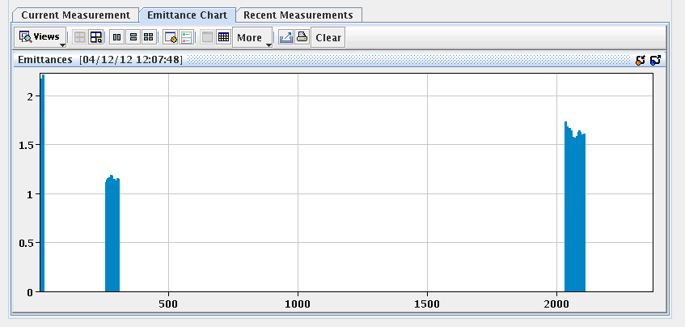
High brightness
12:00 Filling a mixture of high brightness and standard 50 ns.
Emittance for HB beam ~ 1-1.2 um, standard 1.4-1.6 um.
13:00 1 hour of stable beams with high brightness bunches.
6 bunches that are not colliding in IR1/5 suffered heavy losses when octupoles were turned down.
Standard
High B

Slide 3
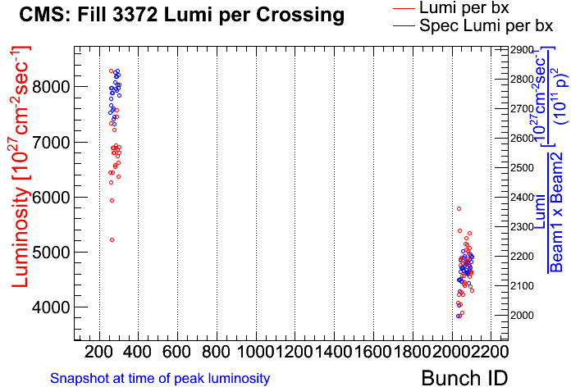
Seems that the relative brightness reduction is maintained with few bunches. Would be interesting to see with a completely filled machine !

Slide 4
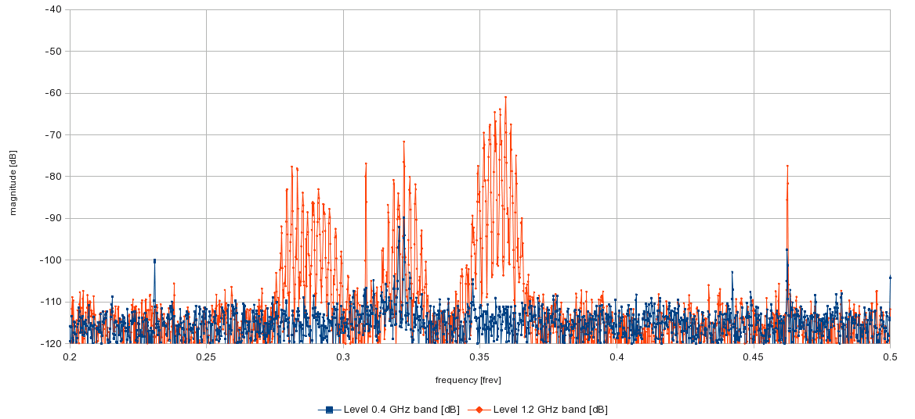
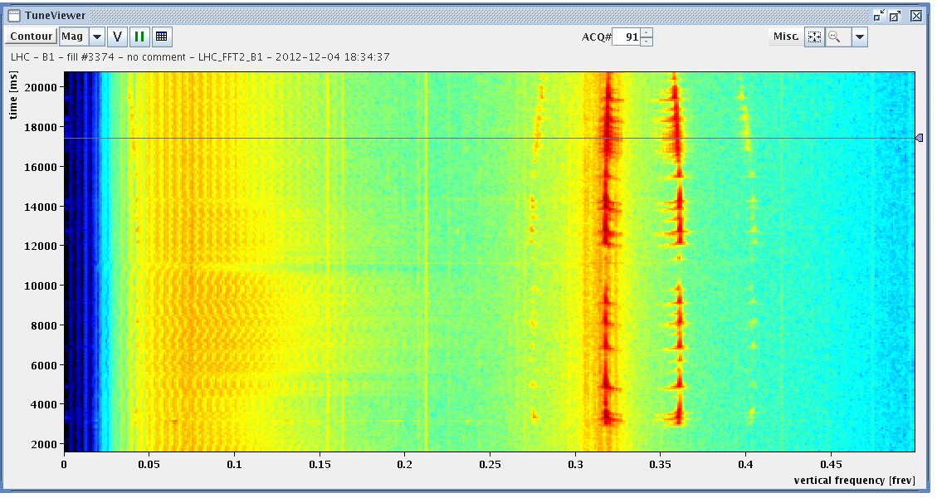
Tuesday afternoon
17:30 Refilling for physics.
Instability at end of squeeze. Possibly intra-bunch as more prominent in high frequency band.
18:40 Stable beams fill 3374, 6.9e33 cm-2-s-1.
TCLs opened for loss / cryo studies.

Slide 5
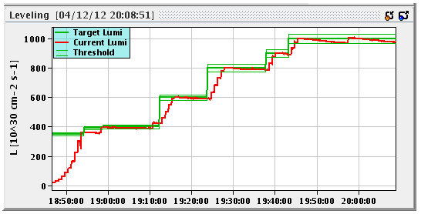
Tuesday evening
LHCb at 1e33…
Richard: The VELO, ST , all CALOs and MUON are in the data taking and all detectors are behaving well!
22:25 Beam dump – RF trip, 70 pb-1.

Slide 6
Night
23:30 Need access to IP4. Starting the procedure.
00:30 TED out of chain.
RF intervention on circuit breaker.
05:00 Machine back. Preparing injection.
07:00 Stable beams fill #3375, 6.8e33 cm-2s-1.

Slide 7
Compatibility 25ns – ions SPS
In a meeting involving all concerned parties it was agreed that the scrubbing, RF and OP teams should check the quality of the 25 ns beam in the SPS in parallel with the NA61 ion beam delivered to physics (with the PS 80 MHz cavity relay gap open).
Conclusion of the SPS test are similar to the observations made at the PS: it should be possible to inject and use the 25 ns beam for LHC scrubbing in parallel with ions for NA61. The electron cloud signals, transverse emittance, and beam profiles with satellite detection were recorded and did not exhibit visible difference along the SPS cycle between relay gap open and relay gap closed. More offline analysis will come tomorrow.
As agreed at the meeting, the final test is to inject the 25 ns beam into the LHC in parallel with ions for NA61 on Thursday.

Slide 8
Today
~ 5 hour intervention to repair the TED TI2.
Access will be prepared for 12:00.
Then a last fill before 25 ns setting tomorrow morning.

