Slide 1
Scrubbing progress - 10/12/2012
G. Arduini, H. Bartosik, G. Iadarola, G. Rumolo
Machine Coordinators: J. Uythoven J. Wenninger
Cryogenics, Damper, EN/STI, Injection,
Operation, Vacuum teams
Several ABP and RF colleagues contributing to measurements

Slide 2
Aims of the 2012 scrubbing run
Collect additional information on the evolution on the Secondary Electron Yield as a function of the electron dose when low SEY are achieved (in order to define post-LS1 scrubbing strategy)
Further reduce the SEY in the arcs and straight sections to allow ramping to 4TeV at least a few hundred bunches with 25ns bunch spacing (for beam-beam, e-cloud, and UFO studies and for 25ns pilot run)
In parallel learn on possible other differences 25 ns vs. 50 ns at 450GeV (concerning heating, stability, UFOs)

Slide 3
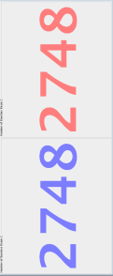
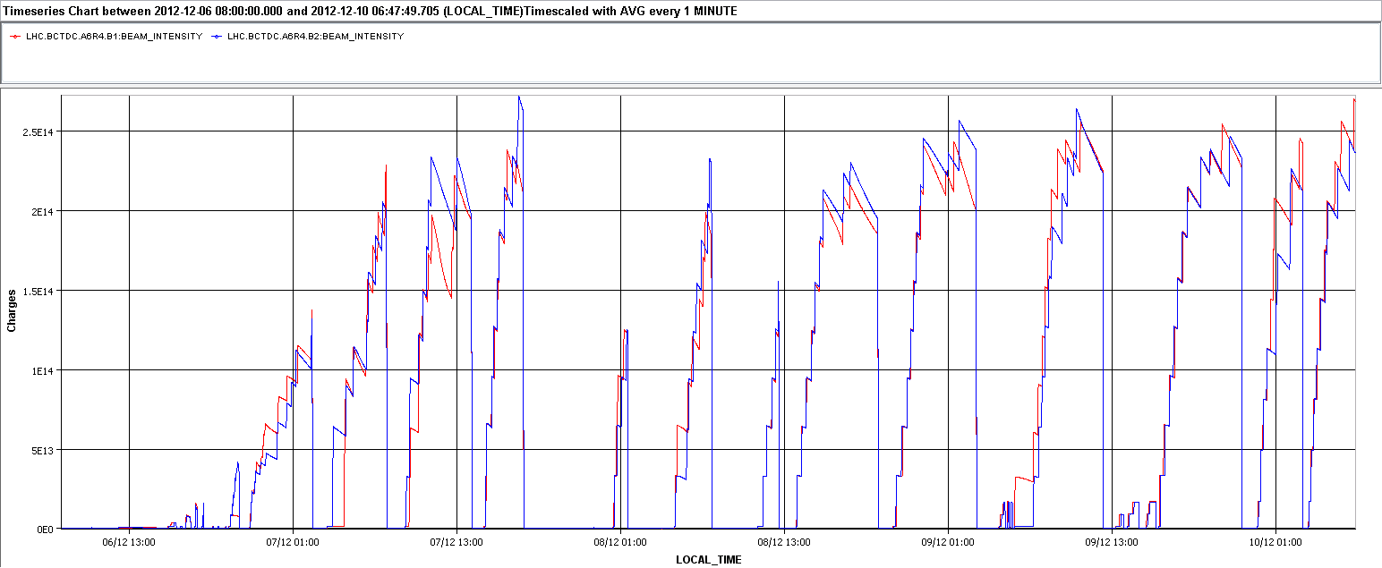
Scrubbing Overview
I_{B1} I_{B2}
Cryo-regulation MSR8+cycle
TDI outgassing, Cryo-regulation MSR8+cycle
Investigations on blow-up
Investigations on blow-up+POPS
ALICE UFO Cryo-regulation MSR8+cycle
Inj. setting-up
Damper setting-up
Fast intensity ramp-up and overall excellent efficiency
Beam under control (damper, chromaticity, octupoles) in spite of the record intensities (up to 2.7x10¹⁴ p, 2748 bunches per beam)
10/12/2012

Slide 4
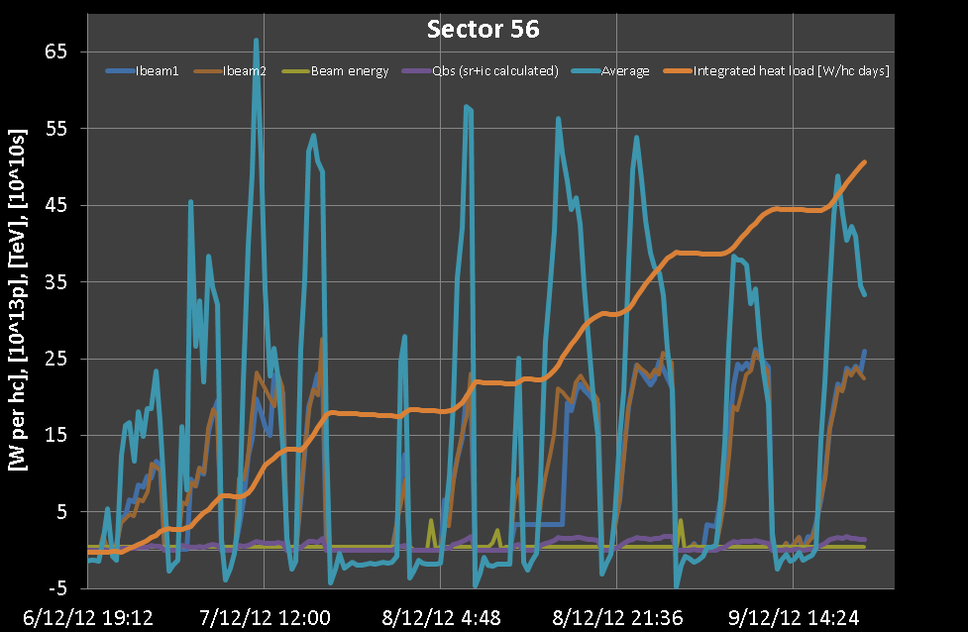
Heat load evolution
The heat load on the cold beam screens can be used to estimate the effectiveness of the scrubbing process (used also on-line to decide when to dump and refill).
Thanks to L. Tavian

Slide 5
Main limitations
No fundamental show-stopper was found. It was possible to keep a satisfactory scrubbing dose all along the scrubbing period.
The overall efficiency was determined by:
Vacuum pressure in the MKI region (during the initial stages):
  The interlock levels were gradually increased (tanks: 2∙10⁻⁹ → 4∙10⁻⁹, interconnects: 1∙10⁻⁸ → 4∙10⁻⁸)
Cryogenics when high intensity were achieved:
  Limited cooling power at stand alones in P6 and 8 required to wait some time (~10min.) between successive injections
  Some care to be taken also when dumping the beams (the abrupt change in the heat loads cause fluctuations on 120A current lead temperature → precycle needed)

Slide 6
Other limitations
Vacuum pressures along the ring were continuously monitored by the vacuum team
  Apart from MKIs, no slow down coming from pressure rises
Thanks to TE-VSC and EN-STI

Slide 7
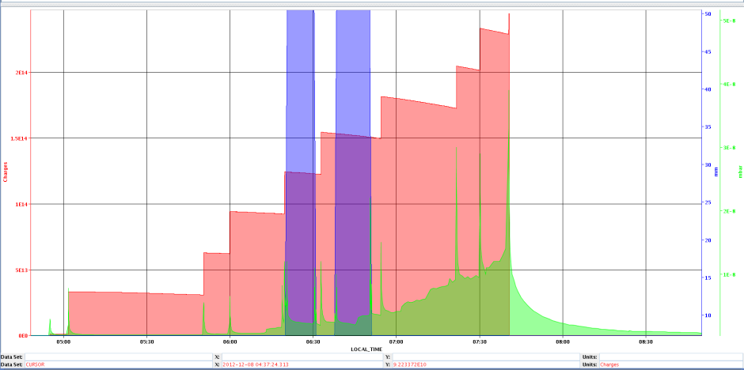
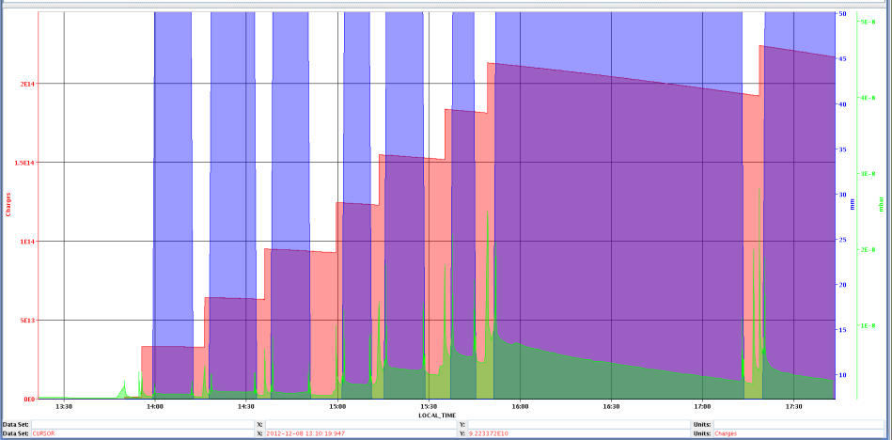
Other limitations
Vacuum pressures along the ring were continuously monitored by the vacuum team
  Apart from MKIs, no slow down coming from pressure rises
TDIs had to be opened after each injection in order to keep heating and outgassing under control.
A. Lechner

Slide 8
Other limitations
Vacuum pressures along the ring were continuously monitored by the vacuum team
  Apart from MKIs, no slow down coming from pressure rises
TDIs had to be opened after each injection in order to keep heating and outgassing under control.
A. Lechner

Slide 9
Other limitations
Vacuum pressures along the ring were continuously monitored by the vacuum team
  Apart from MKIs, no slow down coming from pressure rises
TDIs had to be opened after each injection in order to keep heating and outgassing under control.
  Last evening one jaw (on the TDI in point 8) got blocked in open position (twice) → The EN/STI piquet could remotely reset the motor
Thanks to TE-VSC and EN-STI

Slide 10
Other limitations
Vacuum pressures along the ring were continuously monitored by the vacuum team
  Apart from MKIs, no slow down coming from pressure rises
TDIs had to be opened after each injection in order to keep heating and outgassing under control.
  Last evening one jaw (on the TDI in point 8) got blocked in open position (twice) → The EN/STI piquet could remotely reset the motor
No particular heating was observed on other sensitive elements (e.g. collimators) (larger bunch lengths and smaller bunch intensities)
Thanks to TE-VSC and EN-STI

Slide 11
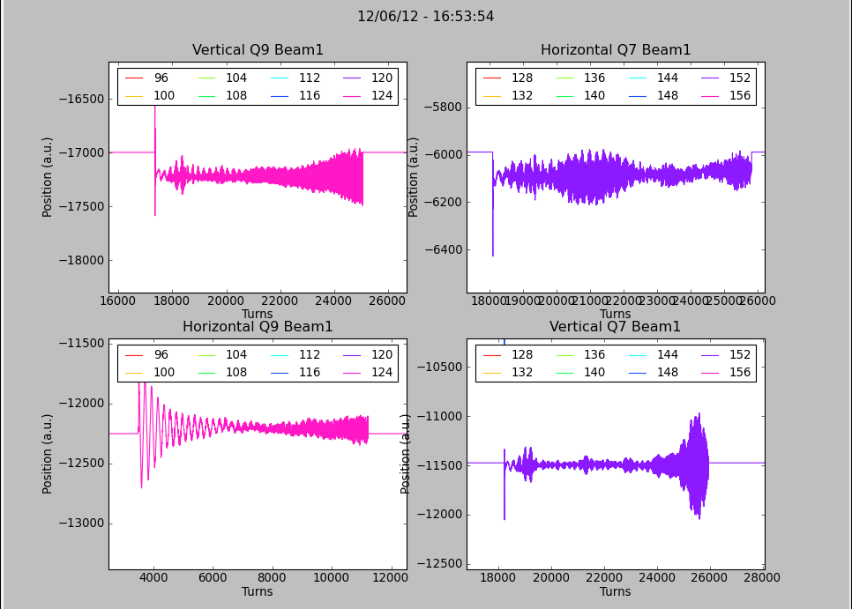
Beam quality evolution (preliminary)
Initial conditions:
  Transverse instability leading to beam dump right after the injection of a single train of 72 bunches (with chromaticity at 2 units)
Thanks to R. De Maria,
W. Höfle, D. Valuch

Slide 12
Beam quality evolution (preliminary)
Initial conditions:
  Transverse instability leading to beam dump right after the injection of a single train of 72 bunches (with chromaticity at 2 units)
  With high chromaticity settings (15 units) it was possible to circulate trains of 72b. (injection of more the 1 batch from SPS was often leading to beam dump due to fast losses)
  Very poor lifetime (typical e-cloud like loss pattern)

Slide 13
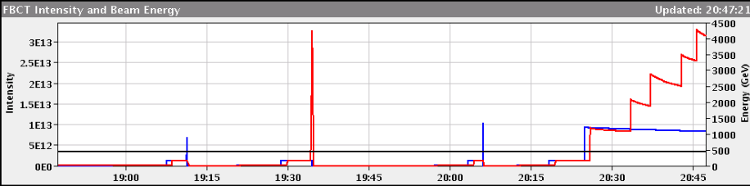
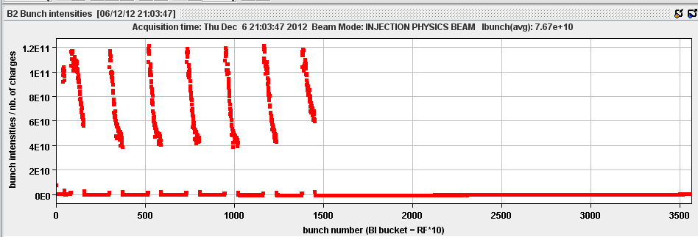
Beam quality evolution (preliminary)
Initial conditions:
  Transverse instability leading to beam dump right after the injection of a single train of 72 bunches (with chromaticity at 2 units)
  With high chromaticity settings (15 units) it was possible to circulate trains of 72b. (injection of more the 1 batch from SPS was often leading to beam dump due to fast losses)
  Very poor lifetime (typical e-cloud like loss pattern)

Slide 14
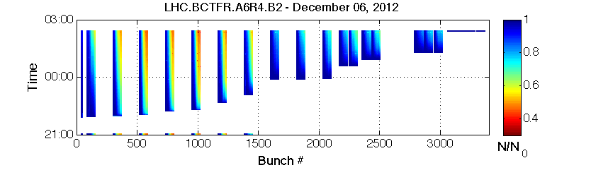
Beam quality evolution (preliminary)
Bunch by bunch lifetime strongly improved within the first scrubbing fill (carried out with train of 72b. with 3.7µs batch spacing).
Thanks to H. Bartosik

Slide 15
Beam quality evolution (preliminary)
Bunch by bunch lifetime strongly improved within the first scrubbing fill (carried out with train of 72b. with 3.7µs batch spacing).
Filling scheme with minimum possible batch spacing and maximum number of bunches was employed for the following fills.
Between Friday Dec. 7th and Sunday Dec. 9th there were 9 scrubbing fills with more than 2000b. per beam.

Slide 16
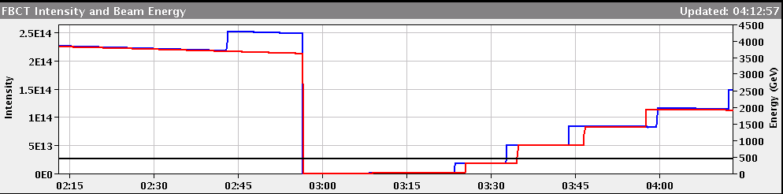
Beam quality evolution (preliminary)
Beam lifetime
Friday11 Dec
Sunday 10 Dec

Slide 17
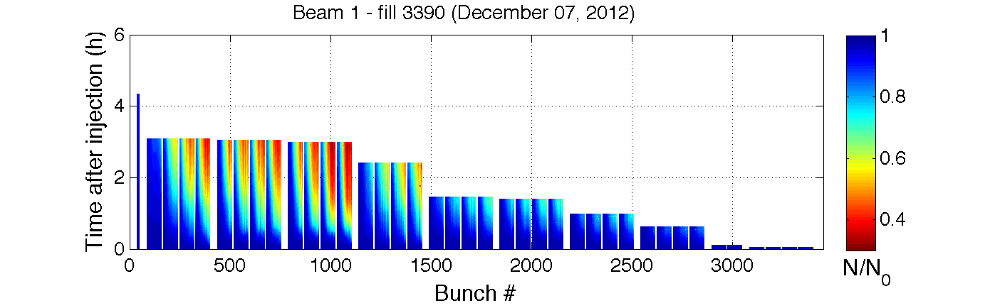
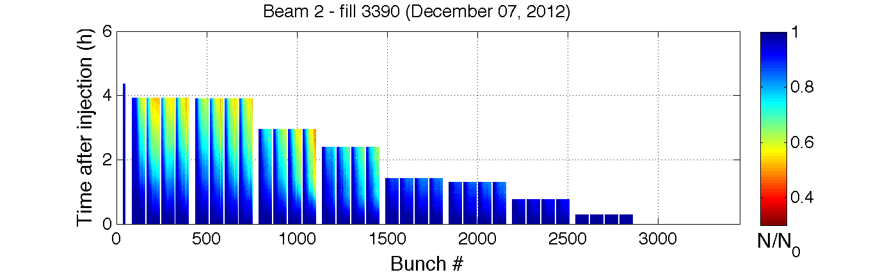
Beam quality evolution (preliminary)
Beam lifetime – Friday Dec. 7th
Thanks to H. Bartosik

Slide 18
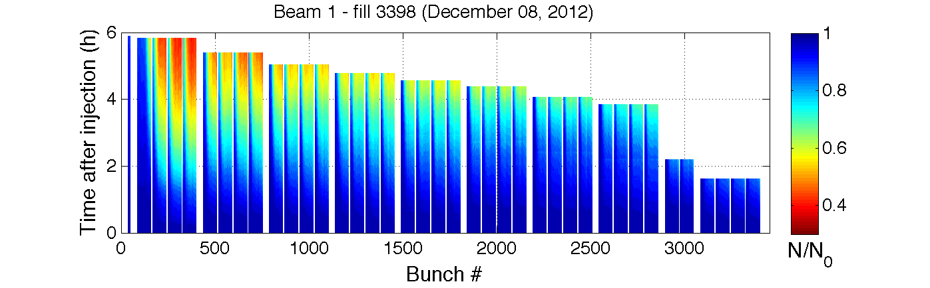
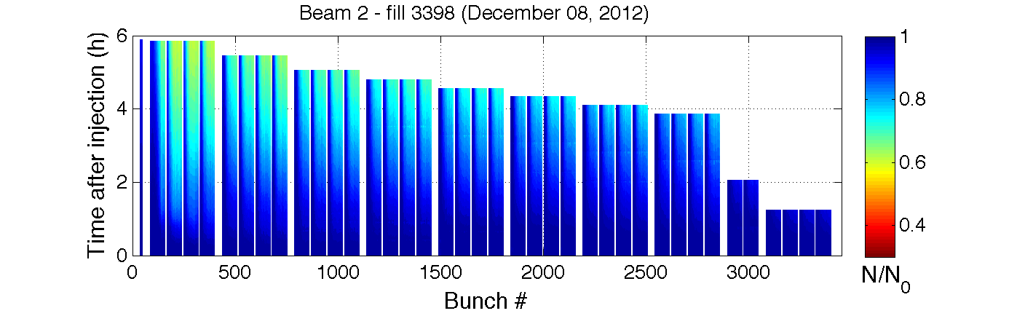
Beam quality evolution (preliminary)
Beam lifetime – Friday Dec. 8th
Thanks to H. Bartosik

Slide 19
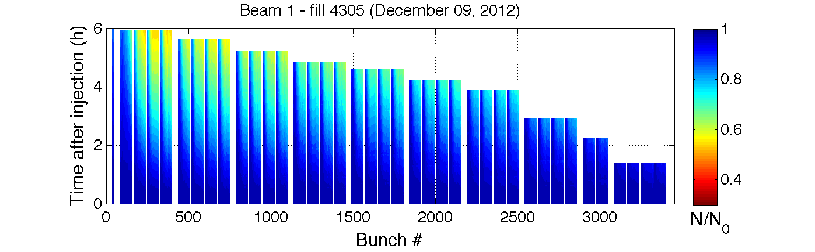
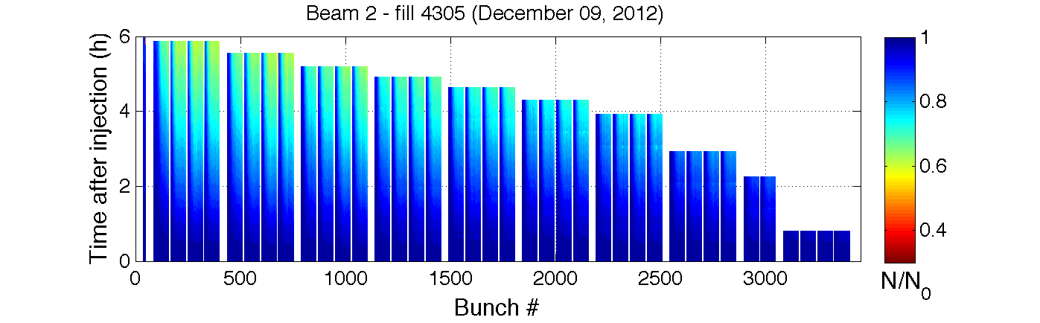
Beam quality evolution (preliminary)
Beam lifetime – Sunday Dec. 9th
Thanks to H. Bartosik
10/12/2012

Slide 20
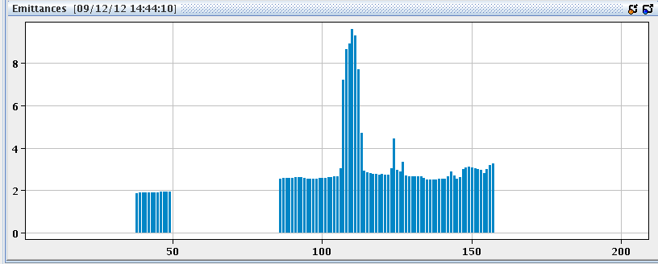
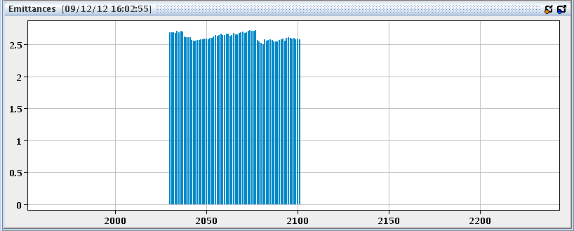
Emitt. blow-up in the first train of 72b.
Important emittance blow up (likely not due to e-cloud) observed on a certain number of bunches of the first train which is injected.
Effect suppressed by increasing the octupole strength from -0.5 to -2.0
Low oct. strength
High oct. strength
10/12/2012

Slide 21
In conclusion
3.5 days of scrubbing with 25ns beams at 450GeV were carried out with a satisfactory electron dose (heat load) rate
e-cloud effects on the beam were strongly mitigated but not suppressed yet (heat load measurements confirm that there is still e-cloud in the arcs)
Important information on the SEY evolution vs. electron dose is being collected
10/12/2012

Slide 22
Thanks for your attention!

Slide 23
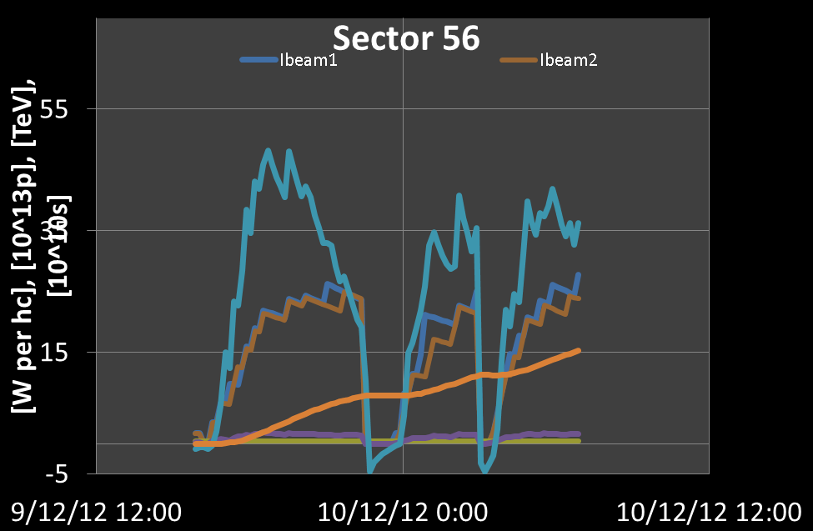

Slide 24
25 ns beam scrubbing 08-09 Dec’12
Arc half-cells
L. Tavian

Slide 25
25 ns beam scrubbing 08-09 Dec’12
Inner triplet cooling loops
L. Tavian

Slide 26
25 ns beam scrubbing 08-09 Dec’12
SAM cooling loops
L. Tavian

Slide 27
25 ns beam scrubbing 08-09 Dec’12
Semi-SAM cooling loops
L. Tavian

