Slide 1
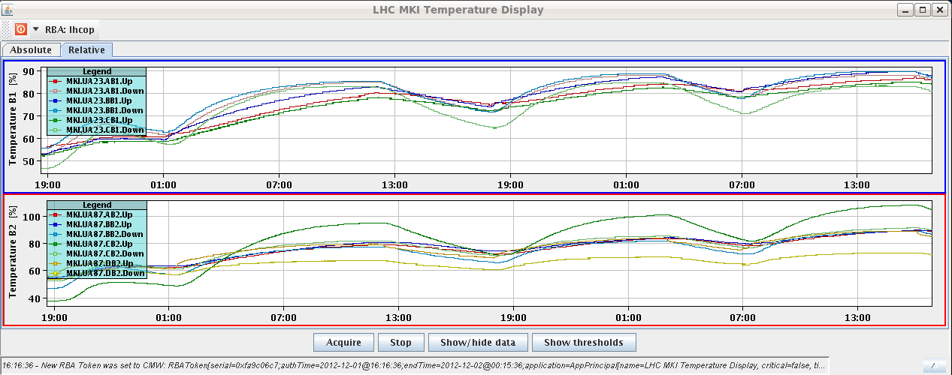
Saturday 1.12.
08:12 Stable beams fill 3351
Initial luminosity
Atlas/CMS up to 6.9E33 cm-2s-1
ALICE at ~1E31 cm-2s-1
16:00 OP dump of fill 3351
120 pb-1 in 7.7 hours
MKI8_C_Up at ~108% of temperature interlock

Slide 2
Afternoon
Access:
TI2 TED movement could block anytime – don’t move anymore before repair
Attempt to put in place compensatory measures proposed by the DSO and disable TED in the “safe for beam” position; but not possible to get beam into the LHC when TED is disabled → reverted and updated procedure
New configuration for PS extraction bump (extraction conditions at the extraction septum in the PS are constant)
19:30 injecting and steering transfer lines
beam was dumped several times by LHCb
injection was not reproducible - several 144 shots passed OK
→ revert the PS settings to those used on the last fill: extraction bump, extraction kicker and RF settings

Slide 3
From PS
The problems encountered with the new cycle are not related to the new set of correctors used for the extraction but to a non conform copy of the RF settings and of the extraction kicker timing for the new cycle. This has resulted in larger satellite population and in particular of those in front and behind the main trains. These bunches are partly intercepted by the upper jaw of the TED and result in losses in LHCb
As a result of that we have reverted back to the standard cycle with the same satellite population as in the last two fills.

Slide 4
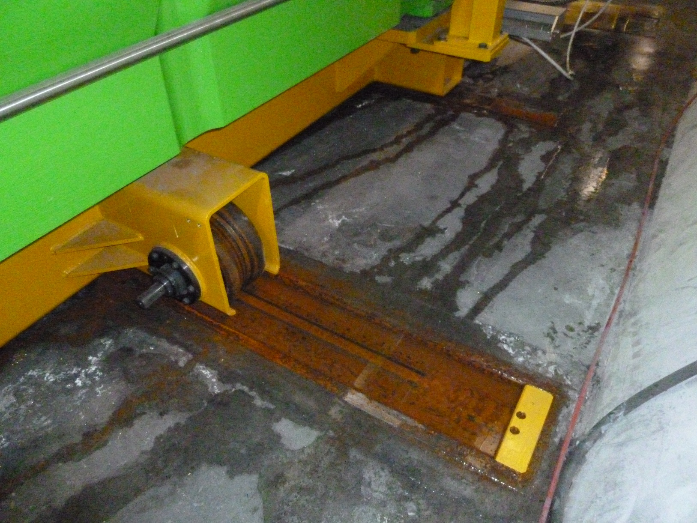
TED TI2 Rails
Repair to be done asap (next week)

Slide 5
TED TI2 Procedure
LHC Access Safety System (LASS)
EIS – Elements Importants pour la Sûreté (f-faisceau, m-machine)
EDMS 1255294 2.0
In TI2 the three EIS elements are the beam stopper TED 29132, MBIBH29314 and MSIB29529. Currently a mechanical fault prevents the TED moving
→ ensure that SPS chain 4 is in access mode whenever access is needed in the LHC; this chain includes TED6103 thus providing a mechanical block to any potential beam
Putting any LHC EIS out of chain makes it impossible to re-arm that chain for beam, so for each period of LHC access the TED must be removed and then replaced in chain in order to take beam
This temporary procedure replaces the automatic positioning of a beam block with a manual check that another block is in place → repair estimated less than one week

Slide 6
Night
23:30 beam dump during injection by RF crowbar event on M1B1 → reset
0:08 re-injecting fill 3359; Max losses
at injection: 35% of dump threshold
At start of ramp: 42%
1:23 beam dump in adjust: Slow losses close to roman pots (MQML 6R5) during collapse of IP1/5 separation bumps
2:30 injecting for fill 3360
IQC latched twice for B1 on TL BPMs
Losses at start of ramp up to 36%
3:55 stable beams fill 3360
Initial luminosity
Atlas/CMS up to 7.2E33 cm-2s-1
ALICE at ~0.9E31 cm-2s-1

Slide 7
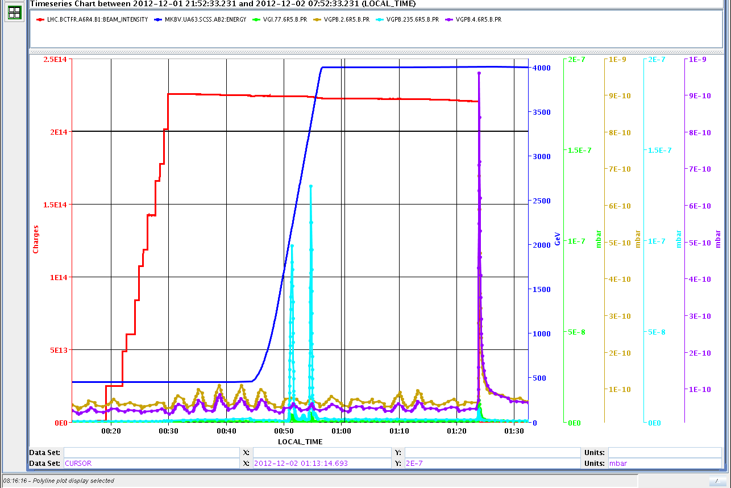
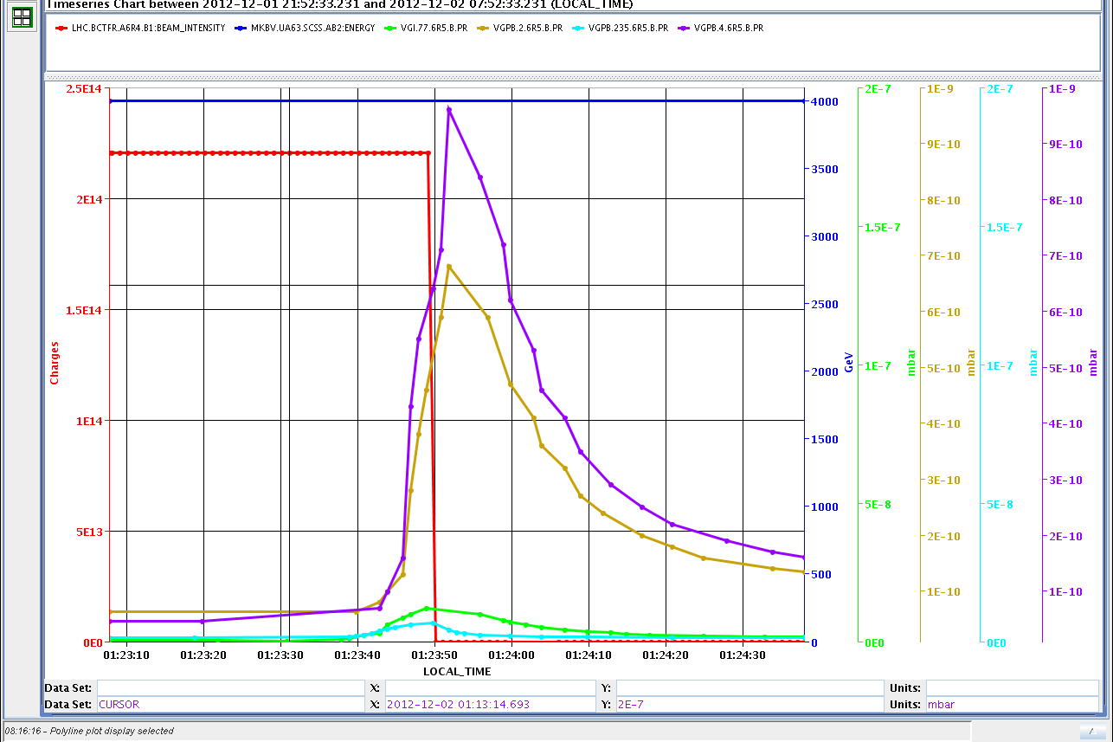
Vacuum around roman pot 6R5

Slide 8
Last 24 hours

Slide 9
Pending issues:
TI2 TED
ODH sensor in UP62. In case of access fire brigade to intervene first. Intervention required.
To come (next week):
High brightness beam test. Tests ongoing in the SPS with new PS extraction timing.
Monday: LHCb polarity change
Reactivation ATLAS BCM

