Slide 1
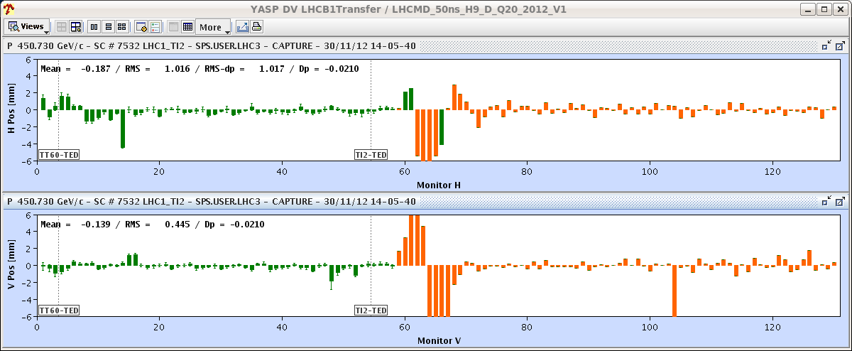
Friday 30/11
12:07 OP dump. End of fill #3347. ~156 pb-1 in 9.8 h
14:00-17:00 Attempt of injecting high brightness beam.
Beam dump due to ALICE trigger when injecting B1 with high brightness beam (24 bunches):
Requested B1
Extracted B1 from SPS
MKI8 (B2) kicker fired but not MKI2 (B1)
Beam not kicked and dumped on TDI in point 2.
ALICE trigger

Slide 2
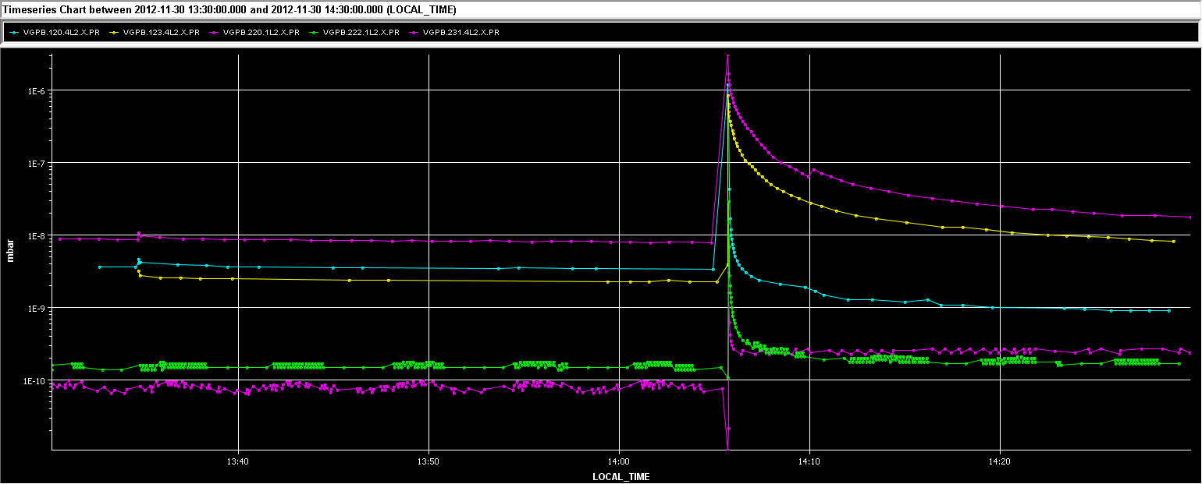
VGPB.231.4L2.X
VGPB.123.4L2.X
VGPB.120.4L2.X
VGPB.222.1L2.X
VGPB.220.1L2.X
Vacuum spike around TDI leading to vacuum valve closure

Slide 3
15 ms can make the difference…
Extraction time from PS (w.r.t. start of PS magnetic cycle) delayed by 390 ms to allow time for RF gymnastics for the h=9/batch compression/bunch merging
Injection time in the SPS (w.r.t. start of SPS magnetic cycle) delayed accordingly. I.e. injection occurring 1015 ms after start cycle
The injection warning event (Inj. -1s) and the bit defining the ring need to be present on the same cycle to update the destination in the telegram
Inj. -1s
Inj.
Next LHC Injection =
R2
R1
MKI8
MKI2
Thanks to J.C. Bau, J. Kozsar, N. Magnin,G. Hagman

Slide 4
Timing team looking at options to make the timing system more robust against these situations
S. Gilardoni and H. Damerau have already prepared another cycle with extraction timing advanced by 25 ms
17:00 Filling for physics #3350 after further enhancement of satellites in the PS
19:10 STABLE BEAMS #3350.Initial luminosity 6.7E33 cm-2s-1. ALICE initial luminosity ~1E31 cm-2s-1

Slide 5
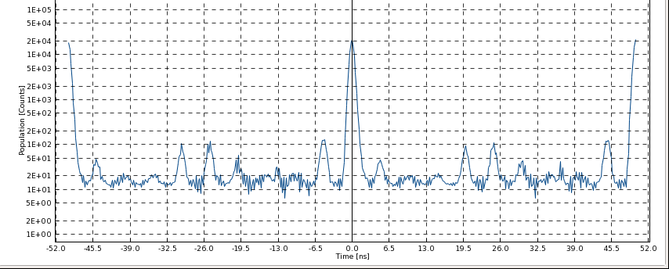
Satellites
Fill 3345-3346: 0.25 %
Fill 3350: 0.5 %

Slide 6
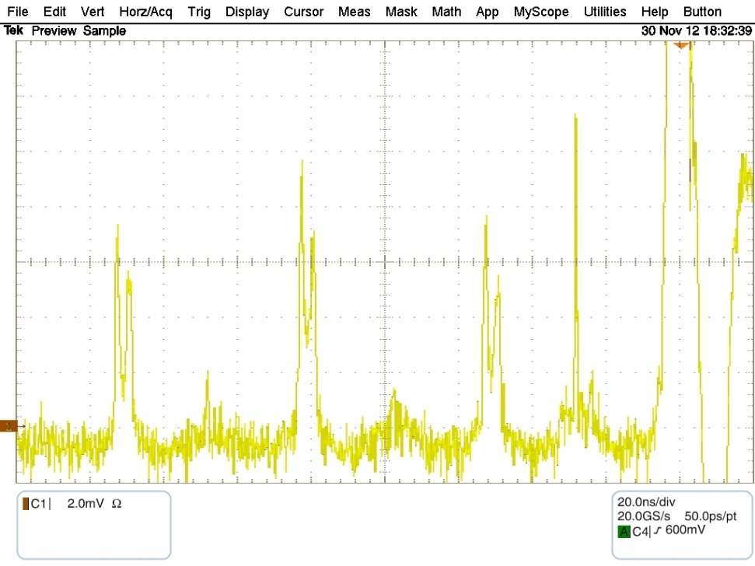
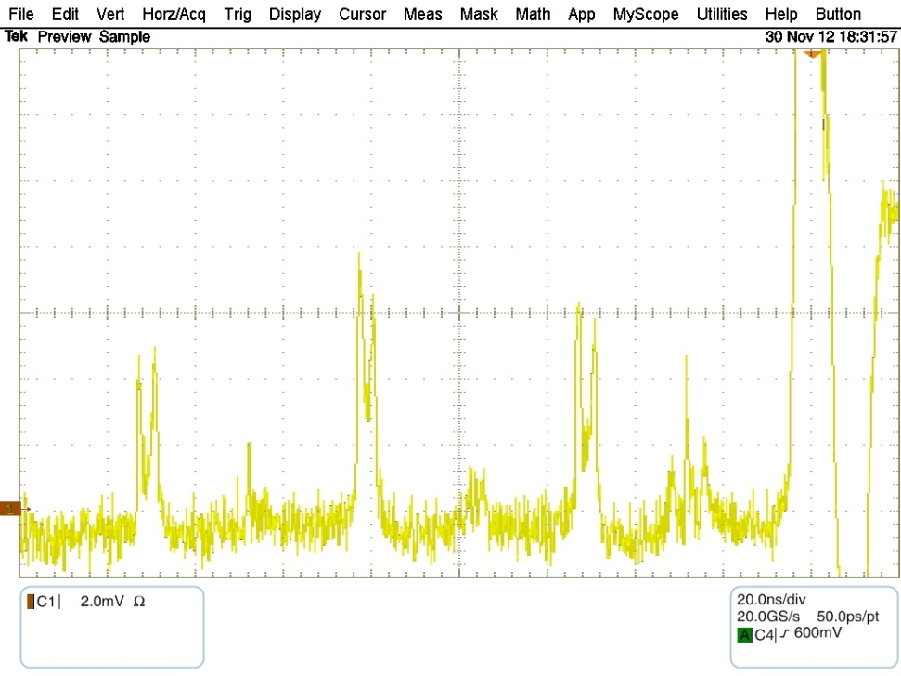
At SPS injection
Not easy to observe except at the LHC. Satellites are captured in two 5 ns SPS buckets ➔ Satellites are generated also at multiples of 5 ns (not useful for luminosity). Contacted PS RF expert (S. Hancock) to see whether we can further push satellites.
20 ns
T. Bohl

Slide 7
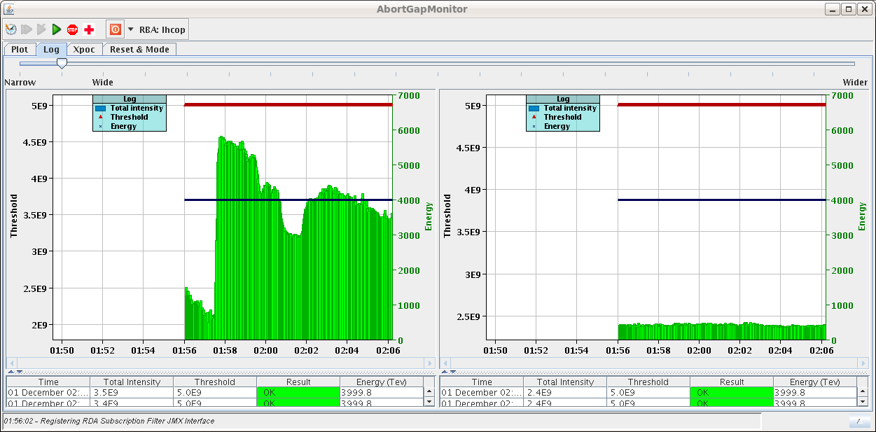
Thu 1/12
01:54 Warning from Big Sister about abort gap cleaning required for beam 1. Lost communication with RF FGCs. Switch ON Abort Gap Cleaning.
02:57 Not possible to restore communication. Dump and give access. End of fill #3350. 120 pb-1 in 7:50 h
04:49 End of access. Power supply of control crate for feedback line 5B1 replaced. Still problems with the movement of the TED in TI2

Slide 8
Thu 1/12
TI2 TED moved out after intervention of the piquet. An (heavy) intervention is required . The TED might block after the next access. Might need compensatory measure (TT60 TED). DSO to be contacted
06:15 Injection
Injection losses at warning level (up to 70% of dump threshold) as in previous fill in spite of good trajectory.
08:12 Stable beams #3351. Initial luminosity up to 6.9E33 cm-2s-1. ALICE at ~1E31.

Slide 9
Plan & pending issues
Next fill for physics (new extraction bump from PS – tested already in the SPS).
Pending issues:
TI2 TED
ODH sensor in UP62. In case of access fire brigade to intervene first. Intervention required.
To come (next week):
High brightness beam test. Tests ongoing in the SPS with new PS extraction timing.

Slide 11
Explanation (J.C. Bau, I. Kozsar)
The delay in production of H9 in the PS caused the SPS to set the injection moment at C1015 (on SPS user LHC3). This means that the event SIX.F1KFO-CT came in the present cycle, while the NLHCINJ bit in the LHCSSEQE group is present only in the previous cycle. The two need present at the same time in order to trigger the sending of HX.RNGI-CT on the LHC timing cable. Because this latter event was missing, the RNGI group in the LHC telegram remained at the value present before delaying the SPS injection (RING 2). Nevertheless, the LHC requests were still being executed, sending the LHC injection events (HIX.xxx), prepulses generated, etc. but for the wrong ring in case the requested one was R1.

