Slide 1
Friday 23rd November - morning
Coming out of loss maps over night Thu – Fri
in shadow of MKD problem in SPS (and CMS cryo recovery)
07:35 Start pre-cycle in preparation for VdM
10:15 Start ramp
10:45 colliding – no problems – clean – good lifetimes
10:55 Stable beams
11:05 beams dumped during ALICE separation
Software interlock (Power converter surveillance). This interlock was not masked as it should have been for the VdM scans.
Not good…
11:16 CMS solenoid back-up

Slide 2
Friday 23rd November - afternoon
RCBV27.L5B1 tripped during ramp-down – taken out of service for the moment
12:20 ready to inject again but again a problem with the MKD in the SPS
Decision taken by ABT not to change switch …
Another switch is being prepared, and will be tested in the lab, in order to have a fully tested spare by the week-end
18:00 Injecting physics beam
18:15 MKD tripped again
19:10 SPS back again
20:00 Start ramp
20:30 Stable beams

Slide 3
Van der Meer scans – part II
20:55 Start 1st CMS scan
00:50 End 17th CMS scan
00:55 X/Y scan for ATLAS
02:25 Start VdMs for ALICE
05:00 End ALICE scan
No wire scan – intensity limit
05:10 Dump beams
Switch hypercycle
Called JJ Gras to change the BCT range settings
Reverted the beta* limits for the stable beams flag

Slide 4
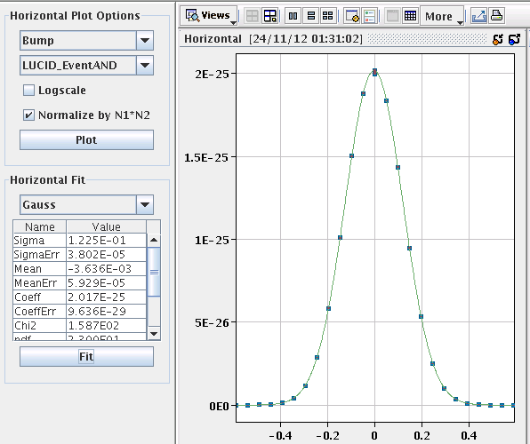
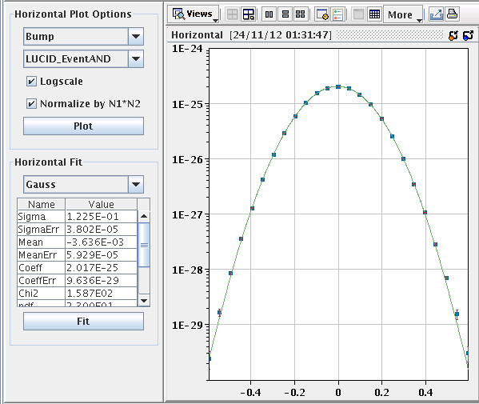
One of many…
ATLAS in X plane (separation): -6 sigma to 6 sigmas in 25 steps with 30s integration time

Slide 5
Saturday 24th November - morning
06:05 Probes in
06:15 Steering lines
06:45 No beam from SPS – MKD fault
Switch erratics - MKDV3
Piquet called – Pete Burkel – he changed a module on the thyratron heater and increased the pressure a little – switch holds for the moment but after discussion Laurent Ducimetiere…
Switch needs to be changed
08:15 Go for a fill
08:45 LHC full…

Slide 6
On the list
MKDV3 switch replacement (~9 hours)
Started Saturday 10:00
Switching position of first 6 bunches B1/B2
Re-enhanced satellites for ALICE
Access for RCBV27.L5B1

