Slide 1
Sat 17/11 – Sun 18/11
08:23 Stable beams 3296, initial lumi around 7.1x10³³ cm⁻²s⁻¹.
15:30 No beam from SPS Beam dump switch to be replaced)
20:40 Beam available from SPS
20:50 OP dump: ~180 pb⁻¹ in 12:30 hours.
23:39 Stable beams 3297. Initial luminosity 7.3x10³³ cm⁻²s⁻¹. Larger tune split during the squeeze (-0.005)
00:03 Beam dump due to instability and losses on two bunches leading to BPM LSS6 trigger. ~10 pb⁻¹ in 25 mins. Revert to smaller tune split (-0.003) and only during the last part of the squeeze
02:28 Stable beams 3298. Initial luminosity 7.5x10³³ cm⁻²s⁻¹
05:45 Beam dumped by OP on request of ALICE for an urgent intervention on the cooling of their TPC. End of fill 3298 producing ~70 pb⁻¹ in 3:17 h.
06:20 Access starting
08:30 Access finished. Restarting

Slide 2
Squeeze - Adjust
BBQ-H B1
β*
Sep – IP1
β*=80 cm

Slide 3
Squeeze - Adjust
3023 – 3368 – max. LR - collisions in 1/5/8

Slide 4
Squeeze - Adjust
β*=60 cm

Slide 5
STABLE BEAMS
After optimization 1-5-8

Slide 6
STABLE BEAMS
BBQ-V B2
Sep – IP8

Slide 7
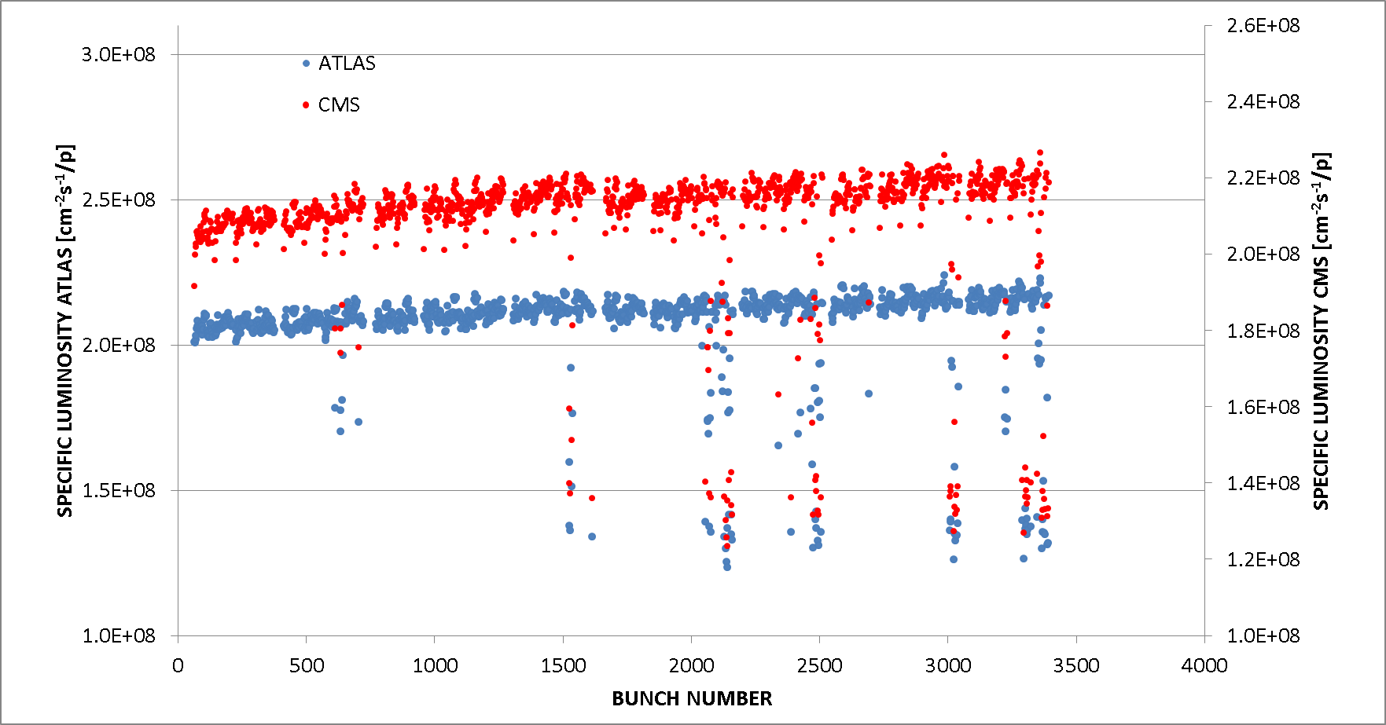
Beginning of Stable Beams
3296
Q_{VB1}-Q_{VB2}=-0.003
3297
Q_{VB1}-Q_{VB2}=-0.005

Slide 8
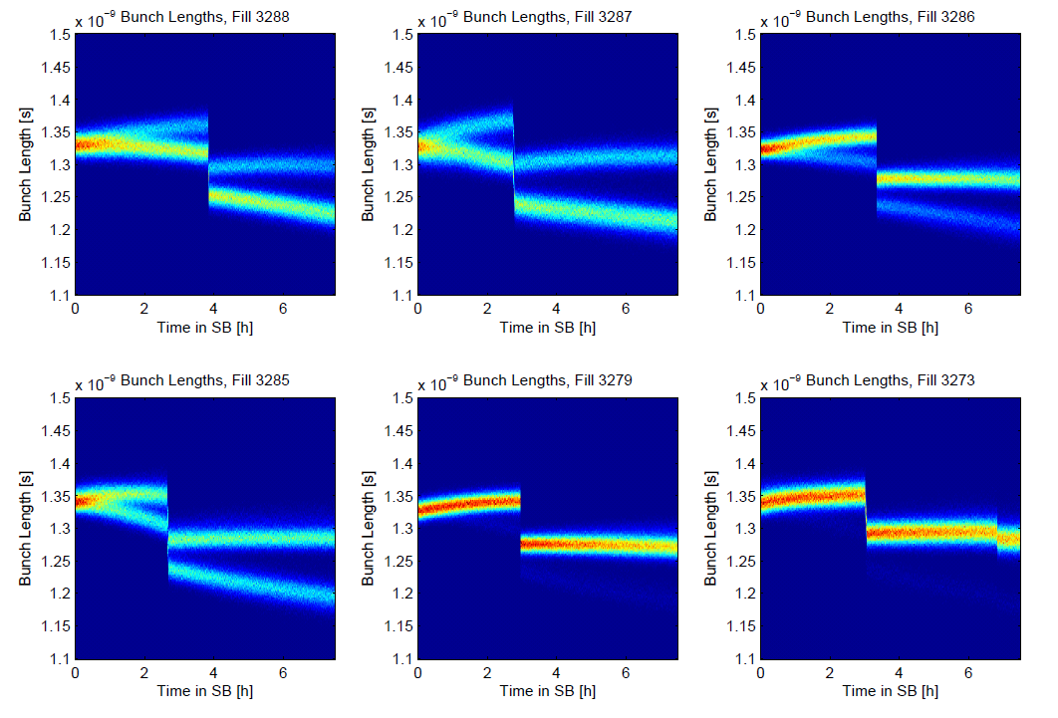
Bunch length reduction in Stable Beams
M. Hostettler

Slide 9
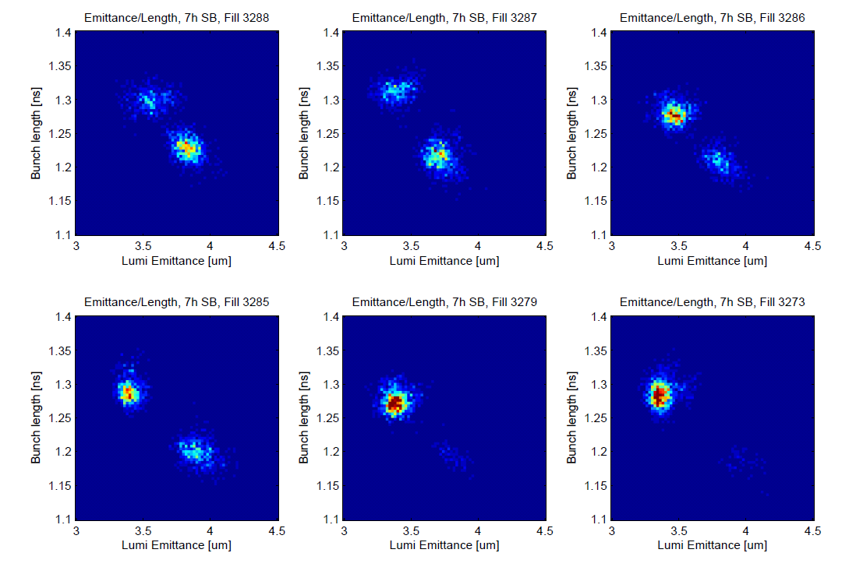
M. Hostettler

Slide 10
Plan
Physics
Pending access:
Access wire scanner requested for Monday, including tunnel (RP).
PM32 : CV to check / remove sand.
Access system
CMS (Hadronic Forward Calorimeter) > 1 h
BI: wall current monitor (1 h – point 4 RF zone)

Slide 12
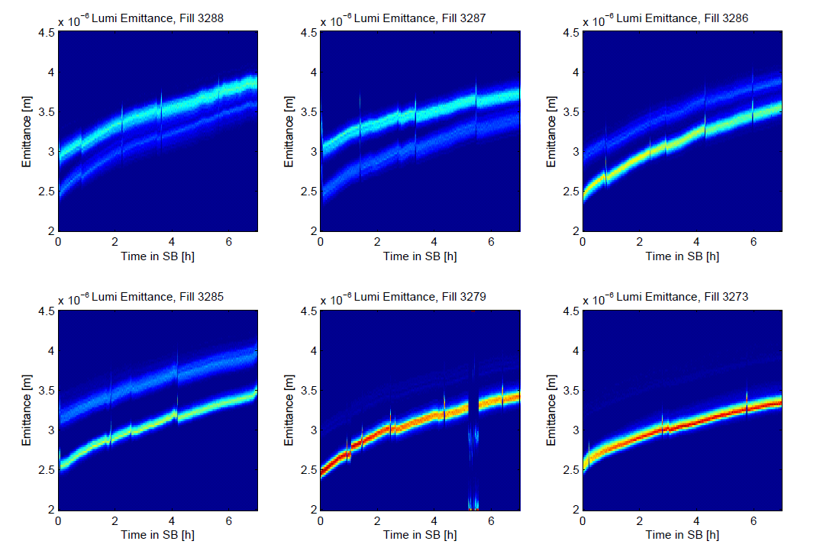
M. Hostettler

