Slide 1
Summary week 45
Barbara Holzer, Jorg Wenninger

Slide 2
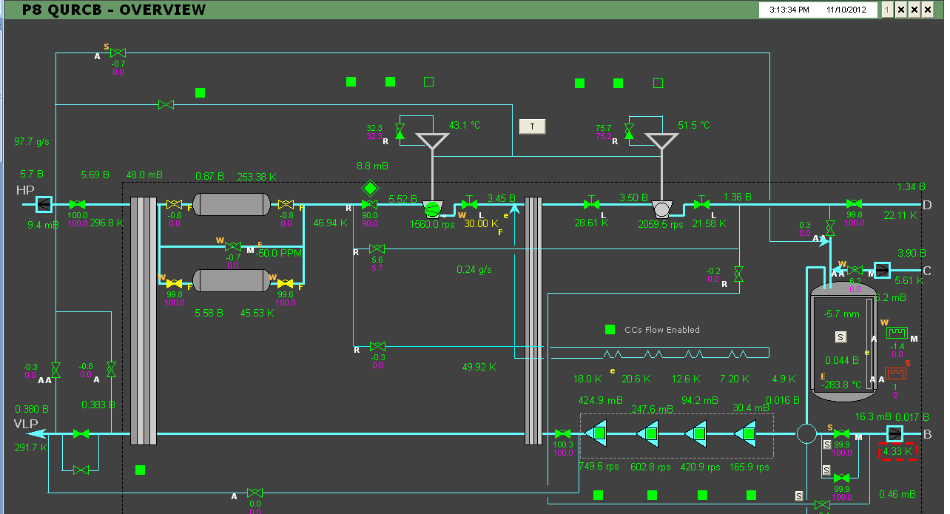
P8 Cryogenics, timing
Friday 09Nov’12 10h38:
Cold compressors stop,
“fault” of magnetic bearings for CC2
11h15: Access in cavern and simple reset
12h: 1st restart of cold compressors
13h08: 2nd CC2 bearings fault, decision to replace electronic module for magnetic bearings
15h15: 2nd restart of cold compressors
19h30: Full flow dedicated to sector cooling
Sat. 10Nov’12 10h: Cryo conditions back
Repair: 4h45 - Prepare for cooling: 4h15 - Cooling: 14h30
Cryo down-time: 23h30

Slide 3
Last week, we had to make a quick warm-up of the other cold compressor box (minor air impurities), available again Saturday 10Nov’12…
CC2 Magnetic bearings
Stable situation, could continue like this until Xmas
If short stop of cold compressors only, 1 quick restart allowed (≈18hrs)
If stop of cold compressors >3hrs or complete cryo stop, separation back to 1 refrigerator on 1 sector to be made (≈18hrs the first time, faster if a 2nd case)
All HW ready? Friday afternoon?

Slide 4
Saturday
10:00: Cryo Pt8 back, starting the pre-cycle.
11:00 LHC ready, but SPS dump kicker problem – switch exchange + reconditioning.
15:00 Injecting !
Phase and bucket off. Corrected.
LBDS arming issues (self trigger). Checked by experts but not understood. We manage to carry on.
16:00 Pt8 compensator off.
17:00 We decide to carry since we can live without.
18:00 POPS off.
19:30 Filling again. Problem with losses at injection. B1 dumped with 144b.
20:30 SPS off – major flood in BA2 (surface + tunnel).

Slide 5
SPS BA2
Water from nearby fields passed through SPS HV cable trenches to enter building…

Slide 6
SPS BA2

Slide 7
SPS BA2 - tunnel
Fortunately the water height was limited – no damage to vacuum equipment and damper electronics.

Slide 8
Saturday - Sunday
On the LHC side limited ‘problems’ – galleries and CV buldings under water in Pt8.
Overnight : pumping of the water by FB and by the normal pumps. Situation improving.
Sunday morning: BA2 tunnel area ~dry. SPS trying to restart.
11:00 LHC beam back in the SPS.
12:00 LHC closed, pre-cycle.
13:30 Beam back !!!
Transfer line steering….
LHC wire scanner not working – application blocked.
Related to B1 FBCT intensity issue (phase) ?

Slide 9
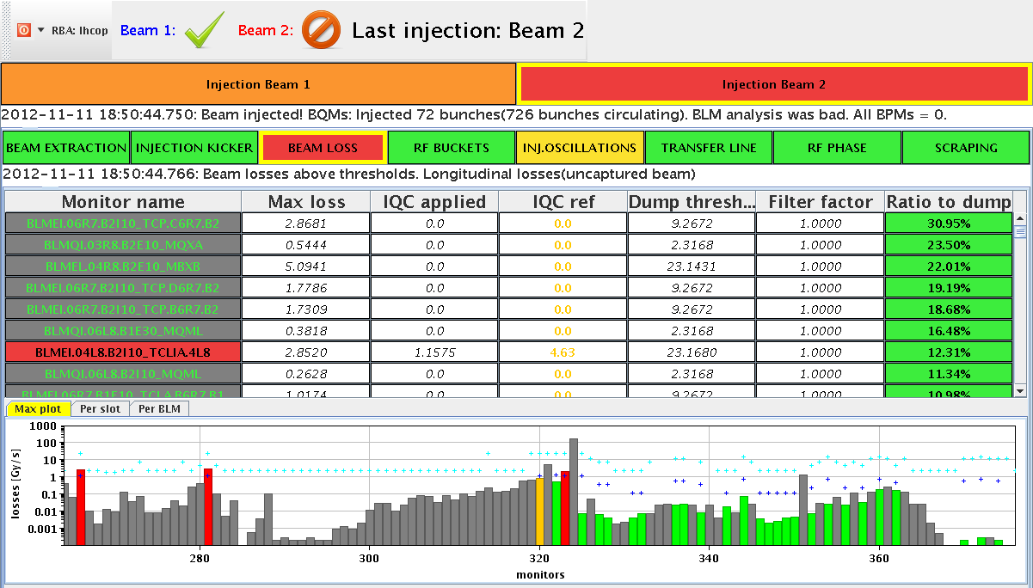
Sunday
17:00 First fill lost during ADJUST – trip of RF line 4B1.
Dump by LHCb during refilling – signature of capture losses / ghost bunches.
Again large synchro errors ~ 50 deg.
Orbit offset to lower synchro error.
To gain some extra margin, we set back the target for batch-by-batch blowup to 1.1 ns (from 1.4 ns).
TDI-TCLIs – not OK !
Line - OK

Slide 10
Sunday
Refill and…
20:50 Stable beams fill 3279, L ~ 7e33 cm-2s-1.
After ~58 hours without beam.
LHCb high at start (~250), separate more for next fill.
04:50 Beam dump, again RF line 4B1, same fault.
Access for RF power.
07:00 Refill.
Steering lines.
FBCT phasing/calibration.

Slide 11
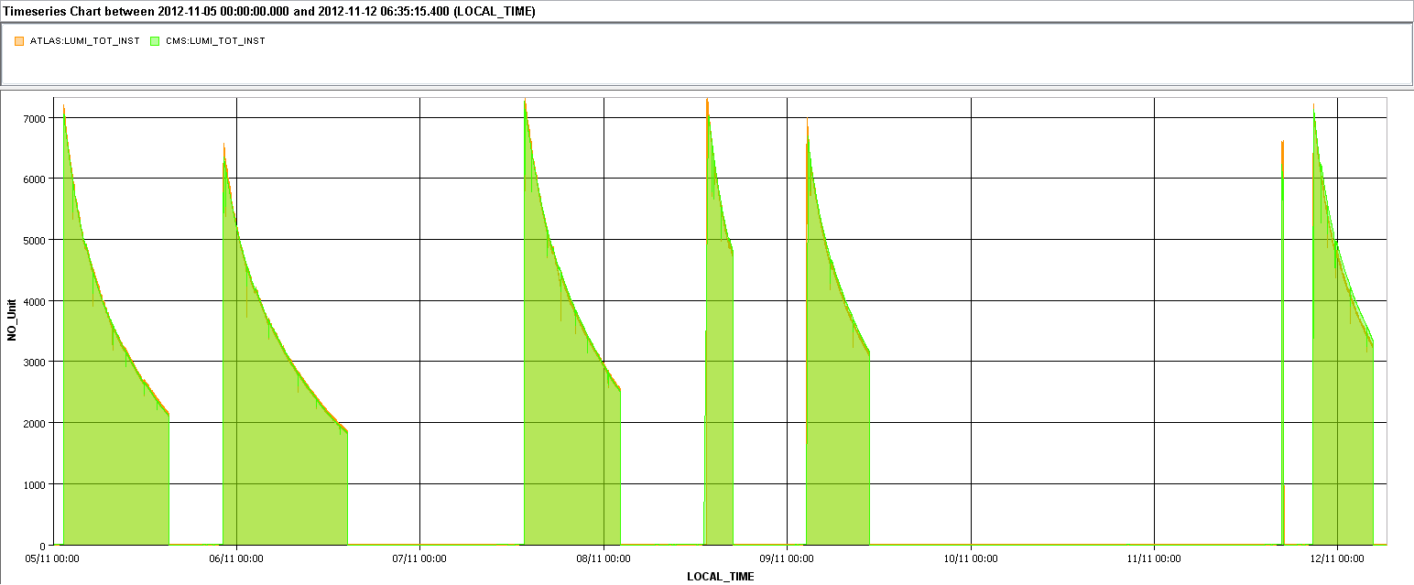
Week overview
ALICE
LHCb polarity
RF B1
Injector TS
Recovery TS & MD
RB S67
SPS MKDV & flooding
Cryo Pt8

Slide 12
Fills of the week
Fill | Day | L (h) | Int L (pb-1) | Dump
3265 | Mo | 13:40 | 183 (~30) | TOTEM BLM – EoF study
3266 | Mo | 16:10 | 198 | QPS on Q9.L2
3269 | We | 12:30 | 188 | OP
3272 | Th | 3:30 | 66 | COD trip
3273 | Fr | 8:00 | 126 | OP – preventive dump / cryo Pt8
3279 | Su | 7:45 | 120 | RF line 4B1
Integrated ~730 pb-1, 54h ~32%

Slide 13
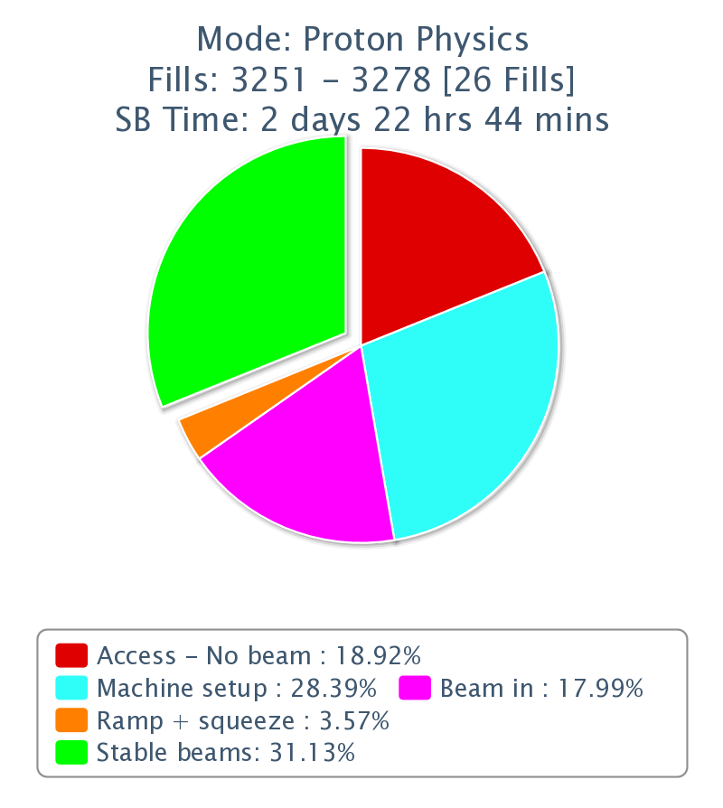
Downtime
Cryo Pt 8 ~24 hours.
‘Recovery’ after injector TS & MD ~ 16 hours.
Many mixed issues…
SPS flooding ~16 hours.
Injection line steering 6+ hours.
SPS dump kicker ~4 hours.
ALICE ~4 hours.

Slide 14
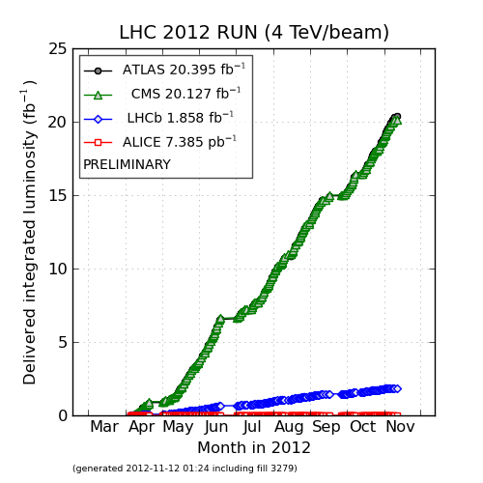
Overall status
Passed the 20 fb-1 mark last Wednesday.
ALTAS @ 20.4 fb-1
LHCb close to 2 fb-1.

Slide 15
Transfer lines and injection
Almost systematic TL steering before injection (1/day).
MSE stability, plus orbit in SPS. Relative importance of the 2 components to be clarified.
Fluctuating losses, unclear origin.
Sometimes losses in the lines (collimators), sometimes from un-captured beam in LHC and/or ghosts in SPS.
Sunday evening: dump by LHCb.
Ghost bunches with large emittance?
SPS is observing significant tails at injection.

Slide 16
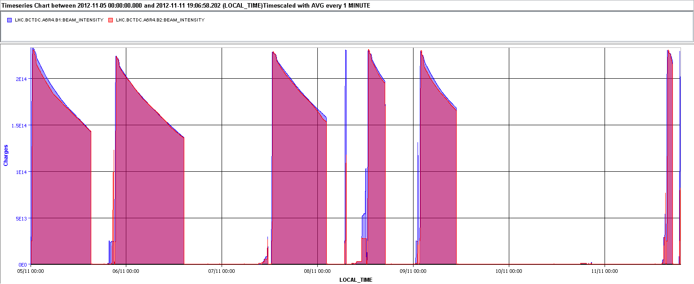
Steering at injection

Slide 17
Injection continued
Thursday: energy matching with horizontal CODs in LHC (~0.02% each beam) to reduce the RF synchro errors.
Improved losses on LHC side, also at ramp start (IR3).
But then we observed again rather large synchro errors on Sunday ~ 30-50 deg. Circumference moving (on top of tides) or magnetic fields ? Not tides – they have no effect if the beam is well centered because the SPS sees the same change.
Batch-by-batch blowup:
Was re-activated on Thursday with a target of 1.4 ns, after energy matching.
Was re-deactivated on Sunday (target back to 1.1 ns) to gain some margin at injection.

Slide 18
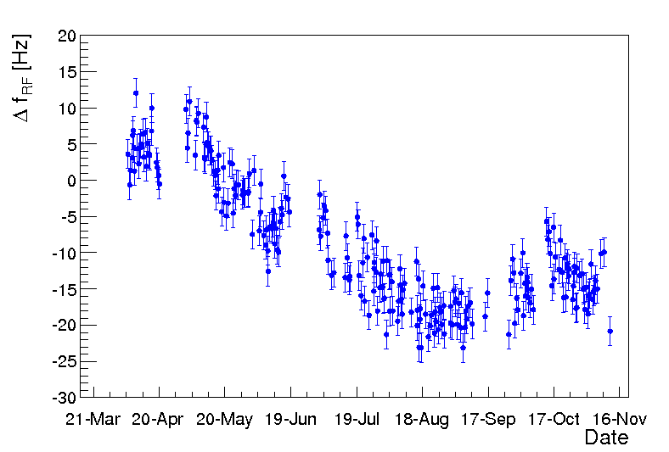
Central fRF – E-matching
RF frequency to center the beam radially in the BPMs.
Reference point at flat top, corrected for tides.
Relatively large change during WE, but seems still a bit small to explain all the RF synchro / E-matching effects.
~ 2mm

Slide 19
Injection todo’s
Injection steering - causes,
Energy matching,
Ghosts ?,
Batch-by-batch blowup.

Slide 20
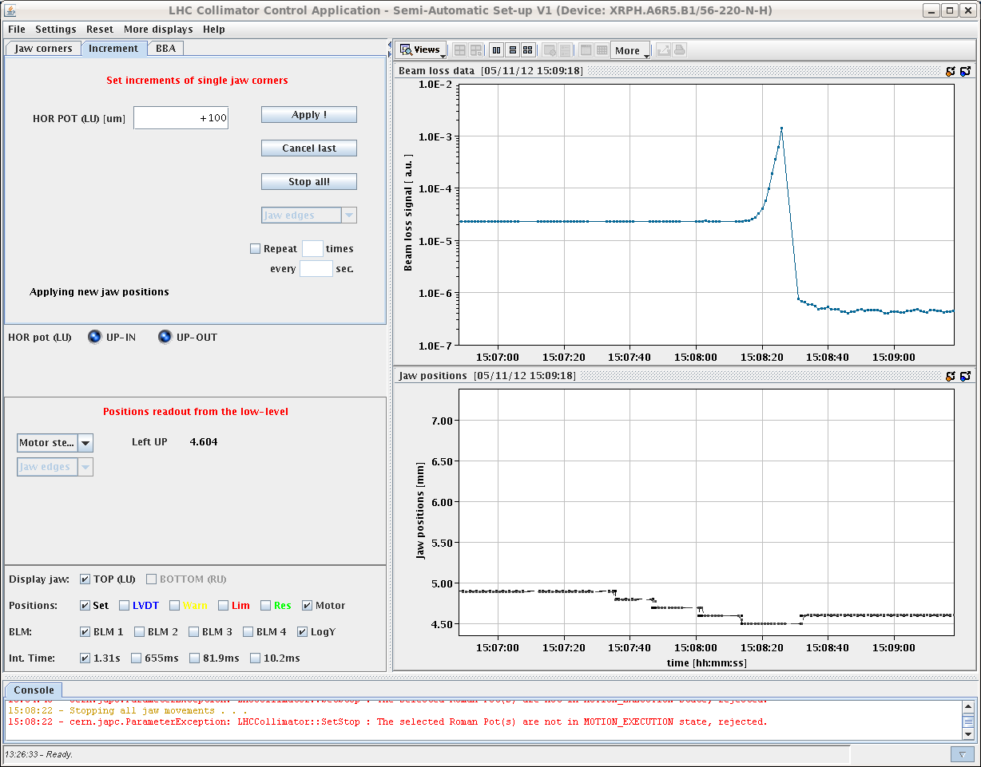
TOTEM
Once more beam dump during EoF study.
TCL’s opened to > 60σ.
Unusual loss behavior on B1 – due to beam leaking out of IR3?
Dumped on increasing loss rate (over few seconds), RP XRPH.A6R5.B1 @ 32σ, not moving.
Traced to a large increase in the vacuum pressure !
Heating by beam or impedance, e-clouds ?

Slide 21
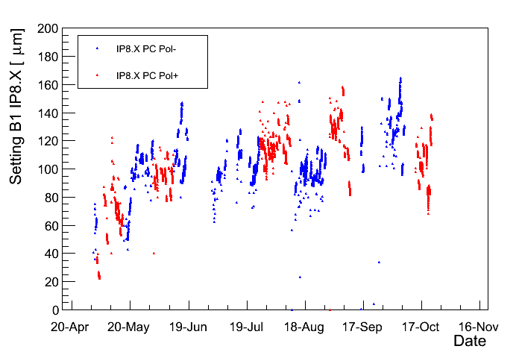
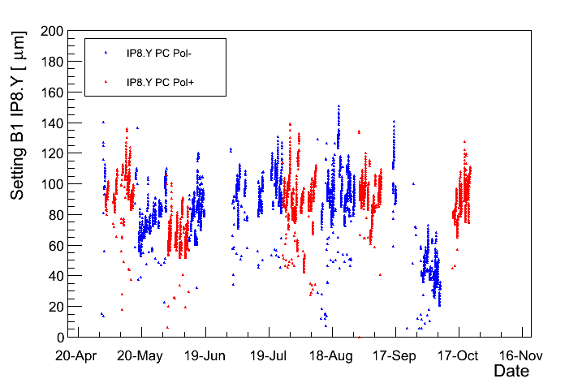
LHCb polarity switch
LHCb polarity switched without test cycle – no problem.
Settings sufficiently reproducible,
Very small shifts whenever polarity changed.
2-step collision BP,
Global V orbit correction,
Separation adjustment
Lumi knob trims Beam1
H
V

Slide 22
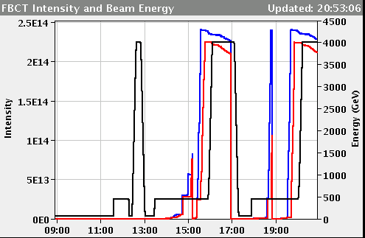
Miscellaneous
TCLs were opened in fill 3272 at start of stable beams to measure cryo load due to losses.
Tune split at end of squeeze -3e-3 on B1V.
Prepared the same trim starting earlier in squeeze (from 600 s / 1 m) – coming in for next fill.
BPMs acquisition problems (again). Many packets missing.
FBCT calibration/phasing (in particular B1) to be done!
LHC wire scanner application blocking to be investigated. Correlated to FBCT B1?

Slide 23
Pending ‘tests’
VdM scans – to be confirmed.
If YES – need pre-warning (1+ day) to check / finalize settings.
Availability of collimator people this week? HL-LHC meeting…
TOTEM end of fill test at > 40σ with beams re-separated (1-2 hours).
Tune splits at end of squeeze (sort of parasitic).
Next step prepared.
Heating with short bunches at 450 GeV (B. Salvant et al).
Followed by tests at 4 TeV.
Periodic loss maps.
Gated Q measurement for B2.
Possibly increase of ADT gain at start of ramp.
6 non-colliding bunches then ~ un-damped by ADT !!
Tuning of ADT for injection/abort gap cleaning.
Requires thorough checking if to be used in operation. Test only?

Slide 24
Pending access requests / intervention
Compensator + filters in Pt8 – off for the moment.
PM32 : CV to check / remove sand.

