Slide 1
Saturday
10:00: Cryo Pt8 back, starting the pre-cycle.
11:00 LHC ready, but SPS bump kicker problem – switch exchange + reconditioning.
15:00 Injecting !
  LBDS arming issues (self trigger). Checked by experts but not understood. We manage to carry on.
16:00 Pt8 compensator off.
17:00 We decide to carry on as repair lengthy (2 ½ hours) and we can live without.
18:00 POPS off.
19:30 Filling again. Problem with losses at injection. B1 dumped with 144b.

Slide 2
Saturday
20:30 BA2 & BA5 flooded – SPS off.
22:00 S81 and S78 switched off – water alarms in Pt8, later also in Pt2 and 1.8.
02:00 Inspections show that there is no water in the LHC buildings.

Slide 3
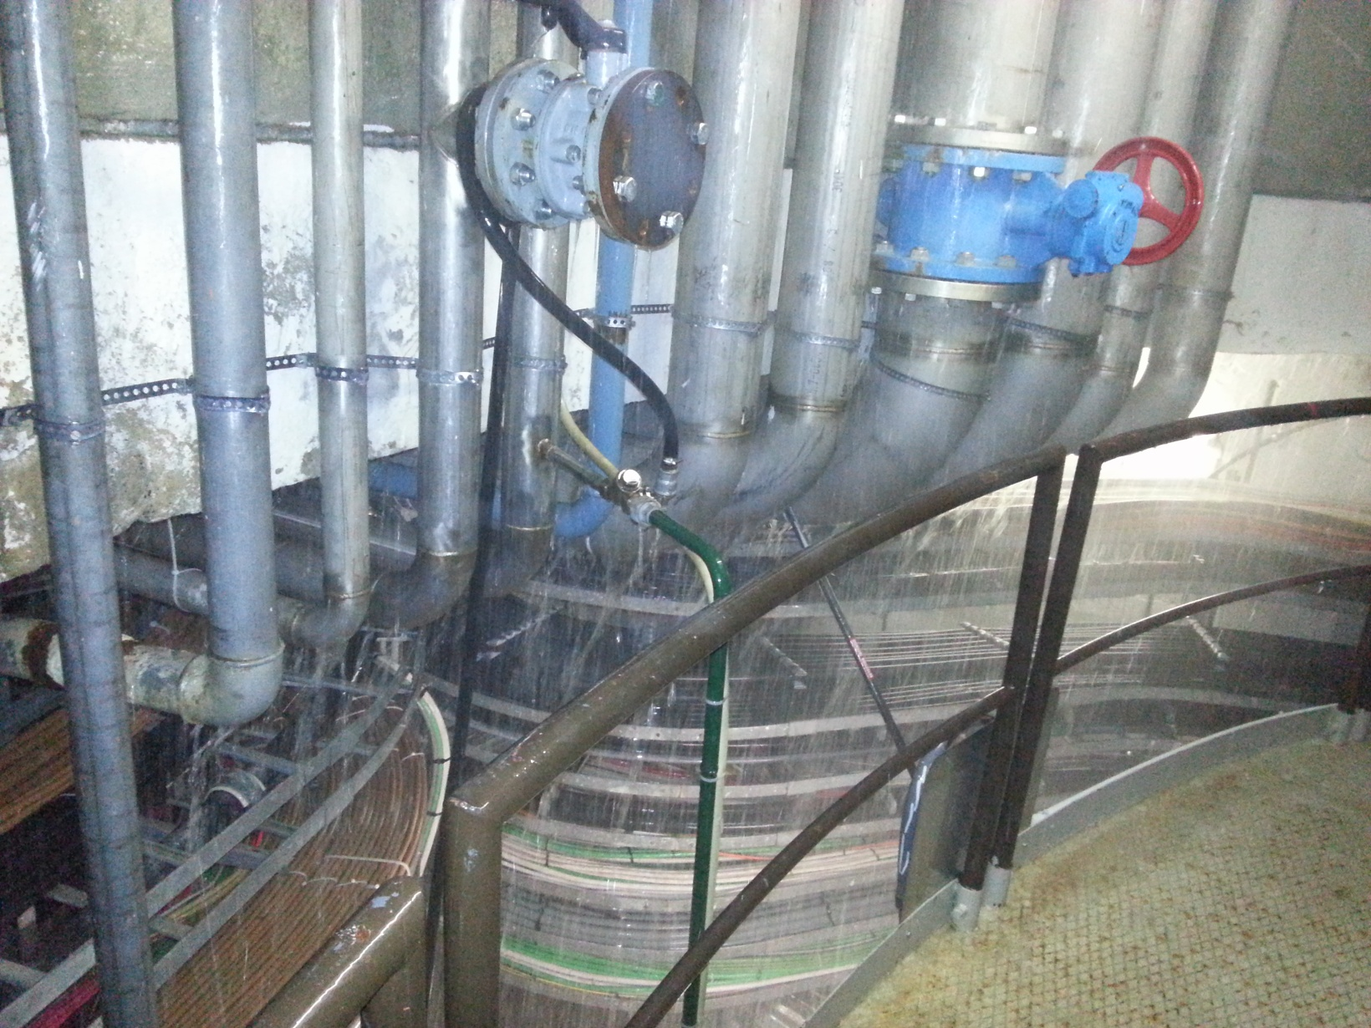
SPS BA2

Slide 4
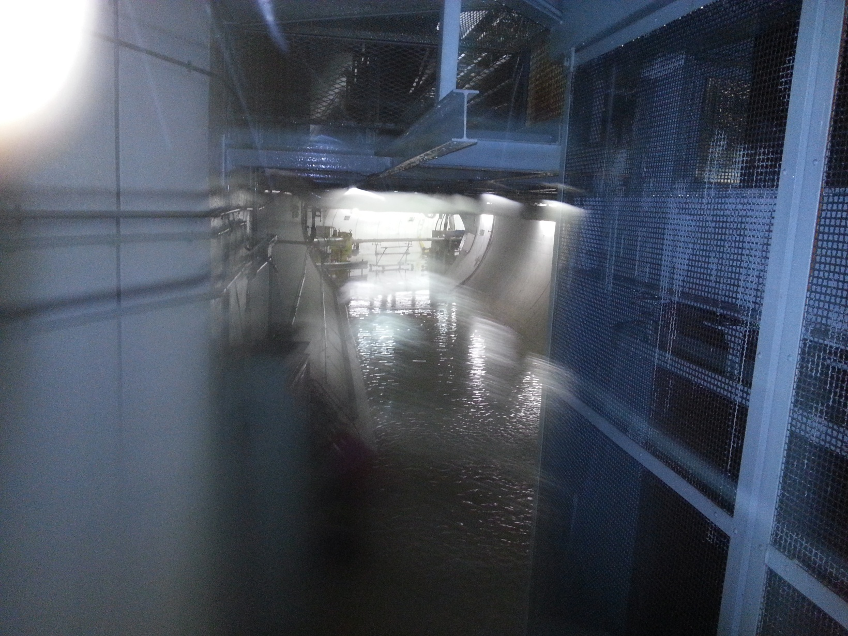
SPS BA2 - tunnel

Slide 5
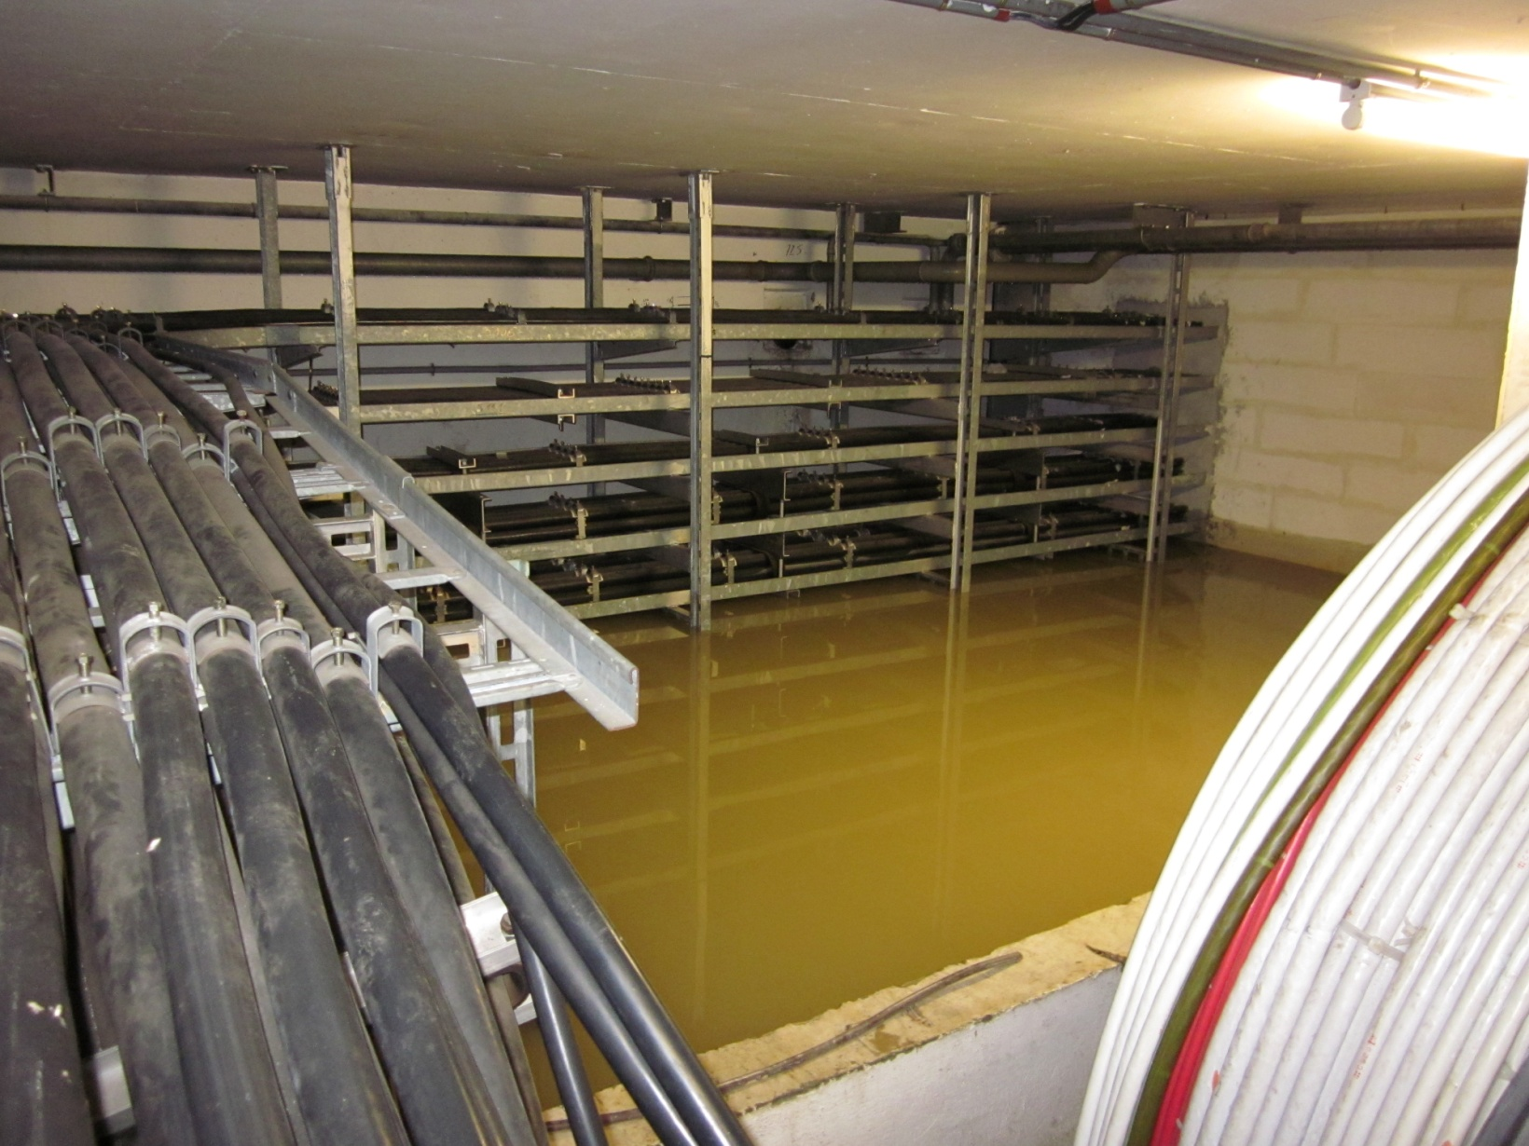
SPS BA2

