Slide 1
Last 24 hours
RQ5.L1
RF trip Line4B1
RQ4.L1

Slide 2
Tuesday 30th October - morning
07:50 Access to PM56 (EPC & RP)
08:30 EPC exchanged an output module on IT.R5
08:40 precycle triplets
09:35 injecting probes
11:15 no beam from LINAC2 – back after 15 minutes
vacuum interlock (sector valve closed)
12:40 Stable beams Fill 3240
Initial luminosity: 6.95e33 cm⁻²s⁻¹

Slide 3
Tuesday 30th October - afternoon
13:10 Lost RQS6.A67.B1 (but keep beam)
Valerie: trip of auxiliary power module (due to radiation) – access required – we live without it for the moment
14:06 beams lost to QPS trigger on RQ5.L1
Fast Power Abort of main circuit, contact MPE for analysis and re-arming; heaters discharged
RQ4.L1B1/2, RQ6.L1.B1/2 and RD2.L1 tripped as well
Fill 3240: 32 pb-1 in 1h28m
14:45 MPE give green light to reset S81 circuits
Pre-cycle
16:00 Give ADT team ~1 hour for adjustments (see over)

Slide 4
Tuesday 30th – Weds. 31st October
18:10 Injecting physics beam
19:35 Stable beams – fill 3242
Initial luminosity: 7.04e33 cm-2s-1
00:04 Beams lost – RF trip Line4B1 – driver fault
RF power piquet gives OK to restart
Fill 3242: 84 pb⁻¹ in 4h30m
MKI8 C up – a little over limit – outlier
01:30 Filling
02:00 MKI8 faulty
Vacuum spike on VGPB.138.5R8
Reset (Jan) and extended softstart

Slide 5
Weds. 31st October
04:15 Stable beams fill 3244
Initial luminosity: 7.34e33 cm-2s-1
06:26 Beam lost – QPS – RQ4.L1
QPS trip on RQ4.L1 that took the whole powering subsector with it, even losing CS and CM for a while.
Spurious self-trigger of heaters
Fill 3244: 50 pb-1 in 2h14m
Prepare for access in shadow of fibre optics cable move and SPS EDF intervention (which started at 08:00 on schedule)

Slide 6
Access now
A. Anthoine and N. Voumard for LBDS beam 2.
EPC for RQS.A67B1 and possibly others (to be verified with Valerie).
Vacuum:
l’alimentation de pompe ionique au point 6 est à changer
la vanne du point 8 qui ne se ferme pas, une intervention doit avoir lieu sur place pour le diagnostic
TI – a couple of urgent interventions
2-3 hours followed by pre-cycle

Slide 7
ADT adjustments
Summary of ADT adjustments for high-bandwidth and 50 ns beam:
With high bandwidth ADT settings checked the fine delay with 50 ns bunch spacing and made the required adjustments. Verified damping time with Qkicker at injection level 450 GeV and with high gain. Estimated damping is 15 turns, i.e. equal to standard bandwidth settings. More details in RF logbook.
Comparison in collision of high and low bandwidth settings can be tested in a future fill by switching during the fill between the settings. Wolfgang and Daniel.

Slide 8
ADT tests
1) Pilot shots with high sensitivity for coupling measurements by Tobias Persson with damper loop off
2) BBQ check with pilot beam with damper loop off (but level 3 on) with switch from BI open and closed to identify if a 8 kHz perturbance comes over the cable from BI to us (as seem during the weekend in BBQ tests), our electronics in high sensitivity mode
3) check of delay and damping time for the high bandwidth settings; this needs more beam than a pilot, 6 nominal bunches and a check with a full batch.
With a circulating batch we would also compare the noise levels for high bandwidth and standard settings.
1) and 2) are relatively short and can easily be combined, 3) needs a bit more time
Wolfgang/Daniel

Slide 9
TCL scans
This week we would like to perform TCL scans in stable beams, combined with cryogenics measurements in the magnets of the matching sections of IR1 and IR5. We have done similar scans in the past and they can be done parasitically during stable beams.
Ideally, I would like to perform an initial test toward the end of one fill, and then repeat it one/two times with higher luminosities. The basic idea is to open the TCL's and monitor the additional heat loads on the cryogenics system. This work is also going to be useful for the TOTEM Roman pot insertions.
Stefano Redaelli

Slide 10
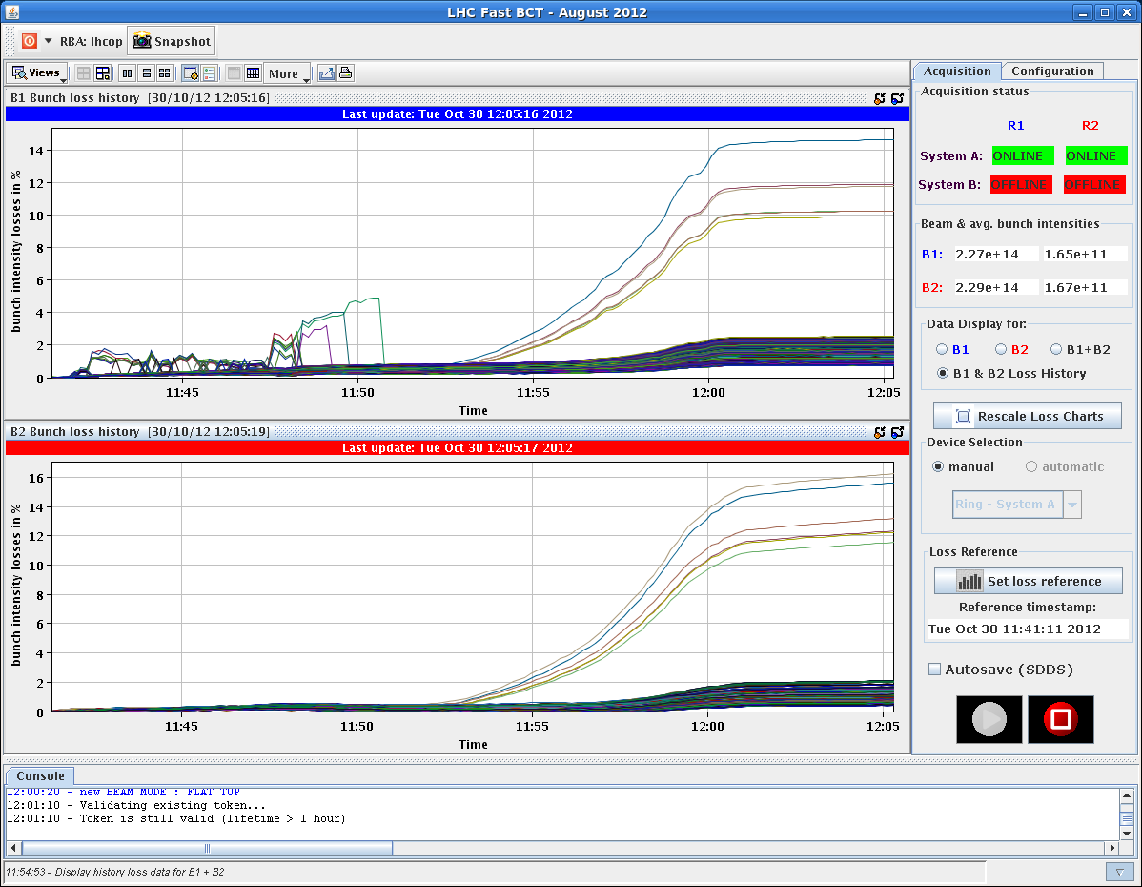
First 6 bunches in the ramp

Slide 11
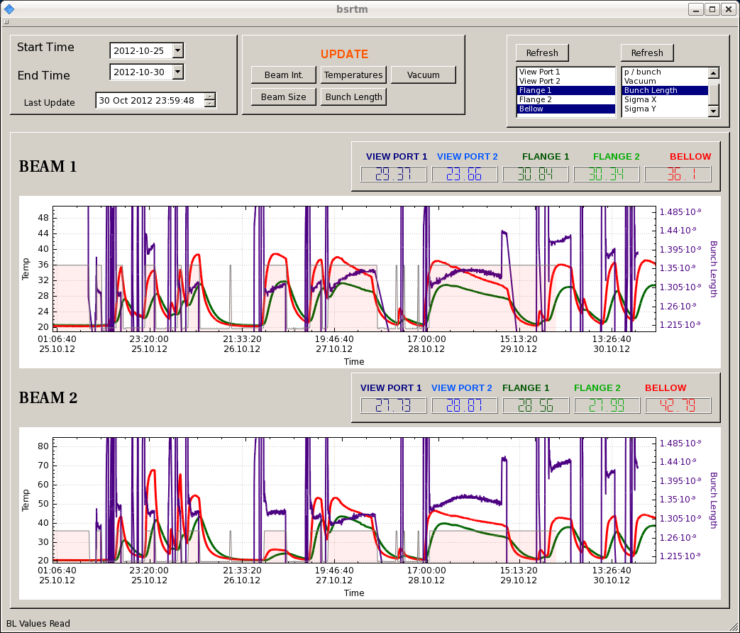
Bunch length

