Slide 1
Wednesday 24.10.
9:08 Fill 3214 dumped by OP after 5:26 hours in stable beams
Delivered luminosity:
ATLAS/CMS: 95 pb-1
LHCb: 7.7 pb-1
Preparing for high beta* fill:
HighBeta_4TeV_2012 hypercycle
Change BLM monitor factors for 21 monitors
Masked all BLM's, BPM's, RF, collimators and TCDQ in SIS + PIC Maskable
Beam flag “VERY RELAXED”
9:45 RSD1.A67B2 tripped during ramp down (QPS signal) → pre-cycle this magnet
10:30 start of high beta*
Fill 3215; 3 bunches + pilot (total intensity: 2.7E11 p)
At injection B1H = 1.33 B2H = 1.48 B1V = 1.25 B2V = 1.44

Slide 2
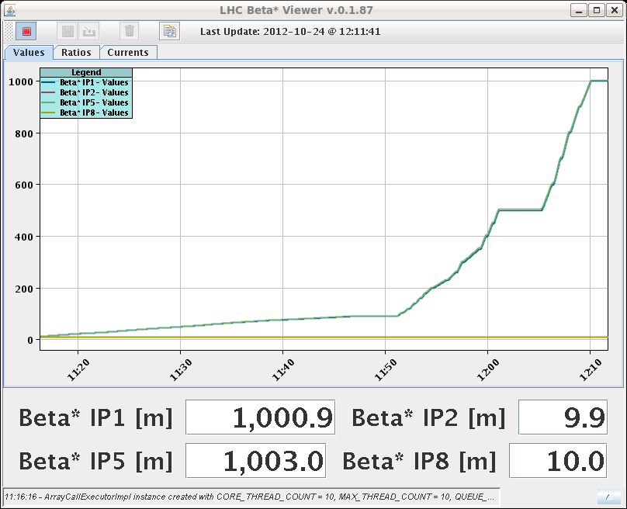
12:10 reached 1000m beta*
De-squeeze went smoothly; all tasks run from the sequencer
12:10 reached 1000m b*
Trimmed tunes Qh B1 +.003, Qh B2 -.005
12:30 IP1 and IP5 optimized
Alignment of TCPs
Alignment of roman pots
Beam mode “Quiet Beams”
15:52 moving TCPs to 2 sigma leads to massive losses: 31% of B1 and 74% of B2 lost by scraping
TCP to 2.5 sigma and RP to 3 sigma → ready to take data when:
16:40 beam dump: Spurious opening of QPS switch on RB.A67
During cool down of dump resistors: flat beam squeeze settings tested, all beam processes executed without trip (Matteo)

Slide 3
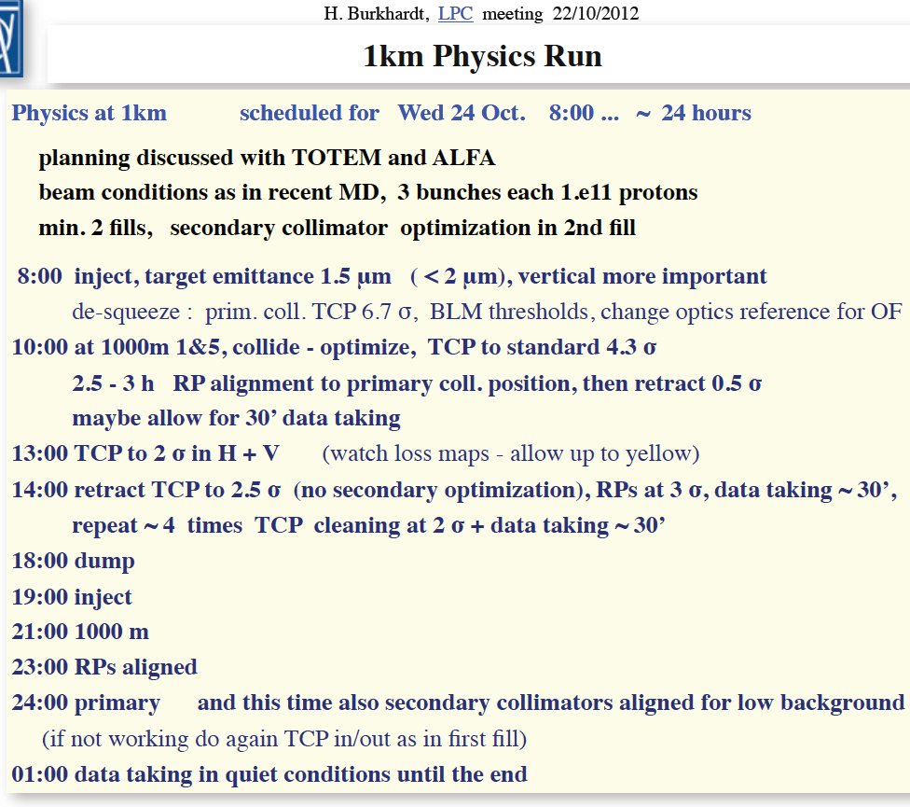
Fill 32015
Set-up completed, just about to start data taking, when beams where dumped

Slide 4
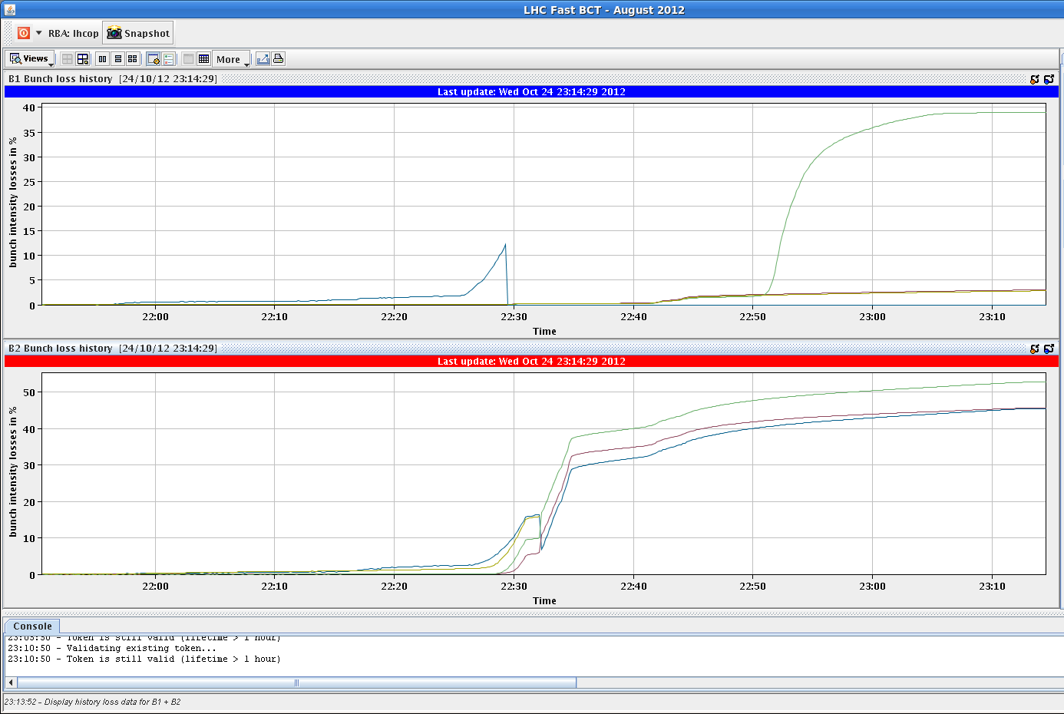
Evening
20:00 injecting for fill 3216, emittances at injection:
B1H = 1.55 B2H = 1.54 B1V = 1.31 B2V = 1.38
Emittances at flat top: B1H = 1.61 B2H = 1.72 B1V = 1.36 B2V = 1.41
Emittances at beta*=90m B1H = 1.71 B2H = 3.54 B1V = 1.29 B2V = 1.52
Emittances at 1km: B1H = 1.83 B2H = 3.31 B1V = 1.3 B2V = 2.24
21:51 arrived at 1000m beat* again; optimizing collisions; fast collimator alignement
22:45 Scraping with collimators to 3 sigma horizontal and 2 sigma vertical → massive losses B2 again (40%-50%), but less than last fill
B1 losses, 35% of the non-colliding bunch after scraping

Slide 5
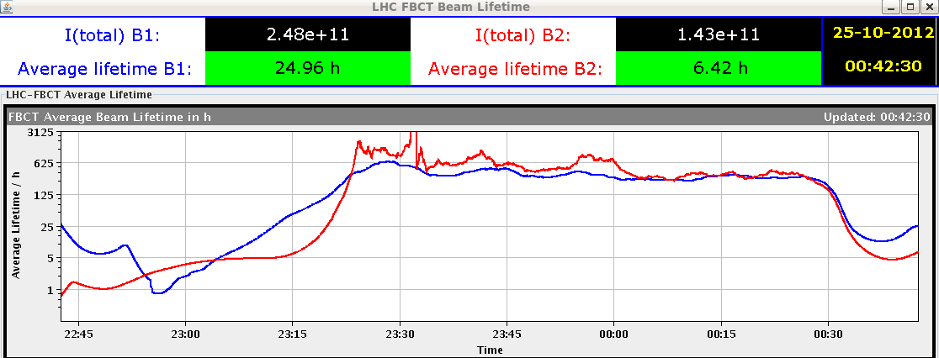
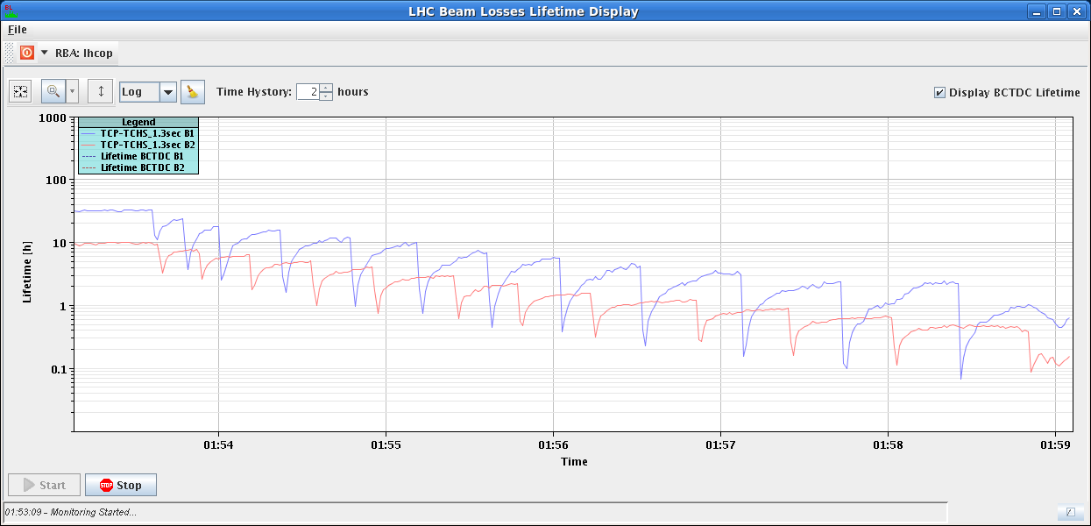
Night of very successful data taking
~ 23:15 start data taking (TCPV at 2.5 sigma, TCTH at 4/5 sigma and RP at 3) with a trigger rate of ~40Hz
~00:30 re-doing the exercise of scraping with the TCPVs to 2 sigma (and back to 2.5 sigma for data taking)
1:50 another TCPV scraping to 2 sigma
2:00 – 2:15 scraping with TCPH to 3 sigma (and back to 5 sigma), losses especially B2 due to the larger emittance
3:50 and 5:50 V+H scraping
7:00 sudden trop in lifetime especially B1
7:20 scraping again – longer tails in H

Slide 6
Pending
Pending Accesses:
LVDT TDI Pt2. Tunnel, 2 hours
LBDS MKD-F-B1: check PC and generator. UA63
Radmon installation between Q5 and Q6 at IP1. 1 hour access, few hours pre-warning. Impact 21253 / D. Macina
Gated BBQ installation for B2 (2 hours) in point 4
Plan for today:
Undo changes (BLM thresholds, masking)
LHCb polarity switch and low intensity ramp (2x6 bunches/beam)
Physics fill (with controlled longitudinal blow-up at injection)
During the day PS/SPS increasing satellite population for ALICE

