Slide 1
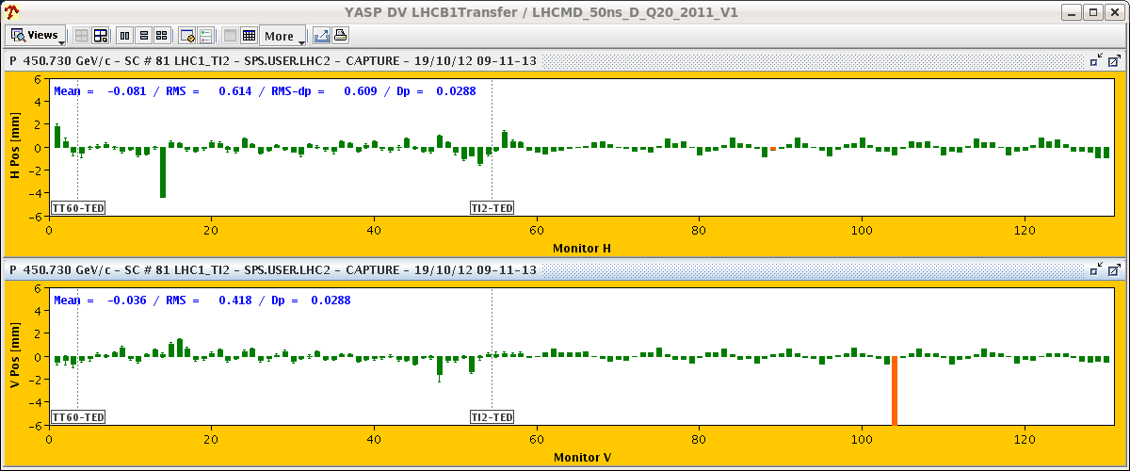
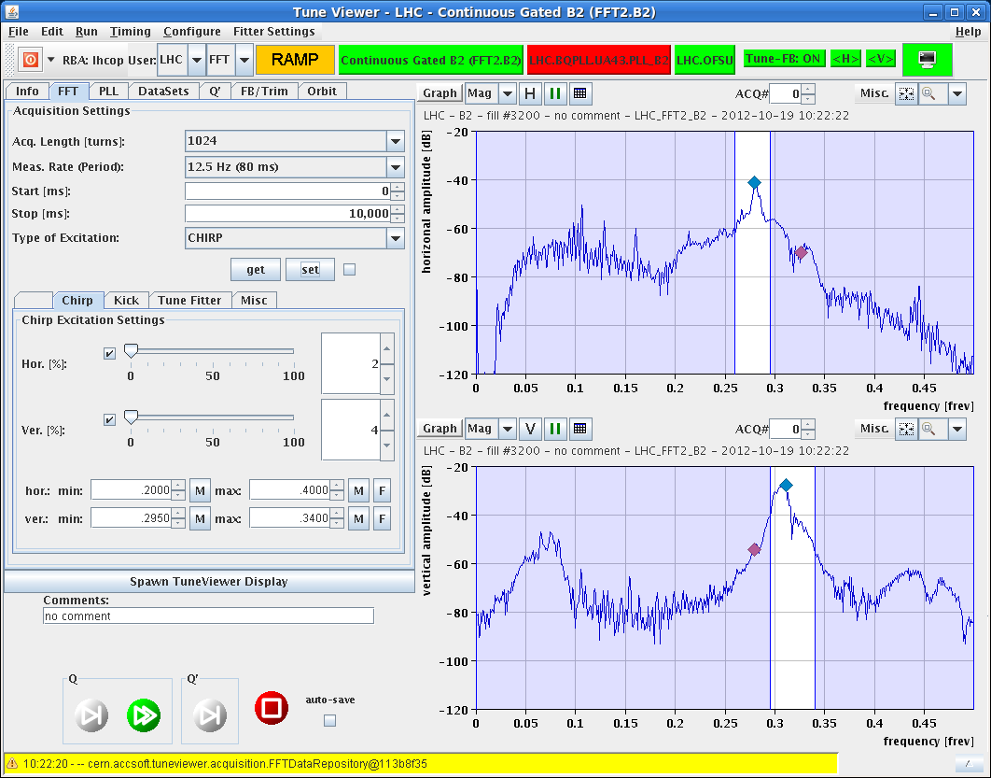
LHC Status Monday Morning 22-Oct
weekly summary
Bernhard Holzer, Mike Lamont
FRIDAY
... since 05:30h WorldFIP problem
07:14h access for WorldFIP intervention in UJ83
exchange of repeater in 78
07:50h cycling
08:50h injection ... still a bit problematic
10:20h ramp ... not without problems
broadband adt // tune spectrum

Slide 2
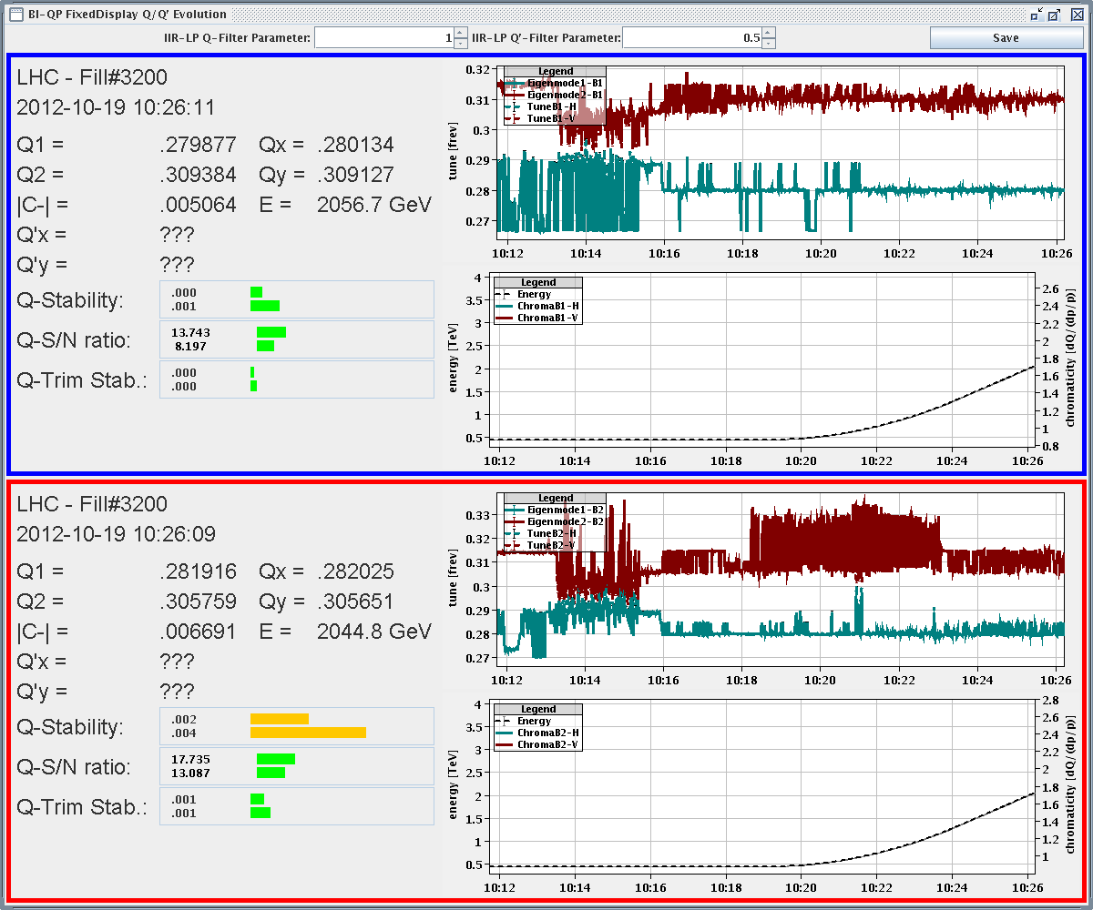
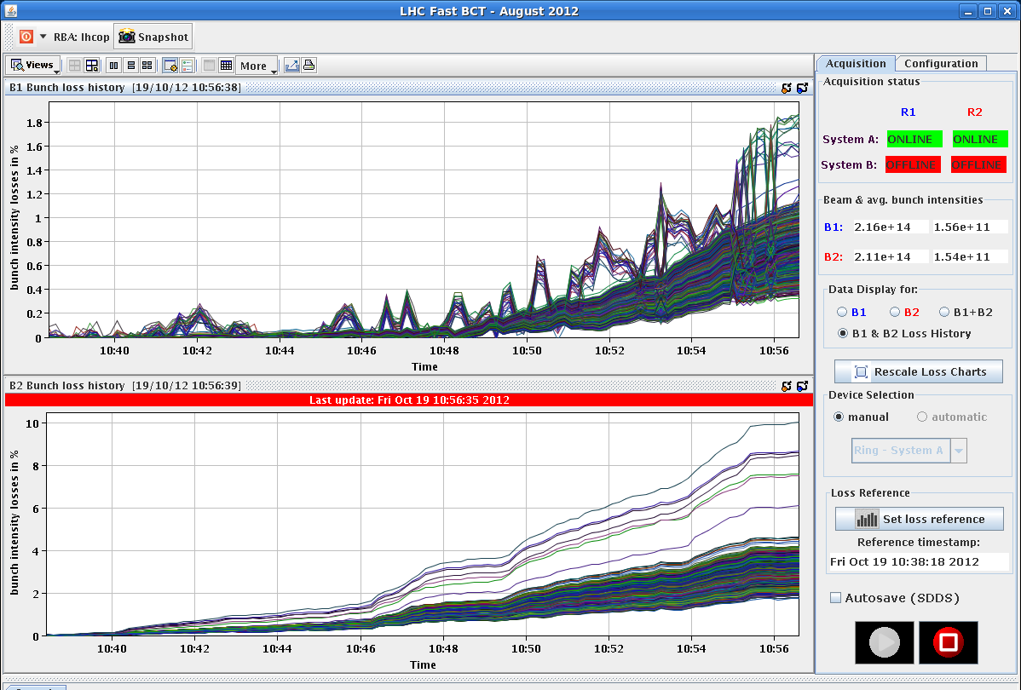
Friday Morning
tune spectrum not easy to interpret
neither the losses easy to understand
11:10h stable beams
18:20h CMS cooling problem
(“water mixer” not ok)
-> solenoid ramped down,
detector off
19:20h ATLAS: gas leak in muon system,
urgent access required

Slide 3
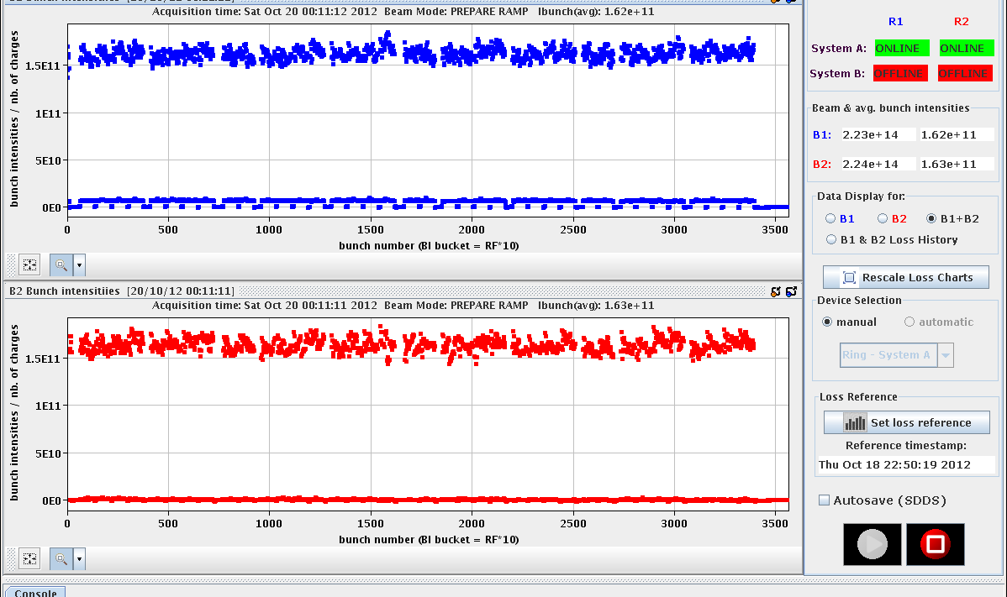
Friday Late
19:30h beam dump and access for
ATLAS & ALICE
23:00h LHC closed, cycled & ready for injection
Emittances (144 bunches)
B1H = 1.54 B1V = 1.45
B2H = 1.43 B2V = 1.48
nice narrow intensity distribution
N_{p}=1.6 e11

Slide 4
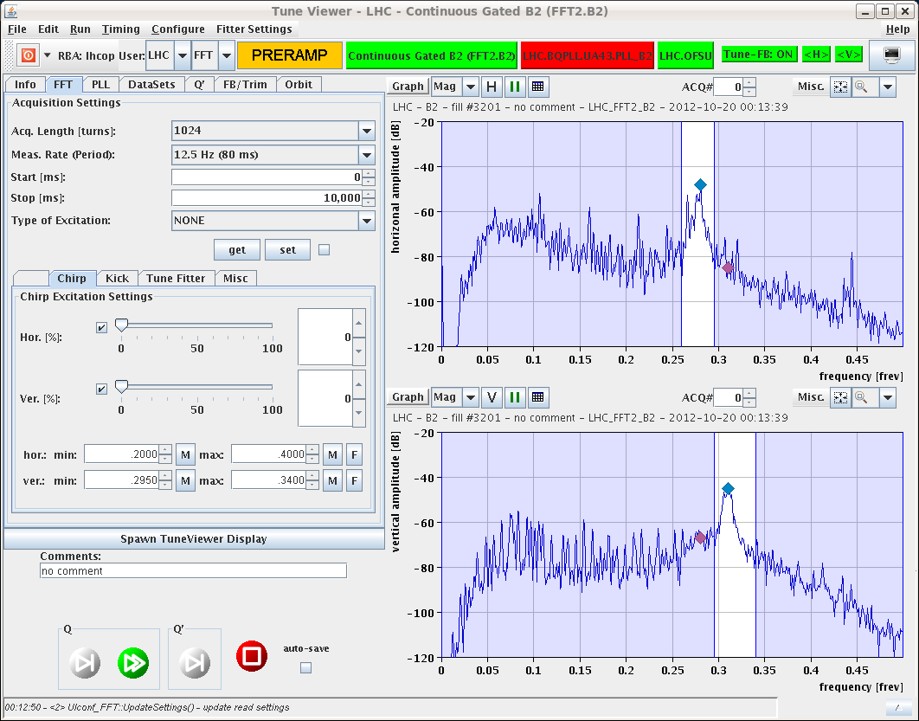
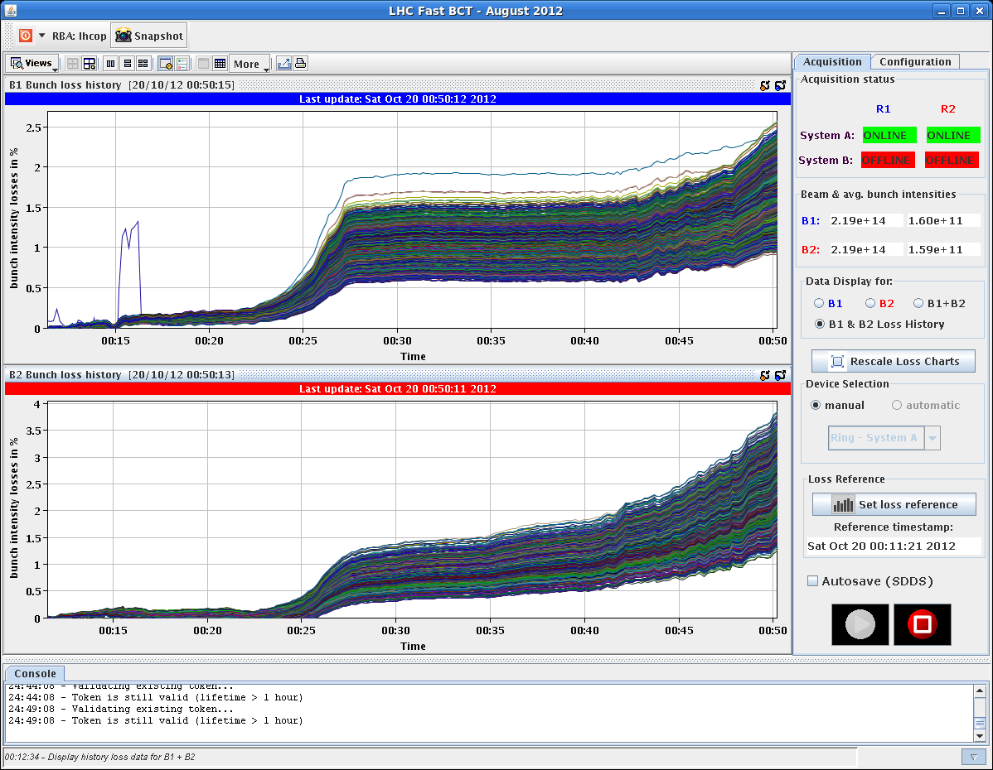
Friday Night
00:00h ramp ... with clean tune signals
00:50h squeeze & adjust
... and nice low losses
2 %
3 %

Slide 5
Friday Night
00:50h stable beams ... with good lumi
small remark: ALICE Lumi L = 4...5
indicates better (long) beam quality
(PS beam settings with lower satellite
population)
11:20h beam dump: spurious opening extraction switch of RCS.A12B1 (as Friday)
Access for MPE piquet – switch replacement
Y.Bastian (QPS) joins Vincent Froidbise for the intervention on RCS.A12.B1

Slide 6
Saturday 20th October
14:00h Injection,
... waiting for SPS and Main Power Supply problem in the Booster
17:00 Injection
Some steering required
QC latched on injection oscillation. steering on both beams correcting the lines but what improved the situation was to increase the SPS scraping. could inject but from time to time the IQC was latching…
19:30 Start ramp
Without high bandwidth ADT
20:20 Stable beams Fill 3203
Initial luminosity: 7.02e33 cm⁻²s⁻¹
ALICE ~5e30 cm⁻²s⁻¹

Slide 7
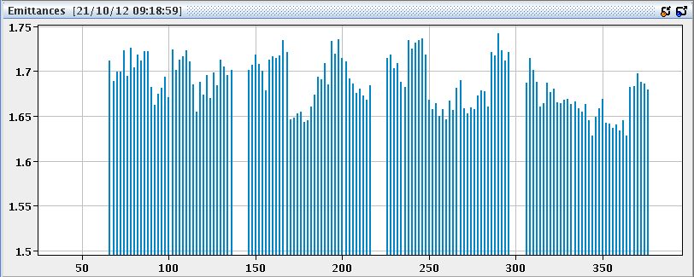
Sunday 21st October
08:03 OP dump of 3203
172 pb⁻¹ in 11h44m
08:55 Re-injecting for physics ...
ε ≈ 1.4
... waiting for SPS ...
09:25h emittance is increasing at flat bottom ... ?
ε ≈ 1.75
10:35h ramp, squeeze ... with some losses: 51% threshold

Slide 8
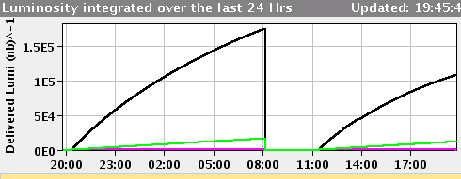
Sunday 21st October
11:25h stable beams
L₀=6.6e33
19:05h ALICE detects a nitrogen leak (going into the cavern): ~1000 l/hour.
observed & N₂ level controlled
Access needed Monday Morning
19:45h beam dump (OP),
luminosity lifetime not ideal

Slide 9
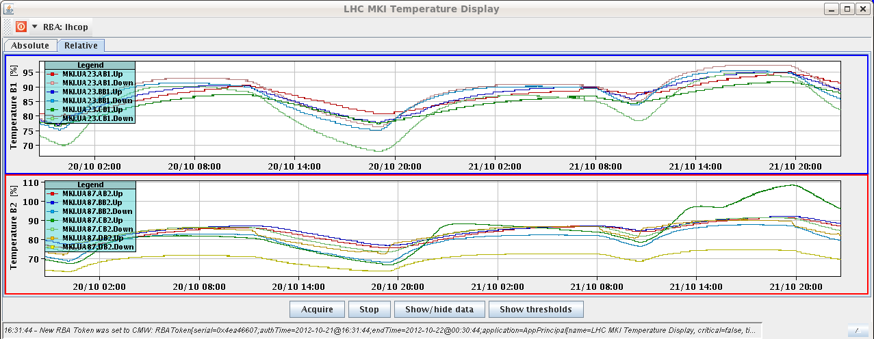
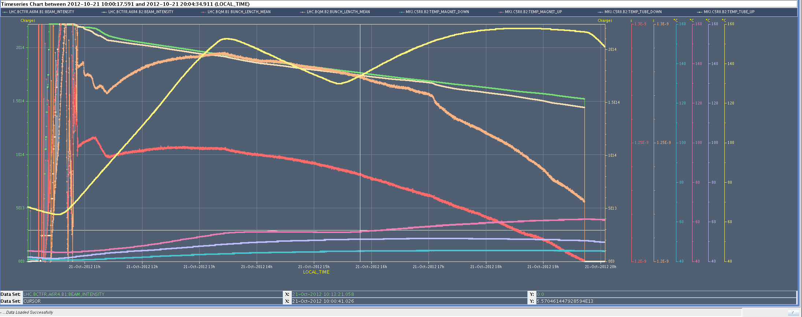
Sunday 21st October
21:05h injection ... delayed a bit due to kicker temperature
MKIC5.R8
sudden heating up during fill
23:19h Ramp
23:27h Beam Dump: UFO
00:24h injection
01:09h Ramp, Squeeze, Adjust

Slide 10
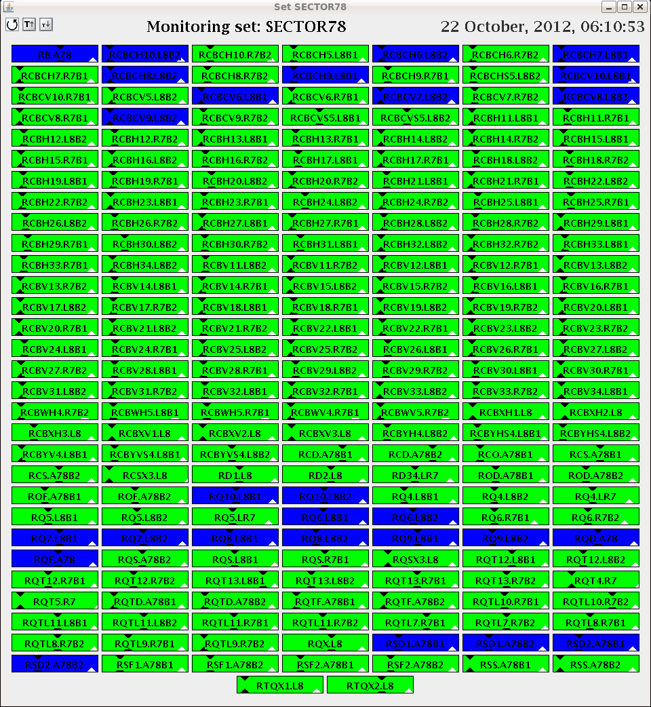
Sunday 21st October
01:50h stable beams
L₀=7.7 e33
06:10h Beam Dump
power converter communication in 78

Slide 11
LHC Status Week #42
Statistic last 7 days:
Fill | length | L0 | int L | Dump
3207 | 4:10 | 7.7 | 88 | power converter
3203 | 11:42 | 7.1 | 175 | OP
3201 | 10:17 | 7.4 | 133 | Power Converter extraction switch RCS.A12B1
3200 | 8:17 | 6.5 | 105 | OP
3194 | 12:34 | 6.5 | 167 | OP
3192 | 10:39 | 6.8 | 154 | OP
3191 | 0:44 | 6.6 | 16 | RF fault (low level rf)
3188 | 6:56 | 6.7 | 105 | Totem BLM
3185 | 7:45 | 6.8 | 122 | Power Converter RCBXV3.R5
access 9%
lumi 38%
set up 28%
ramp & squeeze 9%

Slide 12
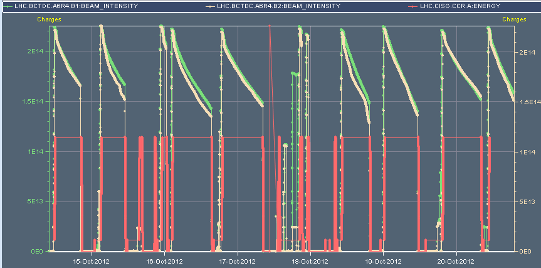
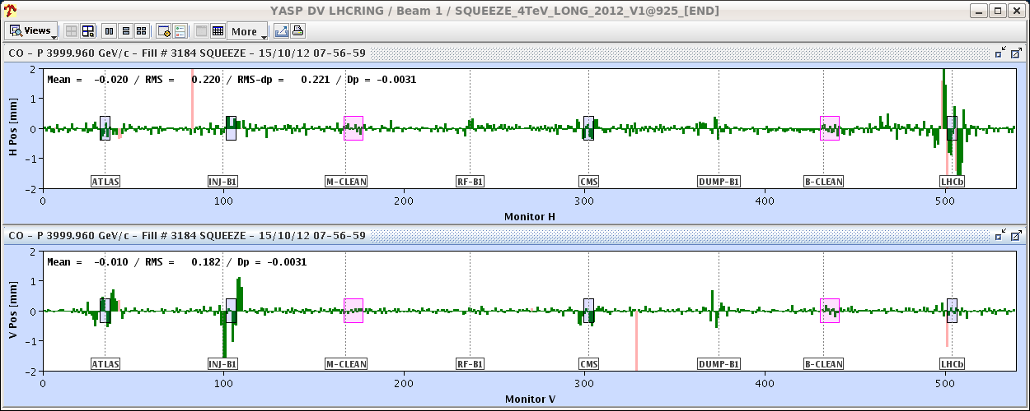
LHC Status Week #42
10 nice fills
Monday:
+2mm
-2mm
08:00h ramp & squeeze
again: OFSU problem
OFB got stuck and did not received the timing event to start the
modifcation of ref orbit.

Slide 13
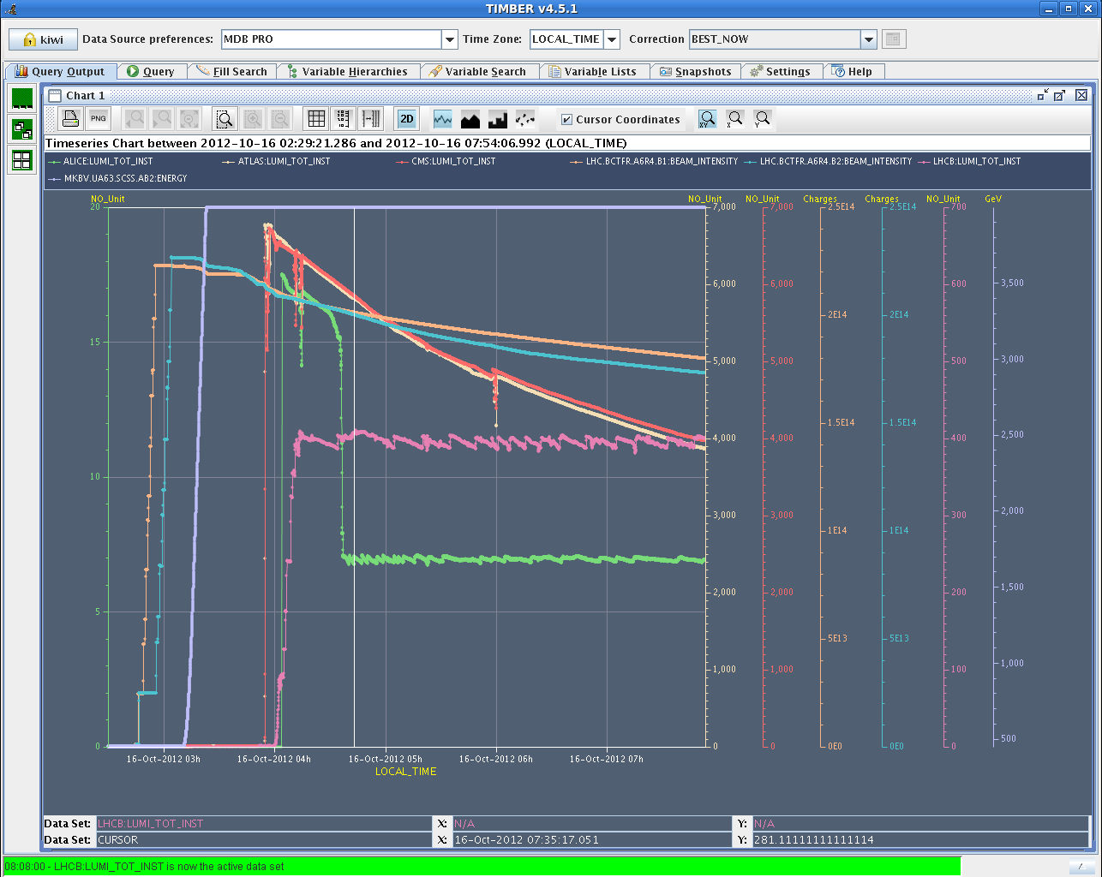
Mon Night
04:00h stable beams
automised lumi leveling ALICE ... step size 2 ... 7 μm
LHCb
ALICE

Slide 14
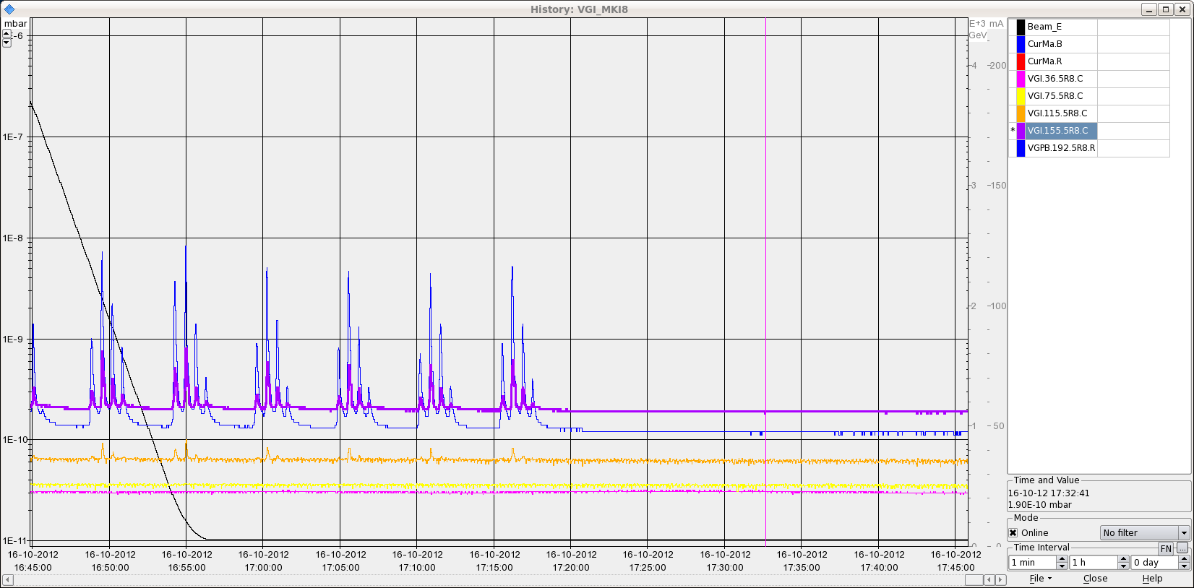
LHC Status Week #42
Tuesday:
Totem dumps the beam due to BLM losses at 31 σ
ADT high bandwidth test
spurious opening of EE switch RB.A67
beam dump: rf low level
MKID Vacuum Oscillations
Cryogenics re-adjust
beam screen regulation

Slide 15
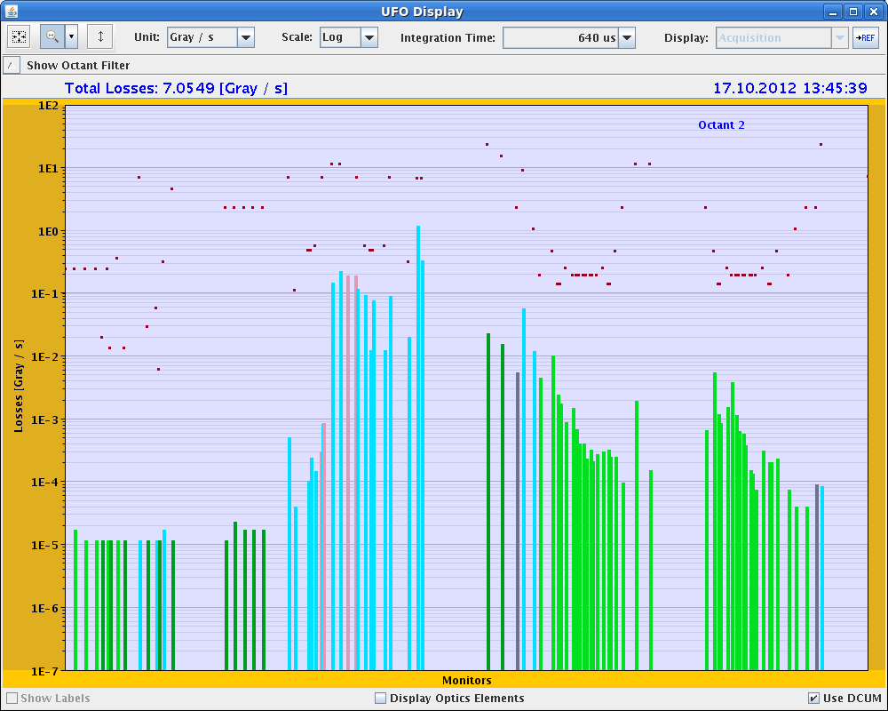
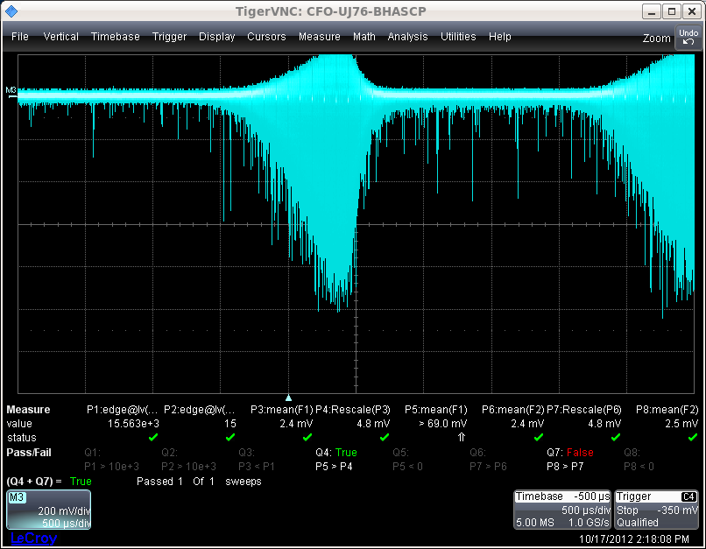
LHC Status Week #42
Wednesday:
... since 03:20h stable beams
13:45h UFO at 44% threshold
diamond BLM data
15:00h end-of-fill study:
Transverse damper gain reduced at the end of the fill from 127 to 40
in steps of 20. No effect seen in the 6 bunches in terms of losses
or beam life time. ( Test for future tune measurements on these bunches )
2.5 ms

Slide 16
Wednesday:
15:30h beam dump: scheduled !!
16:26h injection
problem of beam losses in TI8 ...
BPM.87604 was latching due to trajectory out of 2mm tolerance (MKE waveform)
- added 5 urad kick on MCIAH.87408 to move the trajectory at BPM.87604 closer to the centre
- general steering on TI 2 and TI8

Slide 17
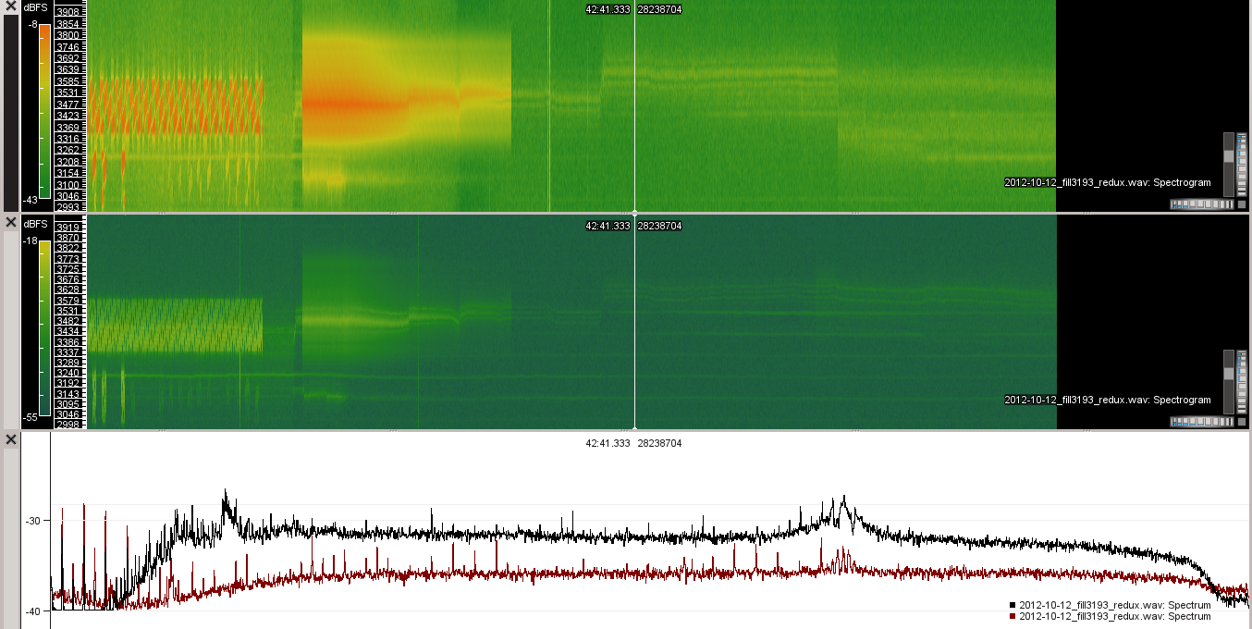
LHC Status Week #42
Thursday:
Power Converter Q8 S81 .
08:15h beam dump (OP), during ramp down:
15:00h RF tuner Optimisation
16:20h injection for physics, BBQ bunch gating test
Access for Power Converter S81 for Q8.
B2 BGI
BSRT
ATLAS & CMS
Roman Pots – TOTEM
1374 bunch average
6 bunch reduced adt

Slide 18
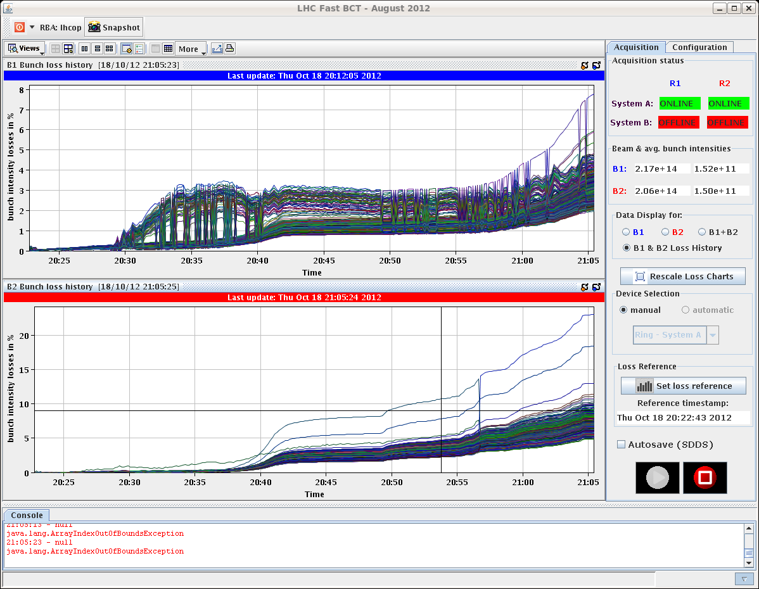
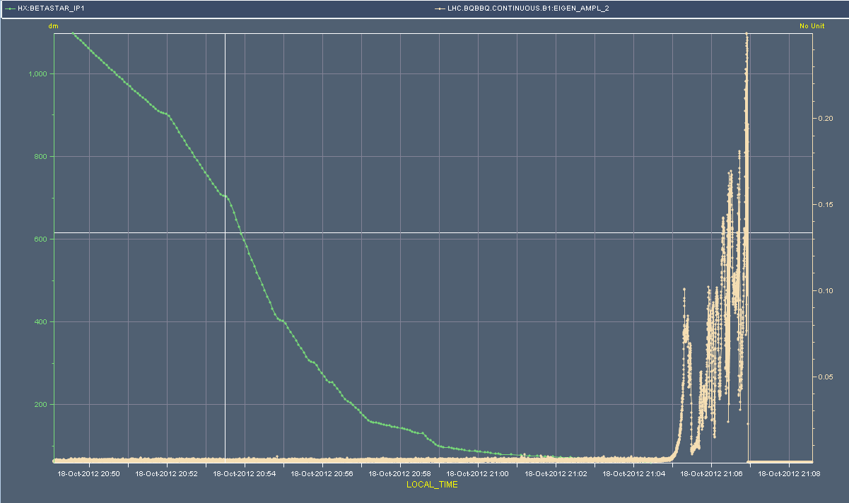
Thursday:
20:30h rocky ramp ... and beam dump at squeeze (BLM)
23:10h beams back at flat top
Beams lost to QPS trigger - RCS.A12B1 switch problem
Calling MPE piquet.
VINCENT, FROIDBISE
changed the switch and the card that goes with it but there is still
something wrong. Go back to the lab and get spares and then try again.
20%
B1V – BBQ amplitude - systematic

Slide 19
Mama told me there’ll be nights like this
Thursday:
04:25 RCS.A12B1, switches are closed.
According to Vincent, it was a DQAMS600 card that had a problem. It is the card that handles the communication, probably one input is broken.
04:30 PSB has a problem with the 16 MHz cavities, PS and SPS have no beam.
05:30 Cryo Start lost / flickering on 78 - could be a WorldFIP problem.
Cryo operator will call the best effort service, we take pilots in the meanwhile but will wait for his ok to get the physics beam.
06:15 WorldFIP repeater needs to be exchanged.
Pt 8 RE82, best effort support is here. Contact fire brigade for RP piquet.
07:15 Access to PM85

Slide 20
Friday Morning
tune spectrum not easy to interpret
neither the losses easy to understand
11:10h stable beams
18:20h CMS cooling problem
(“water mixer” not ok)
-> solenoid ramped down,
detector off
19:20h ATLAS: gas leak in muon system,
urgent access required

Slide 21
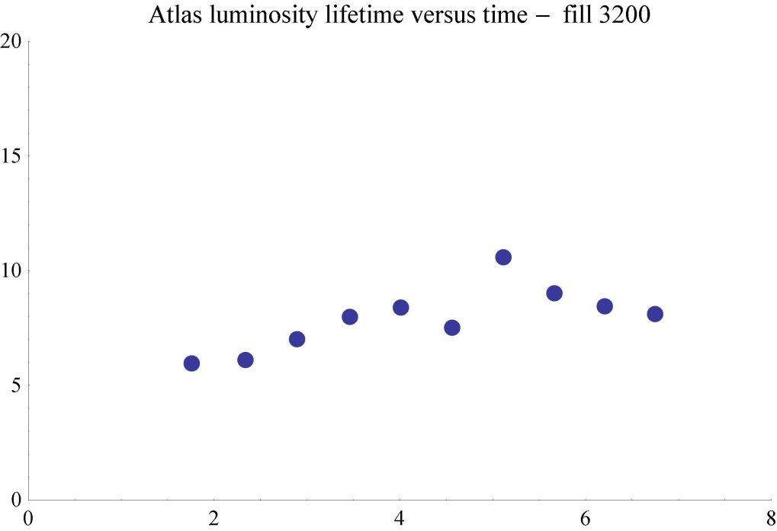
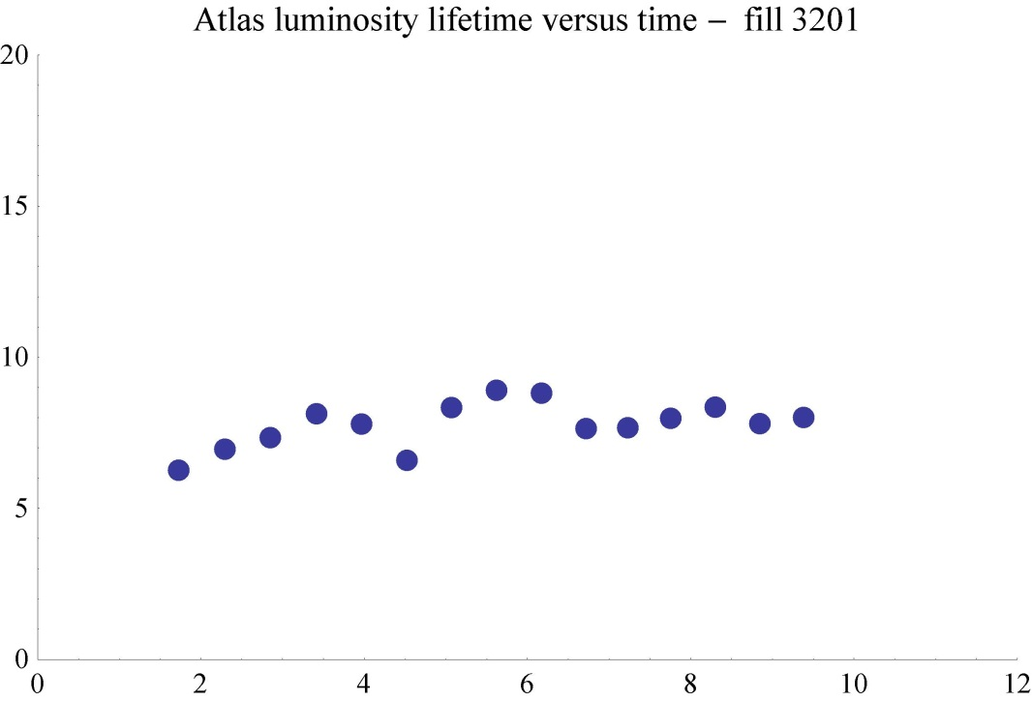
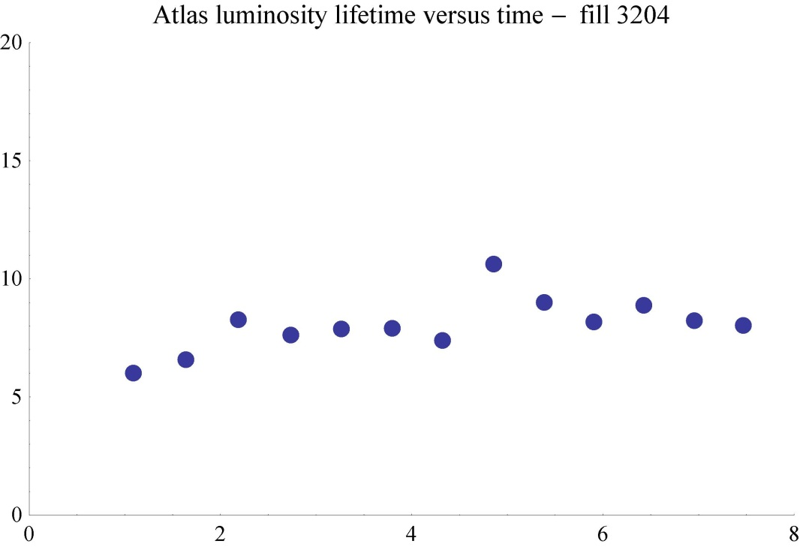
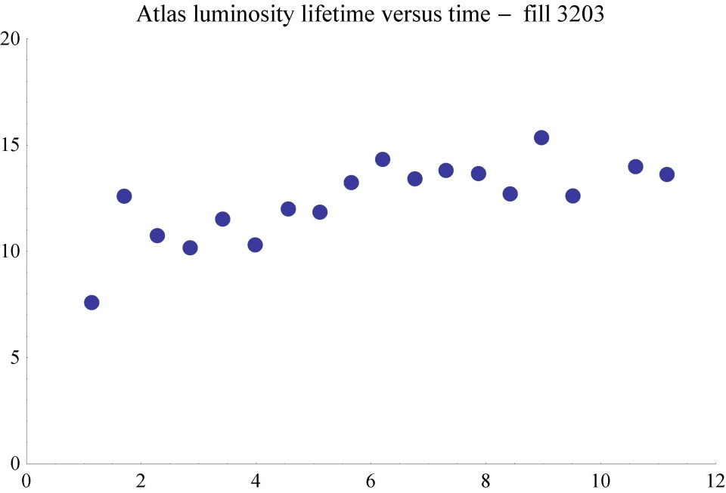
LHC Status Week #42
Special Issues
Kicker Temperature MKIC.R8
Broadband ADT and Lumi Lifetime

Slide 22
LHC Status Week #42
Special Issues
Beam Screen Temperature
gated BBQ
World FIP repeater ??
ALICE Nitrogen Alarm
--> Access ...

Slide 23
LHC Status Week #42
5 nice fills ............................................ and 5 nice fills
beam dump
BLM alarm
at squeeze
trip RQ8L1.b1
-> access
PSB problem
and in between:
a catastrophe
World FIP problem
RF tuner
optimisation
energy extr. switch
RCS.A12.b1

Slide 24
Pending operational development
Batch-by-batch longitudinal blowup at injection.
Gated tune measurement with reduced damper gain on first 6 bunches
Test of broad band ADT
Shorter bunches at injection with adiabatic voltage increase after filling
Fill(s) with shorter bunch length (impedance, heating…). Strategy to be defined. Ideally down to 1 ns.
RF-Tuner Optimisation
✔
✔

Slide 25
Pending access requests
Access system PAD UJ43 (S. di Luca).
LVDT TDI Pt2. Tunnel, 2 hours.
LBDS MKD-F-B1: check PC and generator. UA63.
Radmon installation between Q5 and Q6 at IP1. 1 hour access, few hours pre-warning. Impact 21253 / D. Macina.
ALICE: Nitrogen Alarm

