Slide 1
Summary week 41 (MD) Weekend of physics
Jan Uythoven, Jorg Wenninger
Giulia Papotti, Frank Zimmermann

Slide 2
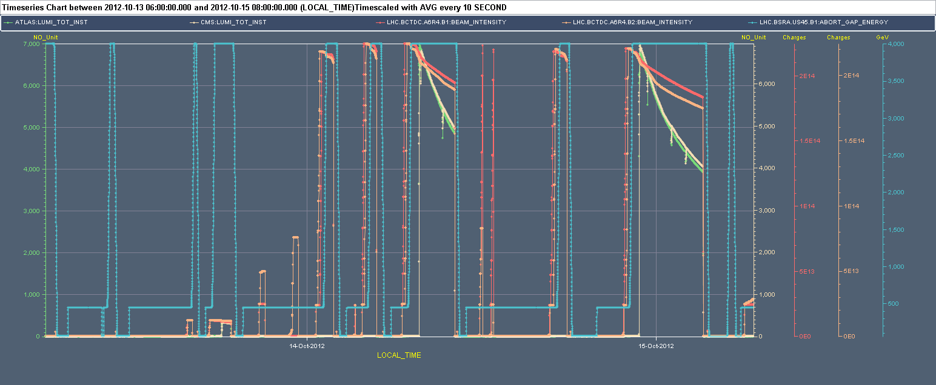
Weekend overview
Started with LHCb polarity switch (to ‘good’ polarity).
Mini-conspiracy against LHC efficiency.
COD surv.
OFSU
ALICE
Q6.L7
MKI8
Feedbacks,
S67, SPS RF
TDI

Slide 3
Saturday
07:00 LHCb polarity switched to + (PC).
08:00 – 12:00 Mixed bag of issues with OFC, OFSU, Optics server, Q systems and S67 trip (spurious RB EE trigger).
12:00 – 15:30 SPS RF problems.
Test cycle with 78b and new LHCb polarity.
16:15 First attempt dumped in the ramp by COD current surveillance.
Surveillance had not switched to the correct settings, it seemed to be stuck on High-beta (most likely).
This is the only ‘hangover’ from the MD.
18:20 Second attempt - short stable beams for final adjustments of LHCb separation.

Slide 4
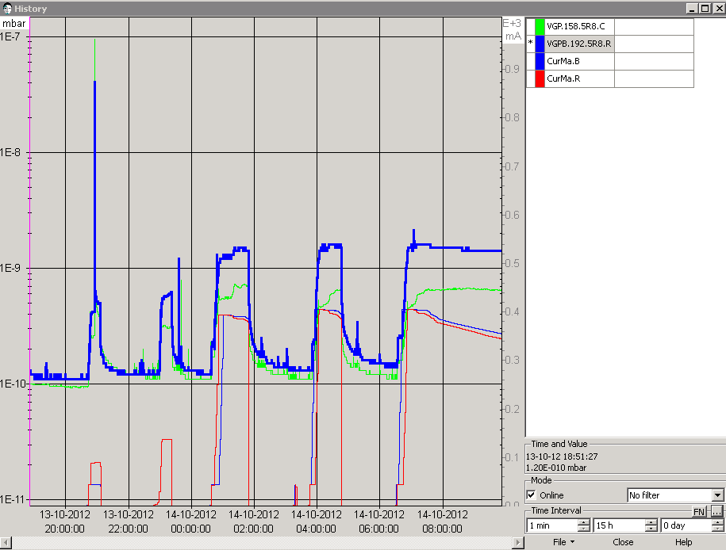
Saturday evening
20:50 MKI8-D spark (& vacuum spike) during TL steering.
22:00 Extended Softstart (conditioning) of MKI8, followed by test injection.
23:00 Another
Softstart .
Spark
Injection test
Softstart
Vacuum in MKI8 now good enough to inject first beam 1
(for ALICE)

Slide 5
FBs in the spotlight
01:00 Ramp…
01:50 OFSU crash just after end of squeeze. Emergency dump by SIS.
03:00 Injecting again.
05:00 Replay: OFSU crash just after end of squeeze, while turning off OFB. Emergency dump by SIS.
Expert called, no evident problem, reboot OFSU machine.
Interlock adjustment in SIS Sunday morning:
Implemented, tested (during ramp-down) and deployed a modification of the SIS protection against OFSU crashes in ramp and squeeze : no action when PC’s are IDLE.
Interlock ‘fine tuning’...

Slide 6
Sunday
06:30 Filling again.
07:50 Stable beams fill 3178, 7E33 cm-2s-1.
10:00 Dump by RF crowbar on M2B2 (spurious).
Reset and go again.
11:00 Filling.
12:00 Beam dump while retracting TDI Pt2 (ring1 full).
Since TDI was moving correctly to parking and back in beam, we try again.
12:50 Our preferred dumps come in pairs… TDI Pt2 dumping again during retraction.

Slide 7
Sunday
13:00-16:00 Investigations on TDI in Pt2.
Problem on LVDT 1 of LU corner for the TDI in IP2. The beam was dumped when moving the TDI to parking, probably a glitch on the faulty LVDT violating the dump inner limits.
LVDT 1 should have be exchanged but this would have required an access of at least 2 h. A. Masi switched the controls to LVDT 2.
This exchange required to reset the position and energy thresholds around the new sensor readout (C. Bracco).
No impact on the position of the TDI!!

Slide 8
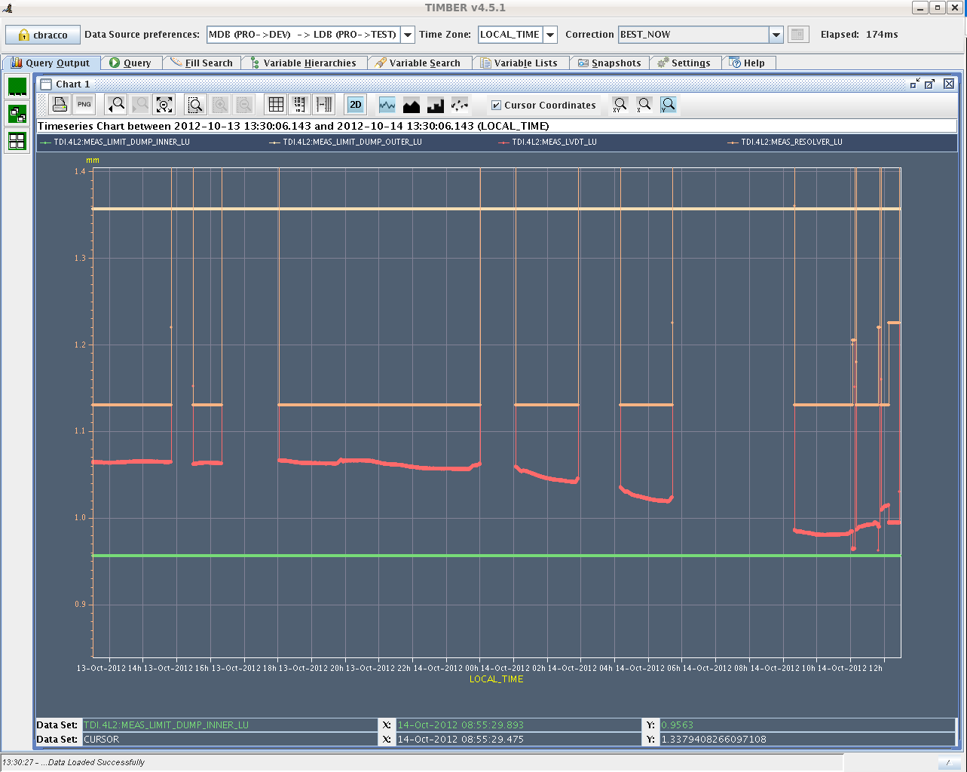
TDI PT2
Saturday
Sunday

Slide 9
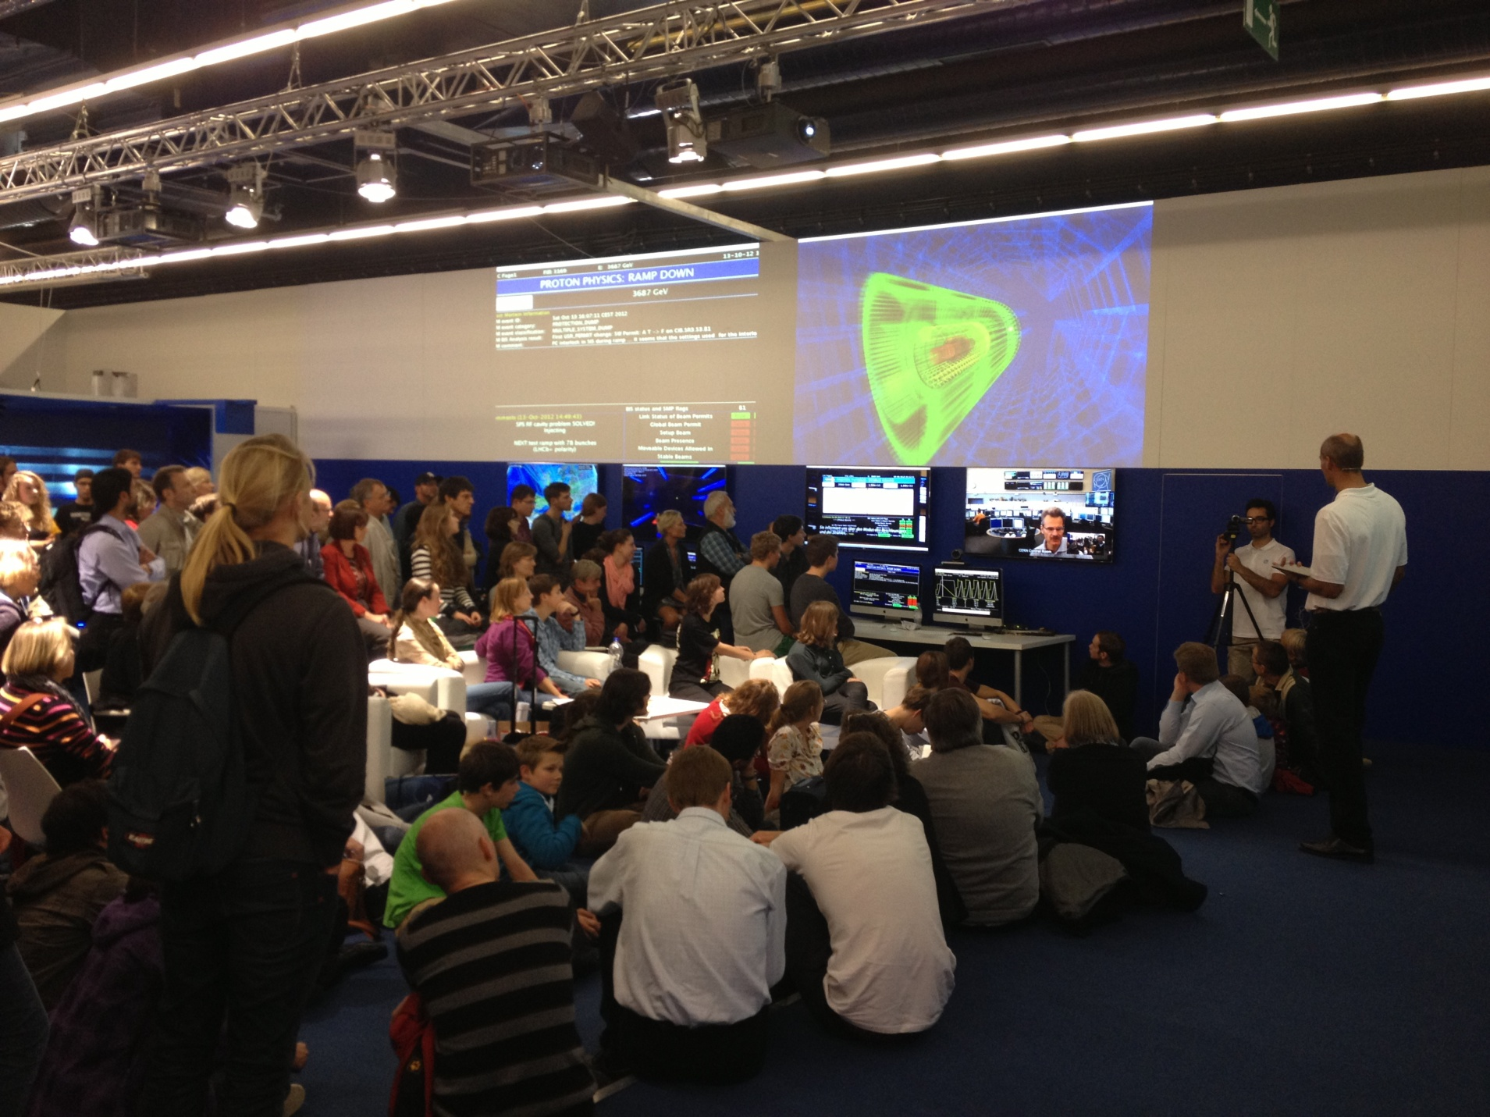
Frankfurt book-fair intermezzo

Slide 10
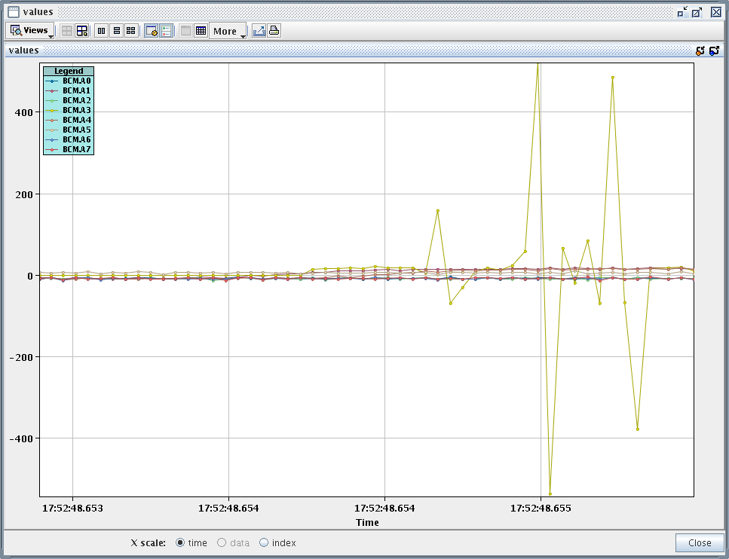
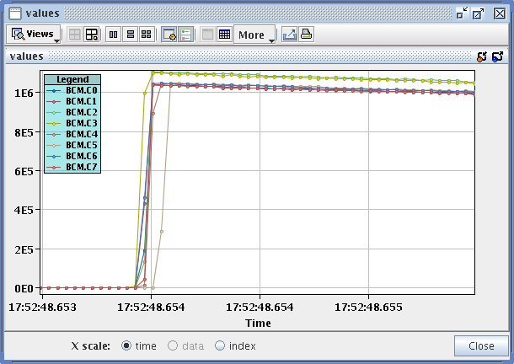
Sunday evening
16:15 Filling again.
OFSU problem, reboot needed.
Ramp, squeeze all fine…
17:52 Dump by ALICE BCM,
just before launching collisions.
No signs of losses or UFOs on LHC side.
Some difficulties to reset BCM after
the event.
ALICE BCM A side
ALICE BCM C side

Slide 11
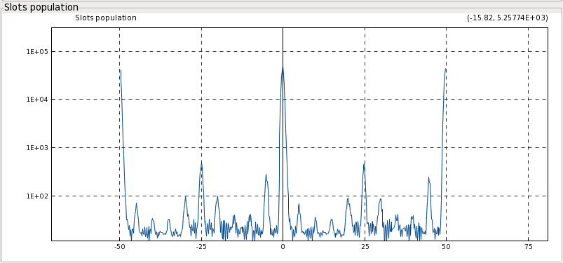
Sunday night
21:00 Refilling.
OFSU problem, reboot needed.
23:00 Stable beam fill 3182, L ~6.8E33 cm-2s-1.
CMS off by 1 sigma (again). Oscillating back and forth.
ALICE initial L > 10.
02:00 25 ns satellites at level of 1% for B1, 0.5% for B2.
03:15 Dump, QPS on Q6.L7B1
B1 satellites

Slide 12
Sunday night – Monday morning
03:30 During pre-cycle trip of RBs (QPS) of S67 (at 200 A). Restart.
05:00 No beam from PS, POPS again.
06:00 Filling again. TL steering.
07:00 Filling for physics.
08:00 Lost at start of squeeze. Problem with orbit FB, most likely OFSU – investigating.

Slide 13
Fills of the weekend
Fill | Day | L (h) | Nb | Int L (pb-1) | Dump
3169 | Sa | 0:30 | 78 | 0.5 | OP. LHCb test fill.
3178 | Su | 2:10 | 1374 | 48 | RF – crowbar M2B2.
3182 | Su | 4:15 | 1374 | 78 | QPS Q6.L7B1
7 hours of SB out of 48 hours (15 %), 136 pb-1.
Lost:
Fill | Day | Mode | Dump reason
3168 | Sa | Ramp | COD current interlock (wrong reference?).
3175 | Su | Squeeze | OFSU crash at end of squeeze
3177 | Su | Squeeze | OFSU crash at end of squeeze
3181 | Su | Adjust | ALICE detector
3184 | Mo | Squeeze | Orbit FB/OFSU – to be understood.

Slide 14
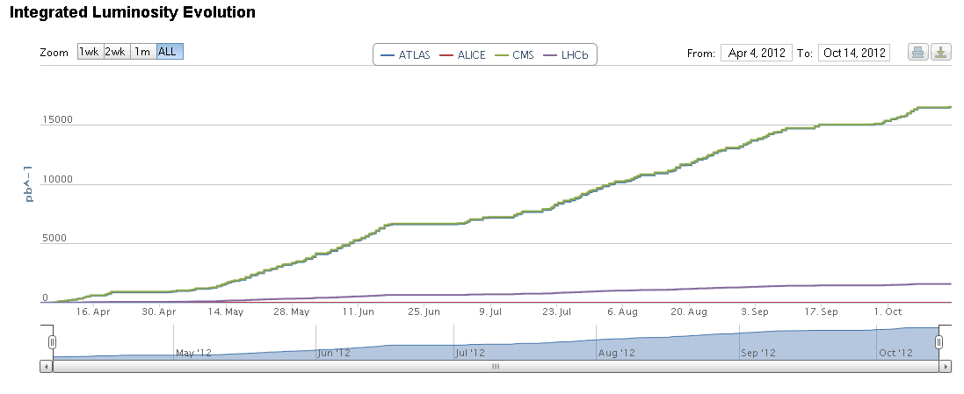
Overall status – small corrections wrt last Monday

Slide 15
Downtime – bathtub curve
Day | Length | System | Comment
Mo | 8h | RF | Line 3B1, 40 MHz clock missing.
Mo | 5h | SPS | Transformer exchange.
Tu | 6h | QPS/EPC | RB.A12 , switch of RCD.A12B2, RD34.LR3
Tu | 3h | Cryo | Cryo valve on Q4.L5
Fr | 7h | LBDS | LBDS B1 MKD_F
Sa | 2h | FB | OFC,OFSU,Q & S67 RB EE mixed bag
Sa | 3h | SPS | RF
Sa | 3h | MKI | MKI8 spark
Su | 5h | TDI | LVDT TDI B1
Su | 2h | ALICE | BCM powering
Mo | 3h | QPS/EPC | QPS Q6.L7B1, RB S67 EE, PS POPS
22h
25h
A few RD2.LR2 trips when at standby current (free wheel diode). Not seen anymore over the weekend.
5 OFSU crashes/issues in little over 24 hours. Worrying.

Slide 16
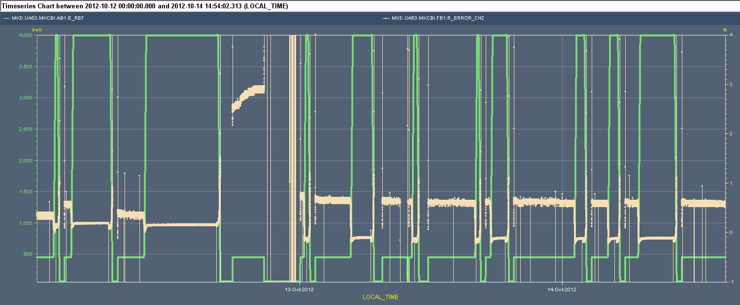
Beam Dump Energy tracking interlock
Friday 16:30 Correct Dump at 4.0 TeV
Afterwards cannot arm LBDS because of Beam Energy Tracking System (BETS) Interlock on compensating voltage
Limit at injection is 1.0 %, error > 2 % and creeping up
Access: not clear if problem at power converter. Apply global correction factor on setting from PLC, change of 0.35 %.
This brings energy tracking within limits over complete energy range
4 %
Energy
4 Tev = ± 0.5%
Interlock limit at injection = 1 %
-1 %

Slide 17
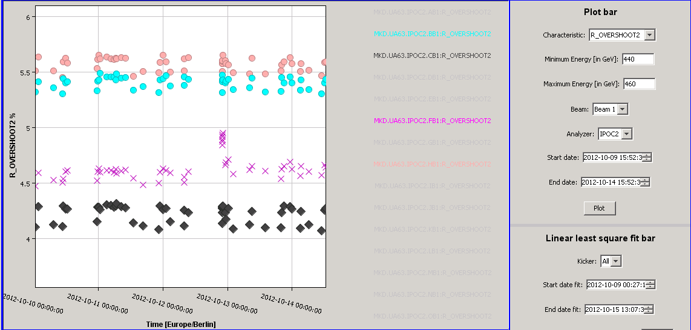
LBDS checks on generator MKD-F
Back again around midnight after test ramp and test dump at 4 TeV
Since then energy tracking on this generator stable (see chart prev. page)
Slightly larger error than before intervention, but still ok.
The actual kicker waveforms are stable and the same as before (see below)
XPOC checks always pass
Still unpleasant situation that something suddenly happened which is not understood
On first occasion check generator and power converter again, possible interventions to follow
Although we have the full redundancy of one generator (14/15 kick still ok)
F

Slide 18
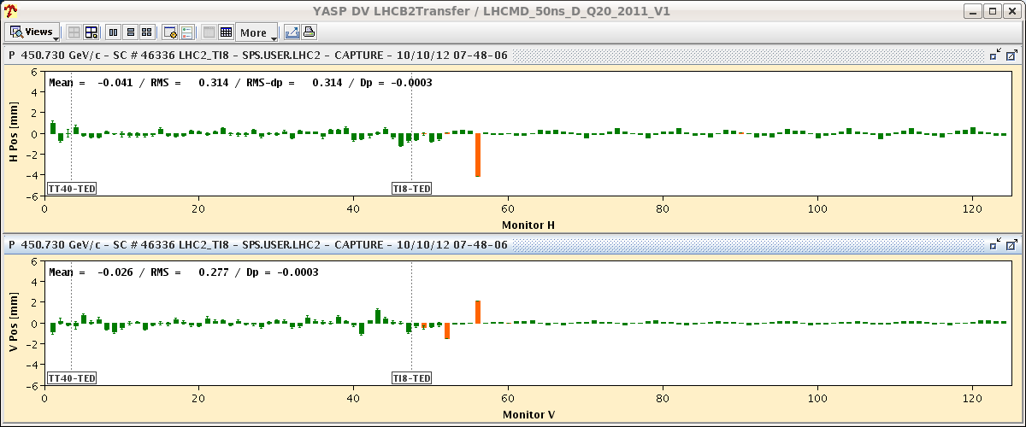
Transfer lines
Again rather frequent steering of both transfer lines.
Recurrent since the last TS.
Note : SPS dipole in sextant 3 is developing inter-turn short.
At end of TI8 some BPMs with larger offsets in H plane lead to almost permanent latches on injections.
Some bunches out of tolerance on one BPM.
Not correctable with CODs, probably requires correction including the MDI. TBC.

Slide 19
Tune systems
We now have distinct tune systems for low intensity beams (FFT3) and for standard beams (FFT2).
FFT2 has the potential to be gated (e.g. 6 first bunches).
Q’ measurement on FFT3 / low intensity B2:
Sign is wrong due to UDP packet latency. Will be fixed this week.
Some issues with state control changes.
States are important to define which system (FFT2/FFt3) is used for QFB.
FESA class?

Slide 20
Pending operational development
ADT bandwidth increase.
Gated BBQ (probably parasitic).
Batch-by-batch longitudinal blowup at injection.
RF phase modulation over 1 turn.
Bringing beams into collision longitudinally.
Fill(s) with shorter bunch length (impedance, heating…). Strategy to be defined. Ideally down to 1 ns.

Slide 21
Pending access requests
Access system PAD UJ43 (S.di Luca).
B2 BGI : UX451 for a camera replacement. 1 hour.
BSRT : tunnel. No time estimate.
BBQ: UA43/7. Short.
LVDT TDI Pt2. Tunnel, 2 hours.
LBDS MKD-F-B1: check PC and generator. UA63.
Radmon installation between Q5 and Q6 at IP1. 1 hour access, few hours pre-warning. Impact 21253 / D. Macina.
ATLAS : ~3 hours. Impact 21251.
ALICE.
RD2.L2 – diodes: few hours after a fault.

