Slide 1
LHC Status Monday Morning 1-Oct
Bernhard Holzer, Joerg Wenninger
Goal of the week:
Restart after technical Stop
Goal of the week:
Collect within this week all kind of technical annoyances that could happen until the end of the year

Slide 2
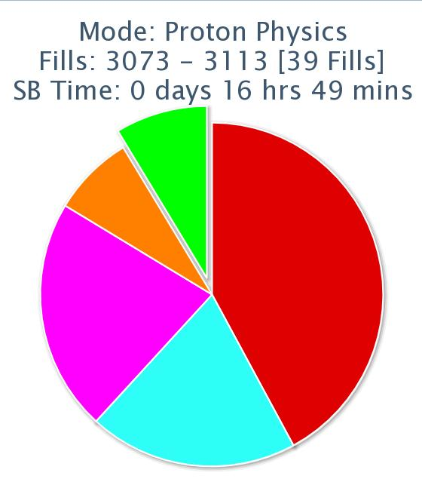
LHC Status Monday Morning 1-Oct
Bernhard Holzer, Joerg Wenninger
Statistics: 5 fills
Fill | length | L0 | int L | Dump
3113 | 8:02 | 5.7 | 103 | Power Converter ROD /ROF/RSD2 67
3110 | 0:40 | 5.4 | 12 | UPS
3109 | 4:31 | 3.0 | 25 | Cryo communication vacuum
3108 | 1:40 | 3.3 | 18 | Power Converter RCBXH3.R1
3102 | 1:10 | 1.7 | 0.003 | Power Converter RQ9.L2
Lumi 9%
Ramp 8%
Access 42%
Setup 20%

Slide 3
Monday
08:00-10:00 Test of cycle with 1 probe / beam.
Q’ measurement.
New collision BP (new : parabolic round-off on all COD functions) ran OK. Orbit leakage in transients is OK.
10:00-12:30 50 Hz noise studies and BRST checks.
No effect on 50 Hz noise of active filters (RBs, warm dipoles and quadrupoles) .
14:00 TCLIB alignment check. Beam centre differs by 75 um and beam size differs by 40 um ==> within measurement accuracy (50 um steps) ==> we keep the old settings.

Slide 4
Monday / Tuesday
set up for Q20 injection
17:30 Observe losses at beginning of line for B1 – problem at extraction from SPS.
extraction bump increased from 37 mm to 40 mm.
re-steering of line.
20:00 Ready for 50 ns with Q20.
since then used as Default setting
22:30 Injections of 36, 72 and 144b with B1. 36b on B2.
23:20 MKI8D faulty. Flashover?
Extended softstart.
Also vacuum activity.
Loss maps (betatron)... including roman pots
Asynch dump test including roman pots

Slide 5
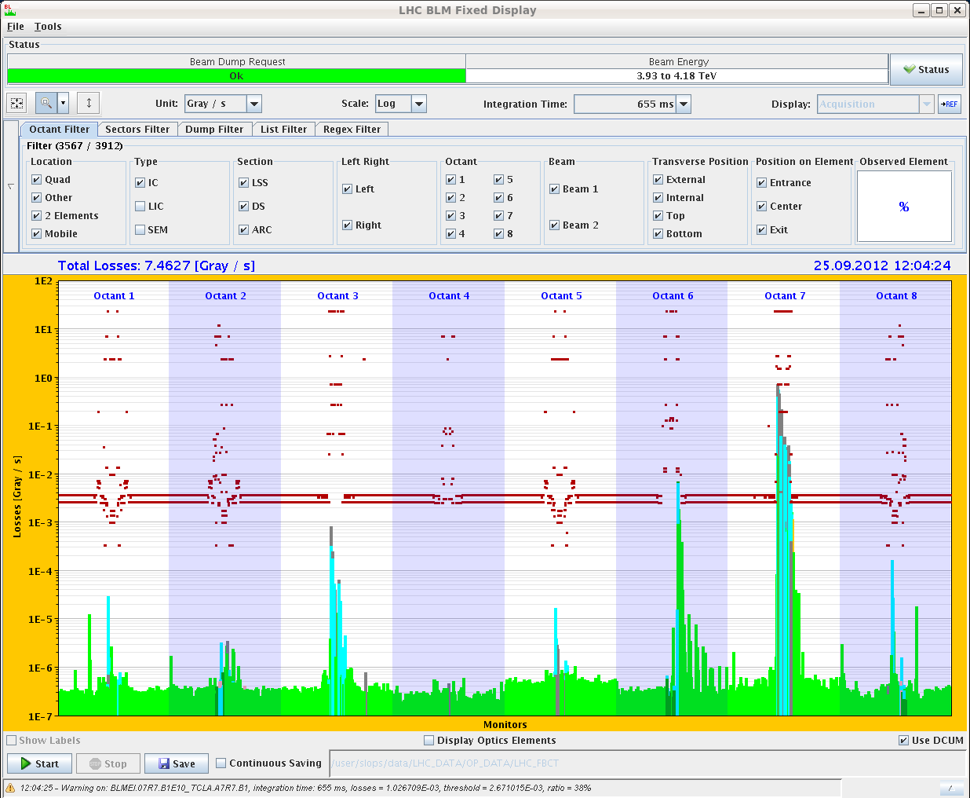
Loss map – funny features (reproducible !)
Loss spikes in cold regions (B1 only).
Not simple noise – appear only during the loss maps. Also present in the loss maps of the previous nights.
Very low (< 1E-4), but should not be there…
B1H

Slide 6
Tuesday afternoon: full house
17:00 SIG transformer manipulation: Volltreffer !!
Compensator filters Pts 2,4 and 6 off, ATLAS toroid trip.
17:30-18:30 Start switching on filters.
Trip of compressor for cryo Pt2 → 6-10 hours recovery.
Trip of ALICE solenoid, spectrometer, undulators and a few other circuits.
When switching back on fllters in 6, compensator filter at Pt2 went off again, could be recovered without more problems.
04:00 Restart: Filling for loss map with RPs.
Betatron V and asynch dump test.

Slide 7
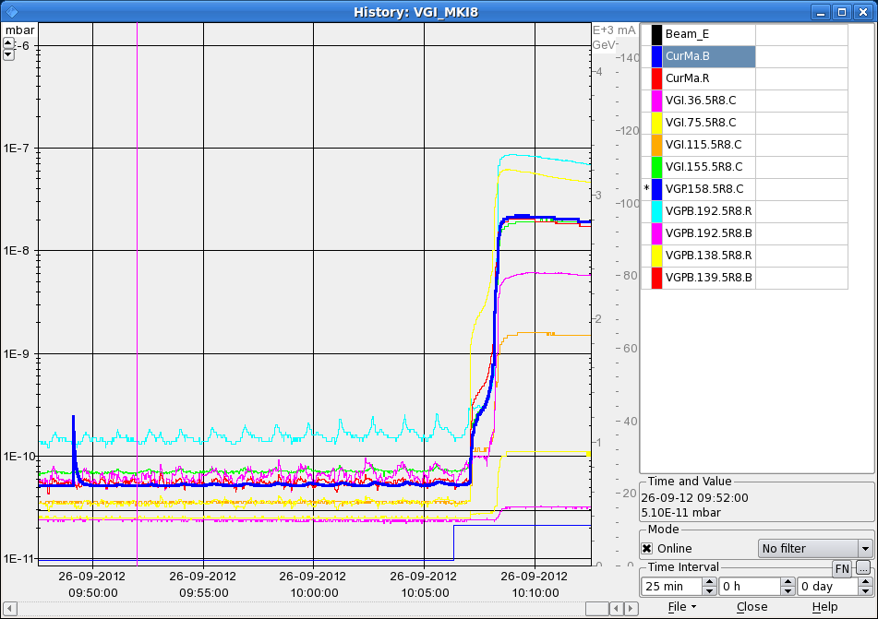
Wednesday
MKI8_D problem
7:00h restart, plan: test fill 78 x 78 for physics
10:00h first bunches (6 + 36 ) in ... but ...
vacuum problems in MKI8_D
After 36 bunch injection the threshold is over passed and a second injection is
vetoed by the SIS
different test to understand the problem: (M. Barnes)
* solenoid currents: 0 ... 3 ... 10 A -> no influence
* dump of beam 1 -> no influence
* ... pressure reduces exponentially
-- electron cloud --
threshold for SIS 2E-9

Slide 8
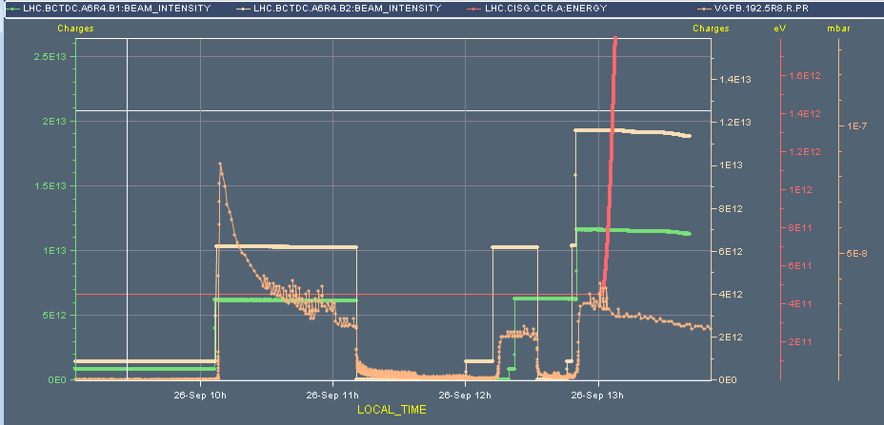
Wed Morning
12:48h preparing 78 bunch fill
two 36 injections afap before vacuum reaches interlock level
conditioning clearly visible
13:00h ramp, squeeze, adjust
13:45h stable beams
72
36
36

Slide 9
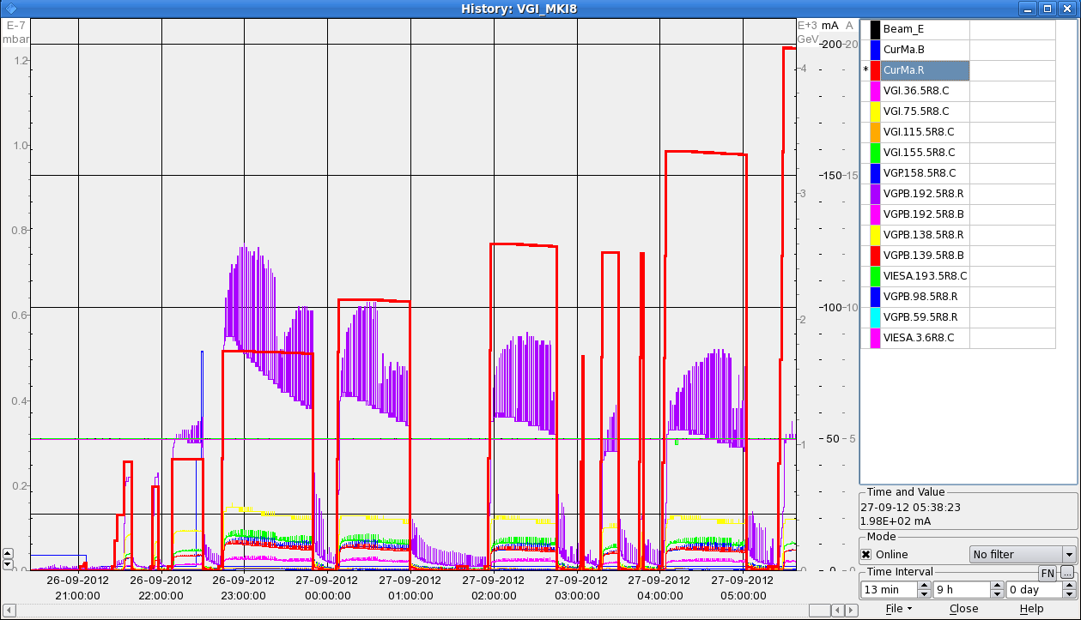
Wed Late
15:30h beam mode adjust: some end-of-fill studies
* local bumps for BSRT 2 alignment
* octupole tuning for lifetime
* β-tron loss maps in beam 1 & 2
18:00h injection for 78x78 bunch fill
2*36 bunches
1*72 bunches
Wednesday Night
4E-10
2E-10
2E-9
1E-9
current b2
pressure
... scrubbing with n*144 bunches

Slide 10
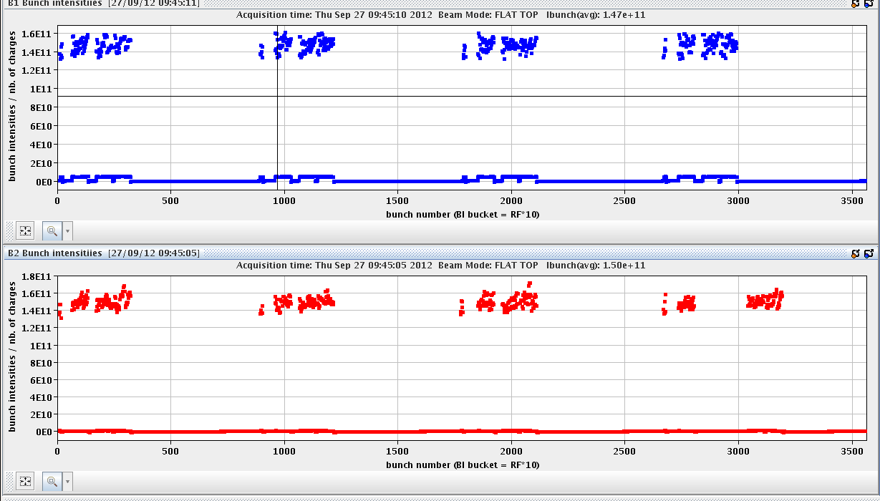
Thu
08:30h injection physics beam 456 x 456
-- beam 2 first –
10:30h stable beams,
11:30h low mu scan for ATLAS
11:46h beam dump: trip of RQ9.L2
access for temperature sensor cryo Pt 8,
... QPS reset Pt 8
... ALICE
... and Q9 in Pt2: earth fault ... due to water leak
20:05h injection delayed... waiting for 40MHz PS
00:45h injection for physics

Slide 11
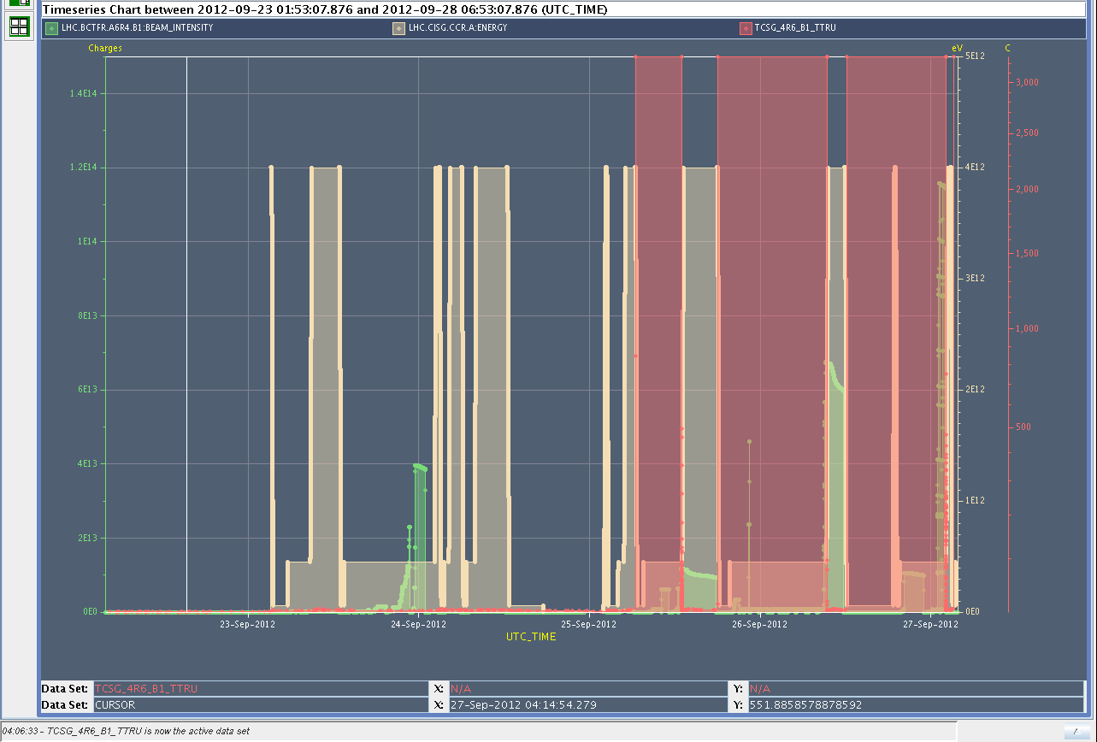
Thu Night
02:08h ramp ... & beam dump:
Bad temperature reading on TCSG_4R6_B1_TTRU triggered interlock on BIS
piquet called to analyse problem
intermittent erratic readings
3000
23-sep 24 25 26 27 sep

Slide 12
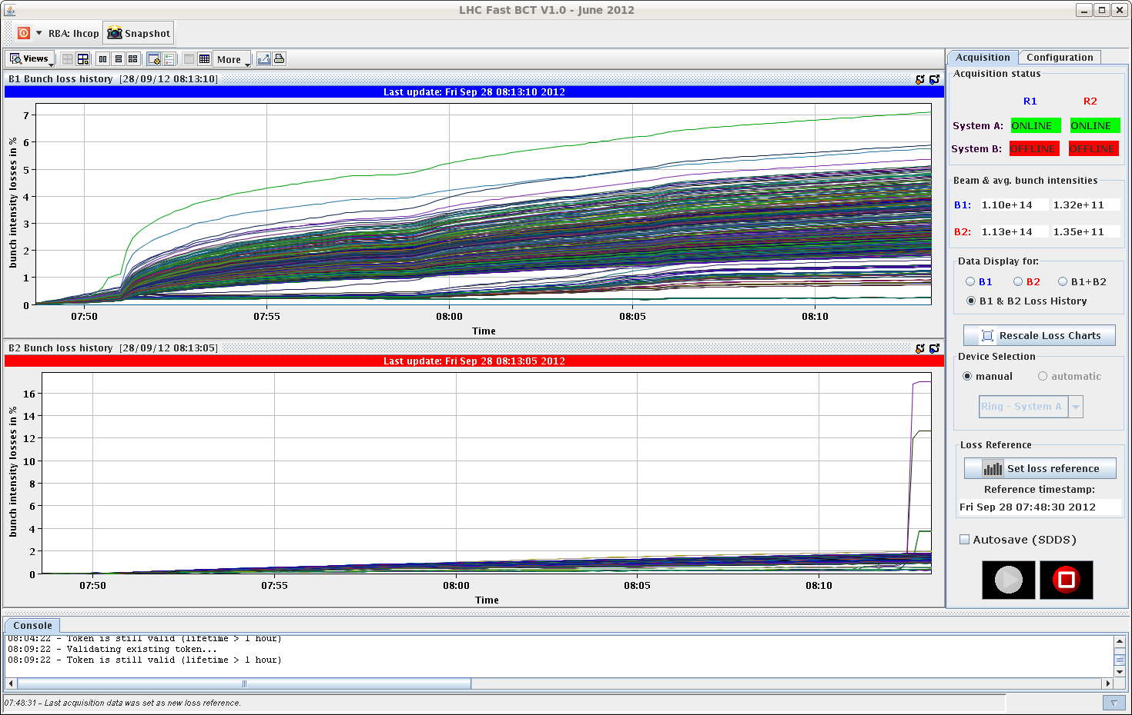
Friday morning
08:00 Stable beams with 840b.
Nice smooth cycle.
08:15 Losing on non-colliding (and no LR) bunches when trimming down the octupoles.
Had to back off in octupole current to stabilize.
Sign that we should avoid bunches without head-on in IR1/5 in the filling schemes.

Slide 13
Friday continued
09:40 Beam dump, trip of RCBXH3.R1.
No faults, reset and go.
10:20 Lost cryo in S78 due to DFB levels.
Unfortunate error while reconnecting the distribution between heat shields. An interlock was left unmasked, and an interlock triggered, closing valves on the 4.5K distribution line.
In the context of decoupling S78 and S81.
Some accesses (LHCb, CMS) during cryo recovery.
Collimator T sensor on TCSG_4R6_B1_TTRU with strange reading disabled (1 out of 4).
15:30 Cryo S78 is back.

Slide 14
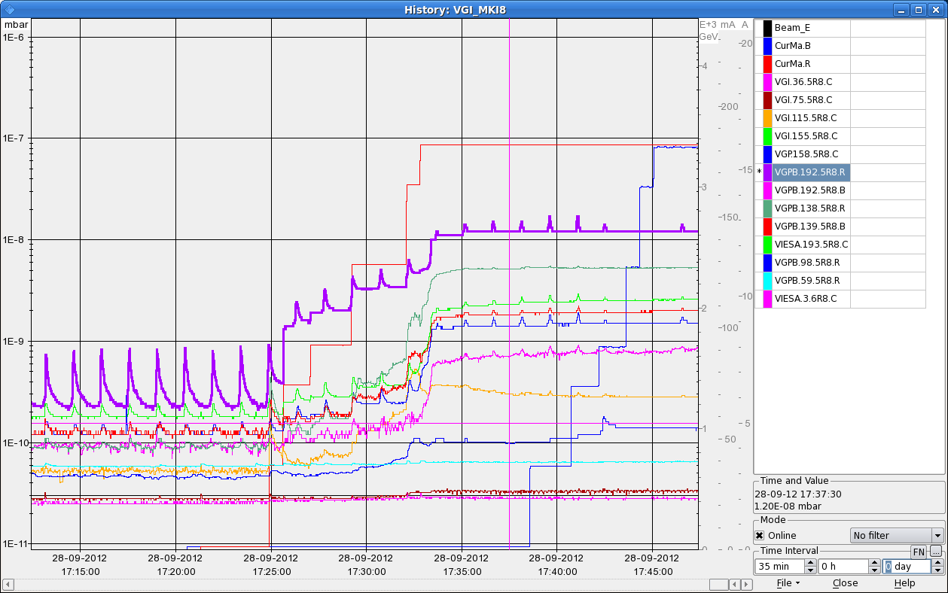
Friday afternoon
17:00 Filling with standard schema, 1.4E11 p/b, as far as vacuum allows.
Had to stop at 726 bunches, vacuum in interconnection > 1E-8.

Slide 15
Friday afternoon
18:40 Stable beams, fill 3109, L ~3E33 cm-2s-1, 726b.
Smooth, a few poor quality batches made it through (we had a some issues with PS bunch length) – reflected in losses.
21:40 Start of ATLAS VdM scans.
23:10 Beam dump – lost cryo sector 78 due to communication with vacuum.

Slide 16
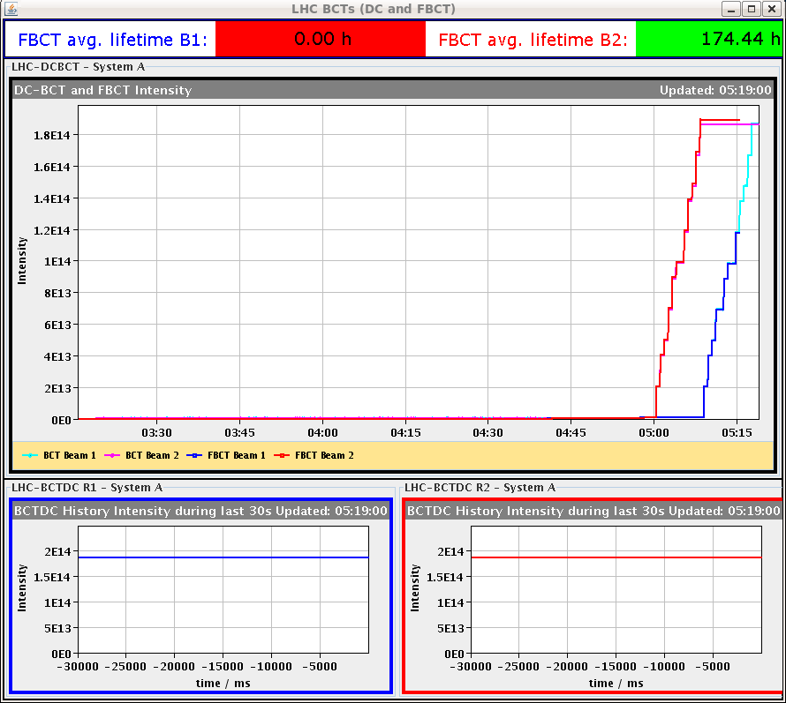
Evening
00:00++ Access LHCb. Followed by CMS. Then vacuum for PLC restart.
00:50 No more logging of some systems (LHC BI) – server hardware failure.
03:30 End of access. Pre-cycle.
04:30 Injection – 1374 bunches @ 1.4E11 !!

Slide 17
Saturday Morning
05:00h injection ... 1374 x 1374
with reduced bunch intensity N_{p} = 1.4*10¹¹
06:30h stable beams
07:10h beam dump: Electrical glitch affecting UPS in Sectors 78 and 81
... lengthy repair ... including support from the UPS company piquet

Slide 18
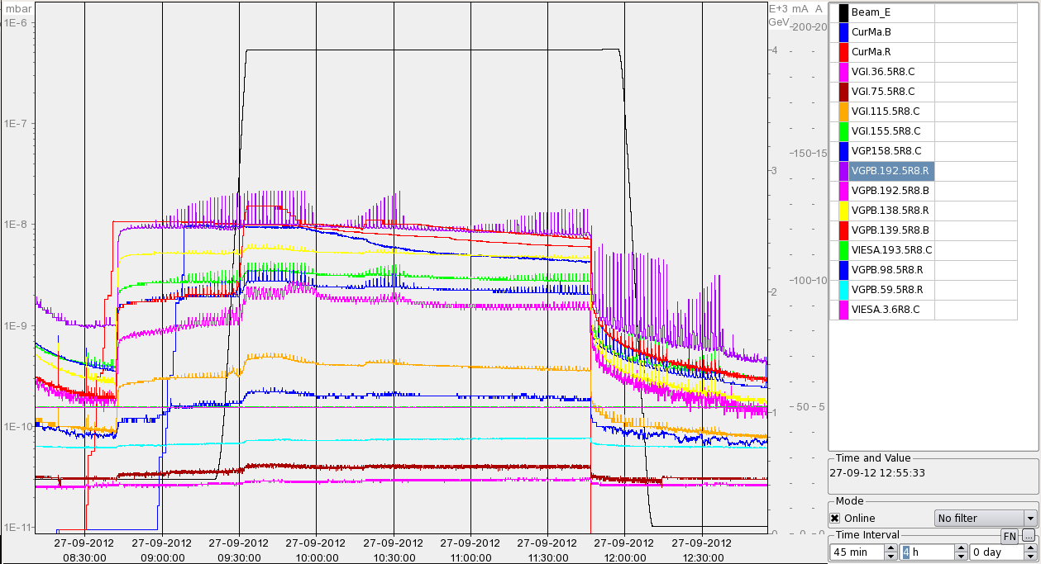
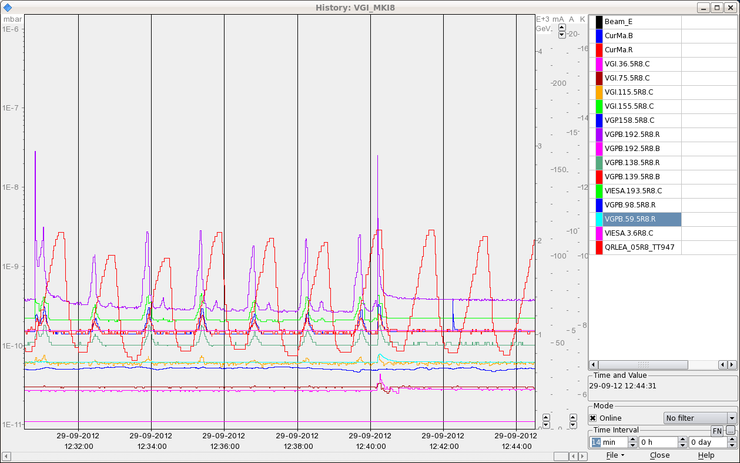
Sat Morning
in parallel to the UPS repair ...
try to improve the spiky situation at MKI8_D:
Vacuum at MKI8_D
seems to be a true vacuum measurement:
several other gauges show the same behavior,
but smaller in amplitude
1E-8
1E-9
1E-10

Slide 19
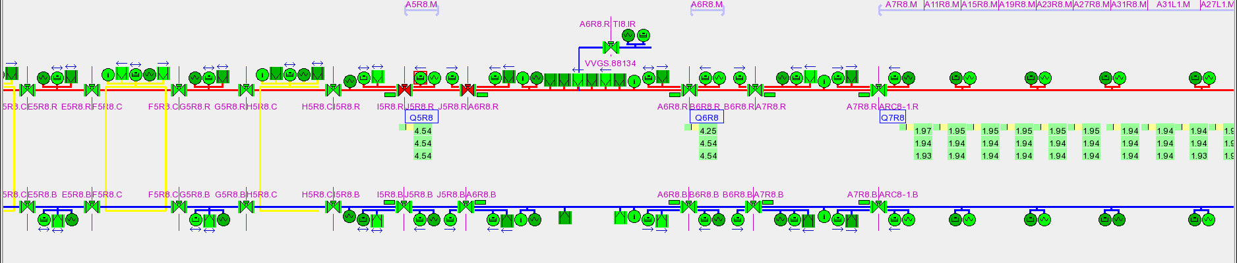
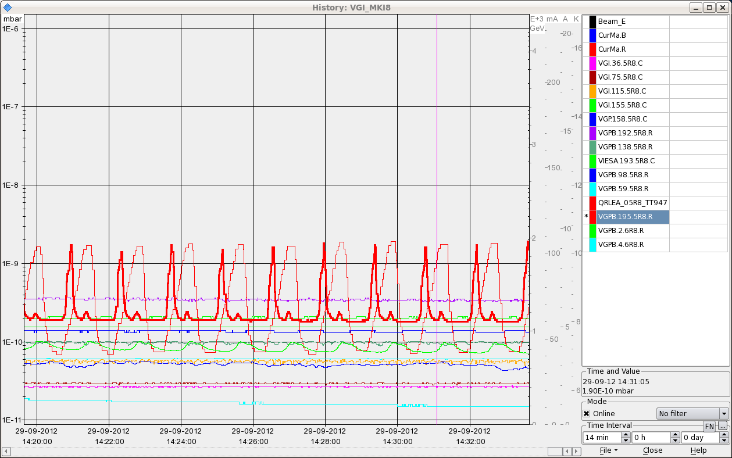
Sat Morning
isolating the section:
and correlating with beam screen temperature that varies with the same
time scale between 5 and 15K.
After consultation with Vincent B. and Udo we decide to close the valves around
Q5 and perform a thermal cycle to 40K of the beam-screen to release gas
from the beamscreen

Slide 20
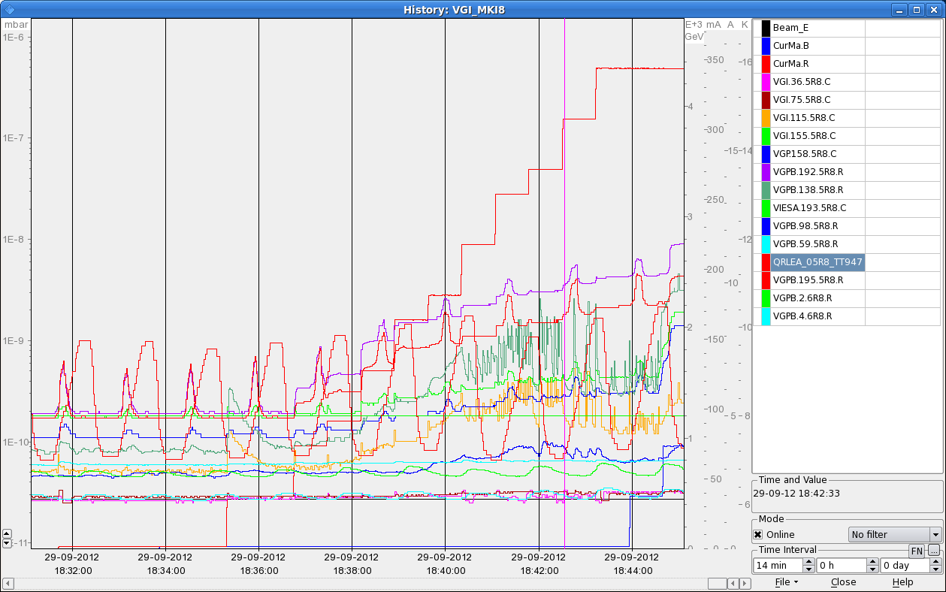
Sat Morning / Late
in parallel: intervention on the water leak on the dump resistors in point 1
16:30h UPS problem fixed, restart LHC
18:10h injection probes
18:30h injection physics: 1374 x 1374
... nota bene
* pressure oscillations still observed, beyond SIS the threshold
* lost again FBCT ...
5e-9

Slide 21
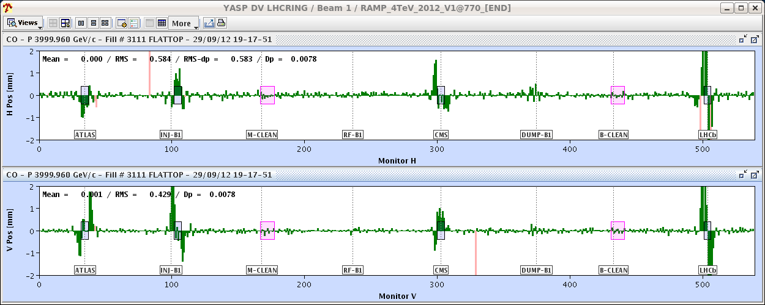
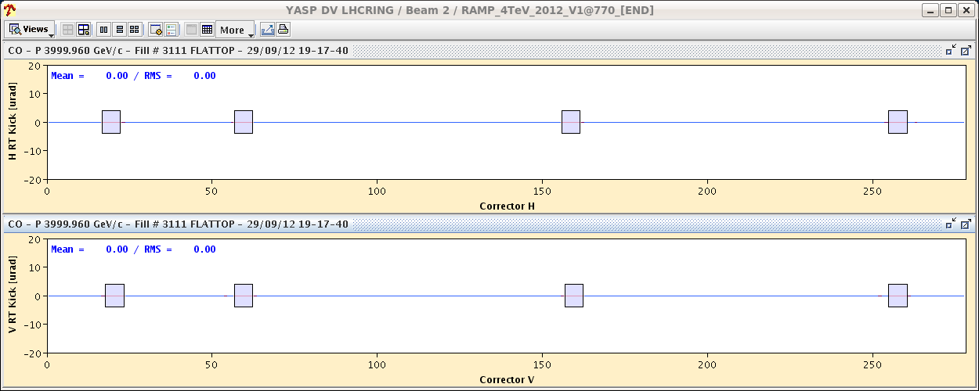
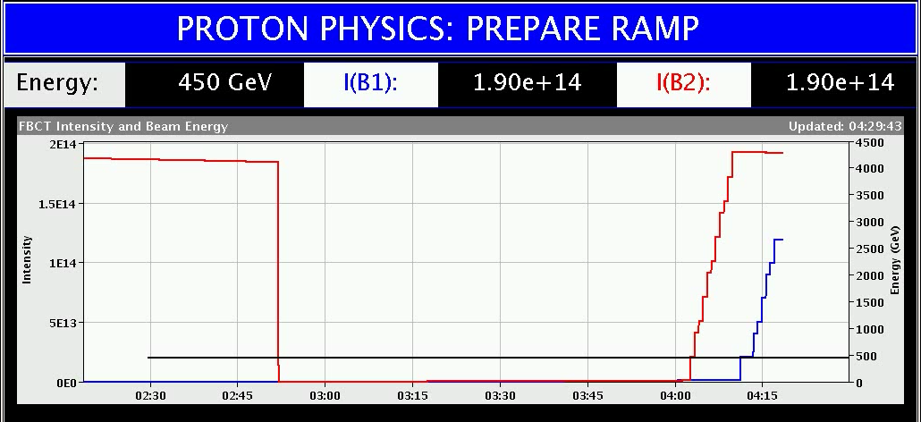
Sat Late
19:00h ramp
19:15h OFC crashed → dump by operation
mismatch between the RT trims in the hardware and what the orbit feedback thinks it put in
22:00h restart
22:30h injection probes ...
problem in TI2, power converter down
00:53h injection physics beam (b2)
03:40h injection physics beam (b1)
... again crash of FBCT !

Slide 22
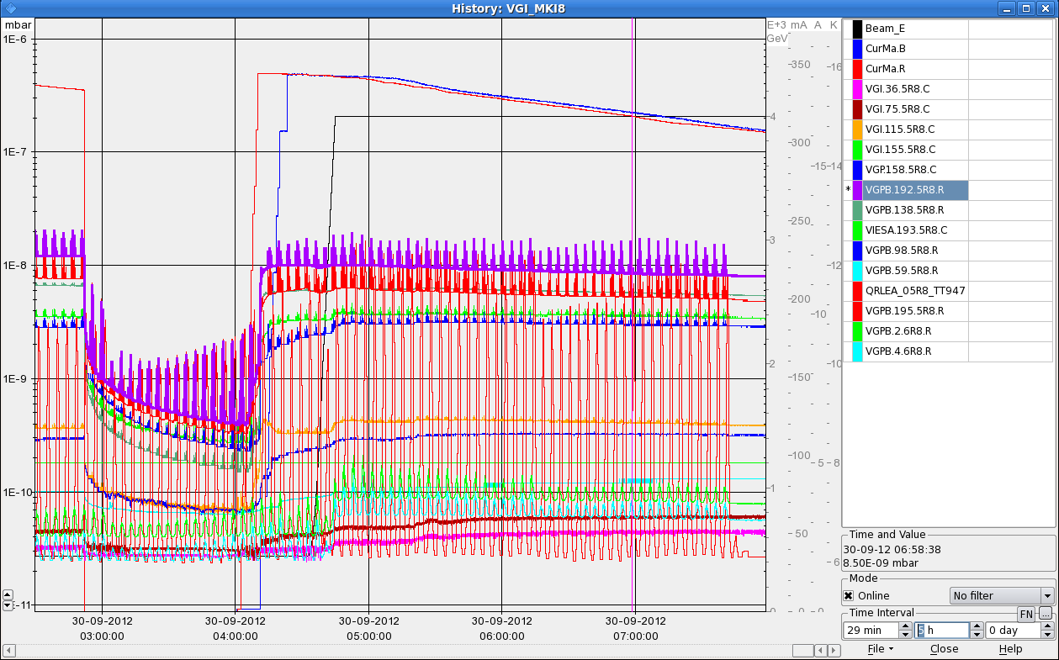
Sat Night
04:32h ramp, squeeze, adjust
05:22h stable beams
07:30h improved beam screen temperature tuning

Slide 23
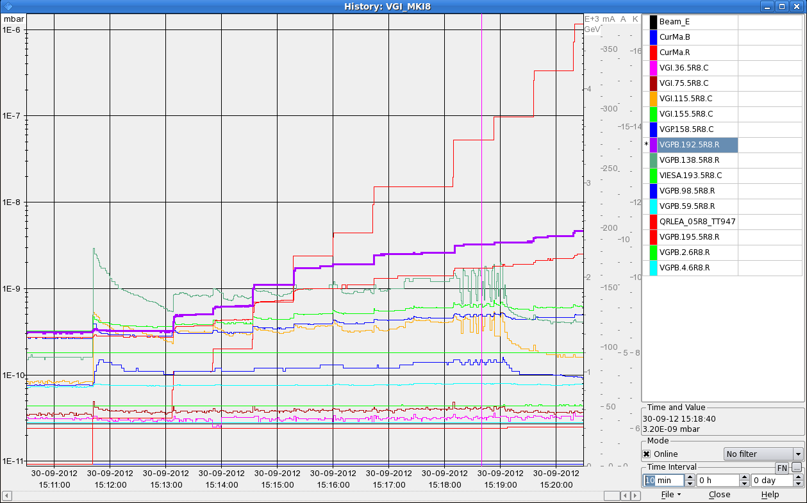
Sun
13:24h beam dump: power converter fault... RSD2.A67B1, ROF.A67B1, ROD.A67B1
15:02h injection for physics
... spike less and just at the limit
15:36h ramp
16:15h stable beams, L0=7.1e33
03:13h beam dump: operation !!!!!
03:46h undulator problem

Slide 24
Tuesday: Strange orbit corrector settings
Minor Problems
Problem of RT trims on common RBBX correctors partly understood.
The RT trims are indeed not applied for those CODs (blocked at FGC level), but they are visible (as if they were applied).
The orbit FB should normally never used them, unless they are explicitly activated.
Searching the logging it became clear that those trims were applied over one minute in the prepare ramp phase – then stayed constant. It also affects the other fills after TS3.
This is the moment when we send a last update of the response matrix - where those CODs should be de-selected.
Why do they seem to be selected when matrix is sent, as should be de-selected? No change in sequence, but the OFSU code was touched…

Slide 25
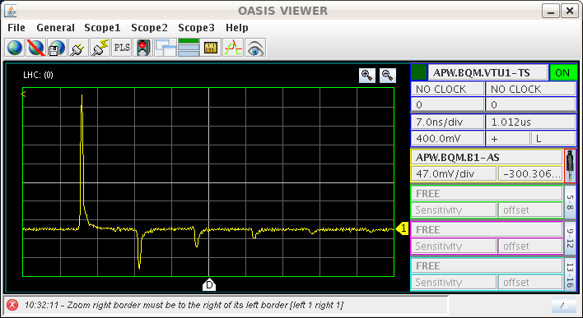
Tuesday: BQM B1 problem
Minor Problems
The BQM problem during Q20 injection setup was traced to broken hardware – signal is perturbed by reflections.
Perturbs bunch identification and bunch length measurement (tbc).
Giulia adapted settings to cope with the poorer signal
problem solved

Slide 26
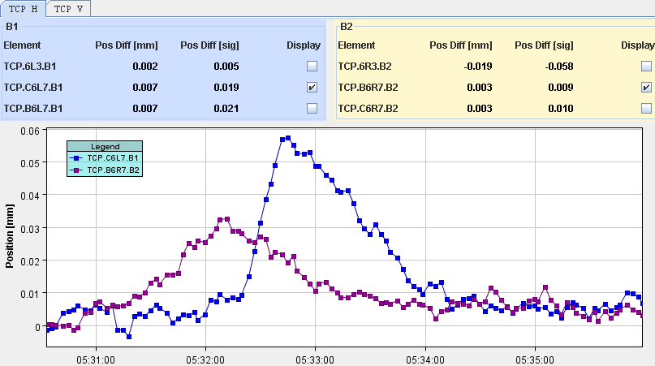
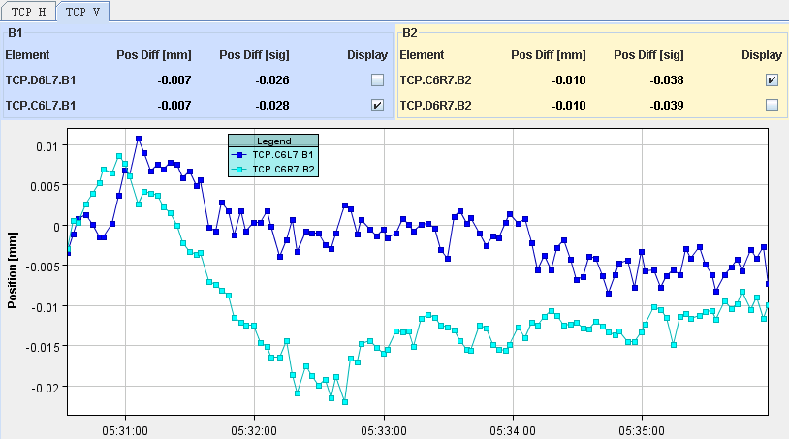
Minor Problems
Orbit excusion during collision BP
beam 1 a bit large… during ramp down of LHCb H Xing.
H
V

Slide 27
Minor Problems
Sat Late
19:15h OFC crashed → dump by operation
mismatch between the RT trims in the hardware and what the orbit feedback thinks it put in
Monday -Monday
... crashes of FBCT !

Slide 28
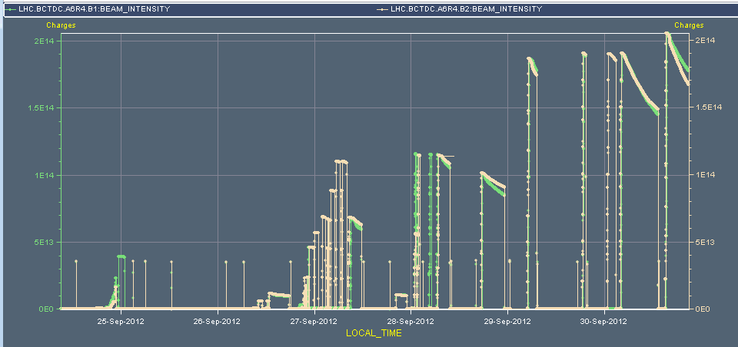
Resume of a tough week
MKI8 vacuum .....................................................
dump cryo
communication
set up Q20
flash over MKI8
loss maps
dump T colli
dump cryo
- 5h -
RQ9
earth fault
– 9h -
test cycle
50Hz noise
Tclib alignment
SIG
-11h -
dump PC
A67
PS 40 MHz
- 4h -
dump RCBXH
dump OFC
dump ups
- 9h -

Slide 29
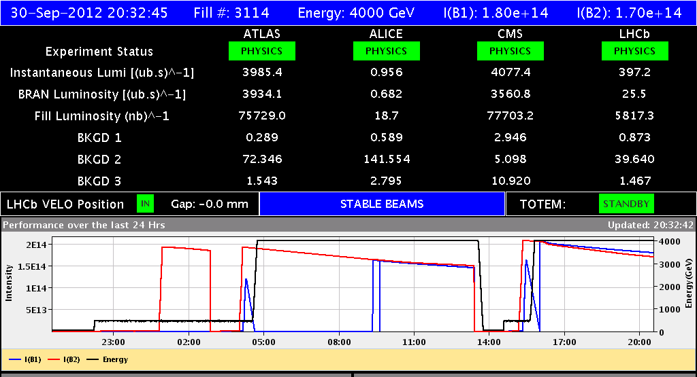
Sunday: Back in Routine

