Slide 1
Thursday 4/10
08:27 Problem with PLC controlling 4.5 K cryogenics cold box in point 4 (US45). Lost sector 34 and RF.
Access for:
installation of additional solenoids in point 8 close to MKI8
CMS
Abort gap monitor (BSRA-B1). Photomultiplier replaced. Fast aging not understood
BRAN in point 8
CV checks in point 4 and 8
EL in point 6 (UPS replacement)
RF (instrumentation checks)
Confirmed that temperature measurement of current lead RCBXV2.R2 (400 K) measured on Tuesday 2/10 evening was spurious. Intervention by cryo yesterday did not reveal any problem.
In the shadow some tests in preparation of MD3
17:45 cryo OK

Slide 2
Thursday 4/10
18:45 Pre-cycle after resetting the sectors (trips of RQ6 in sector 21/34/67/78 due to a bad manipulation)
19:50 Injection. Steering of TI2 required.
Increased Q’V at the end of the squeeze for B1 to try and suppress the instabilities at the end of the squeeze observed for several fills.
22:15 STABLE BEAMS#3130. Initial luminosity ~7.2x10³³ cm⁻²s⁻¹
22:35 Vacuum valves in undefined position in IR7 (B1). Beam dump. End of fill 3130 after 20 mins (~6 pb⁻¹)
23:49-00:42 Access in point 7 for vacuum piquet. Replaced faulty power supply for valve control crate.
02:51 STABLE BEAMS#3131 Initial luminosity 6.5x10³³ cm⁻²s⁻¹
06:19 UFO in sector 23 (BLMQI.31L3.B1I10_MQ) at 138% of dump threshold End of fill #3131. 67 pb⁻¹ in 4.5 h
08:16 Sector 81 trip RQ8.L1 (QPS)

Slide 3
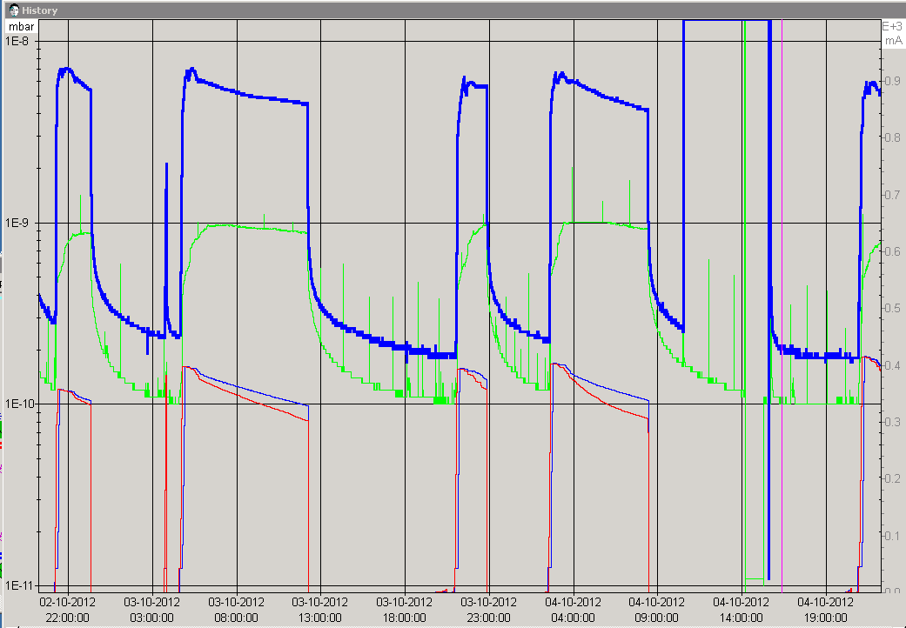
Vacuum (Fill 3130)
J. Uythoven
VGPB.192.5R8.R
VGPB192.5R8.B
Additional windings for the anti e-cloud solenoids added at MKI 8 between interconnect and tank. No significant difference observed

Slide 4
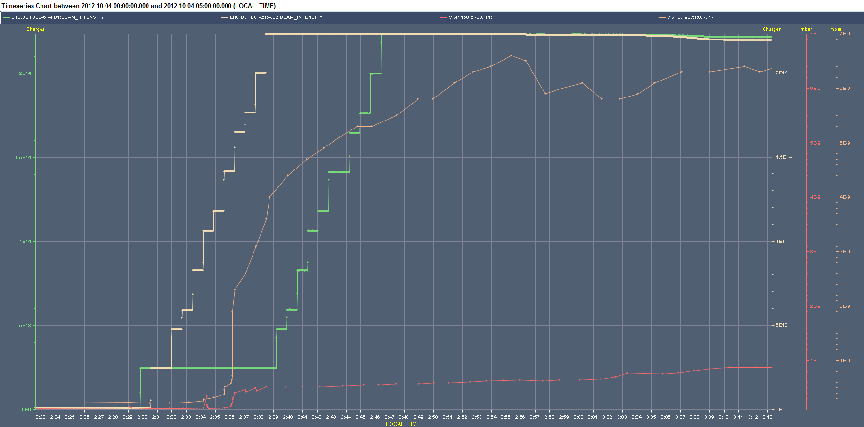
Vacuum (Fill 3128)
J. Uythoven
VGPB.192.5R8.R (interconnect to Q5)
VGPB158.5R8.C (MKID tank)
Pressure rise stating after 7th injection (B2).

Slide 5
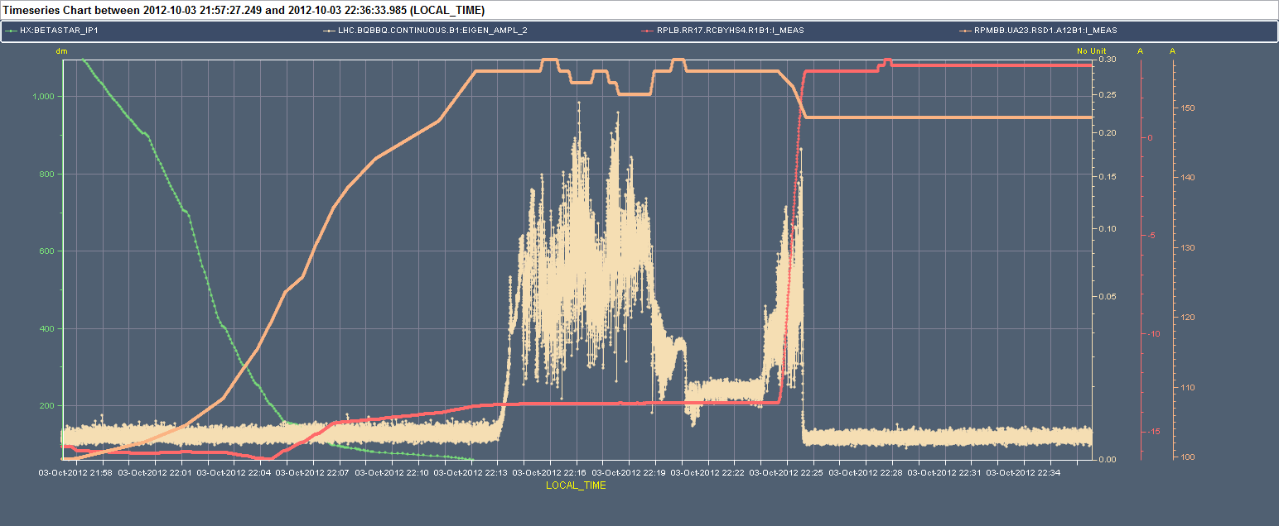
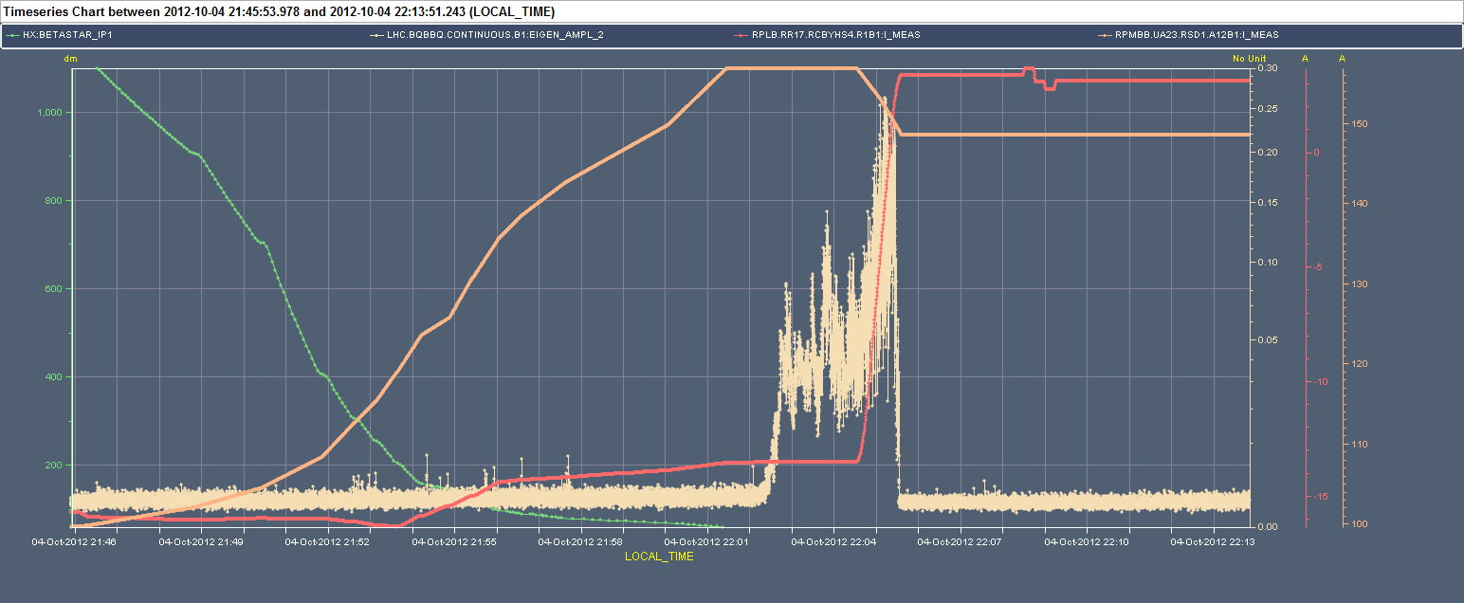
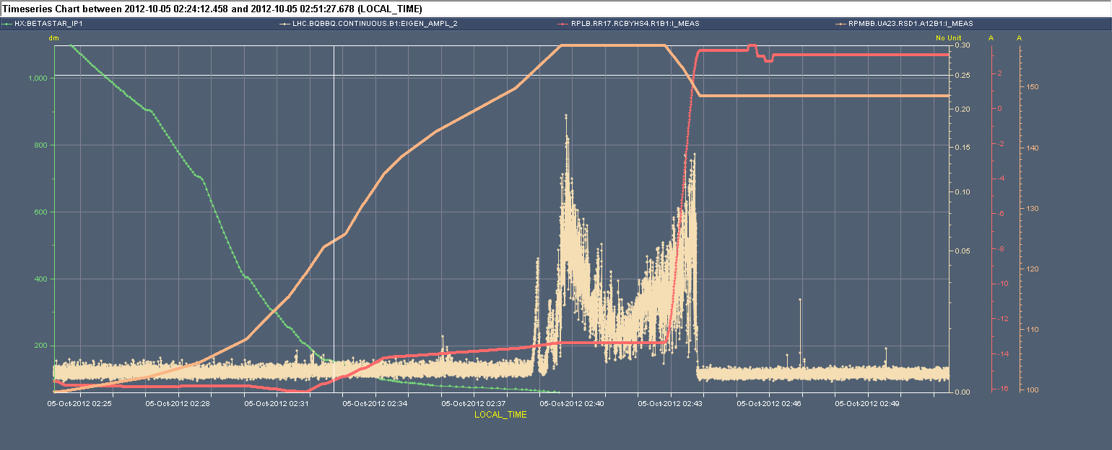
Chromaticity
β* BBQ-V_{B2}
RSD1 [A] Sep-bump [A]
3128
3130
3131

Slide 6
#3130
After optimization
ALICE at 4.25x10³⁰ cm⁻²s⁻¹
“Tuning” of the longitudinal blow-up in the PS to enhance satellites (S. Hancock)

Slide 7
Pending
EOF:
Bunch length variation
Operational Development
Gated tune measurement with reduced damper gain on first 6 bunches
Damper test at injection of the increased bandwidth with 50 ns beam
Batch by batch blow-up (postponed to after MD3)
TOTEM IN during Stable beams

