Slide 1
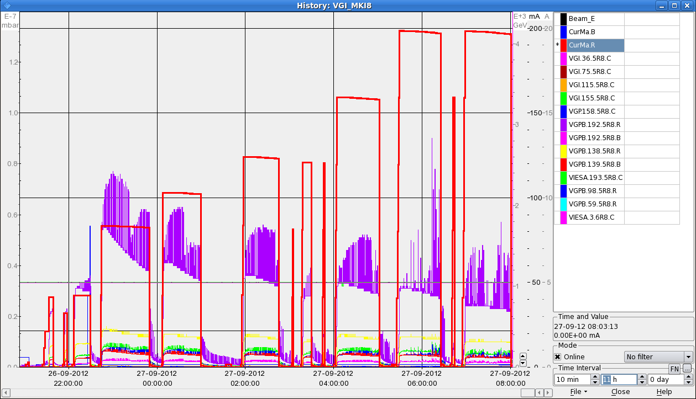
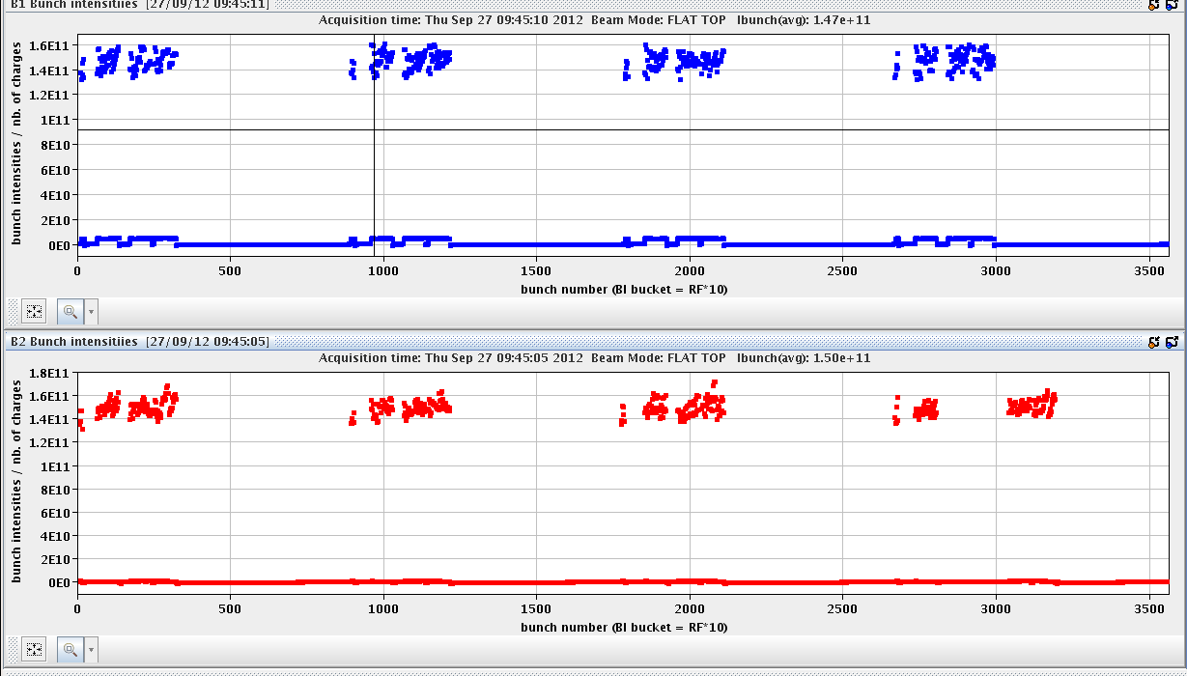
LHC Status Friday Morning 28-Sep
Bernhard Holzer, Joerg Wenninger
Plan:
after conditioning with 144 bunch trains during the night
go for next step in stable beams: 2*456 bunches
08:00h status of MKI8 conditioning
08:30h injection physics beam
-- beam 2 first –
09:16h ramp, N_{p} = 1.5 E¹¹
09:34h squeeze & adjust
456 x 456
current b2
pressure

Slide 2
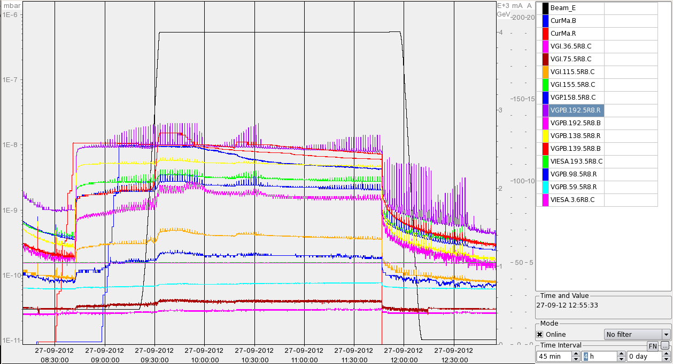
Thu Morning
10:30h stable beams,
ATLAS quite a bit off in the beginning (... orbit problem)
Vacuum at MKI8_D:
1E-8
1E-9
1E-10

Slide 3
Thu Morning/ Late
11:30h low mu scan for ATLAS
11:46h beam dump: trip of RQ9.L2
access for temperatur sensor cryo Pt 8,
(DFBX L8 was fixed by the QPS people, unplugging/plugging a cable)
... QPS reset Pt 8
... ALICE
... and Q9 in Pt2: earth fault ... due to water leak
18:30h machine closed, pre-cycle
20:05h injection for physics → plan: 840 bunches
... but no beam due to 40MHz problem in PS
00:45h injection for physics

Slide 4
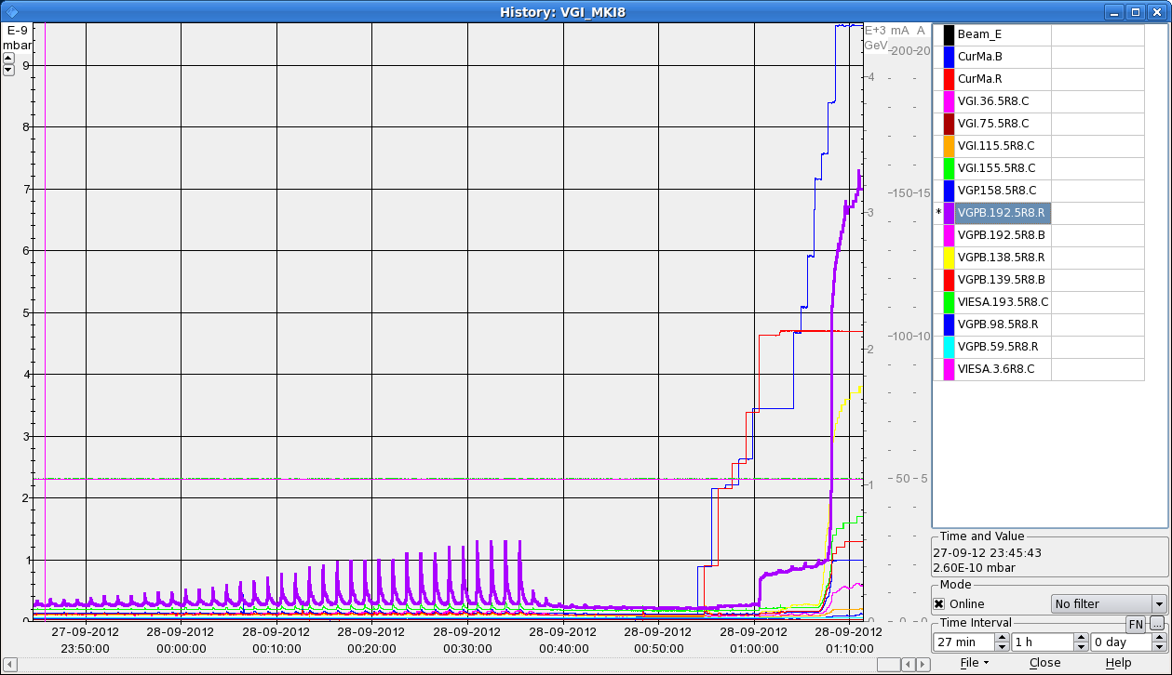
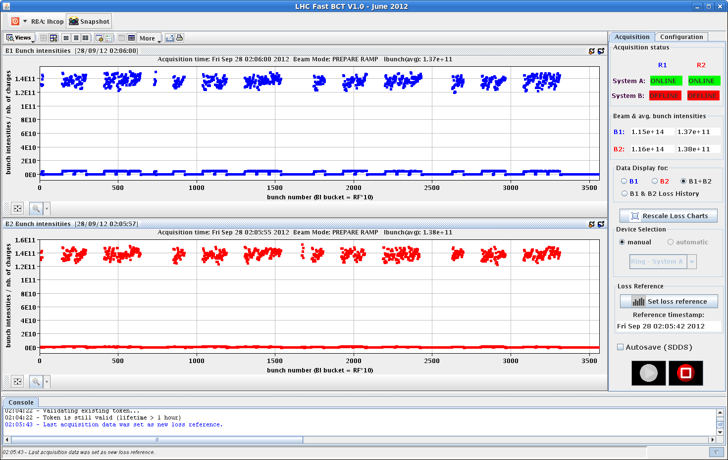
Thu Night
00:45h injection for physics
problem: 108 bunch transfer
02:00h injection successful
reduced single bunch currents
get rid of vac. spikes
5E-9
1E-9
456 bunches (50ns_456b_447_0_432_72bpi12inj
840 bunches (50ns_840b_801_0_804_108bpi13inj
1.4E11

Slide 5
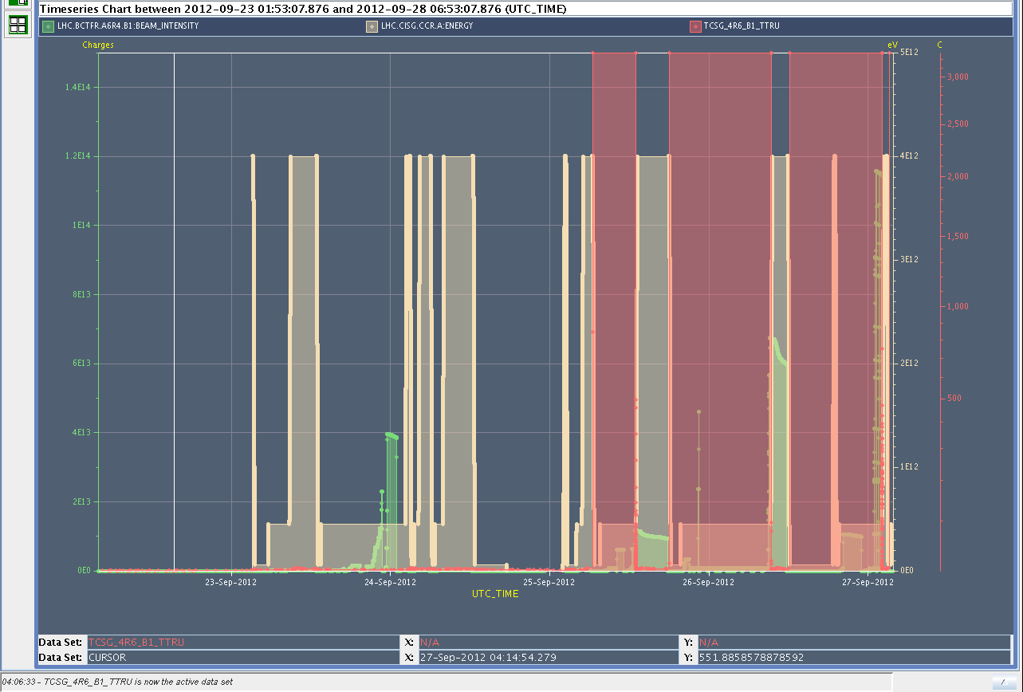
Thu Night
02:08h ramp ... & beam dump:
Bad temperature reading on TCSG_4R6_B1_TTRU triggered interlock on BIS
piquet called to analyse problem
intermittent erratic readings
3000
23-sep 24 25 26 27 sep

Slide 6
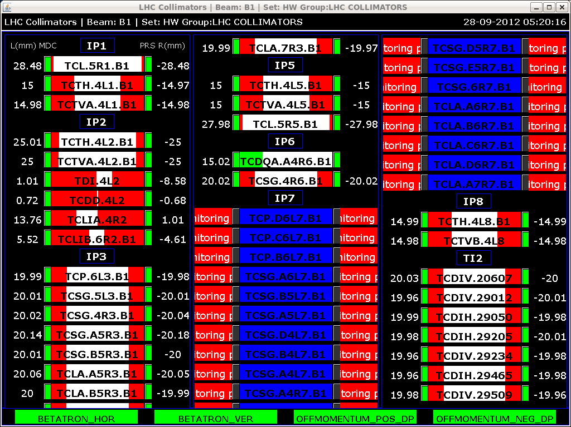
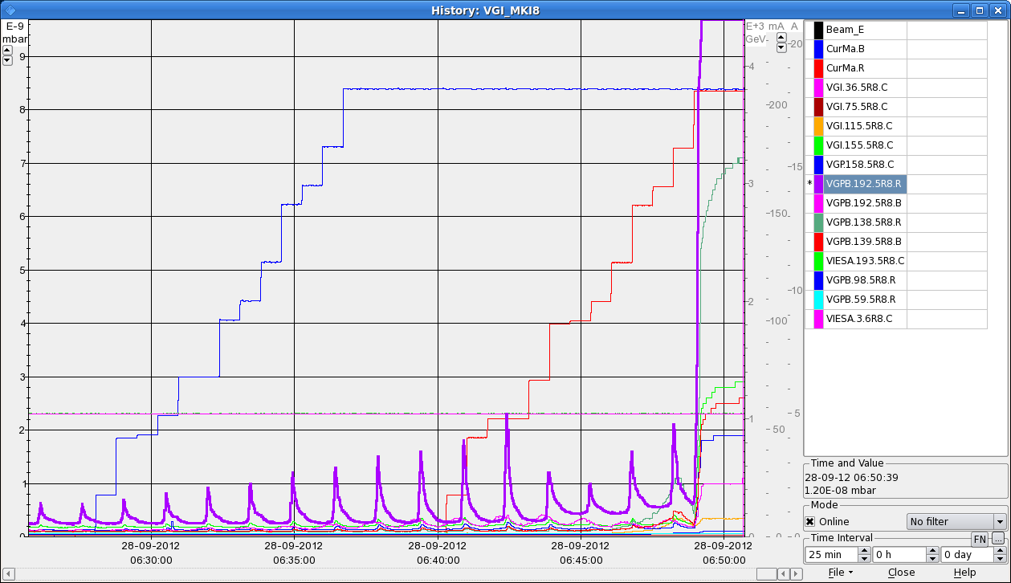
Thu Night
03:30h injection probes
05:00h communication problem at collimators
reset by piquet
06:30h injection for physics
07:00h ramp, squeeze, adjust
08:00h stable beams

Slide 7
Fri Morning, 7:00
finally stable beams
456 bunch fill
access
40 MHz PS
T-reading Collis
beam dump:
Q9.L2 earth fault
(water leak)
MKI8
communication Collis

