Slide 1
Monday
08:00-10:00 Test of cycle with 1 probe / beam.
Q’ measurement.
New collision BP (new : parabolic round-off on all COD functions) ran OK. Orbit leakage in transients is OK.
10:00-12:30 50 Hz noise studies and BRST checks.
No effect on 50 Hz noise of active filters (RBs, warm dipoles and quadrupoles) .
Some mains noise visible, but not affected by filters. Effect of 50 Hz lines possibly observed in tune scans on B1, not on B2.
Offline analysis to follow (R. de Maria).
FBCT calibration in the shadow.

Slide 2
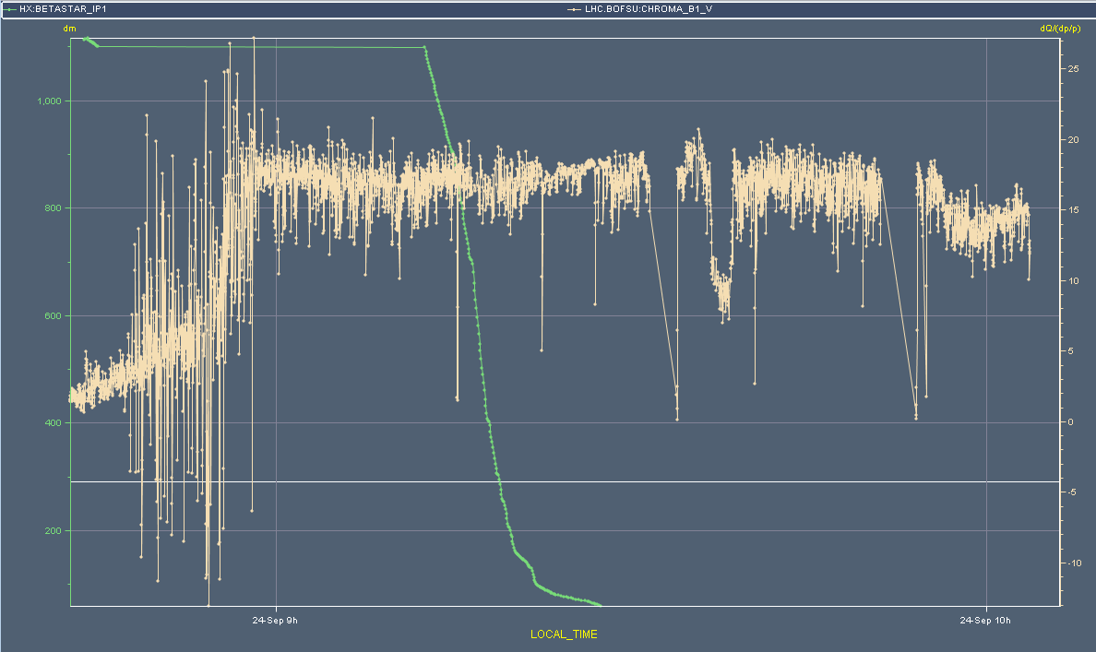
Q’V B1 (M. Lamont)
Test trim +/- 10
B2 results are similar
 | QPV B1
450 GeV | 1.7
Flat top | 17.2
End squeeze | 16.9
Collisions | 14.3

Slide 3
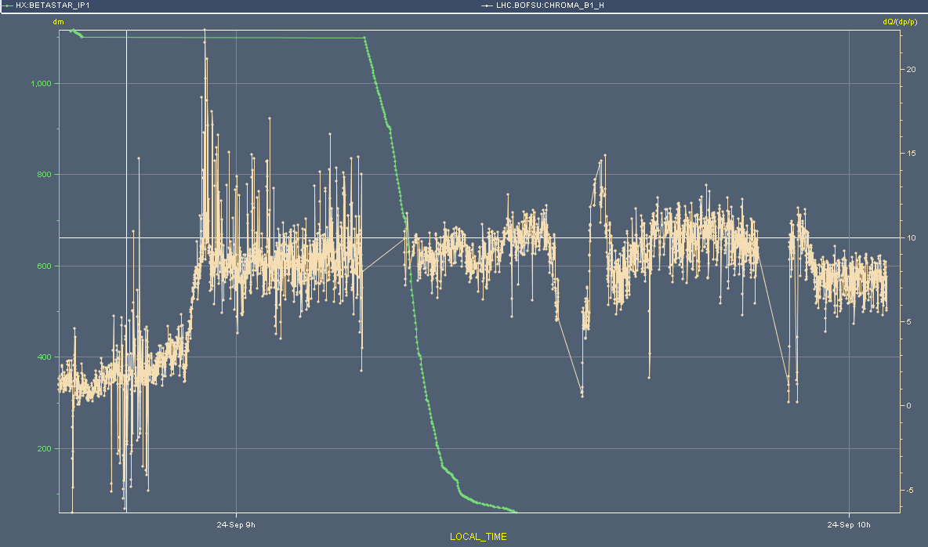
Q’H B1 (M. Lamont)
Test trims
B2 results are similar
 | QPH B1
450 GeV | 1.4
Flat top | 8.5
End squeeze | 9.7
Collisions | 7.4

Slide 4
Monday afternoon
14:00 TCLIB alignment check.
Mesured beam centre = + 0.53 mm (old value = 0.46 mm) Measured beam size = 0.56 mm (old value = 0.61 mm) Beam centre differs by 75 um and beam size differs by 40 um ==> within measurement accuracy (50 um steps) ==> we keep the old settings.
14:30 Q20 setup.
17:30 Observe losses at beginning of line for B1 – problem at extraction from SPS.
Traced to an extraction bump amplitude. Bump increased from 37 mm to 40 mm.
Then re-steering of line.
20:00 Ready for 50 ns with Q20.

Slide 5
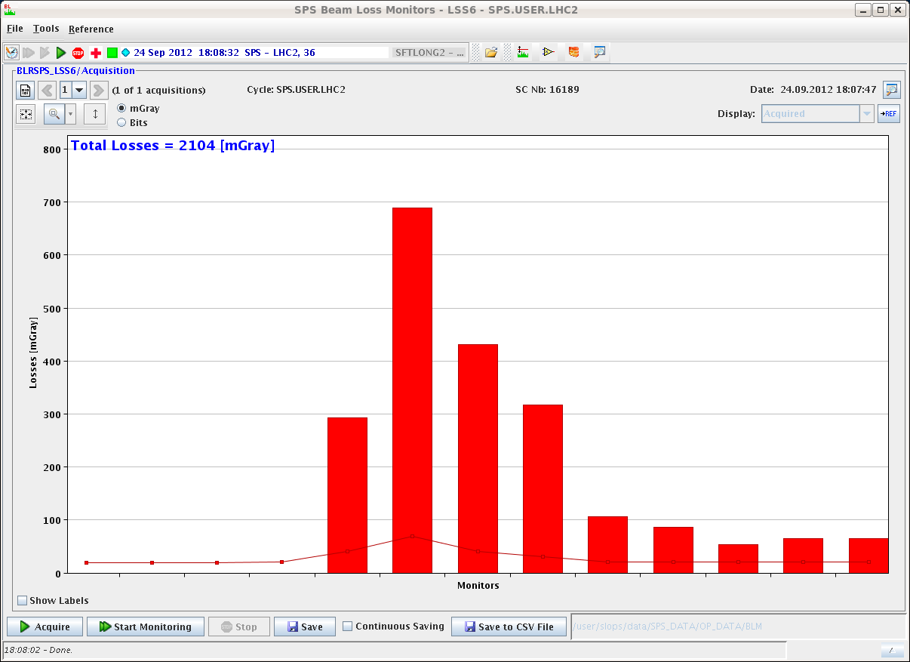
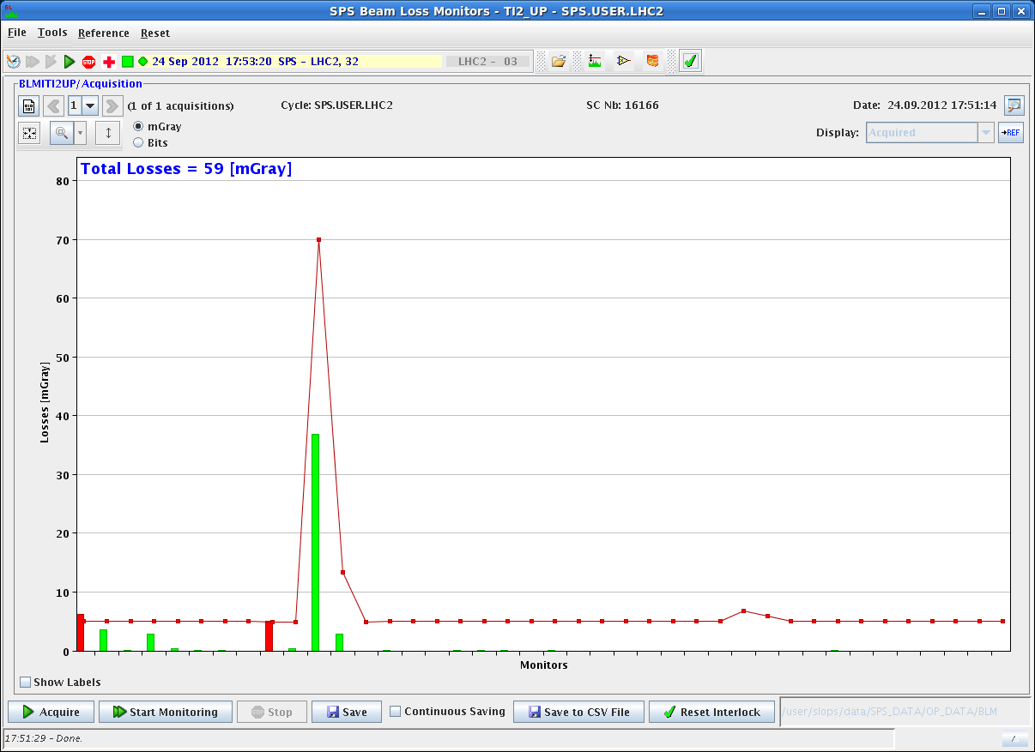
Losses on B1
Losses in extraction channel and in TI2.
Extraction channel

Slide 6
Monday evening/night
20:00 Injection of 6 bunches / 50 ns.
BLMs at ~ 2% of threshold on LHC side.
Some instability observed on losses at extraction for B1. PS working on the beam – satellites?
And some issues with the BQM – server had to be restarted a few times.
22:30 Injections of 36, 72 and 144b with B1. 36b on B2.
23:20 MKI8D faulty. Flashover?
Extended softstart.
Also vacuum activity.
01:20 Cycle for loss maps. Dumped on squeeze on COD interlocks (many !)
To be looked at. Probably wrong BPM calibration (50ns).

Slide 7
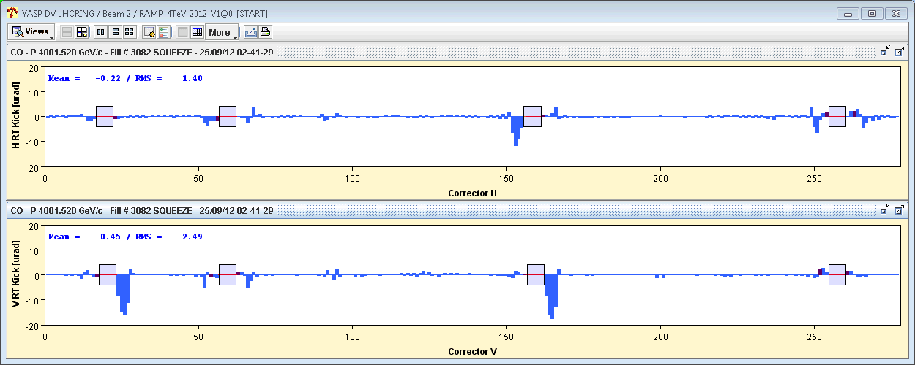
COD interlock
RT trim difference wrt start of squeeze.
Not exactly normal. The new PC interlock (still masked to check handling of 2 collision BPs) has probably triggered earlier.

Slide 8
Monday night
03:30 New attempt for loss map.
05:00 Colliding – problems to find luminosity in IR8.
Found a small peak, most probably not the correct one.
05:30 Moving in RPs. Loss maps (betatron).
Asynch dump test with the remainder of the beam.
Both tests to be analysed.

Slide 9
Plan
Repeat cycle with collisions to find LHCb, repeat betatron loss map and +500 Hz off-momentum.
But not RPs.
Continue Q20 to 144b.
Ramp up : 78b, 480b, 852b, 1374b.
SIG transformer : expected today ~17:00.
Final time has to be confirmed.

