Slide 1
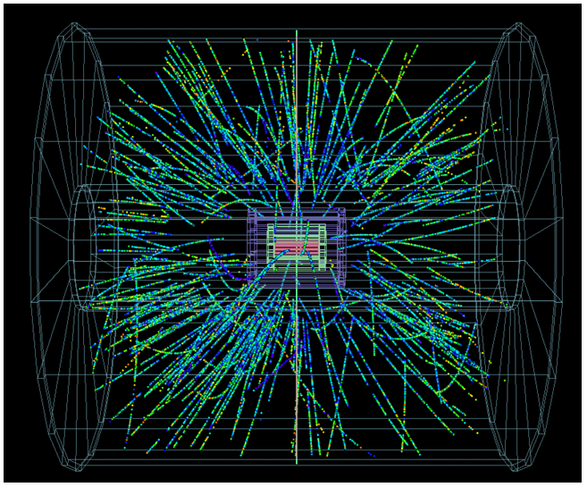
LHC Summary Week 37
Coordination:
Jorg Wenninger & Jan Uythoven

Slide 2
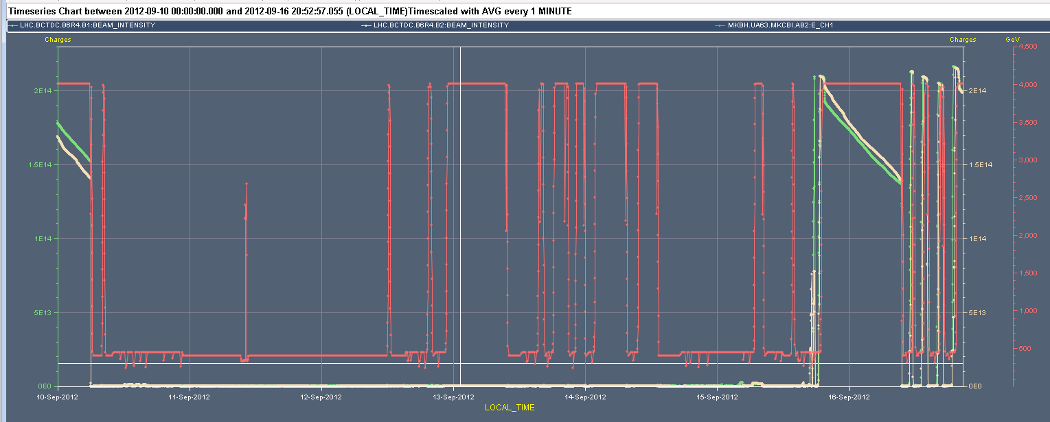
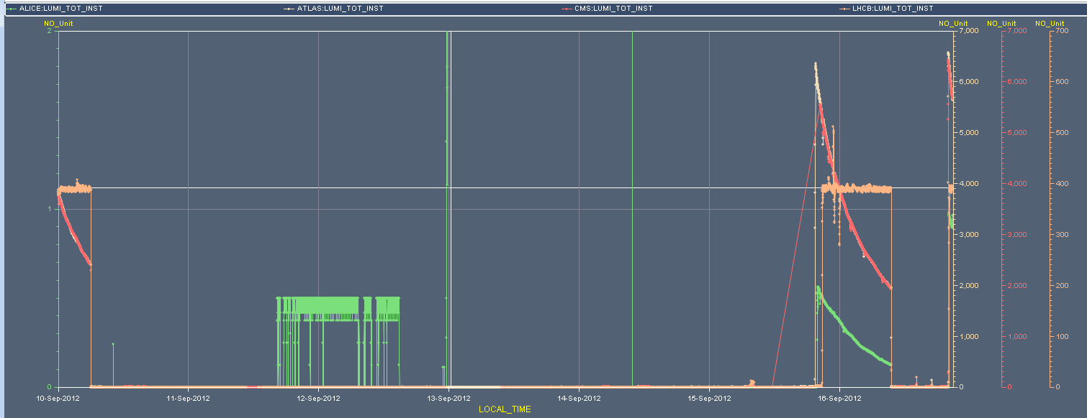
Week 37 – what an (MD) week
BCT @ 2e14
pPb MD – BPMS
EDF
1000 m optics
Vac wire scanner
pPb physics
RF Klystron, I
pPb tests
LHCb polarity BP
Q20
Physics
Lumi @ 6e33

Slide 3
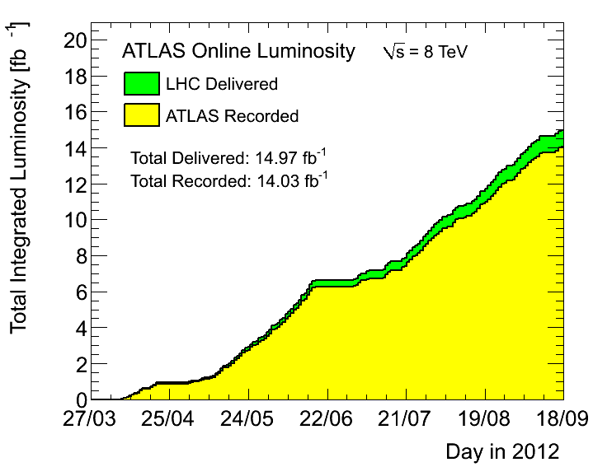
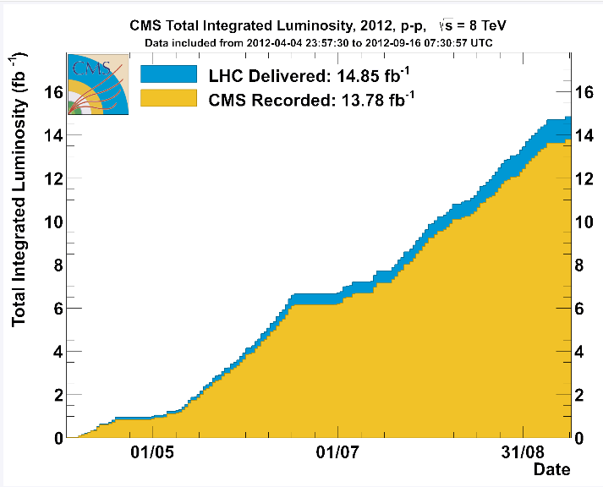
Physics (not the main occupation of the week)
Fill | Lumi | pb⁻¹ | Stable | Dump
3067 (Saturday) | 6.3 | 165 | 13h40m | Operator
3071 (Sunday) | 6.5 | 143 | 9h54m | Operator
Total lumi of the week: 308 pb-1

Slide 4
Main problems of the week
Vacuum leak on wire scanner Point 4
RF klystron beam 1
…..and many smaller ones

Slide 5
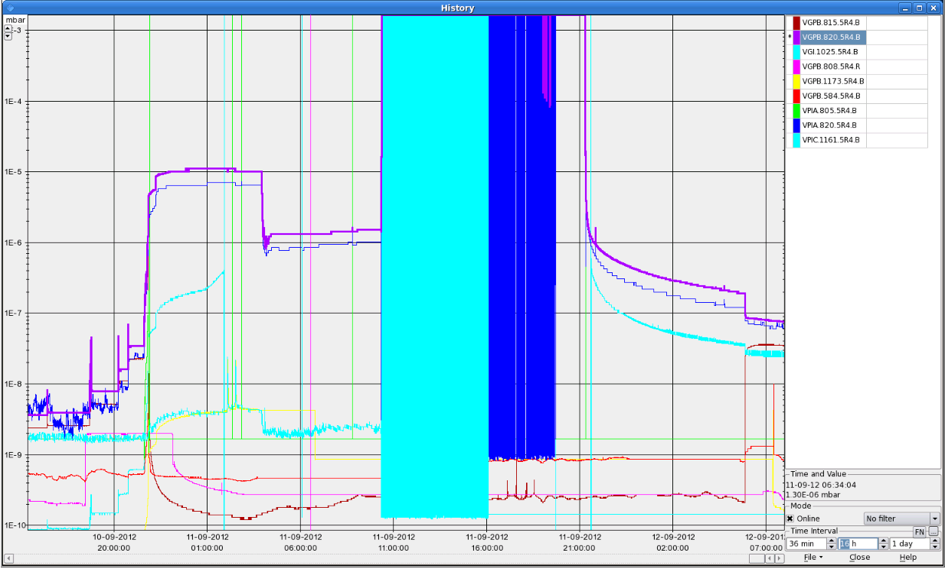
Vacuum leak on wire scanner
the scanner is dismounted and a closing flange is mounted.
the wire has been recuperated for analysis.
the resistivity of all b1 scanners have been measured before and after the opening of the vacuum, integrity check.
the broken scanner had 10000 scans.
all scanners switched to the spare scanners on Wednesday.
the scanner mechanics is in the radioactive equipment storage to be released by RP.
1e-5 mbar
LHC.BWS.5L4.B2H1:NB_PTS_SCAN_IN----3768 LHC.BWS.5L4.B2H2:NB_PTS_SCAN_IN----8124 LHC.BWS.5L4.B2V1:NB_PTS_SCAN_IN----3541 LHC.BWS.5L4.B2V2:NB_PTS_SCAN_IN----6690 LHC.BWS.5R4.B1H1:NB_PTS_SCAN_IN-----781 LHC.BWS.5R4.B1H2:NB_PTS_SCAN_IN---10247 LHC.BWS.5R4.B1V1:NB_PTS_SCAN_IN-----651 LHC.BWS.5R4.B1V2:NB_PTS_SCAN_IN----9468

Slide 6
RF Klystron Problem – Line 2 Beam 1
Required (almost) a hand full of accesses distributed over the week.
During the MDs ran with 1 klystron less, but not possible for full intensity beam due to beam induced power in the cavities
Checks (Olivier Brunner)
primary "low voltage" circuit checked
controls system and 230 V supply verified
replacement of the gradator and 230/115V transformer
replacement of one 100kV cable (in fact swap with another cable that does not need to carry any current)
careful check of all accessible connections (one found very slightly loose in the klystron gun tank)
replacement of the modulator (to eliminate a "suspicious" HV connection sitting in the oil tank)
Fixed on Saturday morning (until TS)
Klystron line 2B1: modulator anode and filament cable swapped, which reduces the load on the suspected faulty HV cable from 25A to a few mA.

Slide 7
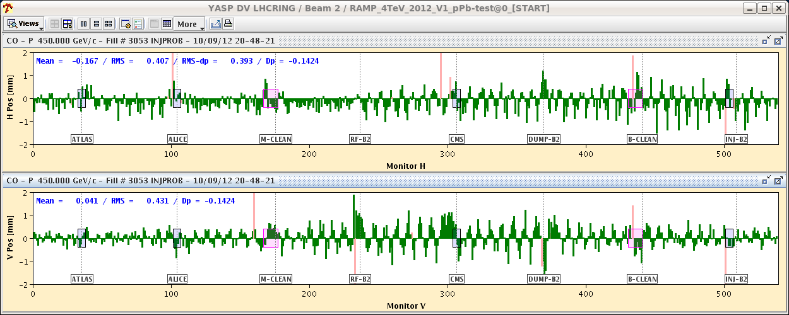
pPb test Phase 1 - Monday
Re-phasing and locking tests performed successfully with protons at 450 GeV.
Quite some problems with injecting Pb due to issues with RF synchronization and SPS rephasing:
20:50 First Pb bunch injection - circulating at first attempt.
And ended up in the correct bucket !
Setting up of RF, ADT, Q, Q’ etc ...
22:00 Vacuum problem WS B1. End of part 1.

Slide 8
pPb Phase 2 – Wednesday/Thursday
Struggling with RF klystron
18:00-19:30 Injection of 15 x 15, first ramp attempt.
Killed by TCT interlocks. TCT settings and position interlocks updated for 35sigma (nom = 26 sigma) on flat top, but update on energy interlocks on gaps was forgotten.
Decide to go back to standard TCT settings, as nominal settings are also OK (35 sigma was pushed by collimation, not MP).

Slide 9
pPb Phase 2 – Wednesday/Thursday
22:30 Second ramp attempt.
22:20 @ 4 TeV.
23:00 Re-phasing – found collisions.
00:50 Loss maps on 2 out of 15 bunches (ADT).
01:26 Stable beams, first time pPb .
Lumi’s approaching 10^26 cm-2s-1
Moved collision point +/- 50 cm

Slide 10
ALICE event
Hannes Wessels

Slide 11
High beta* MD and some data taking
Start Thursday around 15:00, optics checks with pilots
First cycle: lost on collimator gap-energy interlock (again!) of TCTVs in de-squeeze to 90 m.
Second cycle: at 90 m, hit a limit on the current of RTQX in IR1 an IR5
Limits were modified following a MP event with a trip of the triplet circuit. The limits were set based on currents used in OP (ECR) to +- 100 A (need -300 A for 1 km).
The currents used for 500/1 km were overlooked in the analysis.
A change of limits requires PCs to be OFF…
Third cycle: orbit FB becoming unstable in de-squeeze to 500 m. Managed to navigate through switching on/off.
Lost at 500 m after OFC crash during investigations and attempts to switch optics.

Slide 12
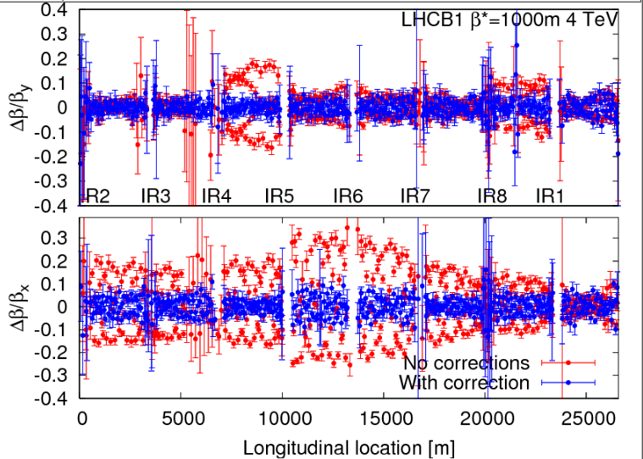
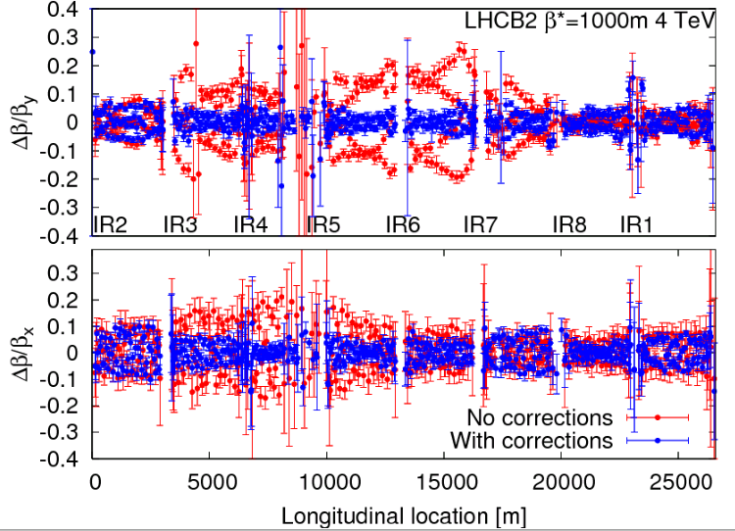
High beta* MD and data taking
Fourth cycle: started with OFB checks at injection. No problems found.
Optics checks along the way.
03:30 – 6:30 beta beat / optics measurements at 1 km
After applying the corrections calculated from the data taken in June 2012 we performed the measurements. The beta-beat went down from ~30% to less then 10% after applying the corrections.

Slide 13
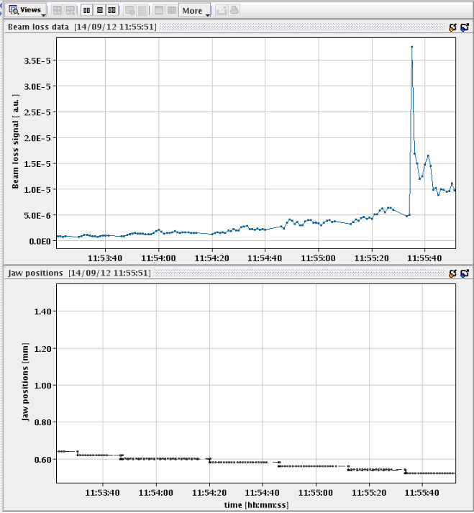
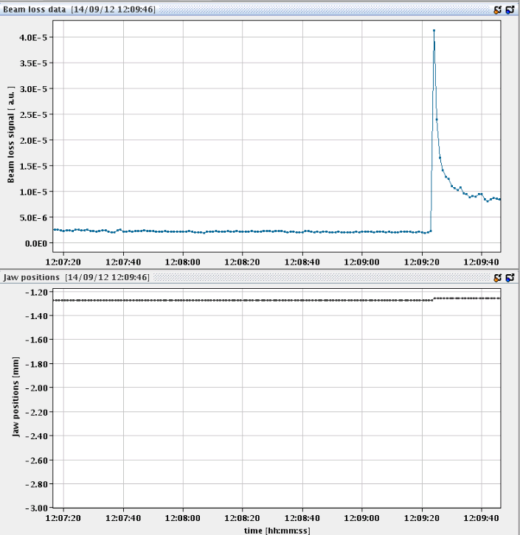
1000 m
Further optics Results
Off-momentum measurements were also done to check the dispersion. No big difference between the measurement and the model was found.
A k-modulation measurements was also performed to measure the beta* at IP1 and IP5. To be analyzed offline.
Filled with 2 x 3 small indivs of about 3e10 p+ for collisions
TOTEM and ALFA collimator and pot set-up. Scraping and some retraction to take some data.
TOTEM @ 0.521 mm
ALFA touching the beam

Slide 14
pPb MD
Plan to inject 318 p+, max 2e10, against 4 Pb bunches
Pb injection fine, problems with RF/bucket/super cycle seem to be fixed
p+ injection difficult. Dumped by BPMS in IP6
Struggle throughout the night
Rhodri came in for BPMS. Reduce bunch intensity. BPMSA.A4L6.B1 vertical channel shows additional triggers even with one probe of 1e10. This channel more sensitive than others.
04:20 all p+ bunches injected.
04:35 Dumped on BPMS:
pPb did not make it, but important lesson learned: needs work from BI and see which additional BPMS attenuators will be needed for the proton – ion run. One BPMS channel seems to be worse than others.

Slide 15
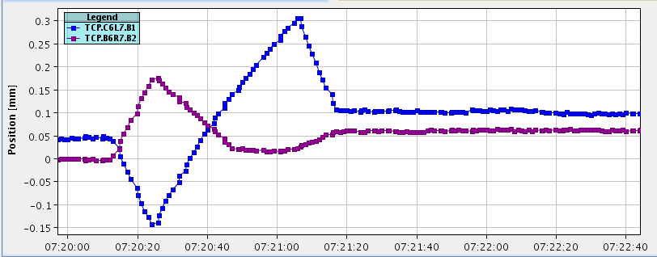
Test ramp with 2 batches of 8
Reversed LHCb polarity to negative
Split beam process: going into collision first in point 1 and 5, then in 8
Quite some corrections for going into collisions in 1 and 5
Beam position at collimator Needs to be corrected – reason for tests

Slide 16
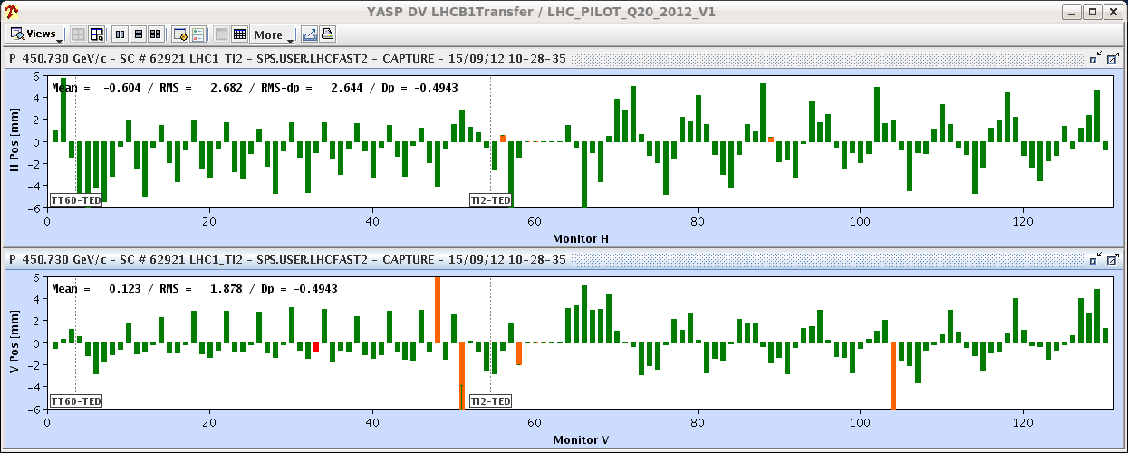
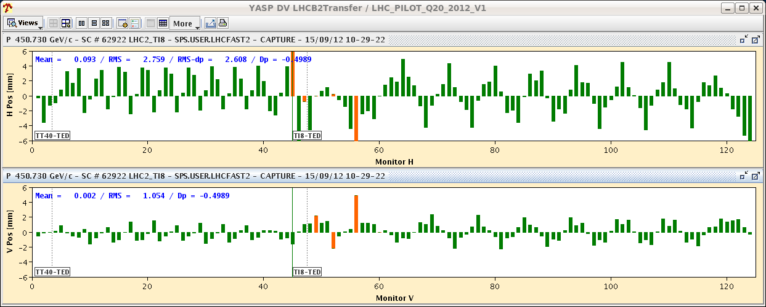
Saturday morning Q20 optics
Bad trajectory, source in the SPS. Seems the SPS orbit at 450 GeV has changed on Q20.
SPS extraction to be revisited…

Slide 17
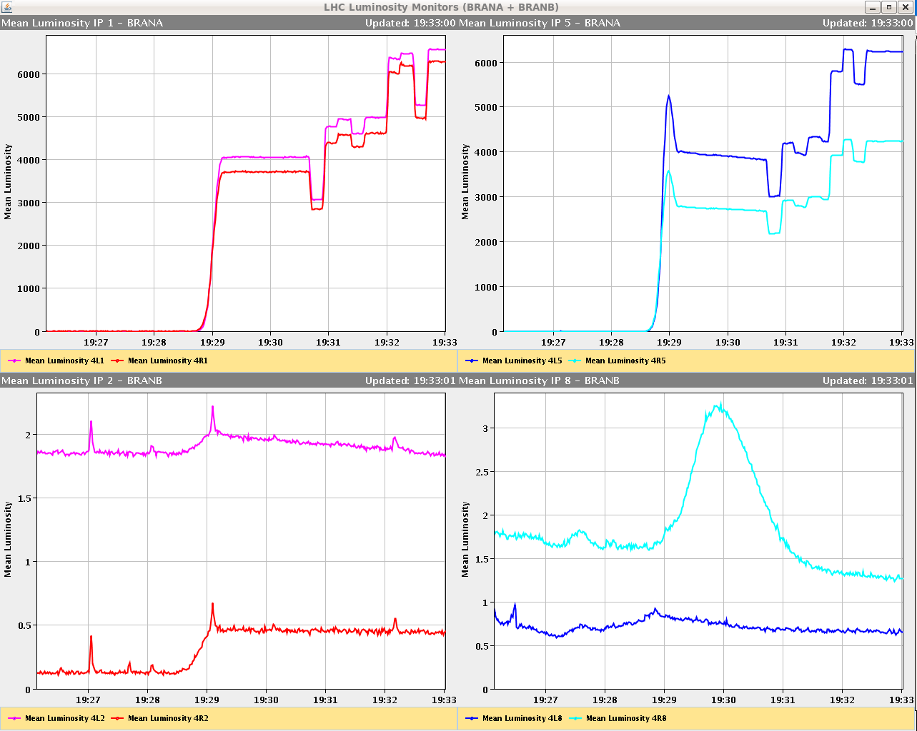
First fill on Saturday evening
CMS and ATLAS a bit off…
ALICE again limited to ~0.5E30 cm-2s-1.
Initial ‘Luminosity’ signal in LHCb very low (good thing). Not possible to exceed 2E30 cm-2s-1.
It seems that we were optimising on beam-gas?
After ~1 hour of scanning overlap was found (off in both Xing & Sep).

Slide 18
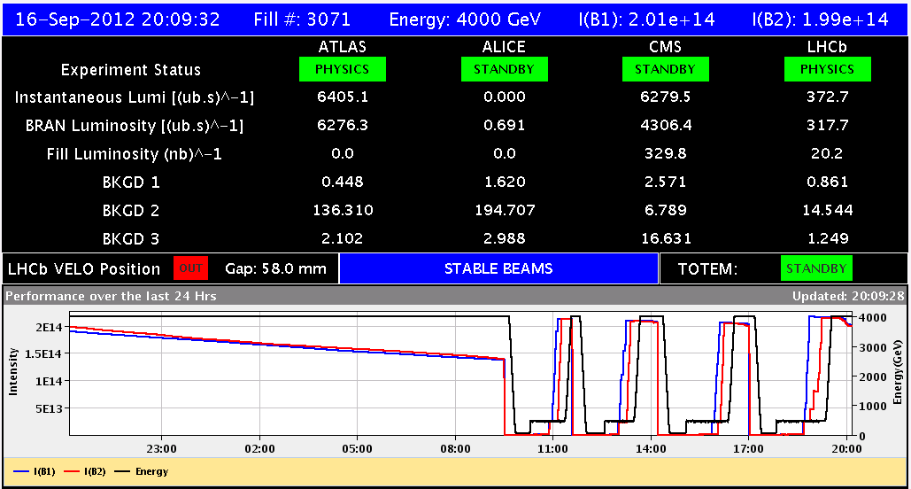
Sunday 16th September
Nice Fill, operator dump HV@BGI Losses Losses YEAH!

Slide 19
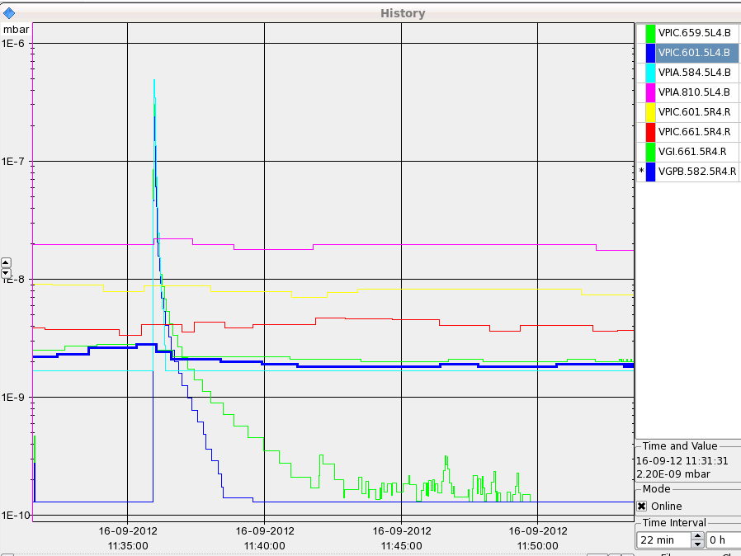
Fill #3068: vacuum point 4
11:36 Fill dumped at flat top due to BLM @ BGI.
Lifetime was good.
Vacuum activity at BGI. No gas injection but HV was on.
Switched off HV from BGI.
1e-6 mbar

Slide 20
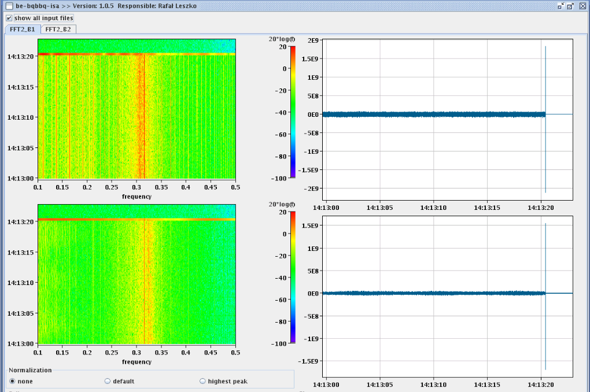
Fill #3069
14:13 Lost when going into collision. Losses on TCP IP7 B1, running sum 8 (655 ms).
BBQ does not show instability.
LHCb lumi going up a bit before ATLAS and CMS

Slide 21
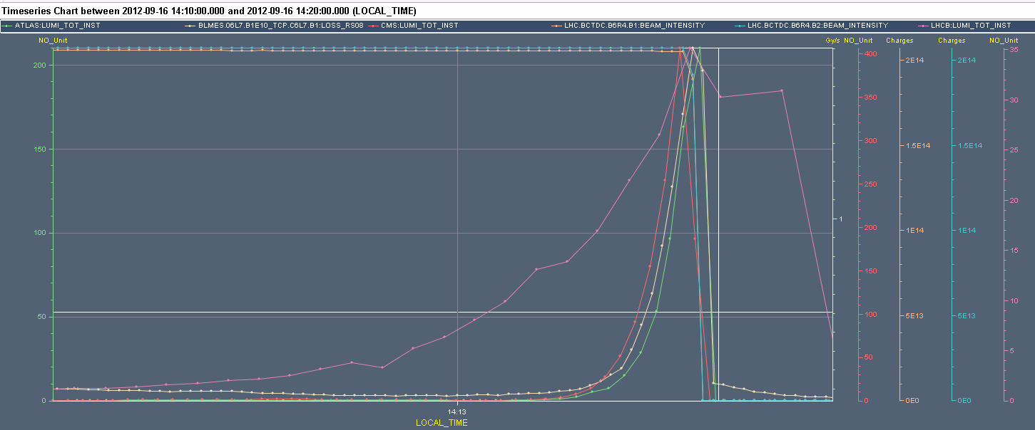
Dump when going into collision, no.1
Dump threshold around 1.7 Gy/s
LHCb lumi
1 Gy/s
ATLAS, CMS and TCP losses

Slide 22
Comparison fill of Saturday evening: no dump
Almost no lumi LHCb, BLM @ TCP down at moment ATLAS going into collision
LHCb lumi (very small)
1 Gy/s
BLM @ TCP
ATLAS lumi

Slide 23
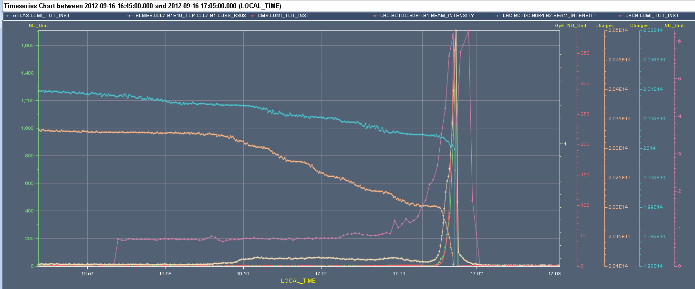
Fill #1370 (no. 2)
17:01 Again lost when going into collision.
LHCb lumi coming up too quickly
1 Gy/s
LHCb lumi
BLM @ TCP

Slide 24
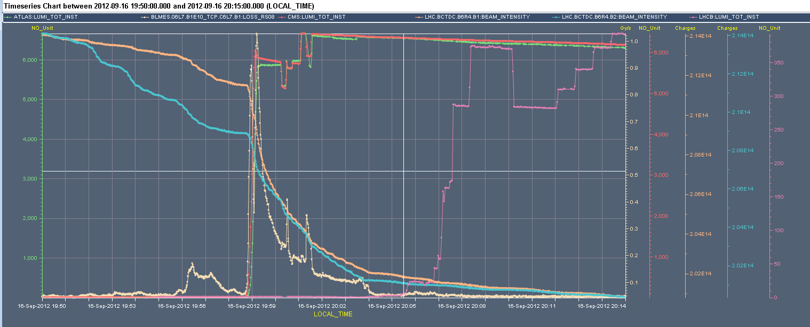
Fill 3071: YEAH
20:08 Stable beams, initial lumi 6.5e33 cm-2s-1
Reverting to the settings of yesterday (thus delaying LHCb luminosity wrt to IP1/5) seems to work.
At the end of the collision beam process we had to trim IP8 Xing plane by -140um and the levelling by 200um before switching ON the levelling.
1 Gy/s
LHCb lumi
BLM @ TCP

Slide 25
A week in which we learned a lot!
pPb
Found bug in RF synchronization and SPS rephasing
First pPb data taking with low intensity bunches
For 2e10 p+ intensity bunches we need to change the attenuators on the BPMS in IP6
1000 m beta*
Optics is good
First tests of collimation and moving in Roman Pots
Q20 optics
Needs more work to optimise extraction on the SPS side
LHCb polarity swtiched
Should not go into collision in LHCb before ATLAS and CMS
Split Beam Processes for going into collision will help
To be commissioned after the TS
The RF klystron line 2B1 needs a new cable
We started Technical Stop 3 – back on Friday evening

