Slide 1
Wednesday 12th September
Pumping, removal of vacuum equipment from tunnel in the morning
TOTEM & ALFA, RP movement tests: OK
11:50 pre-cycle started, RF tests with higher HV
13:00 RF access for klystron problem (not related)
16:00 Starting injection, Problems with ions, timing events not sent out correctly.
18:30 Filling ions.
19:00 Start of ramp. Lost the beam on TCT position interlocks.
QPS problems. RF problems.
22:52 at 4 TeV with 15 p and 15 Pb bunches
00:50 Start of loss maps
01:26 Stable beams, first time pPb

Slide 2
RF – mixed bag of tests and problems
Run with higher HV to test for larger RF power requirement with (more) 25 ns bunches
The klystron high voltage setting was raised from 50 to 58 kV in preparation for the 25 ns ramp. No issues were observed. Philippe, Themis, John
M1B1 went in fault for a problem on the klystron filament heater.
Suspect non-identified dodgy connector
Not related to HV tests
Struggling with B2/Pb injection. There is a problem with the timing system that does not transmit the RF ring/bucket information at the correct time. With some manual tweaks we manage to get in 2 Pb bunches.
Klystron filament problem back in the evening
Klystron 2B1 is disabled by the RF experts
Replace modulator BEFORE going back to high intensity. 1 hour

Slide 3
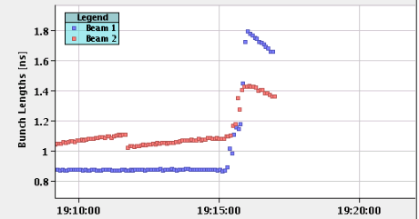
19:14 First ramp pPb started
19:16, dumped at 626 GeV
Collimator functions / limits not coherent
Beams dumped
Move back to standard, tighter collimator settings for next fill
Blow-up during the ramp over-doing it with the small bunch length at the start
Re-program for next ramp

Slide 4
Second pPb ramp
22:42 @ 4 TeV
23:00 Re-phasing – found collisions
00:50 Start of loss maps
01:26 Stable beams, first time pPb
Lumi’s approaching 10^26 cm-2s-1

Slide 5
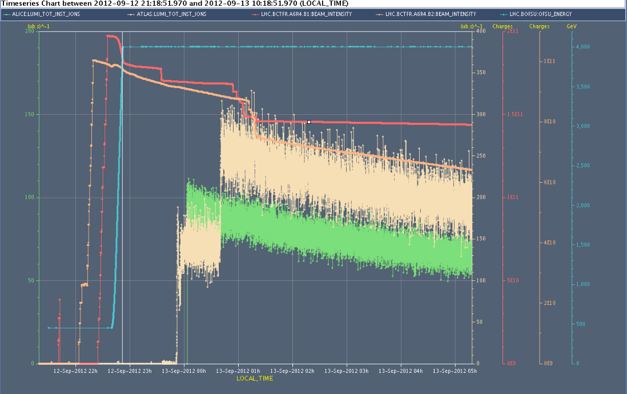
Fill continued
02:44 LHCb switched on SMOG gas injection
06:00 Displace collision point by - 50 cm
We made 4 trims of -120 degrees (400 MHz) on ring 1 (w.r.t. ring 2). That displaces the collision point by half the value, that is 240 degrees at 400 MHz or -50 cm.
07:40 Moved collision point to +50 cm
Lumi from logging, calibration to be verified

Slide 6
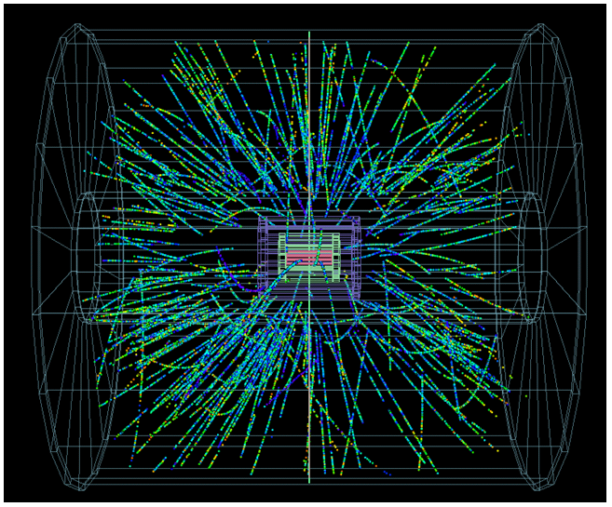
ALICE event
Hannes Wessels

Slide 7
The Plan (updated after the meeting)
Thursday, Today
pPb pilot run – 13 bunches colliding each beam, expect to finish around 9:30
Replace RF modulator during ramp down (1h)
1000 m beta*, few bunches (if all goes well, until 08:00)
Friday
09:00: pPb MD with 318 p+ bunches w. 4 Pb bunches (1 shift max)
Test ramp, reversed LHCb polarity and split collision beam process
SPS switched over to Q20 optics
Physics
Saturday & Sunday: Physics
Monday 06:00 dump for start of Technical Stop 3

