Slide 1
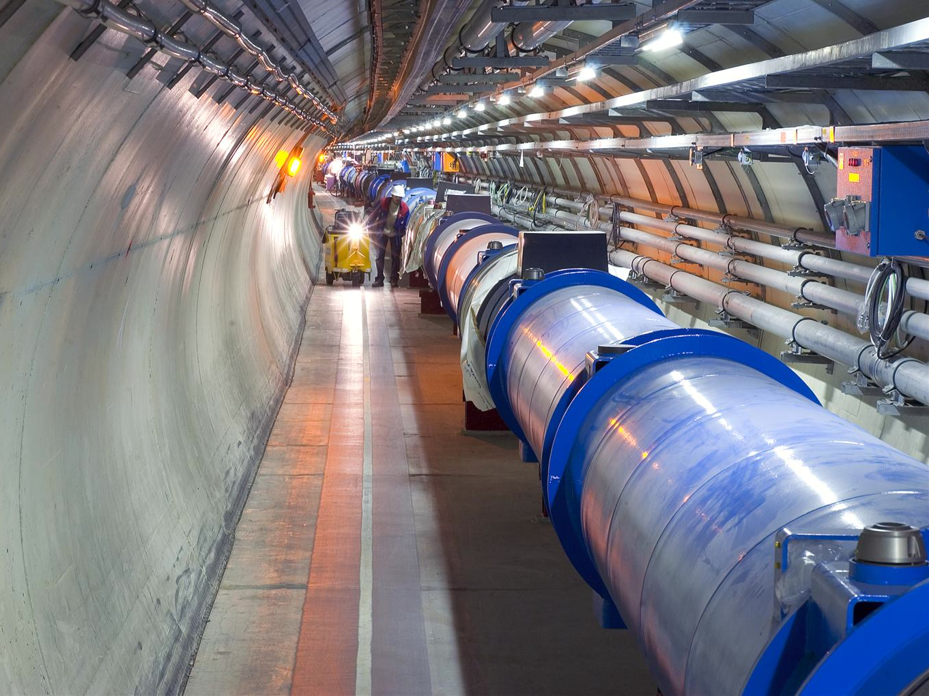
Beam dump on 07. Sept 2012,
Caused by RTQX2.R5 (SEU?)

Slide 2
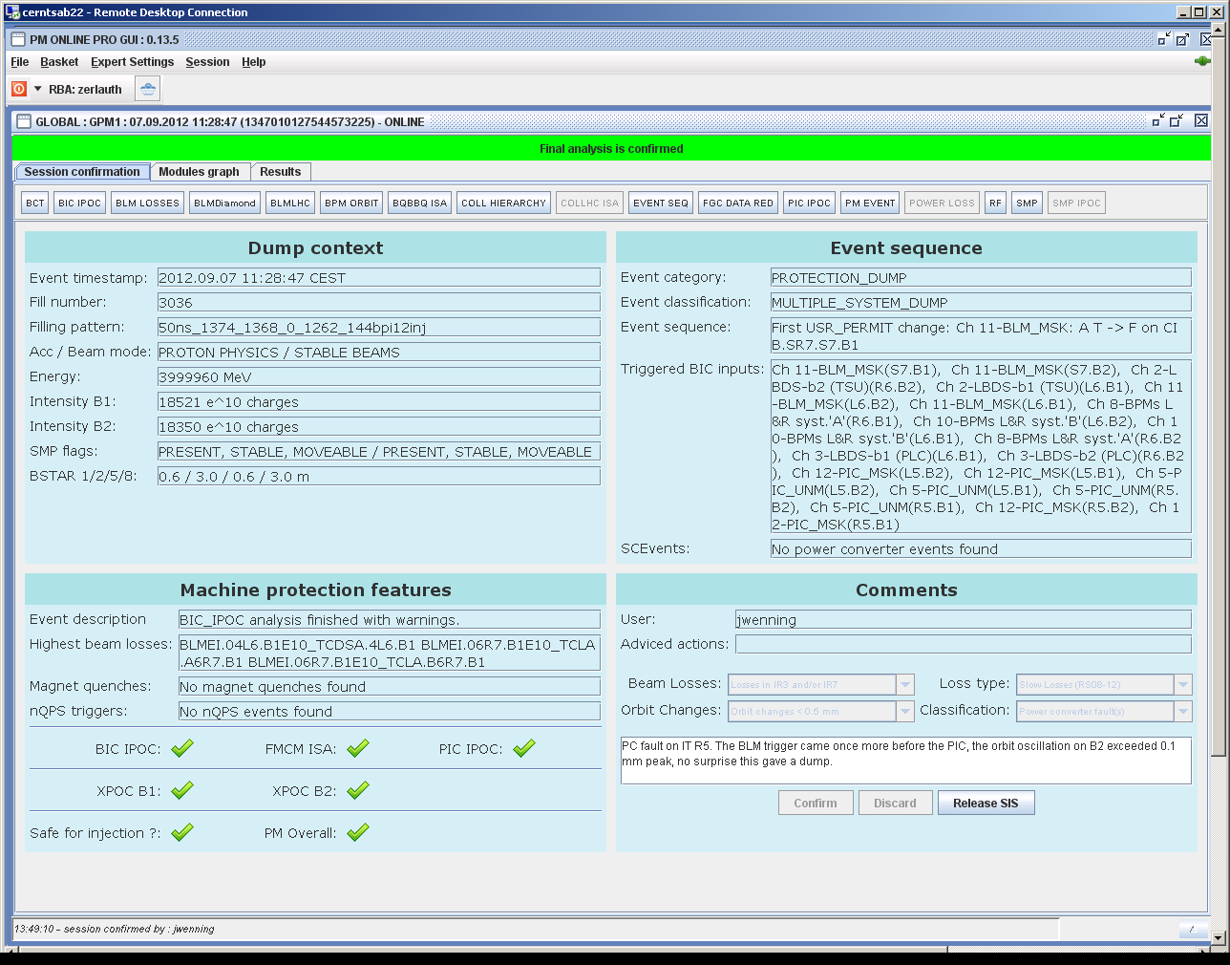
Beam dump @ 11:28:47
Beams were dumped while in STABLE_BEAMS at 11:28:47 on 7th of September due to Beam Losses in IR7

Slide 3
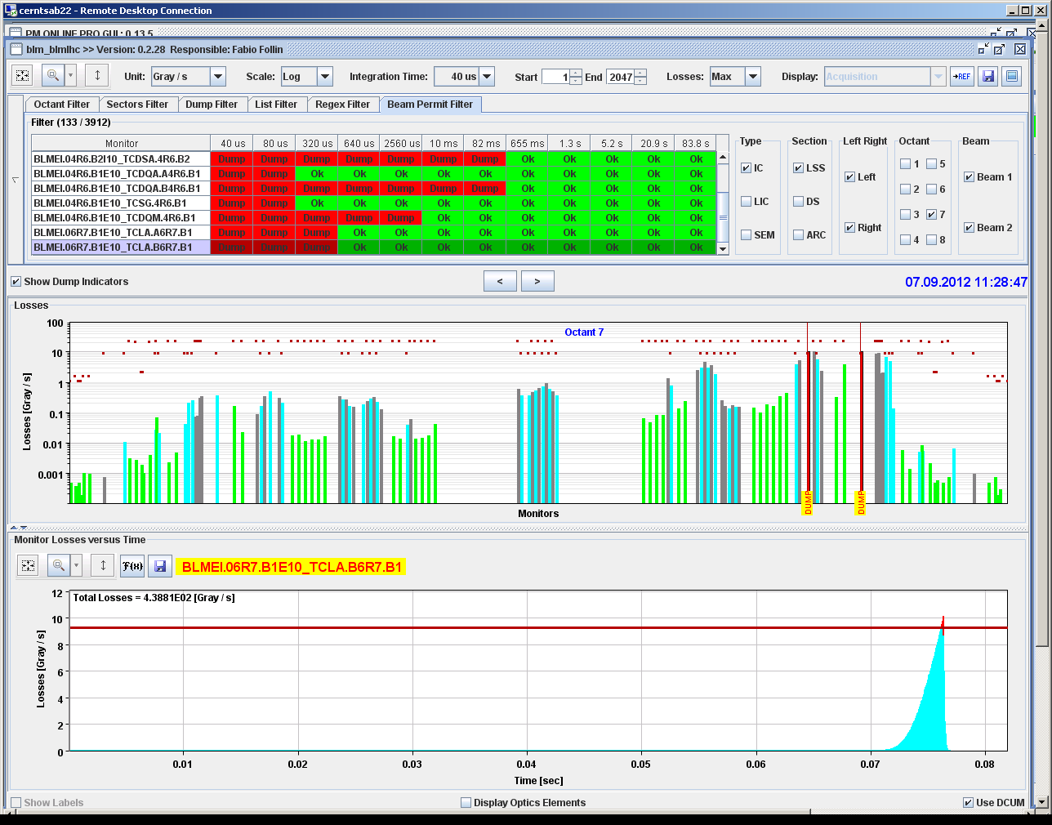
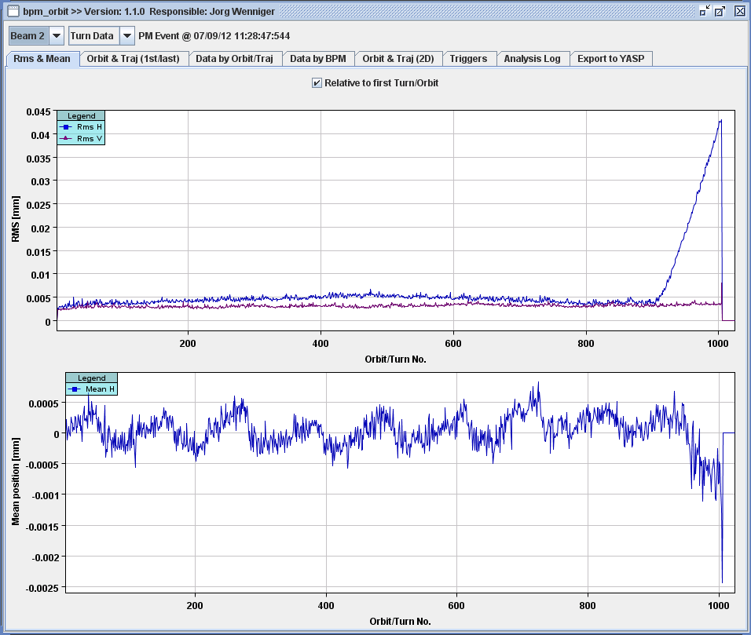
Beam dump @ 11:28:47
First BLM channel to trigger was TCLA.A6R7.B1in the short RS!
Fast change of orbit ~ 100um in last 100 turns

Slide 4
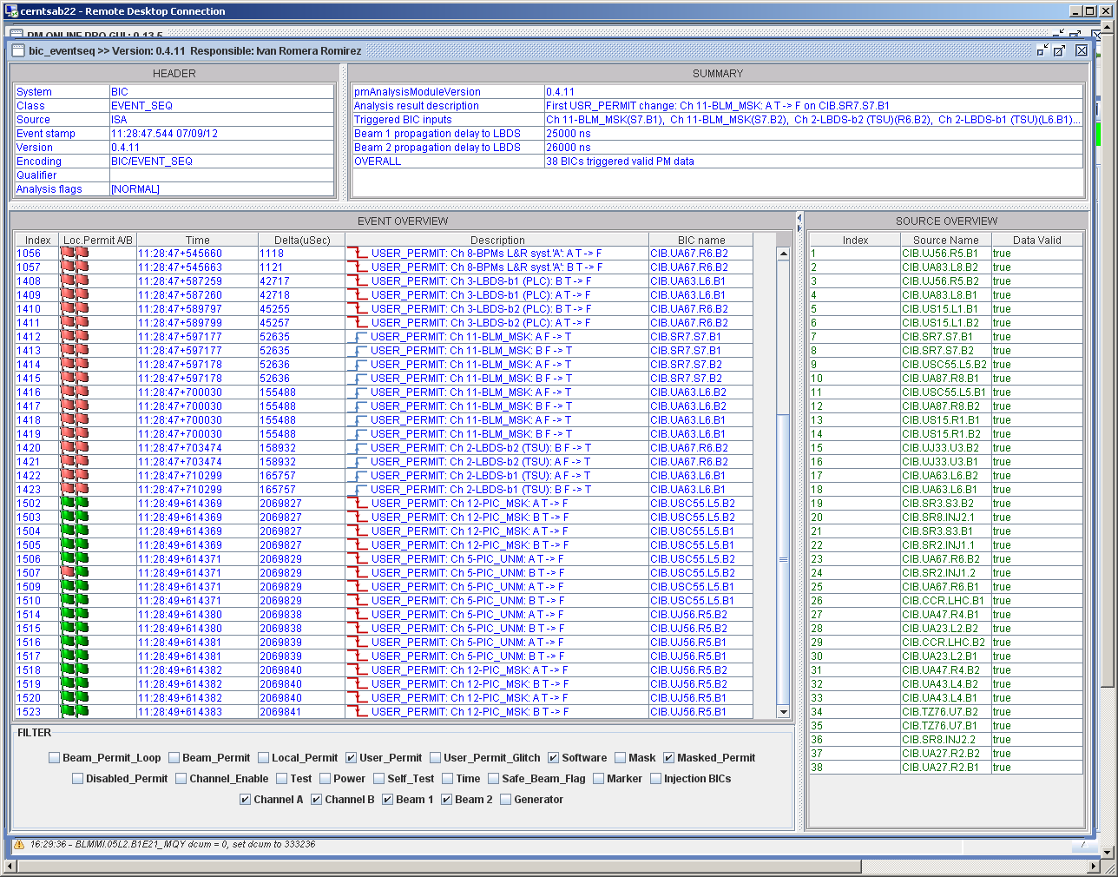
Beam dump @ 11:28:47
Actual cause was converter trip of RQX.R5, which however was reported to the interlock systems only 2.06s later!

Slide 5
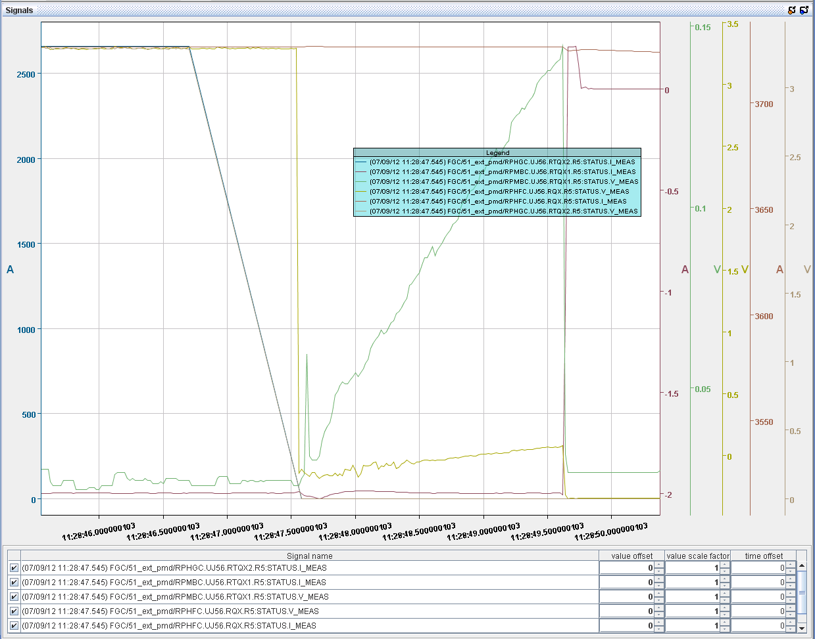
Converter logs
Beam dump by BLM
V_MEAS, I_MEAS from
RTQX2 (No data for ~ 1 sec)
Powering Failure
sent from RTQX1
(due to VS_FAULT),
Remove Power Permit to
all 3 converters

Slide 6
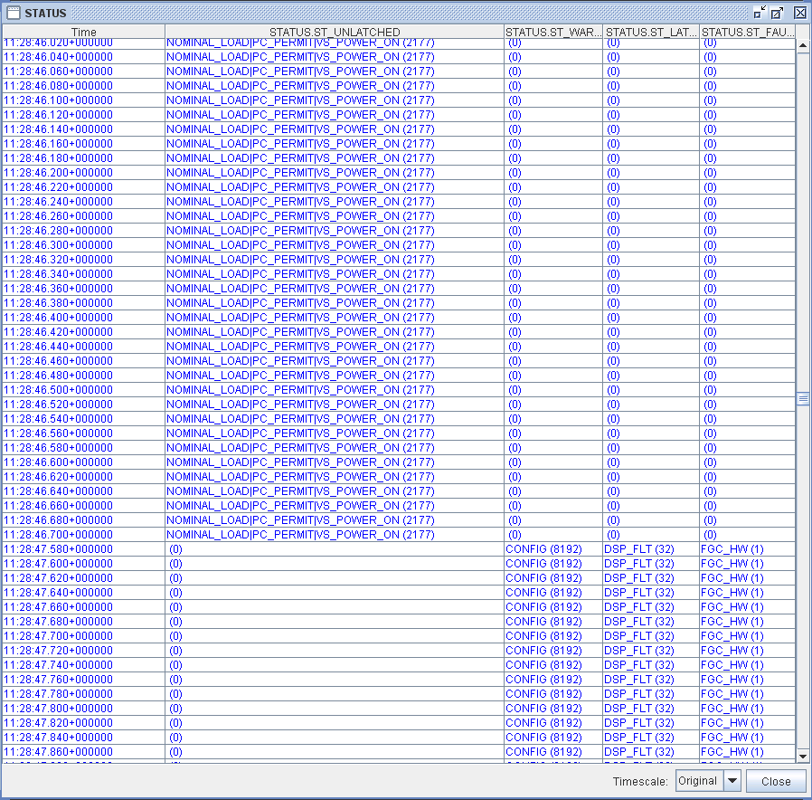
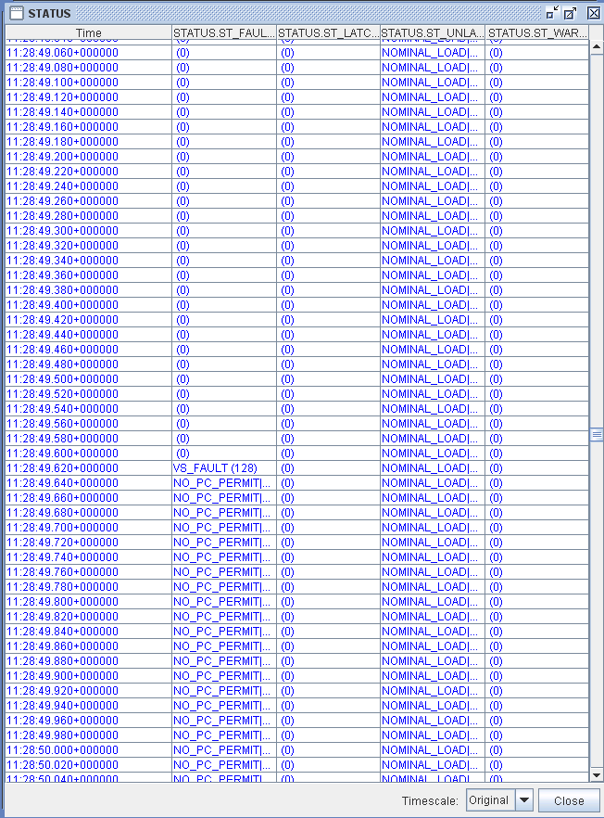
FGC Error log from RTQX2 and RTQX1
RTQX1 finally trips 2 sec later with a VS_FAULT + generates POWERING_FAILURE to PIC
FGC Log from RTQX2 misses entries for ~ 1 second, then shows CONFIG, DSP_FLT.. errors, but no POWERING_FAILURE generated

Slide 7
Summary
Origin of beam dump seems to originate in the loss of the FGC for RTQX2 (maybe due to an SEU seen as it is located in UJ56)?
Failure seems to occur around 11:28:46.700, followed by a period of ~ 900ms without PM data
Consequent movement of orbit created beam losses and dumped beams at 11:28:47.545 by a BLM in IR7
Powering Failure reported by the triplet circuit R5 around 11:28:49.600, due to RTQX1 tripping on a VS_FAULT
Question to EPC expert: Why did the FGC of RTQX2 not remove the Powering Failure signal when it initially failed?

