Slide 1
LHC Status Sat Morning 25-Aug
Bernhard Holzer, Joerg Wenninger
135pb⁻¹
52pb⁻¹
FMCM D1-IR1
power failure in Pt4
BLM/BPM crates

Slide 2
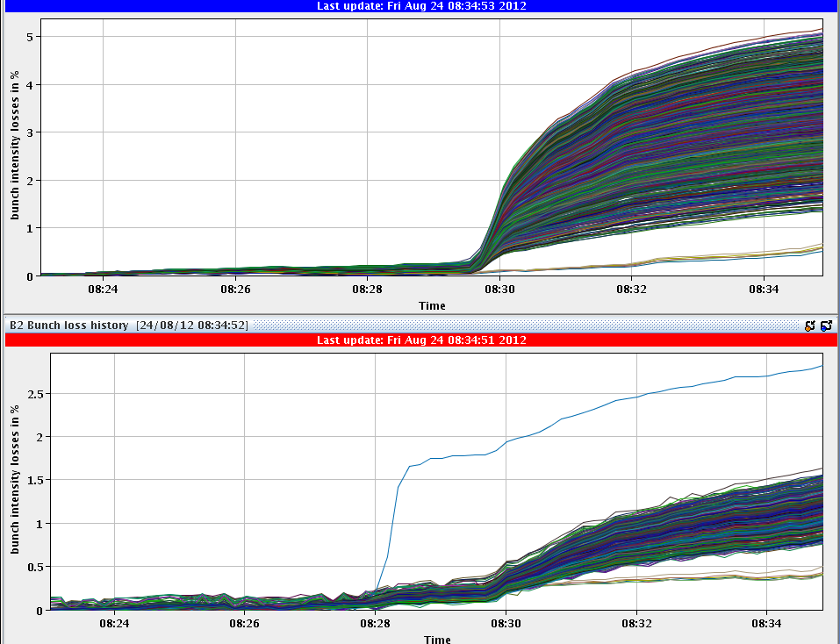
Fri Morning
since 8:30h stable beams
5%
bunch intensities ≈1.6E11
2%

Slide 3
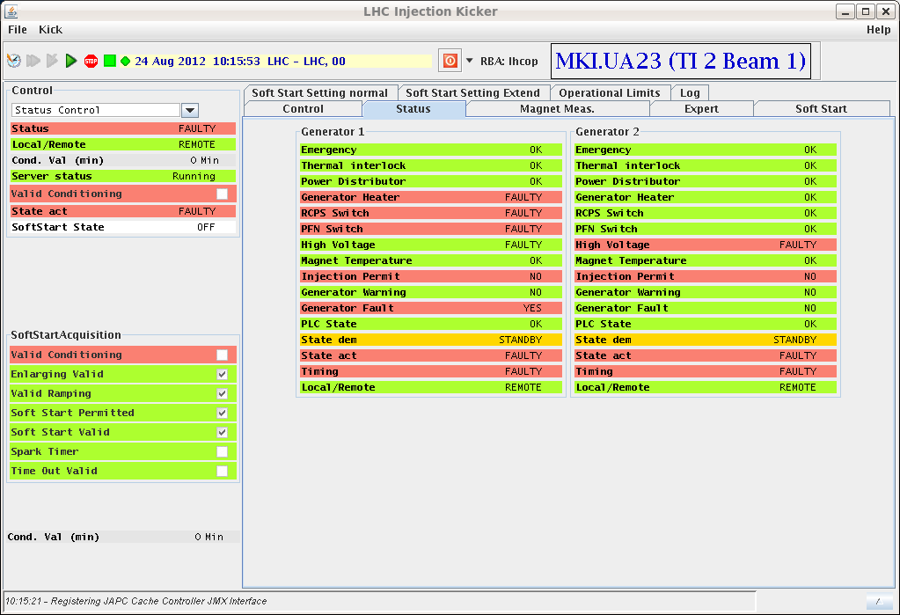
Fri Morning
since 10:15h ... again Injection
Kicker Problem in TI2
16:00h beam dump:
FMCM triggered interlock –
dump was clean.
No electrical disturbance noted by TI ... FMCM_RD1.LR1
preparing LHC or access:
Access for: MKI2,
CMS RPC,
ALICE Muons,
ATLAS RPC,
Current Lead on DFB in pt5 (RQ9.L5)
DFB: regulation module replaced
MKI2 intervention ... no source of fault found but heater module replaced
TDI at Pt 2: the thresholds on the inner gaps (up and downstream) were relaxed by 100 um.

Slide 4
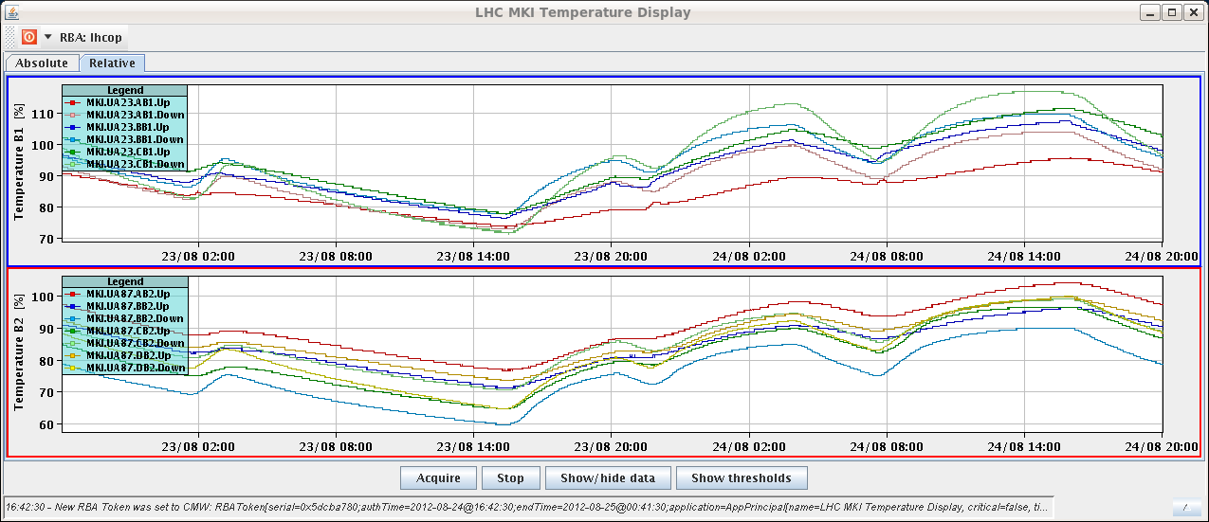
Fri Late
18:00h restart after access: pre-cycle
(twice due to some faulty circuits)
20:00h LHC ready for injection ... but:
MKI2-C temperature limit: 103 %
tolerance increased by 1 degree (i.e. 43.5ºC)

Slide 5
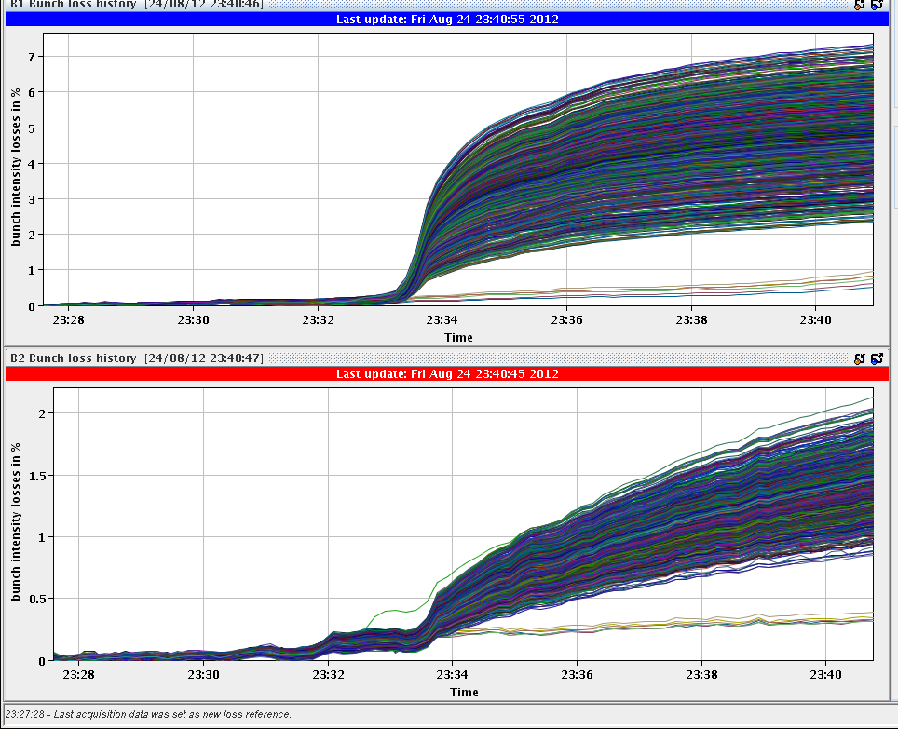
Fri Late
22:00h injection for physics
22:41h squeeze & adjust
... the usual smooth procedure
23:35h stable beams
L₀=7.3 E33
6%
2%

Slide 6
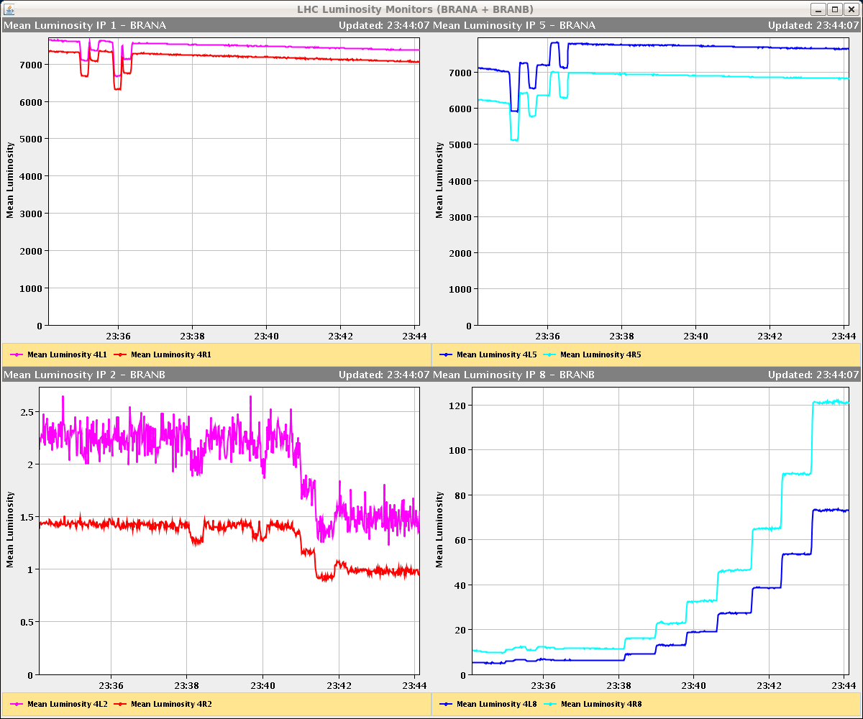
Fri Night
and not to forget: ALICE
IP1
IP5
IP8
IP2

Slide 7
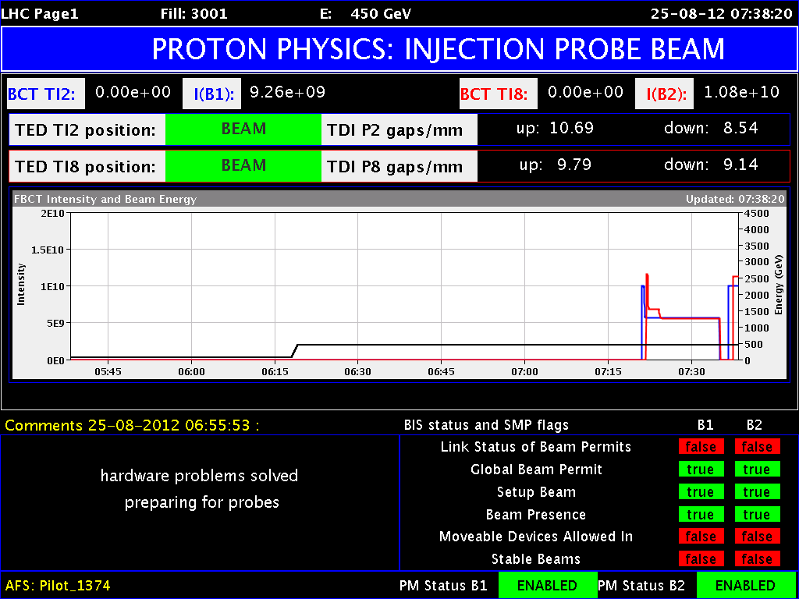
Fri Night
02:00h beam dump: BLM trigger
Electrical distribution of UPS tripped in pt 4, BLM
system not powered anymore → dump.
BLM crate power supply had to be exchanged (Christos)
in addition: 2 power supplies broken in Pt4 in BPM system
07:00h machine ready for injection,
injection probe beam
(nota bene: one BPM erratic
→ disabled)

