Slide 1
Thursday 16.8. – Morning
7:07 dump of previous fill
8:00 start injecting for Fill 2977
IQC B1 latched for all injection: excursion just at the interlock limit in V at the beginning of the line → corrections put in place for the next fill
Average bunch intensity 1.56E11
Losses during ramp B1 / B2: 2 / 1% of intensity
Losses during squeeze: 36% BLM threshold (around 0.65m beta*)
10:12 stable beams
Initial luminosity ~6.3E33 cm-2s-1
10:13 dump: trip power converter ROF.A81B2 → access to change power module (3h), ALTAS access in the shadow
13:20 re-injecting for fill 2978
Average bunch intensity 1.58E11
Losses during ramp B1 / B2: 1.5 / 2% of intensity
Losses during squeeze: 0.5 / 4.8% of intensity 89% BLM threshold (around 0.65m beta*)

Slide 2
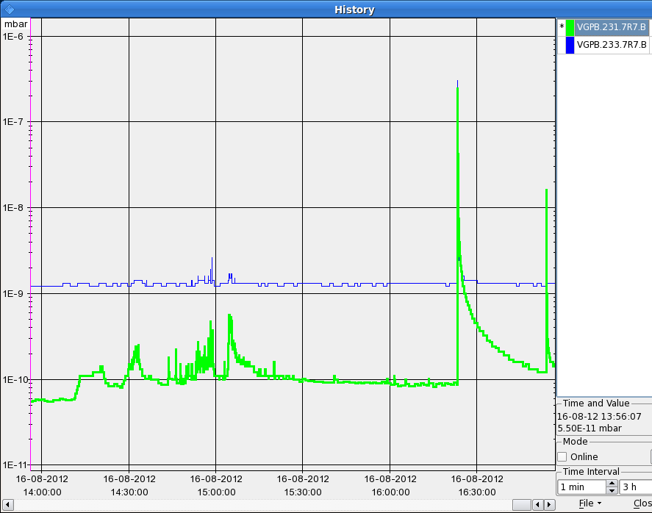
Afternoon
15:06 stable beams fill 2978
Initial lumi ~6.6E33 cm-2s-1
Integrated lumi 27 pb-1
16:23 dump: Vacuum interlock, P7 pressure spike, gauges VGPB.231.7R7.B and VGPB.233.7R7.B, 3 valves closed → threshold increased from 1E-7 to 1E-6 mbar
Access for QPS: local power cycle on RB.A12.C21.R1B and pre-cycle (2h)

Slide 3
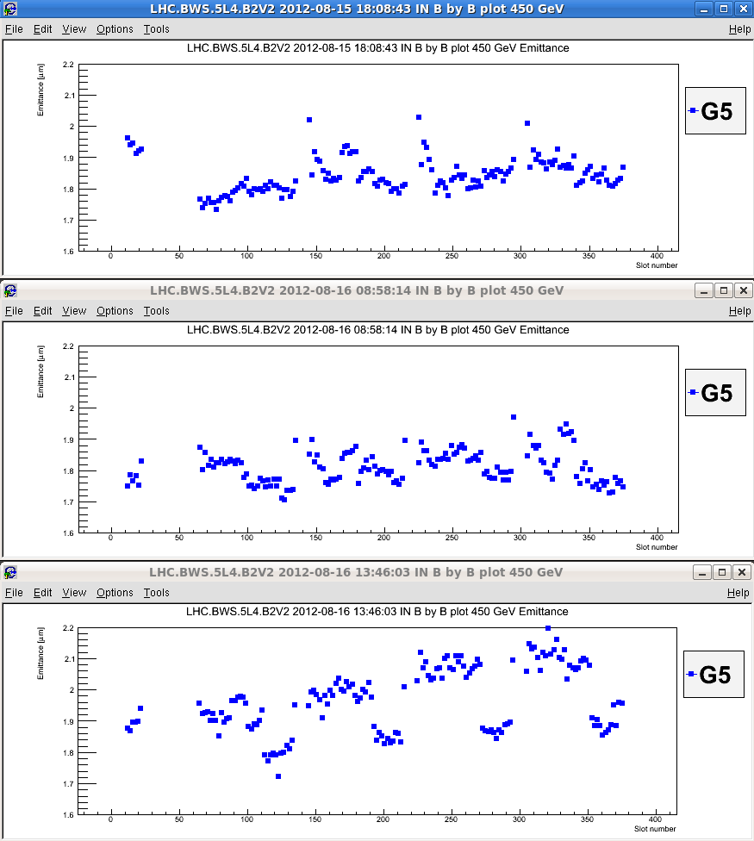
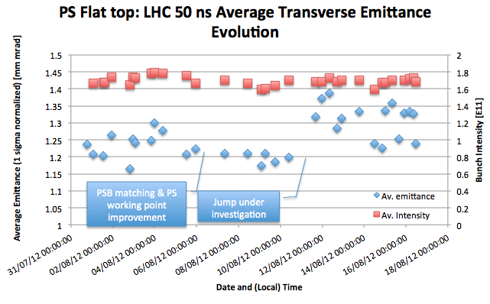
Emittance at injection
Emittances higher than last Sunday
PS sees fluctuations since the week-end
B2V Fill 2976
Average emittances [um] of the first 6 bunches
Fill # | 2954 | 2977 | 2978
B1H | 1.56 | 2.19 | 2.19
B1V | 1.66 | 1.76 | 1.74
B2H | 1.63 | 1.63 | 1.95
B2V | 1.7 | 1.76 | 1.88
B2V Fill 2977
B2V Fill 2978

Slide 4
Evening
19:18 injecting for fill 2979
20:24 dump during ramp: fast losses left of IR6, UFO?; B2; starts at TCSG 4L6
22:00 injecting for fill 2980
Problems with beam from PS: found that the vertical tune was close to the 3rd order resonance towards the end of the ramp
Average bunch intensity 1.58E11
23:39 UFO MKI.L2 during the ramp (losses up to 85%)
Losses during ramp: max. 1.2% of intensity
Losses during squeeze B1 / B2: 0.5 / 3.5% of intensity; no warnings

Slide 5
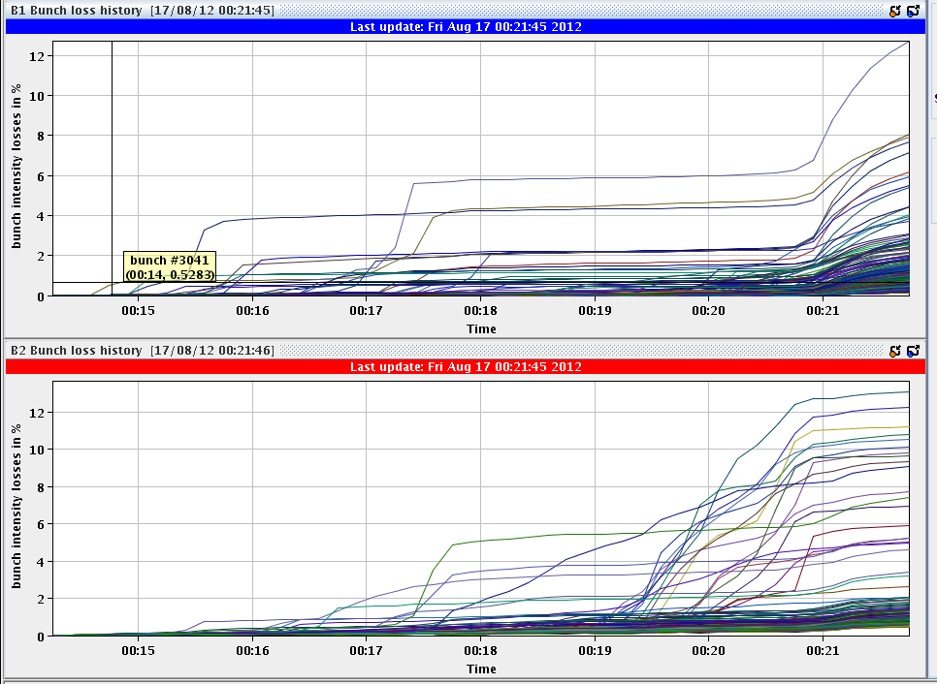
Night
Losses in individual bunches when going into collisions up to 12% mostly at the end of some trains
0:22 stable beams
Initial luminosity ~6.6E33 cm-2s-1
Integrated lumi 55 pb-1
3:07 dump: LBDS self-trigger
Ion pump on the MKBVD generator switched off (no clear why) ~3.02am then the vacuum got worse over few minutes.
→ Kicker: C and D generators went down as the vacuum interlock on MKBVD67 triggered.

Slide 6
Emittance reduction in PS
PS improvement during the night (email from Rende Steernberg):
Average emittance out of the PS of 1.13 pi micro meter and an intensity per bunch of 1.7E11 ppb. Mainly due to working point optimization at low energy in the PS.
SPS has confirmed the emittance reduction.

Slide 7
Morning
4:11 Injection for Fill 2981
Average bunch intensity 1.59E11
Emittances LHC injection 144b: mostly below 1.6 um!
Losses during ramp: max. ~1% of intensity
Losses during squeeze B1 / B2: 0.7 / 4.3% of intensity; no warnings
6:00 stable beams
New record peak luminosity: ~7.1E33 cm-2s-1
Emittance in collision ~2.2um
7:00 dump: QPS trigger on RQT12.R1B2
Currently: trying to re-fill before the intervention in PS for cavity repair (around 6 hours)

Slide 8
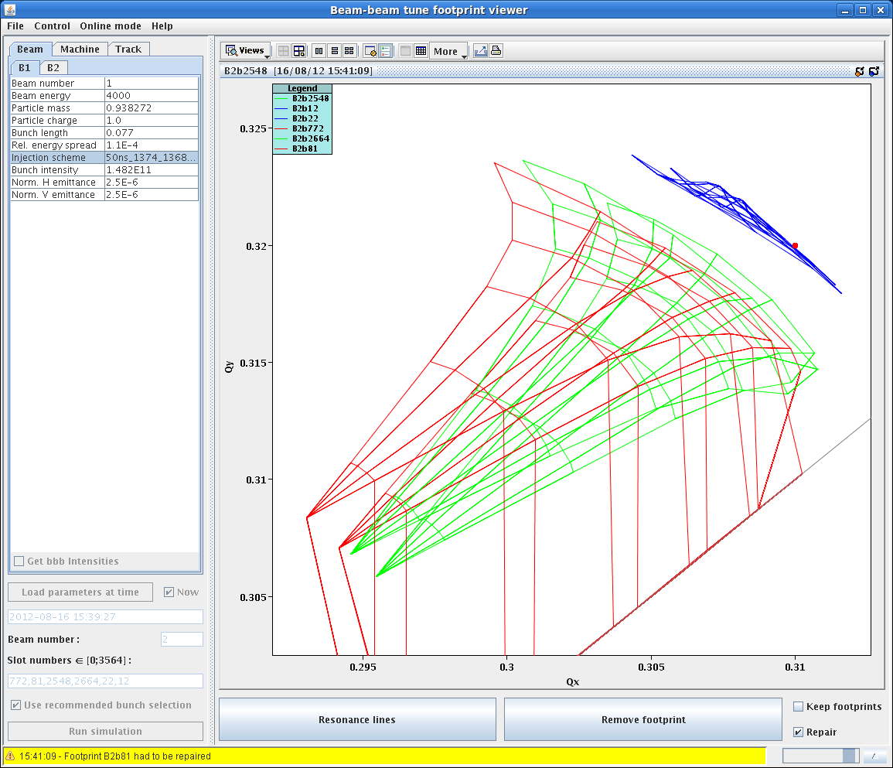
New Online Footprint Viewer

