Slide 1
Summary of week 33
Machine Coordinators: G. Arduini, E. B. Holzer
Many thanks to: Collective effects, Collimation and Injection and Injector teams Main aims: ALICE polarity switch and luminosity production

Slide 2
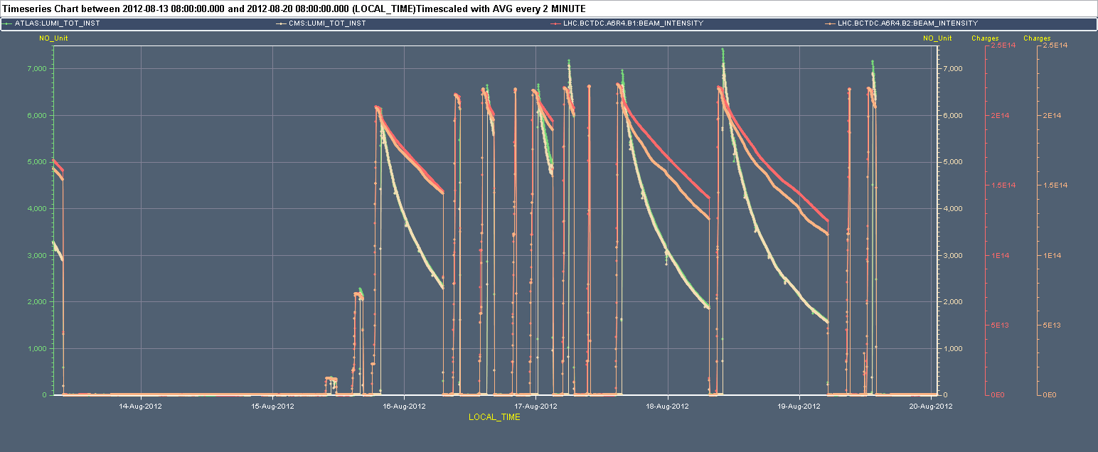
Week 33
7x10³³ cm⁻²s⁻¹
ALICE polarity
L_{ATLAS} L_{CMS} I_{B2} I_{B1}

Slide 3
Last 24 hours
5:14 OP dump. End of fill #2984 223 pb⁻¹ in 19 h
8:30 Injecting physics beam fill #2985 (delayed by MKI2 temperature interlock)
9:15 beams dumped during ramp by trip of LHCb dipole
11:00 Intervention on LHCb dipole power converter completed Filling #2986 delayed by RF problem in the SPS
Dump during injection due to BLM in point 2 close to inection kicker (UFO?) after injection
12:00 Filling #2987
13:23 STABLE BEAMS #2987. Initial luminosities ~7.1x10³³ cm⁻²s⁻¹
13:59 RF Module M2B2 tripped (main coupler vacuum). Beam dump. ~14 pb⁻¹ in 0.6 h.

Slide 4
Last 24 hours
After that all afternoon/night with problems one after the other:
Trip of Arc 45 (RQ7.R4 HTS interlock)
RF problem in the PS (20 MHz) - twice
Cryo PLC replacement in P18 (PLC) ➔ no injection/ramp on request of cryo operator
PS Main Power Supply (POPS)

Slide 5
Main faults
Date | Duration [h] | Description
Mon 13/8 | 7 | PSB, QPS controller reset (main circuits in sector 45) RF cavity in the PS, ALICE solenoid power converter polarity switch
Tue 14/8 | 2.5 | Undulator trip and ML4 cryo lost, PS (POPS)
Thu 16/8 | 5 | ROF.A81.B2 replacement, QPS reset (RB.A12.C21.R1B) requiring access
Fri 17/8 | 3.5 | PS access (RF 40 MHz), CMS
Sat 18/08 | 0.5 | MKI2 temperature
Sun 19/08 | 14.5 | MKI2 temperature, LHCb dipole power converter (spurious temp. interlock), SPS RF, RF Module M2B2 trip (main coupler vacuum), Trip of RQ7.R4 (QPS trigger – HTS), PS RF (20 MHz) Cryo P18 (PLC), POPS
Mon 20/8 | 8 | PS RF (20 MHz), POPS

Slide 6
Main faults by system
System | Time [h] | Comments
Injectors | 20.5 | PSB, PS (POPS, RF), SPS (RF)
PC | 7.5 | ROF.A81, ALICE solenoid, LHCb dipole
QPS | 6 | QPS controller resets + HTS on RQ7.R4
Kickers | 2.5 | MKI2 temperature
RF | 2 | M2B2 module (power coupler vacuum)
Cryo | 2 | P18 PLC
Experiments | 0.5 | CMS
Total | 41 (24%)

Slide 7
Fills from 13/08 – 08:00
Fill | N_{b} | Duration [h] | L_{int} [pb⁻¹] | Dump reason
2957 | 1374 | 1.8 (9.8) | ~20 (152.1) | TCT IP1, loss of b* information
2974 | 78 | 0.8 | 0.9 | OP dump
2975 | 474 | 0.5 | 3.9 | RQTL9.R7B1 QPS (SEU?)
2976 | 1374 | 11.3 | 148.4 | OP dump
2977 | 1374 | 0.01 | 0.1 | Trip of ROF.A81.B2 PC
2978 | 1374 | 1.3 | 27.4 | Vacuum interlock P7 (pressure spike)
2980 | 1374 | 2.8 | 54.9 | MKB ionic pump trip. LBDS trigger.
2981 | 1374 | 1.0 | 22.7 | QPS trigger on RQT12.R1B2
2983 | 1374 | 15.9 | 194.2 | OP dump
2984 | 1374 | 19.2 | 222.9 | OP dump
2987 | 1374 | 0.6 | 14.3 | RF module M2B2 trip
Total |  | 55.2 | 709.6
STABLE BEAMS 55.2 h (33 %)

Slide 8
Lost fills before stable beams (>450 GeV)
c/o Post-Mortem DB
Event Timestamp | Phase | Beam Energy [TeV] | Fill Number | Comment
14-Aug-12 03.21.08 | ADJUST | 4 | 2959 | Enf of fill after setting up collimators
14-Aug-12 07.02.17 | SQUEEZE | 4 | 2960 | Loss map
14-Aug-12 22.05.10 | ADJUST | 4 | 2965 | Loss map
15-Aug-12 12.44.31 | ADJUST | 4 | 2966 | Loss map
15-Aug-12 02.59.43 | ADJUST | 4 | 2967 | Loss map
16-Aug-12 20.24.38 | RAMP | 1 | 2979 | UFO at TDCQ
17-Aug-12 09.52.20 | RAMP | 1.5 | 2982 | SIS (RB energy tracking)
19-Aug-12 09.15.42 | RAMP | 1.5 | 2985 | LHCb dipole power converter
No fill lost due to instabilities

Slide 9
Performance
~11.5 fb⁻¹
~1.15 fb⁻¹

Slide 10
Performance
1.6x10¹¹ p/b @inj

Slide 11
Performance
7.4x10³³ cm⁻²s⁻¹ in ATLAS
2.2-2.3 μm

Slide 12
Performance

Slide 13
ALICE polarity switch + X-ing angle increase
Monday
Orbit measurement and correction with opposite polarity
Collimator alignment (TCTs pt. 2): up to the end of the squeeze
Loss maps up to the end of the squeeze
Tuesday
Injection and injection protection setting-up (point 2)
Feed-forward of orbit corrections in ramp/squeeze (1st iteration)
Collimator alignment (TCTs pt. 2): up to the end of the squeeze
Loss maps in collision (including roman pots)
Wednesday
Angular alignment verification TDI in point 8 following issues observed in week 32
Feed-forward of orbit corrections in ramp/squeeze (2nd iteration)
Intensity ramp up: 78/480/1374 bunches

Slide 14
Collimator set-up
Alignment
Loss Maps- all done. OK by Collimation team
Collimation team
Alignment | Injection | Flat-top | Squeezed, separated | Collision
IP2 TCTVs + TCTHs | done | done | done | done
 | Injection, inj prot. IN | Injection, inj prot. OUT | Flat-top | Squeezed, separated | Collision, RP in physics settings
Betatronic-H | Done | Done | Done | Done | Done
Betatronic-V | Done | Done | Done | Done | Done
Neg. off-mom | +1000 Hz | +1000 Hz | -- | -- | +500 Hz
Pos. off-mom | -1000 Hz | -1000 Hz | -- | -500 Hz | -500 Hz
Asynch dump | Done | -- | -- | -- | Done

Slide 15
TDI deformation
Tuesday 8/8 dumped on beam losses on the TDI Pt8 when moved to parking and probably one side got stuck. After 1 hour with high intensity beams at injection: a large vacuum rise and probably significant heating.
Suspected deformation of the structure, seen as ‘drifts’ on the LVDT readings, much stronger than normal
Not clear at that point which part of the system (jaw or mechanism outside) is deformed
M. Di Castro, R. Losito, A. Masi, J. Uythoven

Slide 16
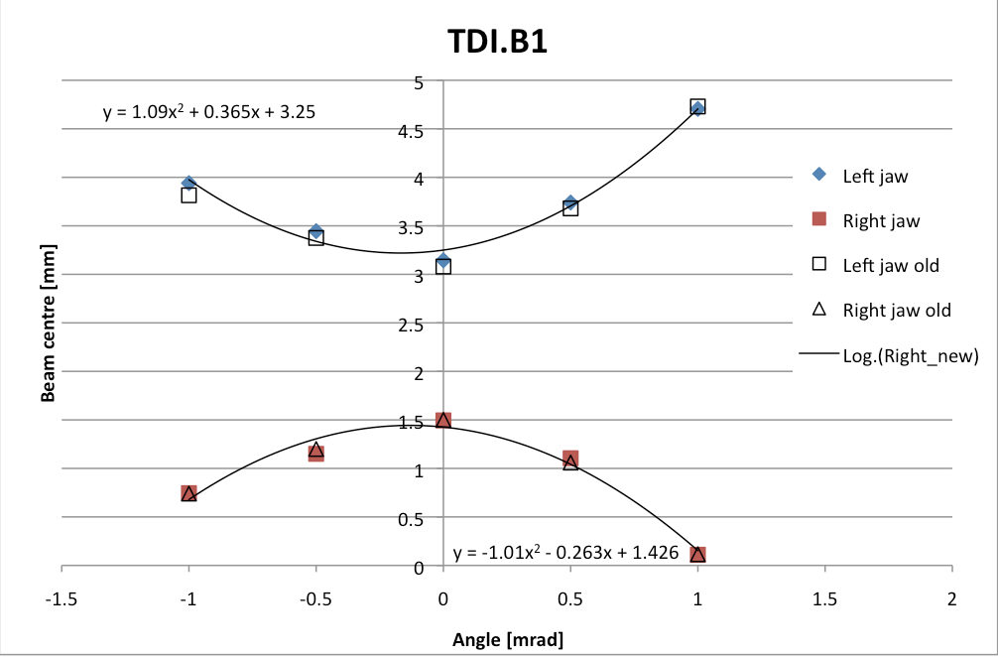
TDI8 alignment check
Angular alignment:
No change as compared to last measurement's changes by 10 μrad for the lower jaw
we keep the same positions and angles as before
Retraction measurement:
Lower TDI.P8 jaw at 6.8 (6.6 previous) σ exactly at nominal setting, OK Upper jaw at 6.4 (6.4) σ, closer to the beam and therefore OK
No evident damage
C. Bracco, W. Bartmann

Slide 17
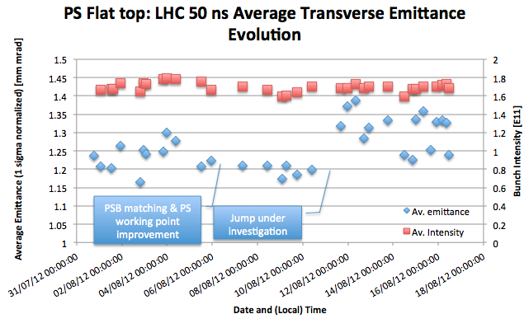
Emittance at injection
Emittances in the LHC larger than last Sunday for similar intensity. PS sees fluctuations since the week-end.
R. Steerenberg

Slide 18
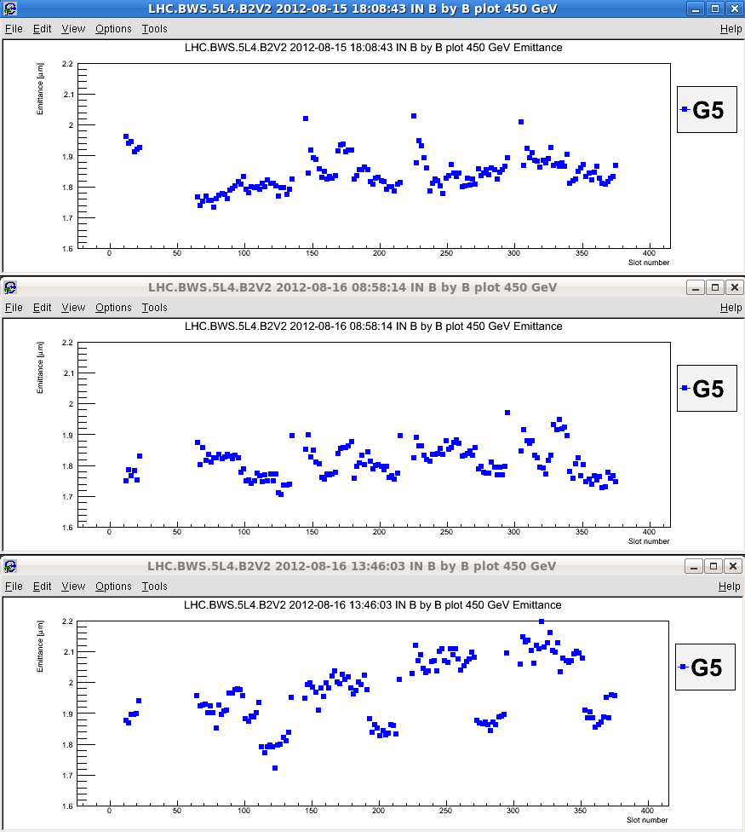
Emittance at injection
Further deterioration during Thursday
Some improvement after SPS inj. Kicker timing adjustment
B2V Fill 2976
B2V Fill 2977
B2V Fill 2978
E. Bravin

Slide 19
Emittance at injection
Striking improvement on Thu night:
Average emittance out of the PS of 1.1 μm and an intensity per bunch of 1.7x10¹¹ p/b. Mainly due to working point optimization at low energy.
SPS has confirmed the emittance reduction with emittances of 1.5 um
Since then emittances at injection in the LHC in the range of 1.6-1.8 um
R. Steerenberg

Slide 20
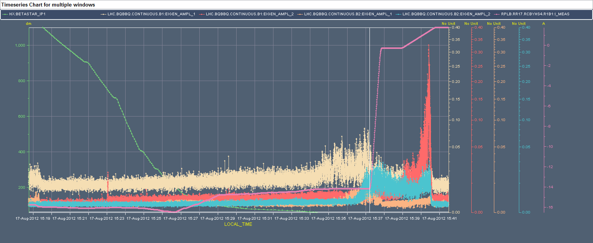
Instabilities
2980 - Q’_{H/V}=11 – Gain_{TFB}=0.01
BBQ-B1H BBQ-B2H
BBQ-B1V BBQ-B2V
2983 - Q’_{H/V}=11 – Gain_{TFB}=0.02

Slide 21
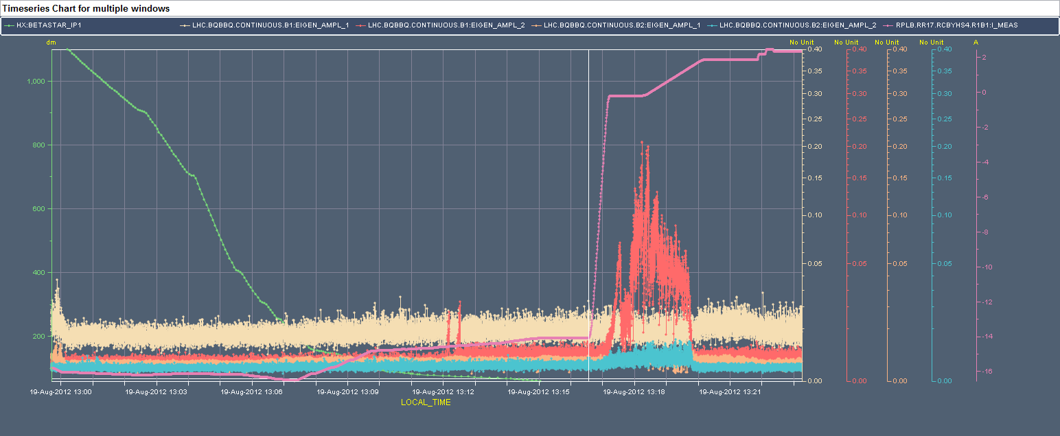
Instabilities
2984 - Q’_{H/V}=13 – Gain_{TFB}=0.04
BBQ-B1H BBQ-B2H
BBQ-B1V BBQ-B2V
2987 - Q’_{H}=13 Q’_{V}=15 – Gain_{TFB}=0.04

Slide 22
Instabilities
Oct+Chrom
BCT-B1
IP1-H-SEP
IP8-H-XING
IP8-V-XING
IP8-V-SEP
BBQ-B1V

Slide 23
Collision
Vertical blow-up of the tails of 36 bunch trains mostly on B1
Losses on the few percent level

Slide 24
Settings
Present settings during squeeze and collision:
Q’_{H}=13 (ramping down to 11 during collision process), Q’_{V}=15 (for next fill)
Octupoles at 510 A during squeeze and ramped down to 394 A during collision process
Transverse damper at maximum normalized gain (0.04 ➔ 50 turns damping time for the low frequency coupled bunch modes)

Slide 25
Kicker temperature
Data from kicker soft-start analyzed.
Slight increase in the interlock levels applied (particularly for magnet B – 2 deg.)
Magnet C: indications that we could be close to the Curie temperature, more data needed.
B. Goddard, V. Gomes Namora

Slide 26
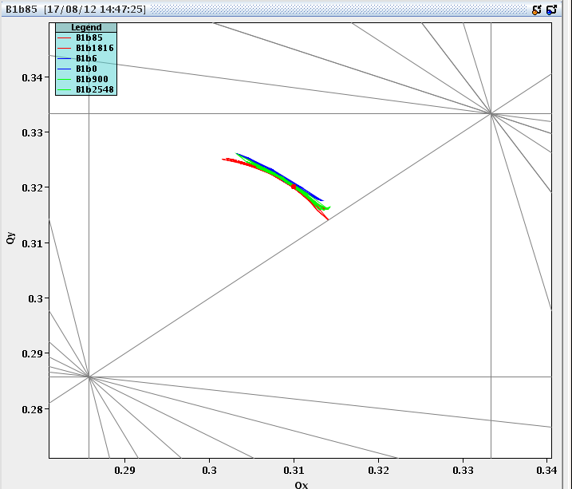
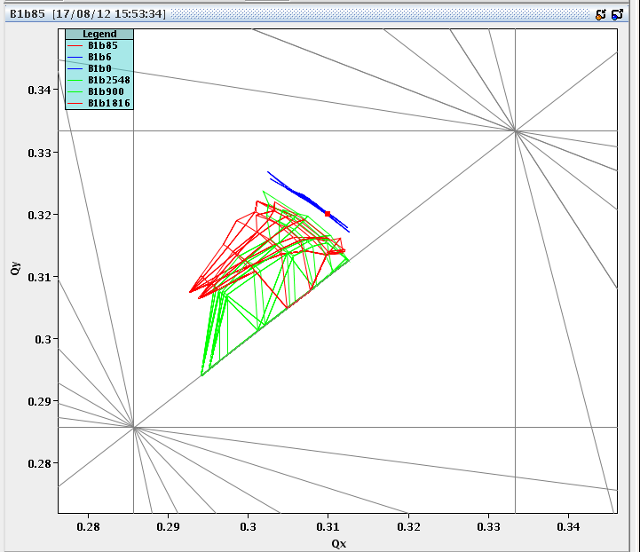
New Online Footprint Viewer
Injection
X. Buffat
Flat top
Collision

Slide 27
Summary
Achieved new record luminosities >7x10³³ cm⁻²s⁻¹ with:
High bunch intensity (~1.6x10¹¹ p/bunch at injection)
Small emittance from the injectors
No fill lost due to instability but still instabilities observed leading to blow-up of some bunches
All countermeasures for instabilities identified so far (octupoles, transverse damper, chromaticity) at or close to their maximum
Good production in spite of the setting-up time dedicated to the ALICE polarity change and yesterday….

