Slide 1
LHC summary week 32
Coordination: Mike Lamont & Jan Uythoven
Gianluigi Arduini and Elias Metral in close attendance

Slide 2
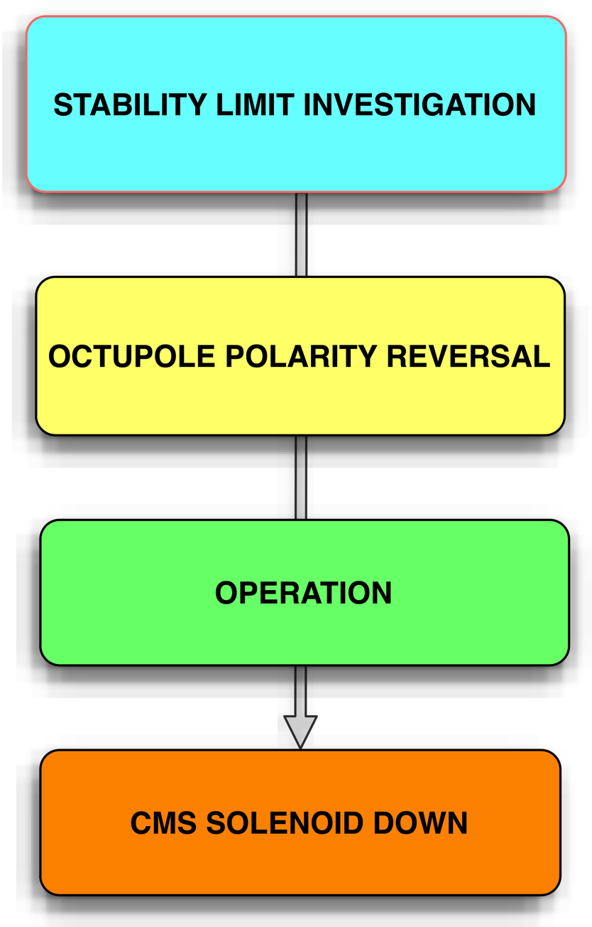
Week 32

Slide 3
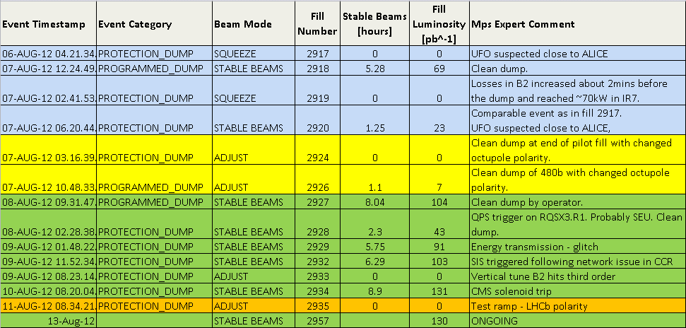
Week 32 - fills
Integrated luminosity for the week: ~720 pb⁻¹

Slide 4
PERFORMANCE

Slide 5
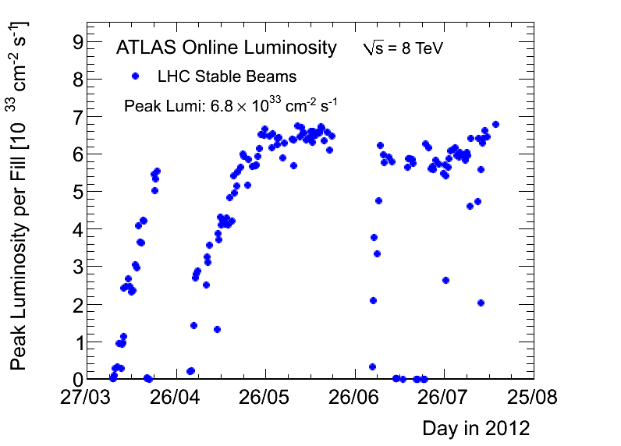
Luminosity

Slide 6
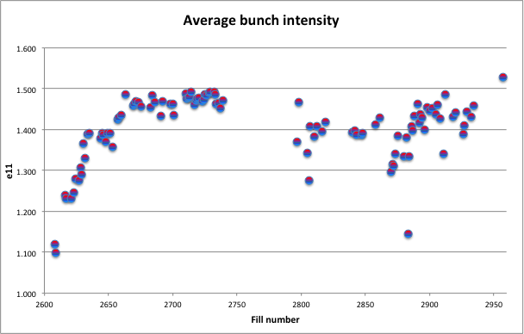
Bunch intensity

Slide 7
Emittance

Slide 8
Last LMC…
Rende Steerenberg, Bettina Mikulec, Verena Kain et al

Slide 9
Timeouts
Monday:
Spent most of the shift with no beam from the SPS, due to a problem with the PFN switch on the SPS MKE4 (9 hours)
TDI IP8 which got stuck when moving out after injection, resulting in a large angle.
Thursday
SIS triggered following network issue in CCR
Access (Atlas Xenon), while SPS is still down for EDF intervention.
Sunday
BPMS triggered after 144b injection – N times – fixed by Eva Calvo

Slide 10
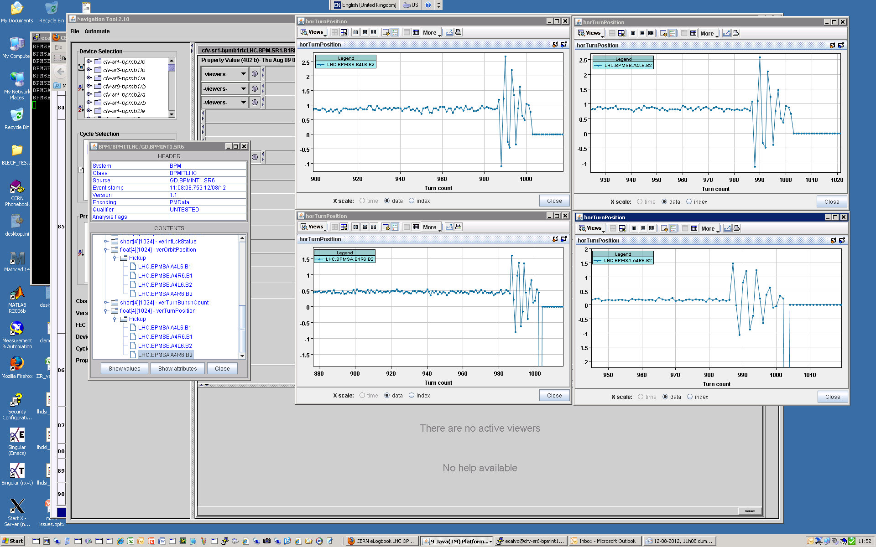
BPMS
Eva Calvo

Slide 11
Stability level investigations
Fill | Date | <Ib> | Q’ | Oct | TFB | Comment
2911 | Sat | 1.51 |  | 417, 475 | reduced in collision | Heavy losses in squeeze Saved by raising Q’
2912 |  | 1.52 | +5 | 417, 475 |  | Looking good
2913 |  | 1.56 |  | 417, 475 |  | Losses in collision BP
2915 |  | 1.52 |  | 330, 417 |  | Losses in collision BP
2917 | Mon | 1.48 | +2 | 150, 417 | reversed | Losses end squeeze
2918 |  | 1.48 |  | 150, 417 |  | Losses end ramp (after Q’ trim)
2919 | Tues | 1.47 |  | 200, 417 |  | Heavy losses end squeeze
2920 | Tues | 1.46 |  | 200 to 475 |  | Sudden losses flat-top Sudden losses end squeeze
Exploration of octupole -chromaticty space
Octupoles not reversed.

Slide 12
Octupole polarity switch - Tuesday
Flip polarity at injection: 6.5 A
Injected 1374 bunches successfully: stable
Also stable with reduced damper gain
Octupoles at 417 A at flat-top & squeeze
Test ramp with pilot bunches – reasonable measurement of chromaticity through ramp, squeeze and collide
Measurements fed-forward into settings for next ramp. Aim for chroma +5 at end of ramp all the way into collision
Fill with 12 nominal bunches: no problem
Fill with 480 bunches:
Stable Beams for 1 hour: no problem
Tune scan at collision shows enough space
Reduce octupole current after one hour:
Loose 3 non-colliding bunches at 23 A (from 250 A): OK

Slide 13
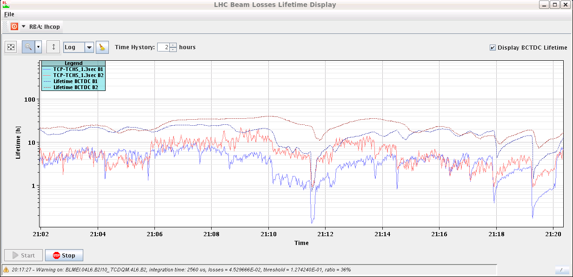
Tune scan at start of collisions
Steps of 1e-3 both planes, both beams
Initial tune +3e-3 with respect to end squeeze (~nominal settings)
Given below – this tune increase in collision beam process removed
-1e-3
-1e-3
-1e-3
-1e-3
etc..

Slide 14
Reverse polarity operations
Fill | Date | <Ib> | Q’ | Oct | TFB | Comment
2926 | Tues | 1.39 |  | 417,300 | N/C | 480b – no problem
2927 | Wed AM | 1.43 |  | 417,300 |  | Vertical instability squeeze
2928 | Wed PM | 1.48 |  | 475,360 |  | Vertical instability end squeeze
2929 | Wed PM | 1.45 | H+4 V+5 | 510,395 |  | B2V unstable at 1.5 m
2932 | Thu AM | 1.44 | V+2 | 510,395,250
2933 | Thu PM | 1.46 | H+2 | 510,395 |  | Heavy losses B2 end squeeze- vertical tune
2934 | Thu PM | 1.46 |  | 510,395,250 |  | Lovely physics fill
Wound up octupoles and then chromaticity until stable
Looking good up to 1.55e11 ppb

Slide 15
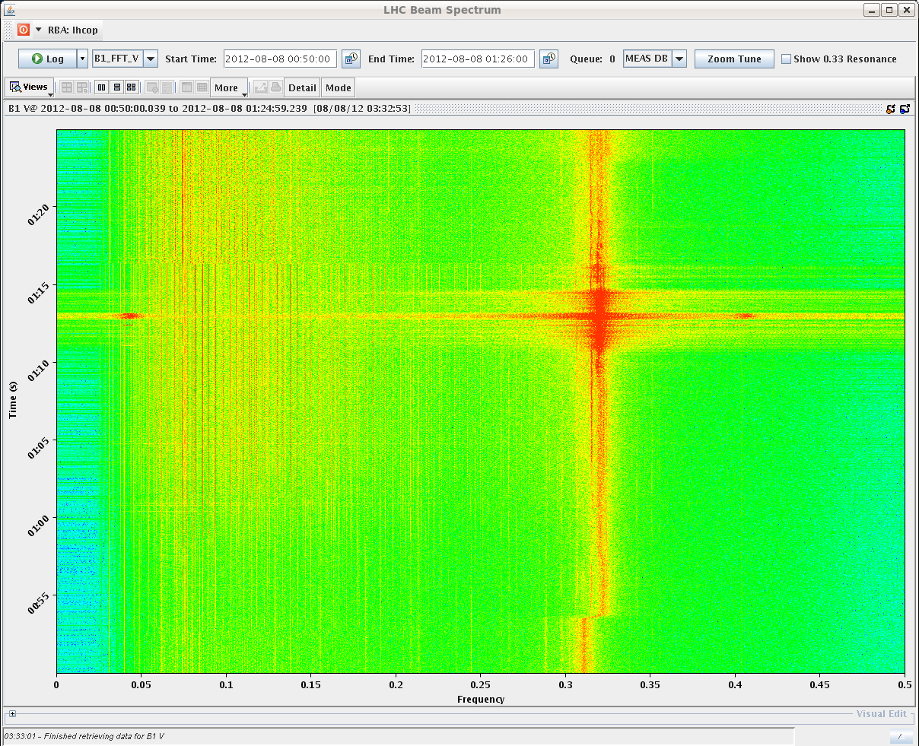
2927 Tune – B1V

Slide 16
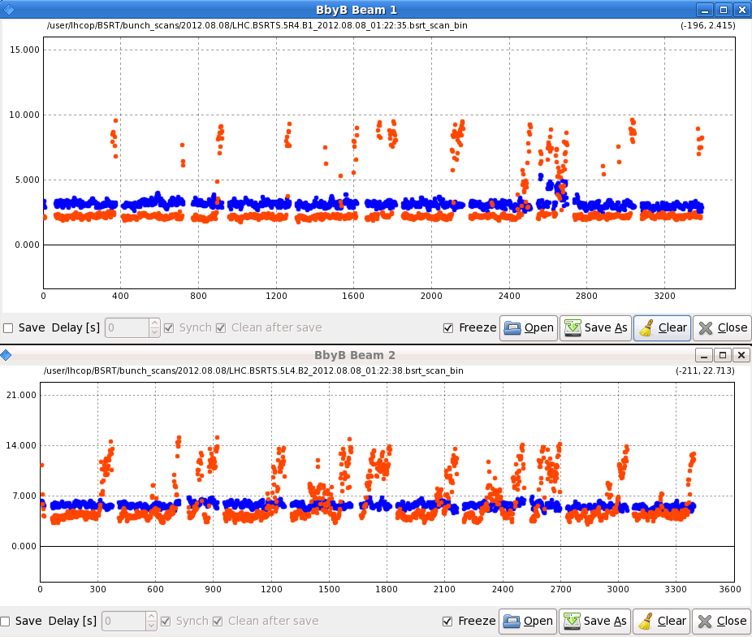
2927 Beam sizes

Slide 17
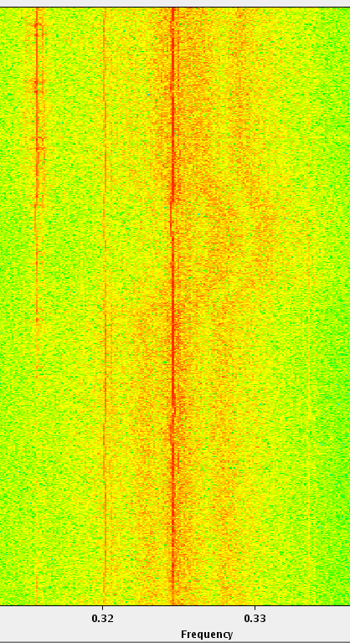
2933 Beam 2 vertical tune

Slide 18
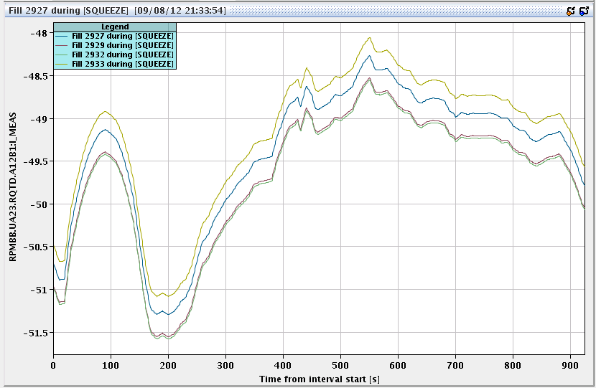
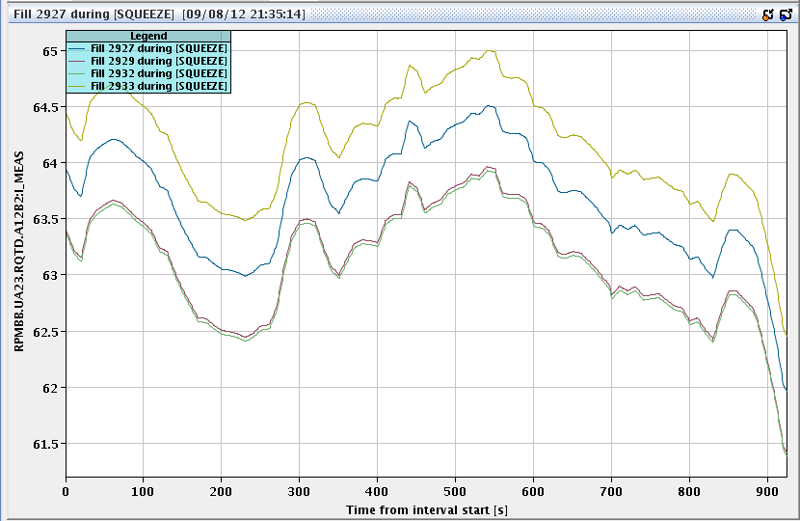
2933 QTD squeeze functions
2933
Now manually checking these as well… (QFB in ramp issues)

Slide 19
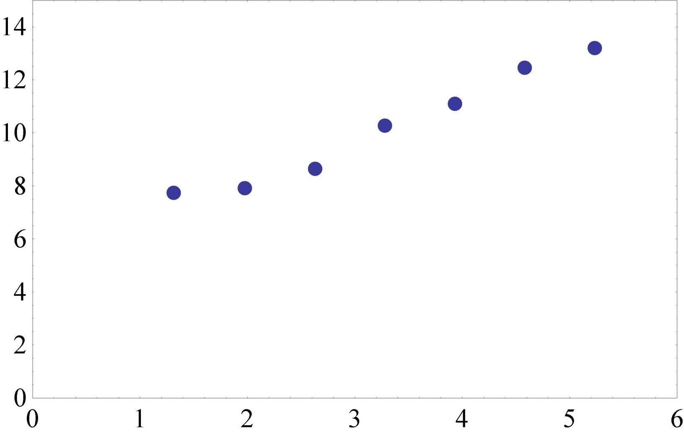
Luminosity lifetime – fill 2932
Octupoles, Q’ reduced
Systematic reduction of octupoles/chromaticity once in collisions

Slide 20
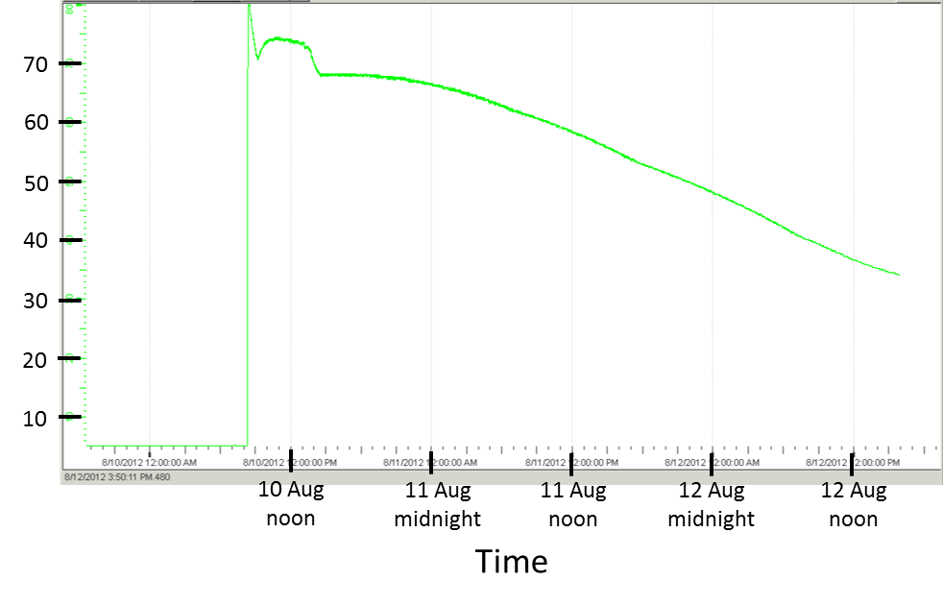
CMS magnet status
c/o Greg Rakness
Temperature (K)
Fast dump
Cause of magnet fast dump is under review. Details will be communicated as they are understood.
Estimated time of CMS “Ready for physics”: sometime Tuesday night (including time for He refill) → to be confirmed Monday

Slide 21
Machine development POST CMS SOLENOID ABORT
Friday morning++

Slide 22
Machine development program
Friday take beam for polarity checks – intervention in SPS for wire scanner repair (back around midnight)
Sat AM: test ramp for chromaticity measurements through the cycle
Sat 12:00 New SPS optics Q20 in SPS
Transfer and injection checks into the LHC
Take beams through the cycle
Sun AM: High intensity tests with normal setup
Sun PM: Transverse damper tune measurement tests
Sun night: Physics
Mon & Tue: Switch ALICE polarity & increase ALICE crossing angle
24 hour program (injection, tertiary collimators through the cycle, loss maps)

Slide 23
Polarity checks
MO polarity check:
applied trims to the MO family by family (32 in total) and observed the shift in Q'' with respect to reference measurements of the nominal machine performed at the start and end. Observations seem to agree with what we expected from the madx predictions for all the families. This will be confirmed offline.
MCO polarity check:
Powered the MCO family by family (7 for B1, 5 for B2) to k=-30. Observed the Q'' shift for each case. Will confirm the polarities offline but didn't notice any that were wrong during the measurement.
KSS:
performed AC dipole measurements with the A12 KSS family for beam1 and beam2 powered to k=+0.5. Kicked at +-80Hz and observed shift in coupling well outside the error bar. More analysis offline..
Rogelio & team

Slide 24
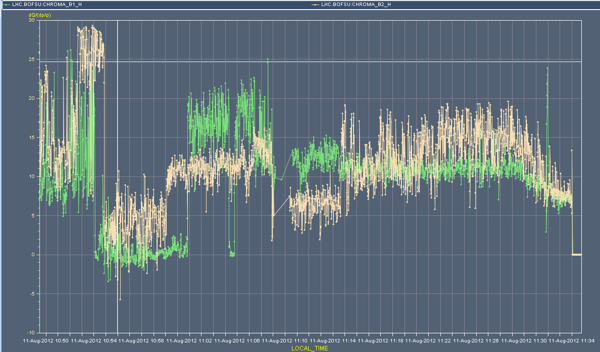
Chromaticity at the end of the week - H
Flat top
Squeeze
Collide

Slide 25
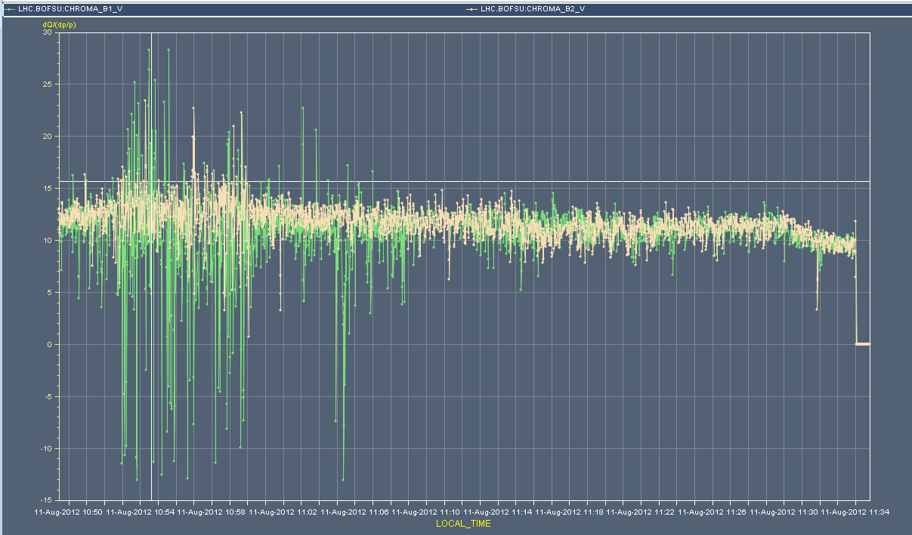
Chromaticity at the end of the week - V
Flat top
Squeeze
Collide

Slide 26
Stability investigations 1/2
At flat-top with ~2.16x10^14 p(B1) a ~2.12x10^14 p(B2) and for chromaticity of 11 in both planes
could reduce the octupoles to 200 A with no sign of instability
(during this process we kept the chromacity constant by trimming the chromaticity according to the tables established earlier)
Went through the squeeze with octupoles at 540 A and chromaticity of 11.
Some incoherent losses but no sign of instability.
Gianluigi Arduini et al

Slide 27
Stability investigations 2/2
End of the squeeze with 2.13 p(B1) and 2.05 (B2)
Could reduce the octupoles to 200 A with no sign of instability
Trimmed the octupoles to 312 A:
Chromaticity H could be reduced to 5 units with no sign of instability
Chromaticity V could be reduced to 7 units - vertical instabilities on selected bunches – heavy losses – end of 144b trains
Trimmed the octupoles to 428 A:
Chromaticity V could be reduced to 5 units and in that case the beam become unstable with losses at the end of the 144 trains

Slide 28
Q measurement
Filled Machine with 6x6 bunches for each beam, bucket 1 and 651, both beams.
Kicked the first 6 bunches of both beams and planes for 4 turns every 4 seconds during entire cycle from prepare for ramp to collisions; recorded oscillation transients for computation of tune.
We did not change the excitation tune during the squeeze (kept the injection setting), the system was tracking correctly the tune change during start of squeeze. Increased losses during squeeze due to the blown-up 6 bunches that were kicked. Emittance of the 6 not kicked bunches remained small.
Wolfgang Hofle: We are quite confident the tested method can be used as an operational method to measure the tune. Daniel and Frederic Dubouchet did a great job so everything worked very smoothly.
Wolfgang Hofle, Daniel Valuch, Frederic Dubouchet

Slide 29
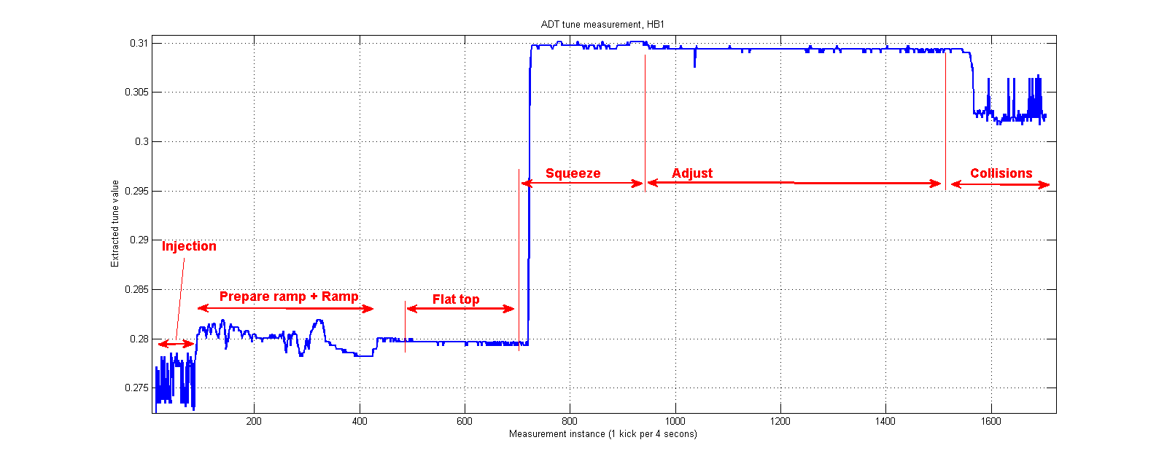
ADT tune measurement test

Slide 30
Incoming
Alice polarity flip
Reference orbit
Injection
Collimation through cycle
Loss maps
[Stability investigations continued
Batch to batch to blow-up
Split collision BP]
Back to physics when CMS ready

