Slide 1
Saturday 11th August
08:30 LHCb polarity flip test ramp dumped by tripped of LHCb dipole
Test ramp OK
LHCb dipole now negative
Dipole tripped on Bridge B:cooling (again) – definitive solution next week (Hugues Thiesen)
10:30 test ramp for chromaticity measurement
Pilots through ramp, squeeze, collide to check after large increases last week (see blow)
11:30 pilots dumped
12:30 Beams back in for Q20
Transfer line optics
Dispersion measurements…

Slide 2
Q20
Measured Dispersion in TI 8 for Q20 optics
Some problems to get the beam down the line because of the function of an RBI that was trimmed to "zero" (not seen immediately because all interlocks were masked)
Dispersion measured and agreement with model even better then for Q26 optics: Horizontal = 0.1 m^1/2, Vertical = 0.04 m^1/2
All interlocks were updated for Q20, masks removed.
Injection of 6 bunches and steering
Injection of 36, 72 and 144 bunches all fine: injection oscillations and losses in injection region < 10%
Injected 4 pilot bunches for both beams, switched RF off for ~ 1 hour and pulsed the MKI for measuring losses of debunched and uncaptured beam at the TDI
Losses at TDI: 1.9642 for B1 and 1.152 for B2

Slide 3
Q20
Filled the machine with both beams, short bunches: losses and injection oscillations fine.
Filled the machine with B1 (long bunches), B2 was dumped during injection because of the TDI going to fault:
RD-LVDT moving towards the limits, similar to "heating" (?) observed at the beginning of the year (see entry 66 in this shift). Losses and injection oscillations during the fill ok for both beams.
Injected 144 bunches for both beams, waited for 20 minutes to see any emittance blowup, injected second batch and then tried to move the TDI out but the beam was dumped again (from timber no evidence of crossing the limit)

Slide 4
Q20
The LVDT of the right jaw of TDI in IP8 has to be recalibrated, no more centered wrt threhsold since august 8th (electronics replaced?)
Piquet contacted – wrong references for MDC – being corrected now
Finally two 144 batches injected and ramped and squeezed
high bunch intensities - ~1.58e11
07:50 beams dumped by OP

Slide 5
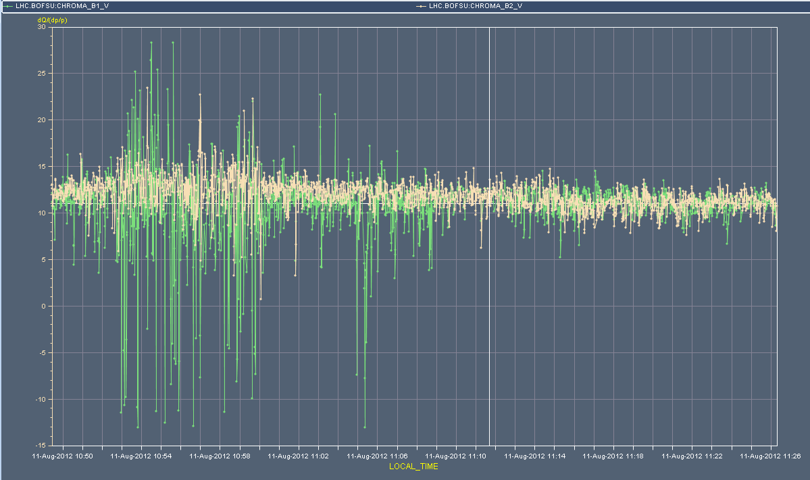
Vertical chromaticity – flat-top and squeeze

Slide 6
Plan for the coming days
Sat AM: test ramp for chromaticity measurements through the cycle
Sat 12:00 New SPS optics Q20 in SPS
Transfer and injection checks into the LHC
Take beams through the cycle
Sun AM: High intensity tests with normal setup
Sun PM: Transverse damper tune measurement tests
Sun night: Physics
Mon & Tue: Switch ALICE polarity & increase ALICE crossing angle
24 hour program (injection, tertiary collimators through the cycle, loss maps)

