Slide 1
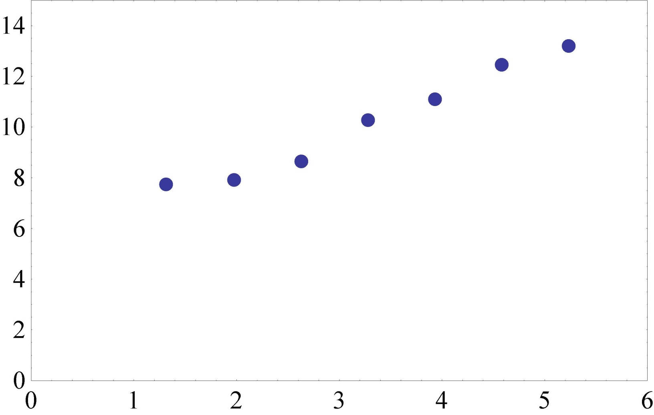
Luminosity lifetime – fill 2932
Octupoles, Q’ reduced

Slide 2
Thursday 9th August - morning
11:52 Fill 2932 dumped by Faulty electrical distribution on network switch
SIS dumped the beam due to communication time-out
103 pb⁻¹ in 6h26m, peak lumi 6.63e33 cm-2s-1
12:30 Access
ATLAS,
di/dt intervention at point 4,
RAMSES reset point 7,
TDI inspection point 8,
LBDS controls intervention point 6
BI at point 4.
ALICE and CMS also went in.
16:30 Start pre-cycle

Slide 3
Dump of 2932
Report by Alastair Bland (BE/CO) and Gyorgy Balazs (IT/CS) on the electrical problem that caused the LHC SIS to dump the LHC Beam at 11:53.
Three Multiprise in the IT/CS Starpoint and one in the CCR lost power, all due to 30mA differential protections.
The equipment connected to the Starpoint Multiprise was the CESAM IP7 switch + other systems with dual sources of power that were not lost.
The equipment connected to the CCR Multiprise was much more important:
IP91 for the Technet
IP71 for the General Network
On IP91 there are:
CS-CCR-NQPS* (all New QPS)
-CS-CCR-CIS/CIRCUIT/CMW4/OAS1/OASIS1/QPSM/RADE2/TIM1/TIM11/TIM12/TIM6/VACLHC
On flipping up the Multiprise breaker around 12:20 power returned but was lost in about 2 minutes. At this point it was noticed that the IP91 switch and the Reserve Power Supply were on the same Multiprise which explains why IP91 was lost, normally power input should have been redundant. This has been fixed now by Gyorgy.
After that around 14 machines still had no network. It was found the the BE/CO Blade enclosure switch for CS-CCR-NQPS/TIM1/TIM6/CIS/DIAM3 did not work. After a reset it worked.
Karsten Kahle had many years ago lent BE/CO and IT/CS some electrical transient recorders. By chance one of them was on one of the Multiprise that tripped… some indications of effects of 18 kV cable testing in SPS

Slide 4
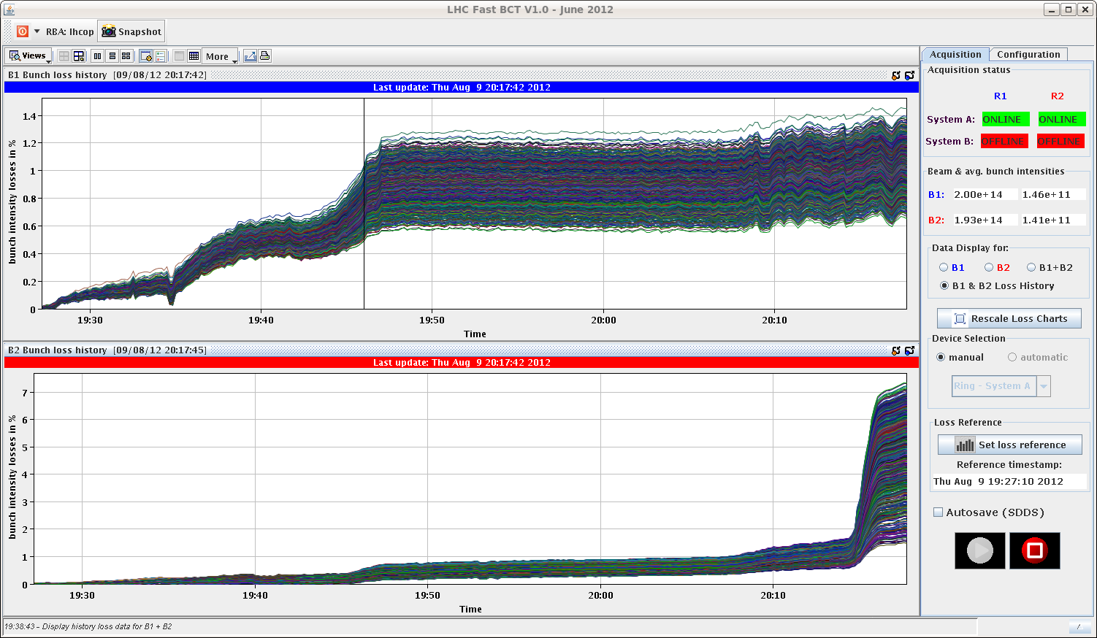
Thursday evening
~18:00 Inject, ramp 2933 – no problem
Heavy losses on beam 2 end squeeze – no sign of coherent instability
Appears high vertical tune, plus bump in function plus sidebands, high chromaticity – pushing beam on to 1/3 order resonance – see below

Slide 5
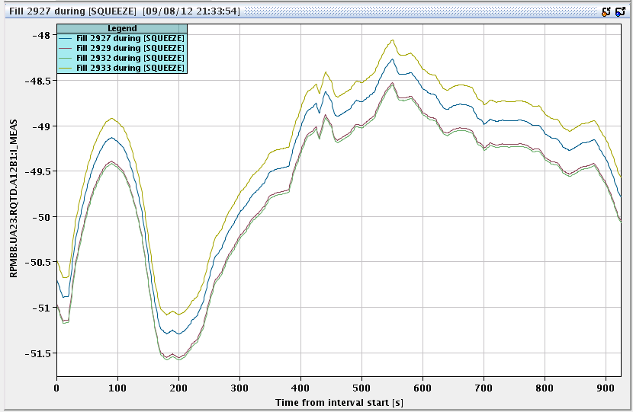
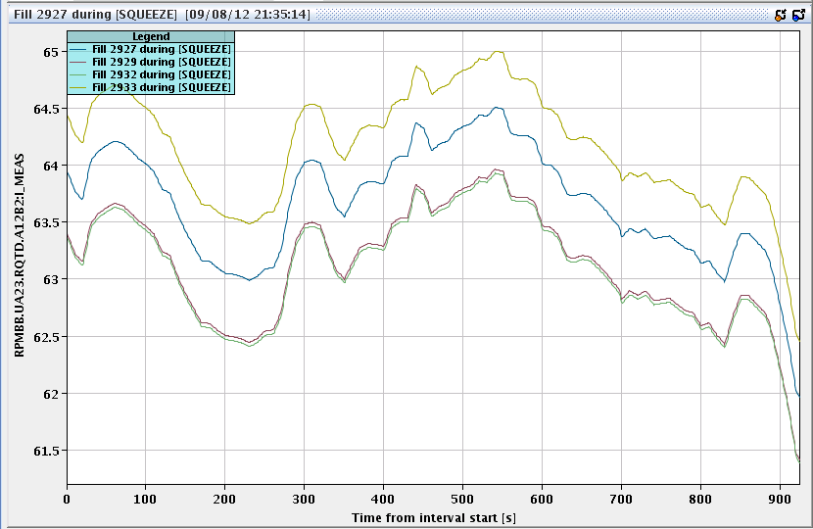
QTD squeeze functions
2933
Now manually checking these as well… (QFB in ramp issues)

Slide 6
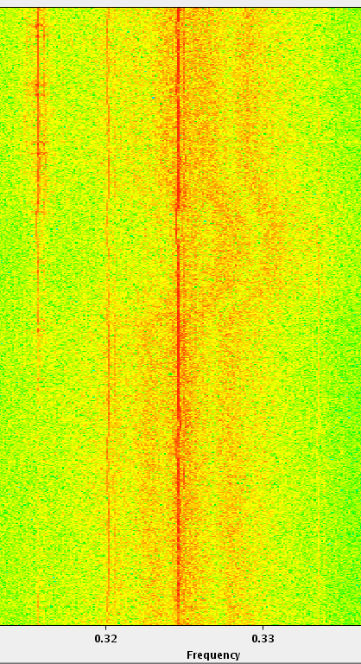
Beam 2 vertical tune
From whence cometh the sidebands?
Long-term coherent synchrotron oscillations?

Slide 7
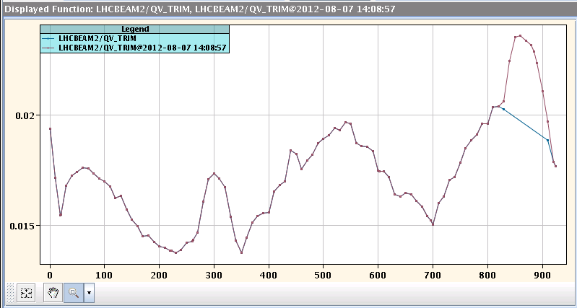
Beam 2 – vertical tune function in squeeze

Slide 8
Thursday night
22:00 injecting for physics again
23:25 Stable beams #2934
Initial lumi 6.47 cm⁻²s⁻¹
Now routine adjustment of Q’ and octupoles once in collisions
Decrease of the chrom in V had a positive effect on beam 1 life-time and the decrease of the octupole on beam 2 life-time.
Beam 2 still very sensitive to any orbit correction/ lumi scan
23:56 LHCb called to announce 1 fb⁻¹ recorded
(Alice luminosity low)

Slide 9
Incoming
Beams just dumped – CMS solenoid
130 pb⁻¹
Octupole polarity check (~4 hours)
LHCb polarity flip
Test ramp – also to be used for ADT tune measurement test

Slide 10
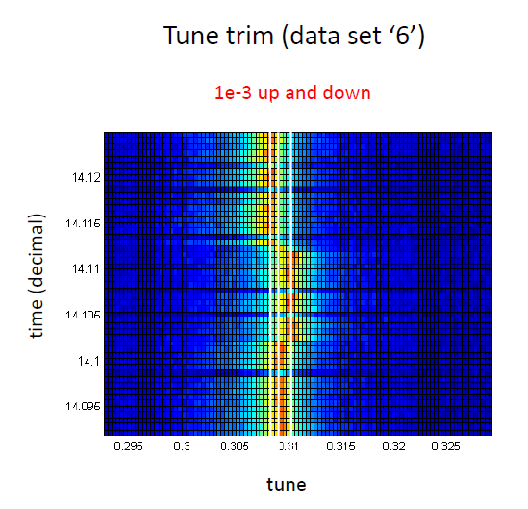
ADT tune measurement
Wolfgang Hofle

Slide 11
Wolfgang Hofle

