Slide 1
Tuesday 7th August - morning
07:10 Reinjection after loss of fill 2920 to UFO near ALICE
26 pb⁻¹ in 1h16m; peak lumi 6.4e33 cm⁻²s⁻¹
08:10 dump at 450 GeV when moving out injection protection at pt 8
first to be a UFO. However, subsequent TDI position faults show that the loss was due to the TDI jaw not moving correctly, and one edge of the jaw going close to the beam. (Stefano)
Some delay to TDI – reset required
CHANGE OF PLAN – SWITCH OCTUPOLE POLARITY
Simple flip at 450 GeV (6.5 A)
417 A at flat-top & squeeze;
down to 300 A in collision BP

Slide 2
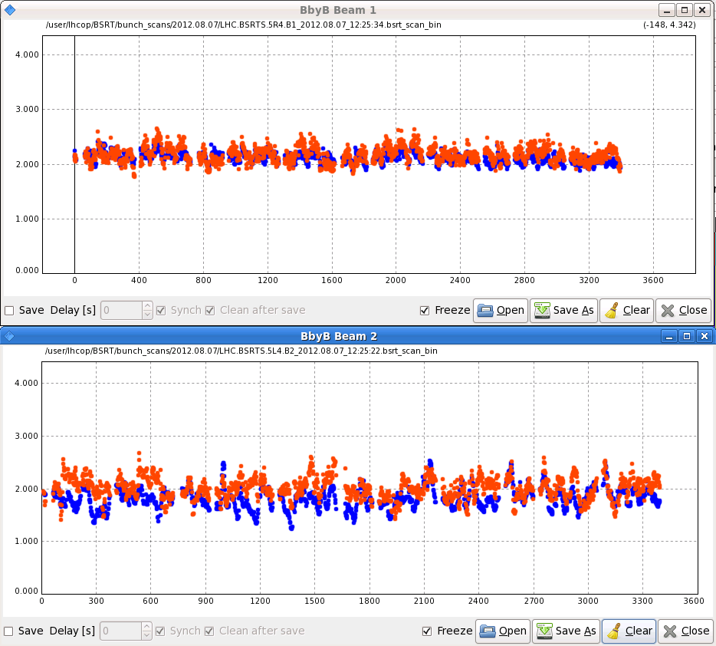
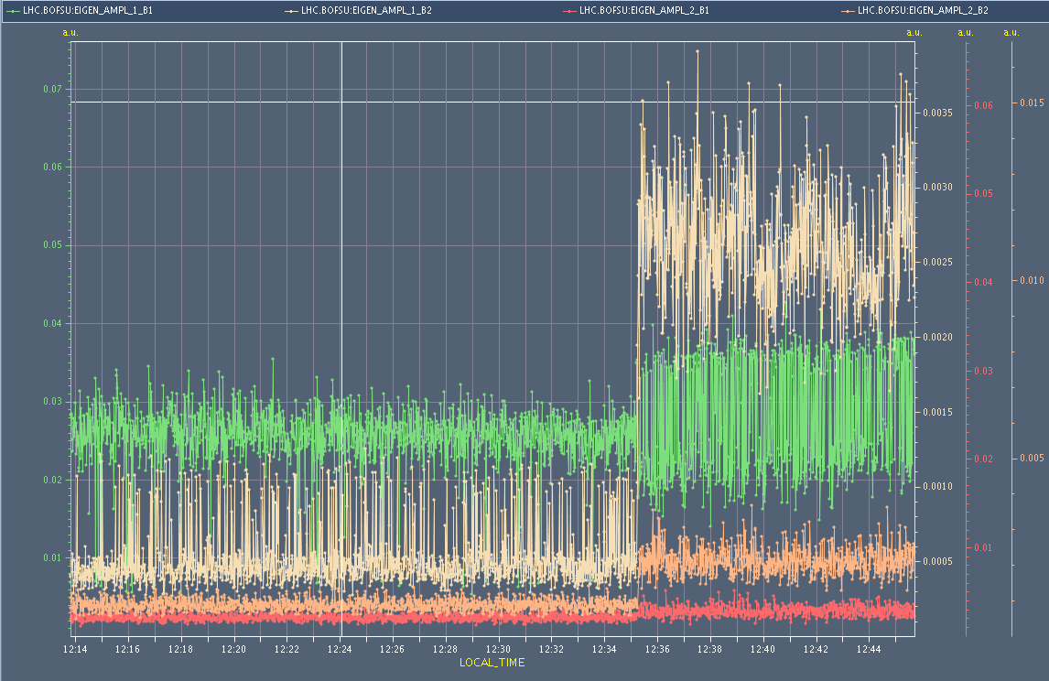
Step 1
Switch polarity at injection and inject full complement of 1374 bunches
Octupoles on at ±6.5 A
No signature selective blow-up seen
Dampers reduced gain - ditto

Slide 3
Step 2
14:00 Test ramp with pilot bunches
Anticipatory Q’ trims performed (up to 12 units at 4 TeV)
Thanks to Daniel and Themis – adjust of phase loop gain to avoid problem with RF modulation/low bunch intensity
Reasonable Q’ measurement through ramp, squeeze and collide as a result.
Chromaticity measurements fed-forward into settings, aiming for:
+2 at 450 GeV
Increasing to + 5 at end of ramp, through squeeze, and into collision
15:15 Beams dumped

Slide 4
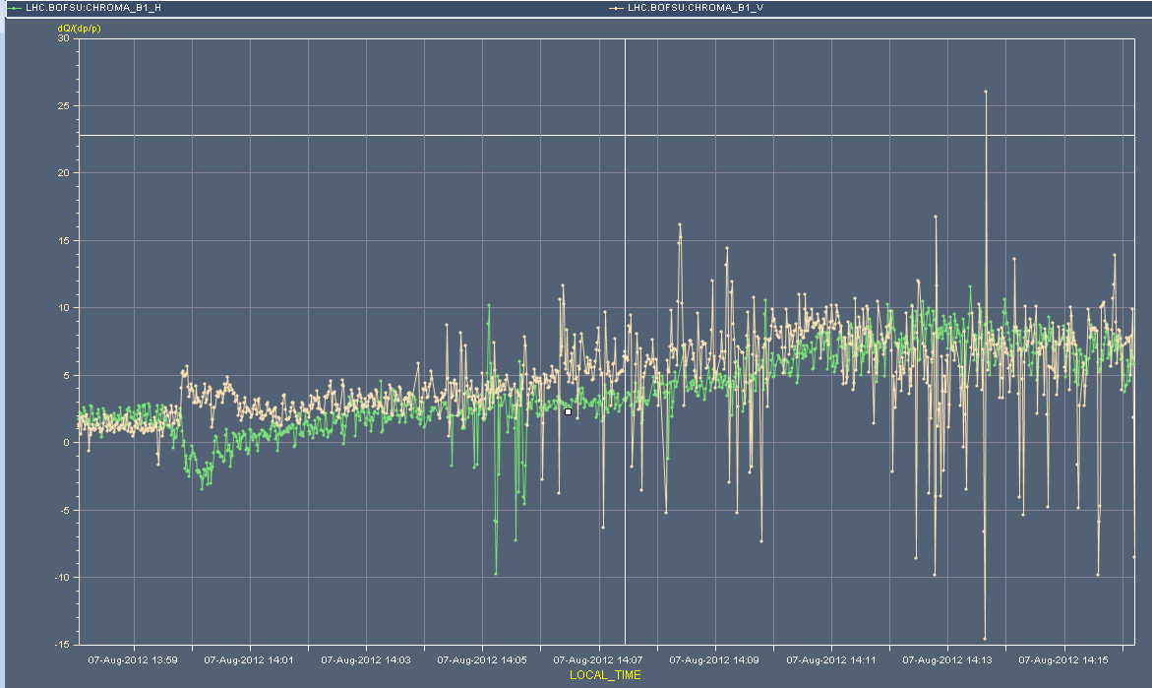
Chromaticity – beam 1 ramp

Slide 5
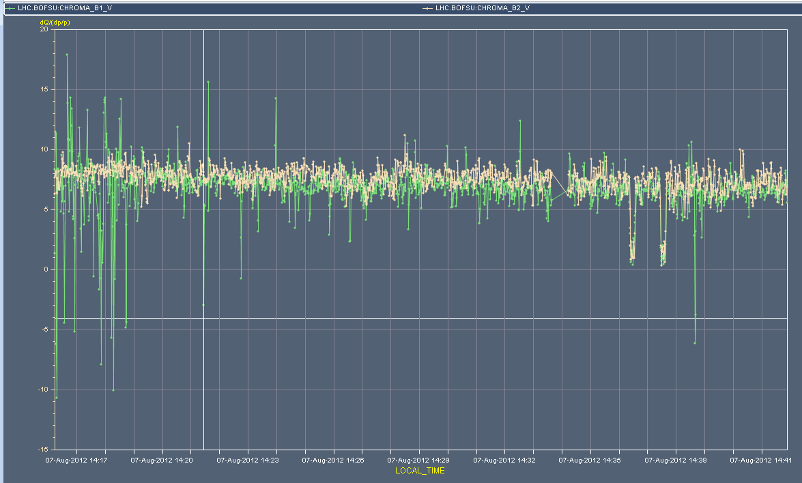
Chromaticity – Vertical B1/B2 – flat top
Decay at 4 TeV

Slide 6
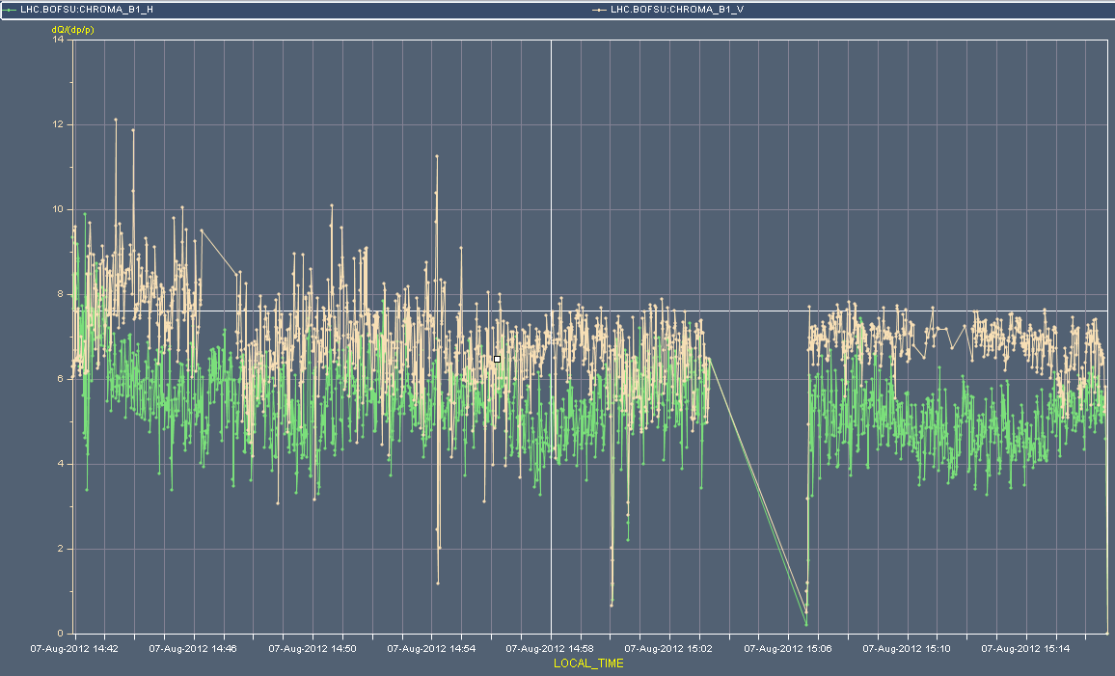
Chromaticity – beam 1 – squeeze & adjust

Slide 7
Step 3
Ramp with 12 nominal bunches – smooth
Beams dumped 18:10

Slide 8
Step 4
Ramp, squeeze, collide, optimize with 480 bunches
Sensible bunch intensities
Ramp, squeeze, collide – no major issues
Tune scan
Stable beams for an hour
Reduce octupoles in Adjust at end-of-fill

Slide 9
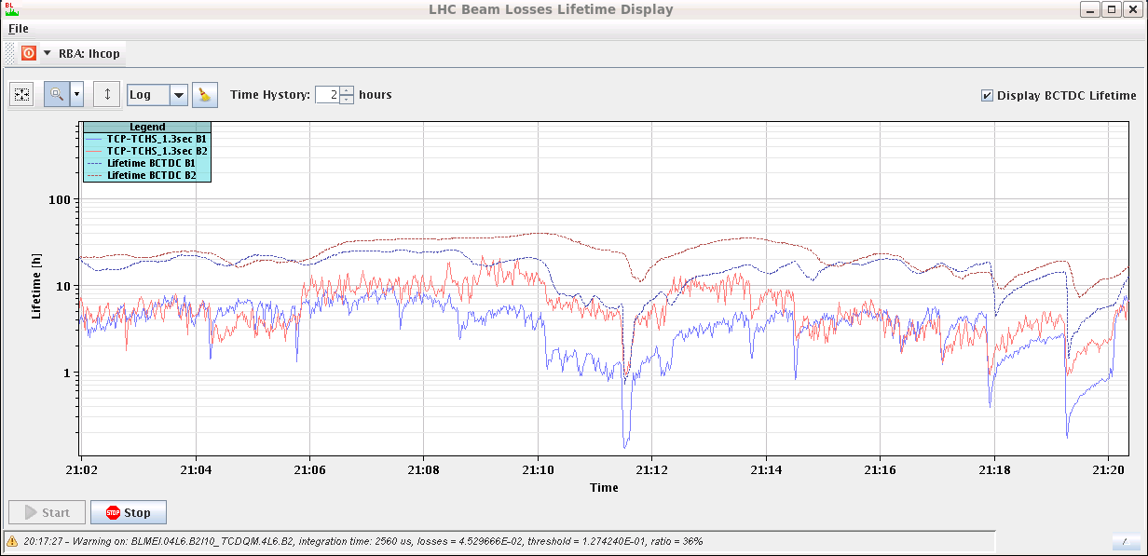
Tune scan at start of collisions
Steps of 1e-3 both planes, both beams
Initial tune +3e-3 with respect to end squeeze (~nominal settings)
Given below – this tune increase in collision beam process removed
-1e-3
-1e-3
-1e-3
-1e-3
etc..

Slide 10
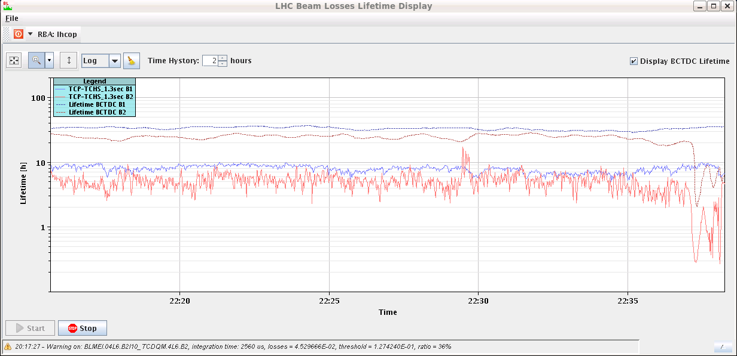
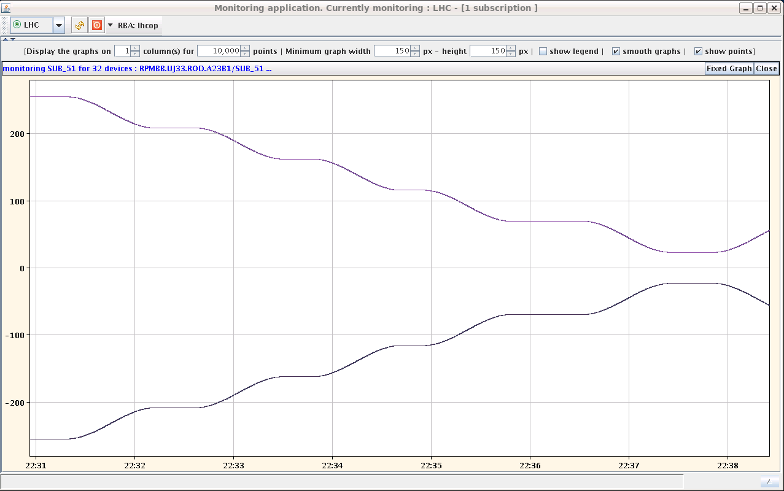
Octupole reduction with 480b
Beam lifetime
Octupole current

Slide 11
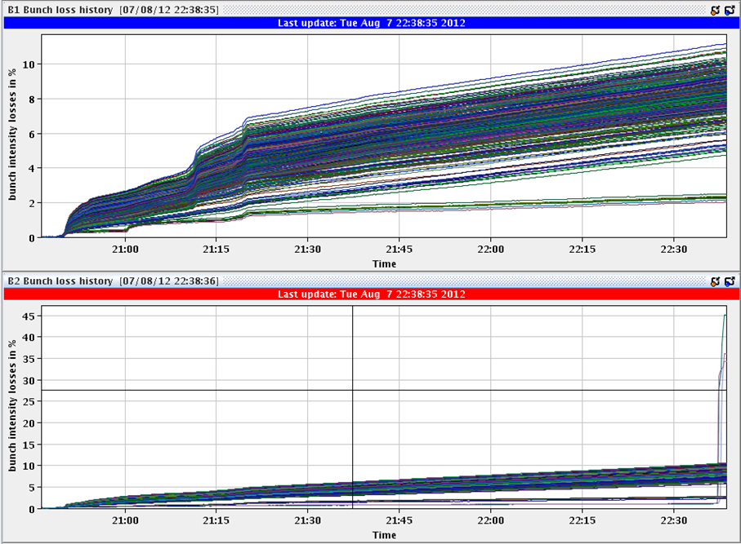
Octupole reduction – beam loss
3 non-colliding bunches go walkies at 23 A

Slide 12
Step 5
Physics fill with 1374 bunches
<Bunch intensity> ~1.47e11 at 450 GeV
Smooth ramp and squeeze
Also enjoying effect of reduced emittances from injectors
Just after end of squeeze - strong vertical instability
Clear visible on BBQ FFT at tune, beam 1 first
Supressed by frantically increasing chromaticity
Q’ trim H+2 V+6 B1/2

Slide 13
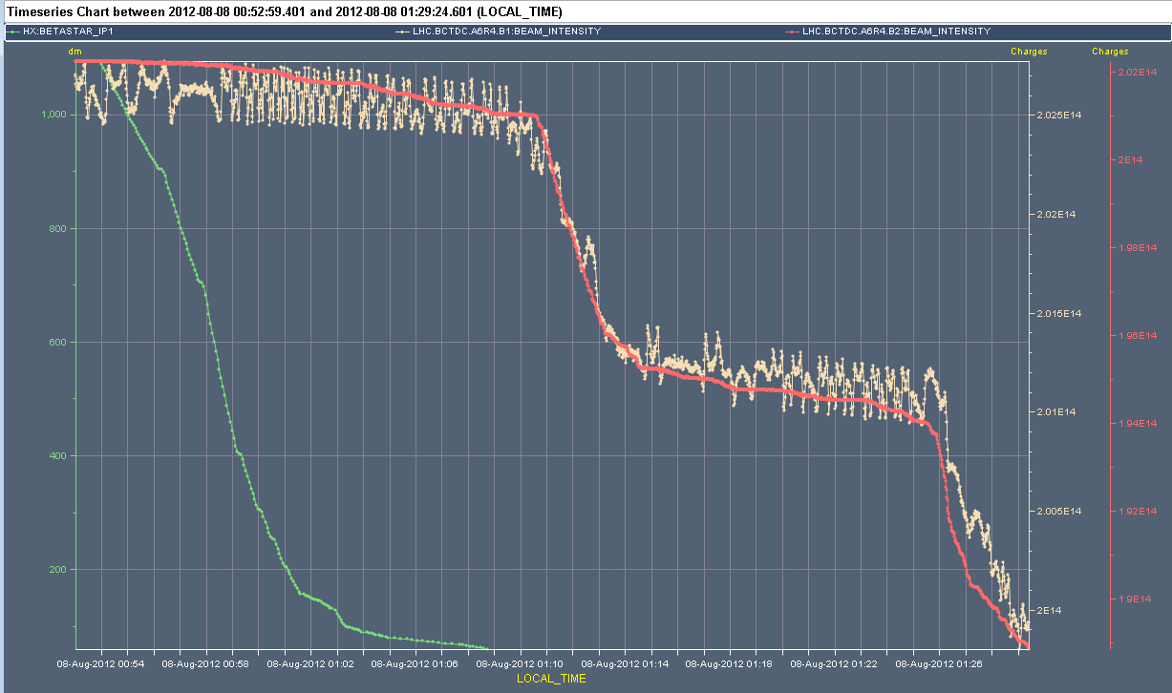
Beam loss – end squeeze

Slide 14
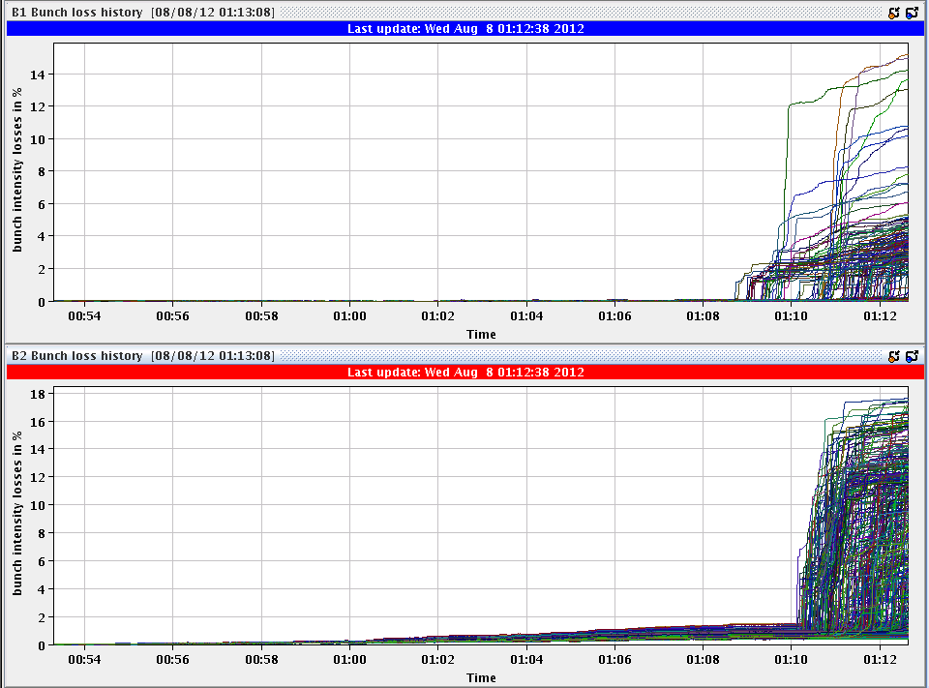
Beam loss – end squeeze

Slide 15
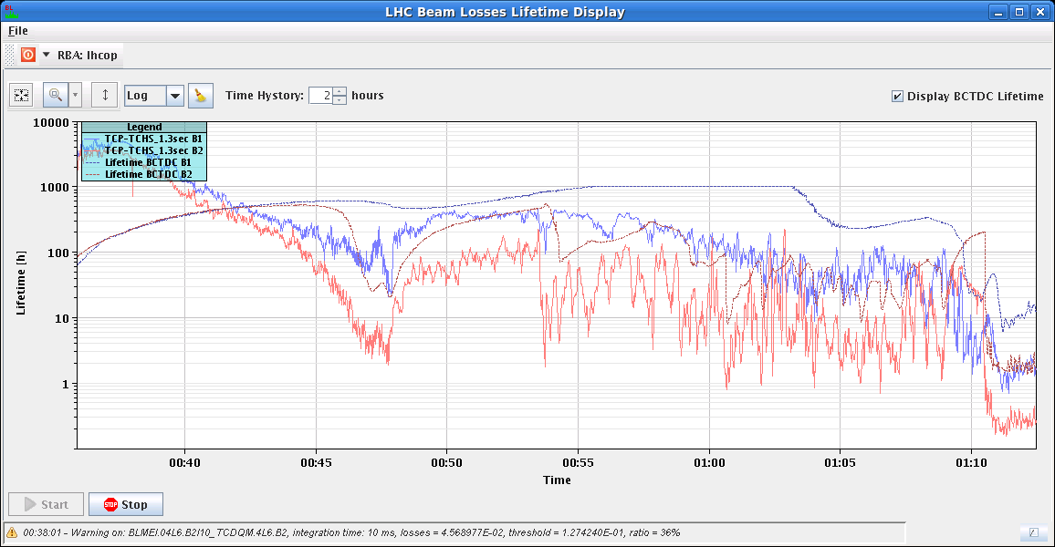
Lifetimes through squeeze and adjust

Slide 16
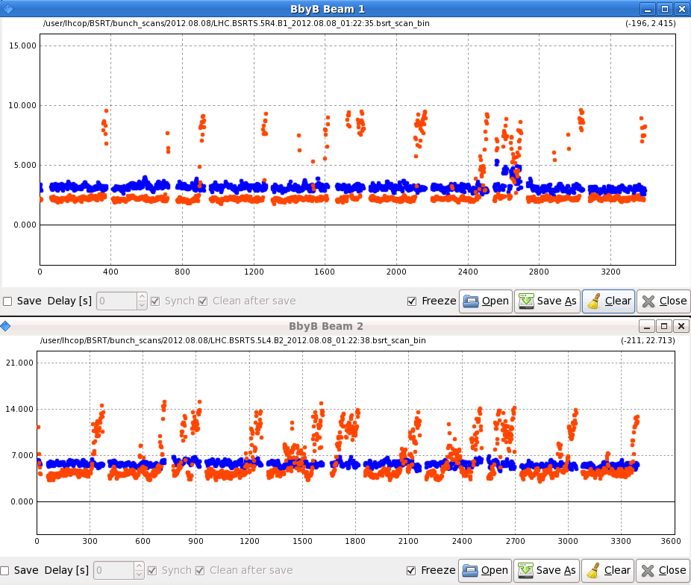
Beam sizes

Slide 17
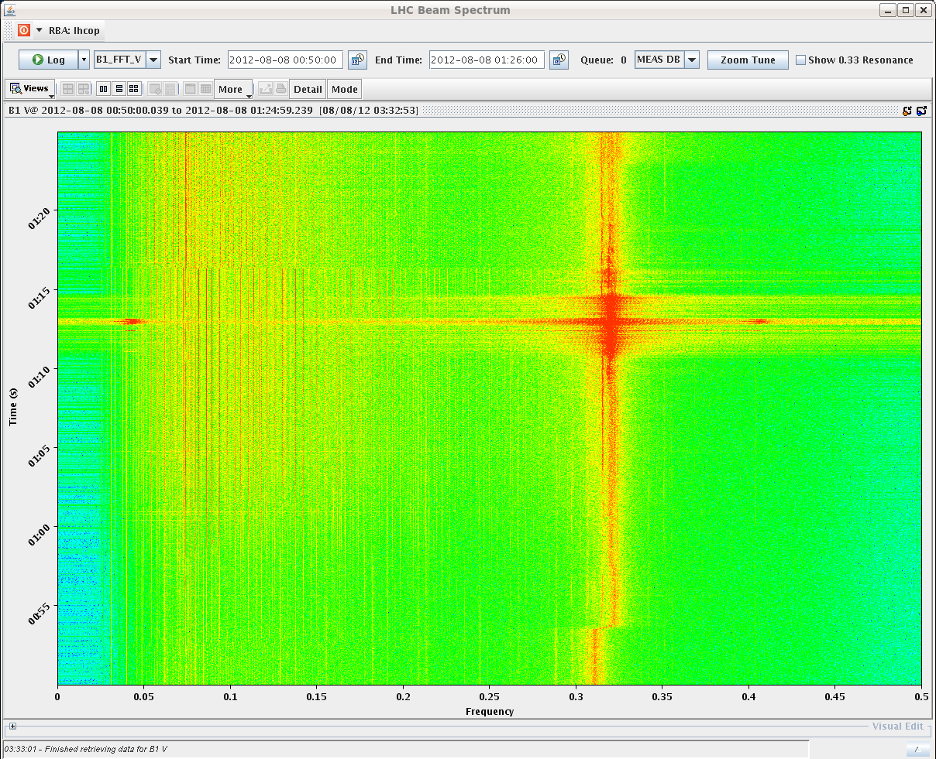
Tune – B1V

Slide 18
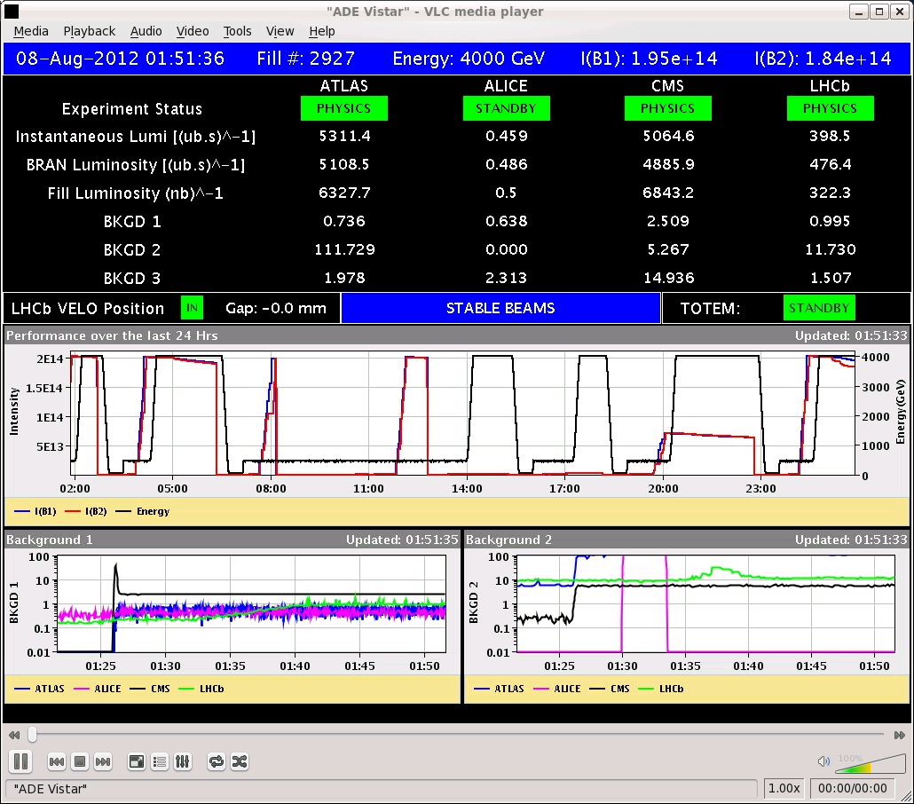
Start of fill 2927

Slide 19
Step 6
Increase octupoles to 475 A
reverse polarity, from 417 A
Bump up vertical chromaticity in squeeze to around 7
Try again… today

Slide 20
Misc
OFSU crashed 3 times during the shift
SPS intervention (EDF) Thursday 10:00 for 2-3 hours
TOTEM – third third of fill test incoming
Access list developing
Markus Z. – point 4 – di/dt
N. Magnin – LBDS
RP – RAMSES reset
Ralph S. – UA47 and tunnel

