Slide 1
Friday 10th August & night
08:20 dump fill #2934 due to CMS solenoid emergency ramp down. Integrated lumi 133 pb-1
Fill two pilots for octupole circuits polarity check
10:15 Start SPS wire scanner exchange
10:15 Octupole polarity checks with pilots
19:58 Beams dumped
01:30 SPS kickers conditioned and ok but PS 40 MHz cavity down
03:37 Injecting probes
05:24 Ramp with LHCb polarity switched to negative, CMS solenoid off
07:00 Optimising collisions
08:35 Beams dumped, LHCb dipole tripped

Slide 2
CMS solenoid
Failure in solenoid cryogenics system, stopped the cold box.
During reconnection something went wrong, leading to a fast discharge of solenoid magnet
Temperature up to 70 K
Will need 4 to 5 days to get back in operation
In this period try to do the maximum of operational development work and only few physics runs

Slide 3
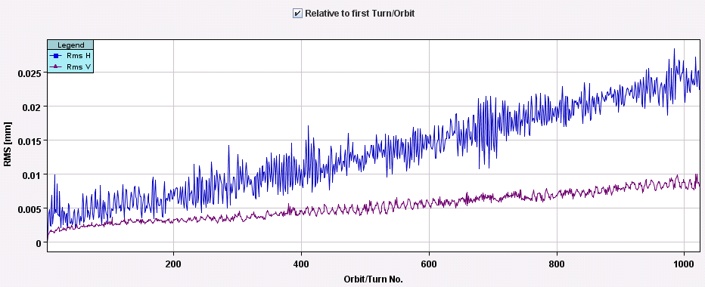
The dump
Losses developed during over > 100 sec, orbit deviating
Finally dumped on BLM reduced HV interlock in SIS
Markus Z. started to look at putting the solenoid in the PIC
Originally expected to have little effect on the beam...

Slide 4
Octupole polarity check
-> Octupole circuits (MO) polarity check: We applied trims to the MO family by family (32 in total) and observed the shift in Q'' with respect to reference measurements of the nominal machine performed at the start and end.
Observations seem to agree with what we expected from the madx predictions for all the families. This will be confirmed offline.
-> Octupole corrector (MCO) polarity check: Powered the MCO family by family (7 for B1, 5 for B2) to k=-30. Observed the Q'' shift for each case. Will confirm the polarities offline but didn't notice any that were wrong during the measurement.
-> Skew sextupole (KSS) check: performed AC dipole measurements with the A12 KSS family for beam1 and beam2 powered to k=+0.5. Kicked at +-80Hz and observed shift in coupling well outside the error bar. More analysis offline. Following these kicks there wasn't enough beam left for us to do any more and we have finished for the day. Plots of the coupling shift are in the OMC logbook.
Rogelio and large team

Slide 5
LHCb reverted polarity
LHCb dipole flipped to negative
Injected 3 x 6 bunches each beam to check collisions
Collisions optimised, everything seems ok
Dumped by LHCb dipole trip
????

Slide 6
Plan for the coming days
Sat AM: test ramp for chromaticity measurements through the cycle
Sat 12:00 New SPS optics Q20 in SPS
Transfer and injection checks into the LHC
Take beams through the cycle
Sun AM: High intensity tests with normal setup
Sun PM: Transverse damper tune measurement tests
Sun night: Physics
Mon & Tue: Switch ALICE polarity & increase ALICE crossing angle
24 hour program (injection, tertiary collimators through the cycle, loss maps)

Slide 7
Demands for access
Non urgent
Viliam Senaj, UA point 6 (take out spare generator, 30 min)
Christos, Diamond BLMs scope UA87 (30 min)

