Slide 1
Monday 6th August & night
04:20 SPS extraction kicker problem - access in the mean time. ALICE solenoid fixed.
13:00 Pre-cycle by running nominal ramp with reduced octupole currents in the ramp.
15:00 Injecting physics beams fill #2917.
16:21 With squeeze finished, beams dumped due to ALICE interlock. ALICE BCM dumped with values 300 % of threshold. Expect UFO.
17:48 Injecting for physics, fill #2918 19:07 Stable beams. Low initial lumi's of about 4.5e33 cm-2s-1 due to blow-up of bunches at the end of ramp with octupoles at 150 A.
00:24 Operator dump. Integrated lumi around 68 pb-1.
02:41 Fill #2919. Beams unstable throughout the squeeze. Lost on HV BLM
05:05 Fill #2920 Stable Beams. Lumi’s around 6.3e33 cm-2s-1 (!), although some losses in squeeze.
06:20 Dump due to ALICE BCM. UFO…
08:10 Fill #2921 Dumped start of ramp.UFO: BLMQI.03R8.B2e10_MQXA

Slide 2
SPS Extraction kicker MKE4 – 9 h 21 min
From Laurent Ducimetière and Volker Mertens:
MKE4 system #1 was switching on with an unstable delay of up to 2 µs, which had activated the interlock of the fast pulse surveillance.
All stages from the timing to the thyratron main switch were checked; the latter was finally diagnosed as causing the fault.
The normal procedure foresees exchanging the faulty switch against the spare. The spare switch is presently used in 867 for the conditioning of the spare MKE magnet; its preparation and transport to ECA4 had been launched.
Acknowledgements to EN-HE for the handling efforts.
In parallel the faulty switch was opened in situ for in-depth investigations. A bad contact was found on a soldered resistor on the thyratron bias circuit. After redoing the soldering the switch was successfully tested and put back in operation.

Slide 3
Access in the morning
Vacuum: repaired TPG at Pt 4
Cryo: replaced magnetic bearing box at pt 8
EPC: replaced RD2.R5 sub-converter
ATLAS: Access for intevention on muon system gas distribution
ALICE solenoid: problem idendified on thyristor, and corrected (polarity issue)

Slide 4
Fill #2917
Different from last night:
Octupoles reduced to 150 A at end of energy ramp, compared to 300 A. Test to prepare for octupole polarity change.
Damper gain brought up again in Adjust, as the low damper gain caused beam losses while going into collision in the previous two fills.
Average bunch intensity 1.49e11 p/b.
Result
Up to 10 % losses at the beginning of the squeeze, most likely due to the lower octupole strength.
At end of squeeze, before going into Adjust beam dumped by ALICE BCM – 3 x above threshold
Categorize this as a UFO in ALICE

Slide 5
Losses at the beginning of the squeeze

Slide 6
Fill #2918
Repeat with same setting as the previous fill to get certainty about the observations
Again beam unstable end of energy ramp with the octupole current at 150 A.
Beam saved by increasing chromaticities. Especially B1 V, in total +5.
Decide to increase octupole current to 200 A at end of energy ramp for the next fill.
Now more beam losses during squeeze, possible due to blown up bunches during the ramp and very large chroma’s
Low initial lumi’s due to blown up beams, mainly B1 according to BSRT scan.

Slide 7
End squeeze
Start squeeze

Slide 8
Start of Stable Beams: low lumi’s

Slide 9
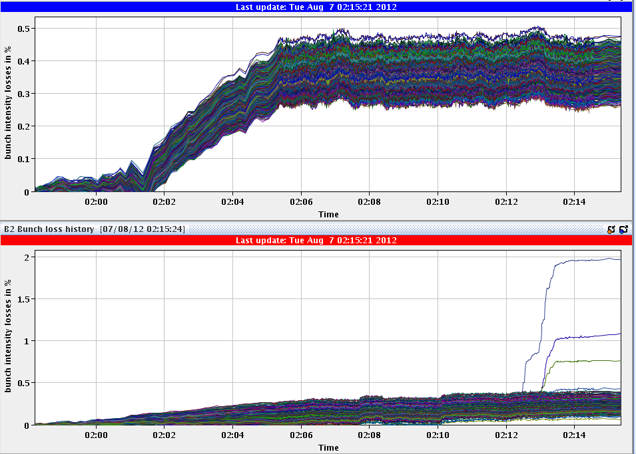
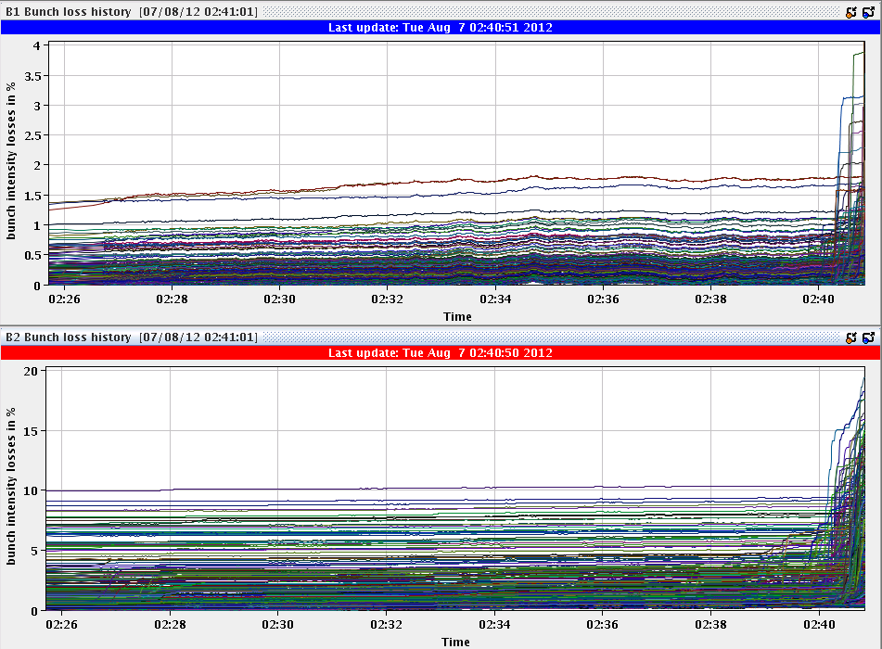
Fill #2919
Some small losses en of energy ramp
Tune trims look at QT currents – improved lifetime
Beam unstable throughout squeeze
This time octupoles were higher at start of squeeze (200 A) and are kept high in squeeze
Lost end of squeeze on BLM HV IP7

Slide 10
BSRT scan: B1 blow up in squeeze

Slide 11
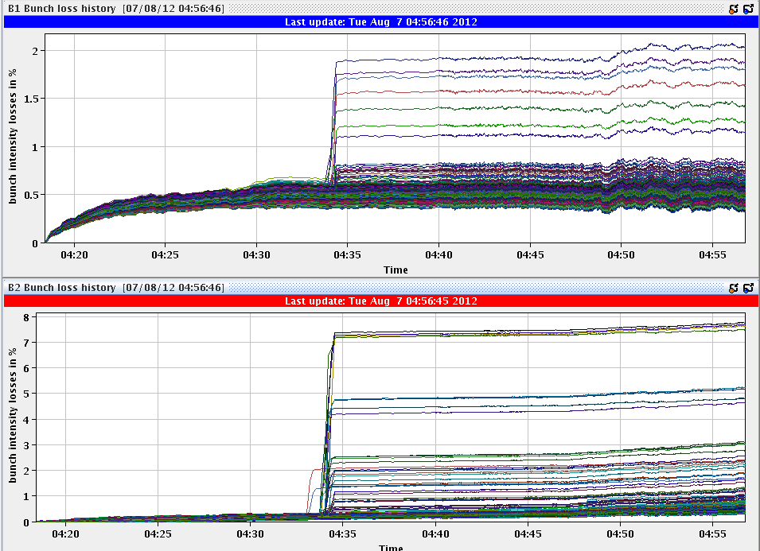
Fill #2920
.... But beam was also unstable, some bunches, during the squeeze.
Start of squeeze
Flat top

Slide 12
Fill #2920
06:20 Lost because of ALICE BCM interlock – like Monday.

Slide 13
ALICE UFO – well possible

Slide 14
The Plan
Do Physics, while preparing the octupole polarity change
Plan for the octupole polarity change
Understand stability problem end of ramp / start of squeeze
Today: test injection with many bunches and high bunch intensities (>1.5e11) with negative octupole polarity. Followed by physics with original octupole polarity. In parallel prepare functions with negative octupole polarity.
Wednesday: Test ramp with two pilots and negative octupole polarity to check tune and chroma all the way up to collision. Pilots not to collide anywhere. Correct chroma functions following the findings.
Stable physics runs with negative octupole polarity, if all goes well.

