Slide 1
Thursday 26th July
13:21 Fill 2880 beam dumped
triggering of heaters on inner triplet R1, closing vacuum valves
118 pb⁻¹ in 9h17m
13pb⁻¹ for LHCb
Initial lumi: 5.5 cm⁻²s⁻¹
From A.Verweij's analysis it looks like RQTX1.R1 tripped and that caused the increase of Ures on the triplet.
We contacted H.Thiesen who will check the PC-PM signals…
QPS SEU suspect – Reiner Denz

Slide 2
Thursday afternoon: access
Cryogenics informed as about a problem with a valve at D4L5 on the DSL line for the main circuits of S45. This valves closes slowly (5%/day) leading to a temperature increase. An intervention needs to be done before tomorrow PM.
Access while triplet investigations ongoing
Given the current situation we decided to prepare access to the tunnel now (close to triplet L5). RP has been informed and will meet cryogenics in about 20min. at PM56.

Slide 3
Thursday evening
17:40 Injection physics beam
Injection optimization by Chiara and Wolfgang
20:20 injecting for physics
Cooling problem effecting MSE – SPS
Ring 1 – booster problems
800 bunches in beam 1, we stop beam2 and finish beam 1 as requested by ALICE
Emittances not brilliant – LHC takes what it can get
21:15 Stable beams #2882
Initial luminosity:
Smooth – lifetime dips to around 1 hour on beam 2 going into collisions

Slide 4
Thursday evening
21:41 Trip of LHCb dipole power converter
BRIDGE B COOLING :FAULT
22:50 ramping up LHCB DIPOLE
23:15 re-injecting
00:40 Flat top
Trimmed B2H tune by 0.002
01:01 end squeeze
Beam 1 horizontal goes unstable shortly after
Trimmed tune B1H by 0.001
Settings issues….
Bad lifetime both beams – beam blown up
01:40 Stable beams .
Beams dumped by temperature of TCP_B6L7_B1

Slide 5
Friday morning
COLLs temperature. Thresholds have been increased by 15 degrees (set to 95). To allow next fill to progress with problems – thanks Stefano
03:00 re-injecting
03:45 OFSU crash on flat-top – thanks Laurette for helping to sort things out
04:30 Stable beams
Initial luminosity 5.4e33 cm⁻²s⁻¹
Moderate bunch currents

Slide 6
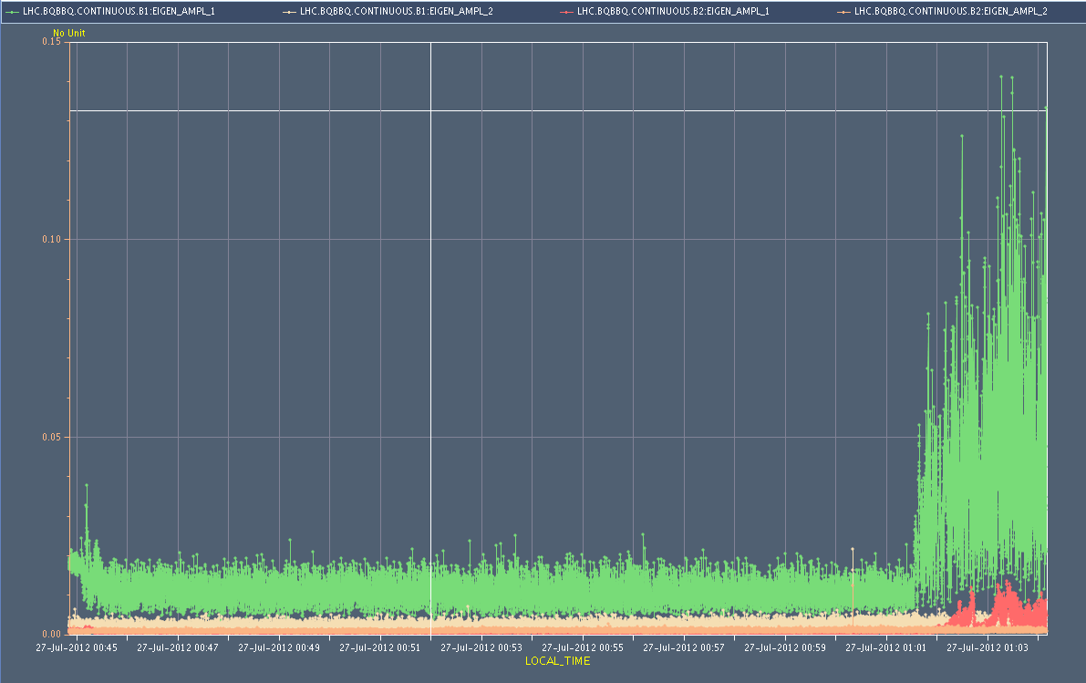
BBQ amplitude

Slide 7
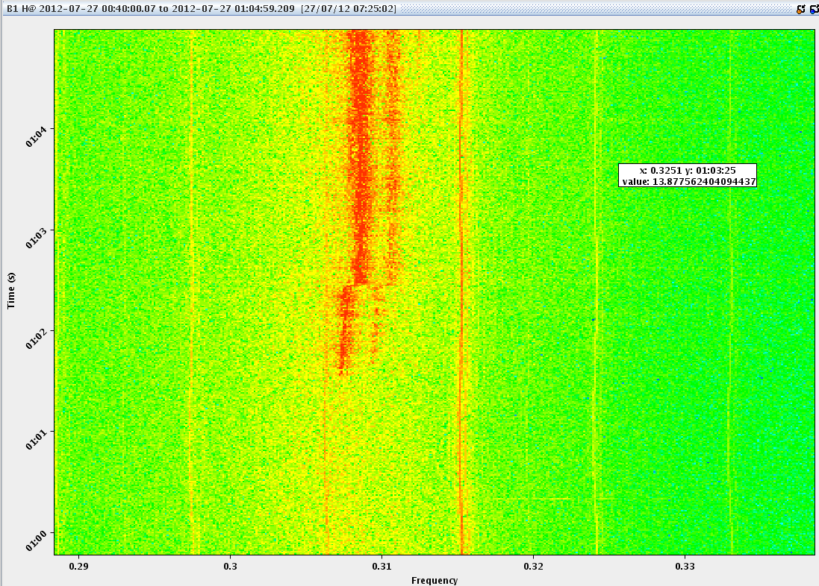
B1H

Slide 8
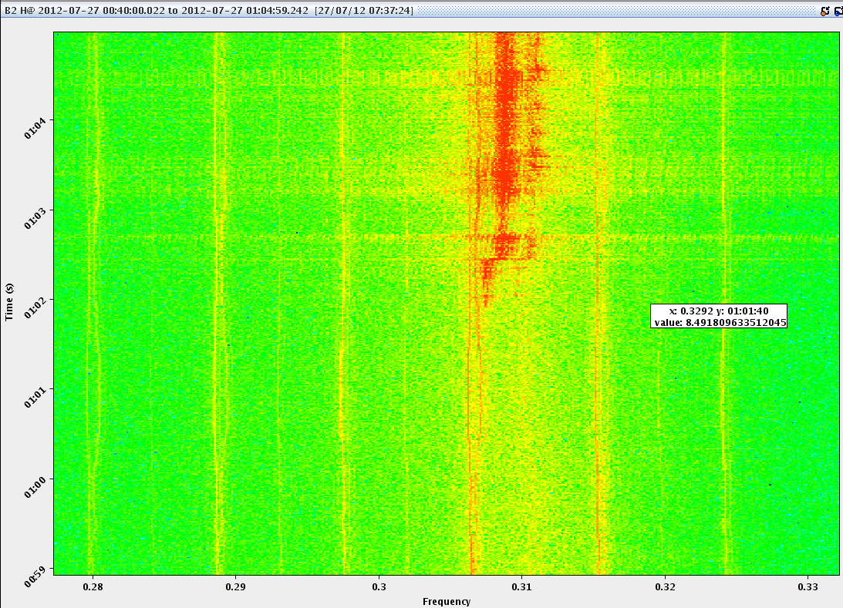
B2H

Slide 9
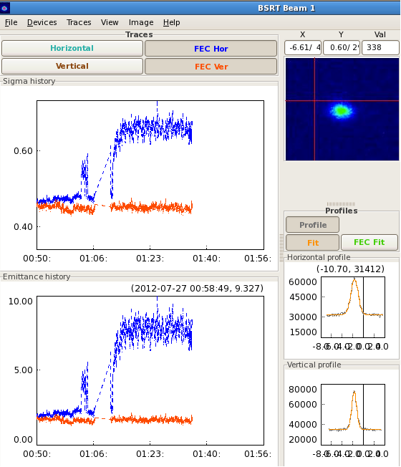
Beam size
Federico Roncarolo

Slide 10
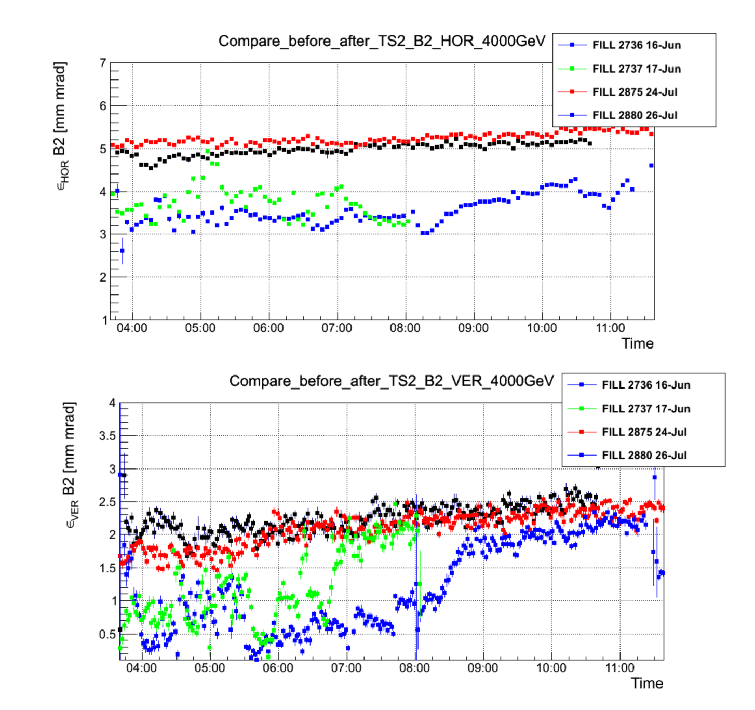
Beam sizes before/after TS
Federico Roncarolo
You see that indeed B2 H and V seems to have changed, even though the BSRT meas. are biased by a larger noise (not optimized settings that I think don't introduce systematics on the average, but to be checked further).

Slide 11
Temperature calibration BPMS - WIP
A temperature calibration was attempted in point 6 on the interlocked BPMS channels
Temperature compensation in interlocked channels showed a big excursion w.r.t the reference orbit. The temperature factors have been manually reverted to 0 (so temperature compensation disabled).
Note: The temperature compensation only affects to the orbit published (not to the interlock process).
E. Calvo.

Slide 12
Incoming – low emittance test
2 fills (but only if first fill looks OK)
50ns_38b_32_0_0_32bpi2inj
50ns_262_256_0_128_128bpi3inj
We'd plan for stable beams if things look OK (not guaranteed) - wouldn't keep them in for longer than 1 hour.
Note nominal intensity: ~1.1e11 - putting in reasonable numbers gives pile-up comparable with normal.

Slide 13
BS
Gianluigi, Elias, Mike, Jorg, Bernhard
Step 0:
Check that we have the sign of the octupoles we think (ABP)
Reproduce the tune footprints with both polarity of the octupoles during the squeeze (ABP)
Step 1:
1) Measure chromaticity through the whole cycle (up to collision with pilot beams – non colliding with chirp, collimators at injection settings, momentum modulation of ~2x10-4)
2) Correct chromaticity to 1-2 unit accordingly
Step 2:
3) Reduce the gain of the damper (at least during end of ramp and squeeze initially) by factor 2/4/10)
In parallel to verify the feasibility of running with opposite polarity of the octupoles a few end-of fill tests will have to be done to optimize the strength of the octupoles and possibly the working point that might have to be changed
Based on the above results we will have a more solid background to see next steps (octupole strength and polarity and operation with larger chromaticity at high damper gain)

