Slide 1
LHC Status Sat Morning 28-July
Bernhard Holzer, Mike Lamont

Slide 2
Fri Morning
Plan: low emittance beam test
2 fills (but only if first fill looks OK)
50ns_38b_32_0_0_32bpi2inj
50ns_262_256_0_128_128bpi3inj
We'd plan for stable beams if things look OK (not guaranteed) - wouldn't keep them in for longer than 1 hour.
Note nominal intensity: ~1.1e11 - putting in reasonable numbers gives pile-up comparable with normal.
Then: Back to Standard Physics Fill

Slide 3
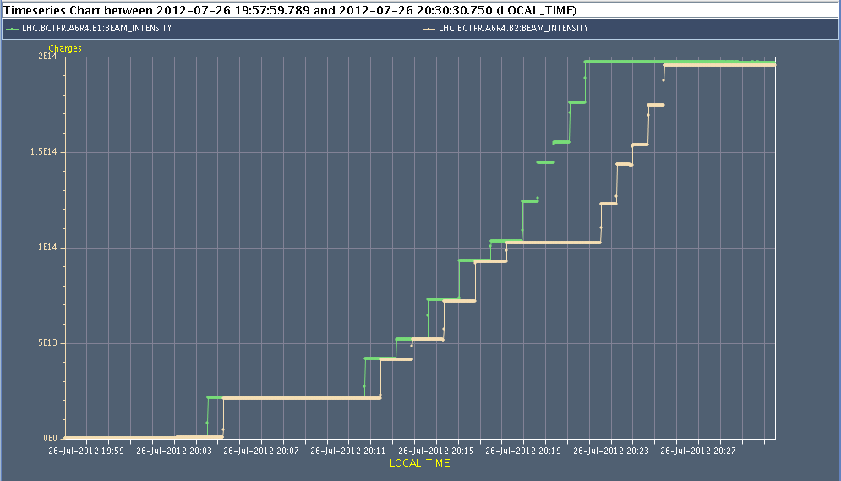
Fri Morning
since 04:30 h ... stable beams ...
following the special filling scheme for Alice
14:11h ... scheduled beam dump
14:50h Access: close ventilation door UL44 in P4 which opened during stable
beams this morning.
15:32h injection probe beam for low ε test
beam1
beam2

Slide 4
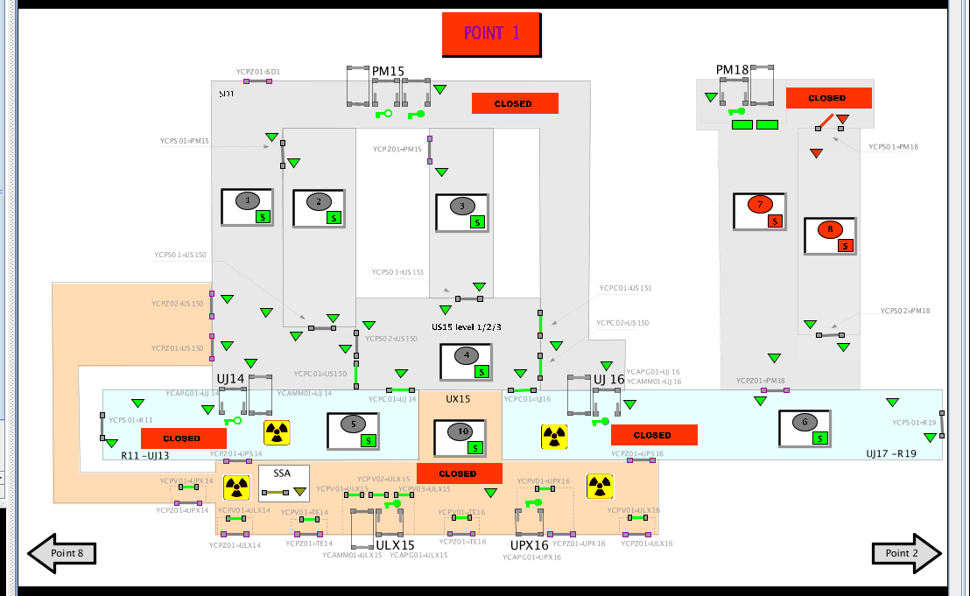
Fri Late
16:06h beam dump: Access interlock from PM18, door open
reason unknown, expert cannot reproduce the error.
17:35h pre-cycle
18:46h injection probe beam
& optimising beam parameters
20:05h controls problem in PS (piquet)
Due to problems with 32 bunch beams ... considerable emittance growth
in pre-accelerators ....
we decide to go back to Standard Physics Fill.

Slide 5
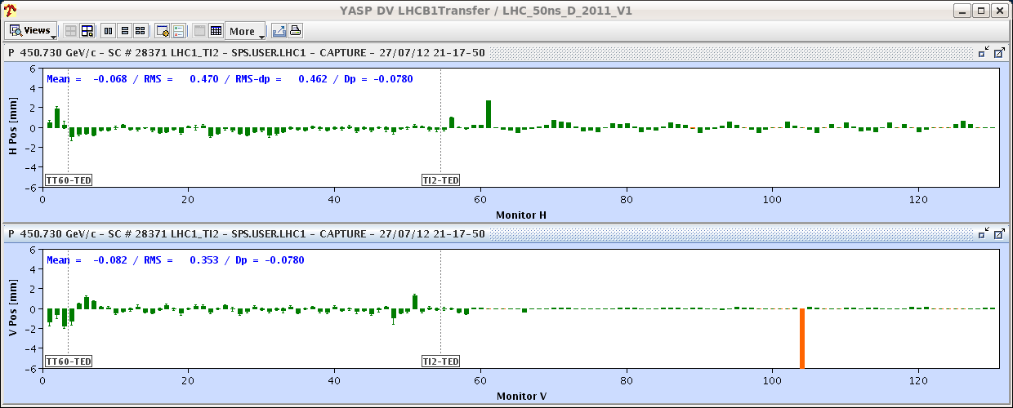
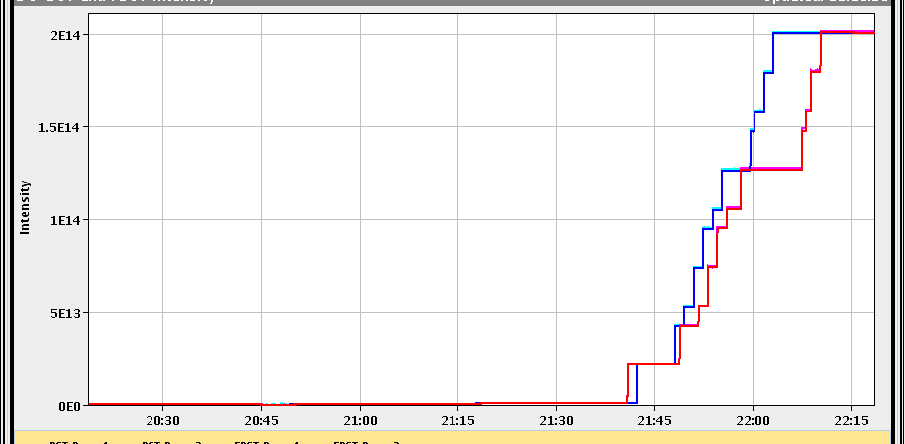
Fri Late
20:57h injection physics beam
by the way:
injection oscillations / orbit
in TL is fine today !!
as before: special procedure
for ALICE

Slide 6
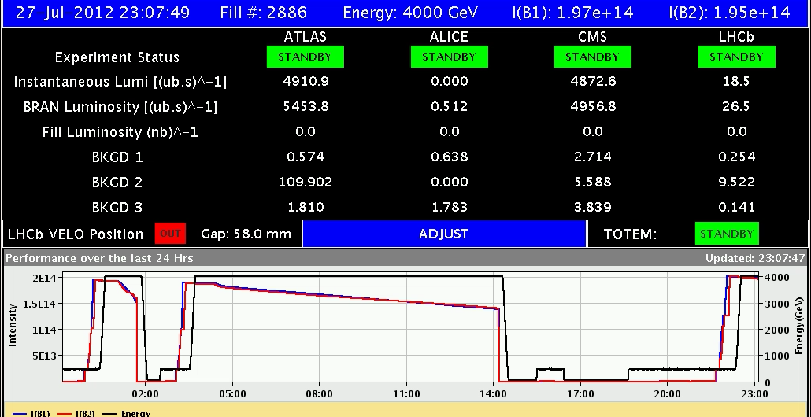
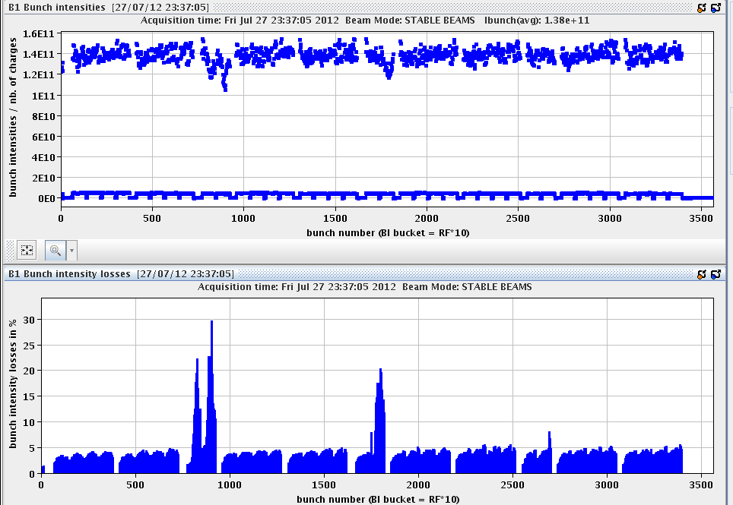
Fri Late
22:14h ramp / squeeze / adjust / stable beams
“Filled with 1.46e11ppb on average and had no warning level losses
until collisions.”
some bunch intensity losses
during squeeze / adjust

Slide 7
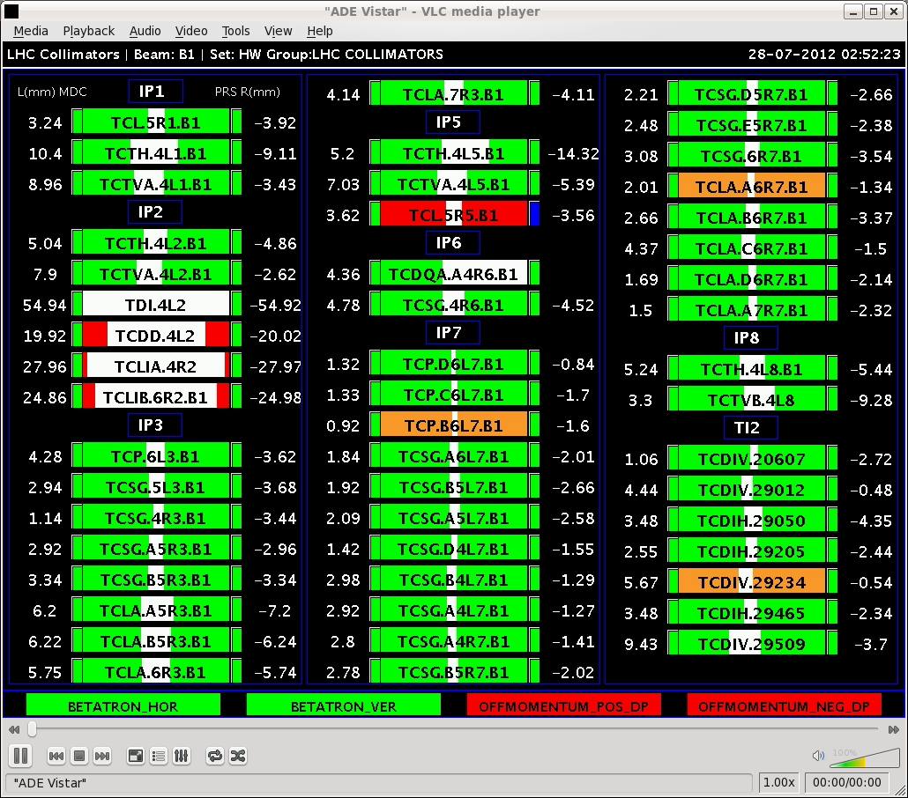
Fri Night
02:50h after 3.5h in stable beams ...
beam dump
“collimator position not correct”
seems to be a communication problem
with TCL.5R5.B1
03:00h precycle
03:57h injection physics beam

Slide 8
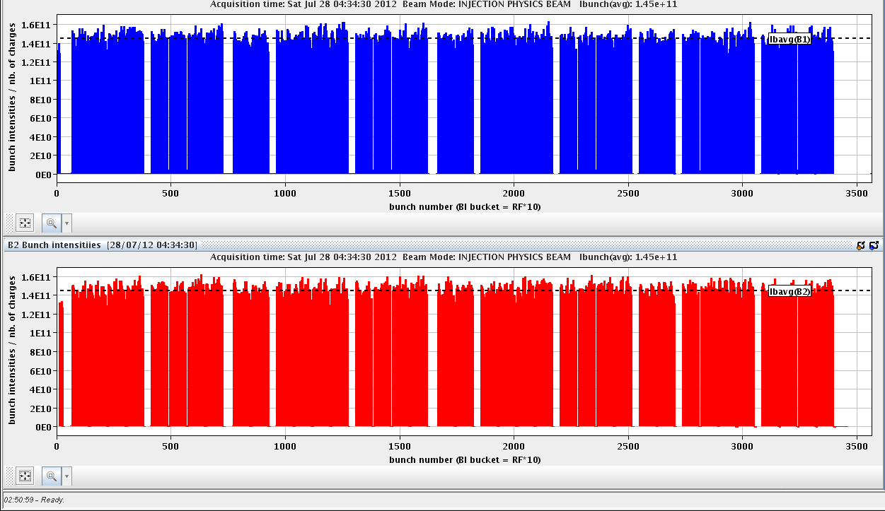
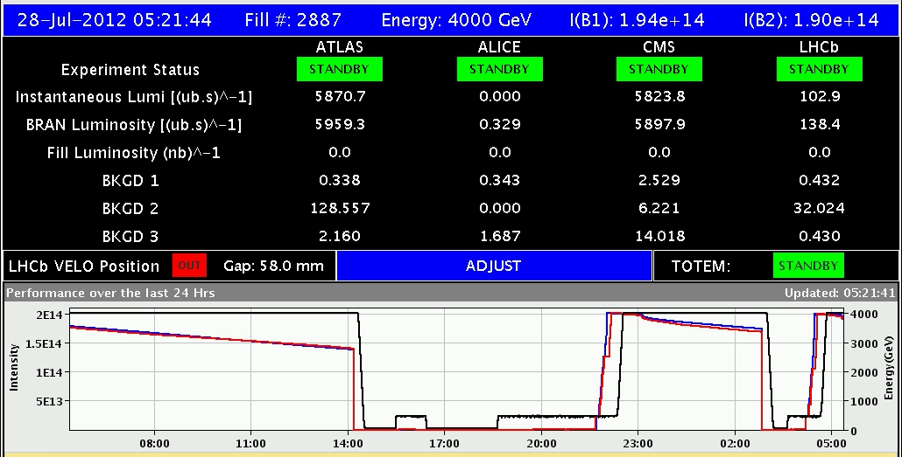
Fri Night
03:57h injection ...
pushing a bit the single bunch intensity
04:38h ramp / squeeze / adjust
05:21h stable beams

