Slide 1
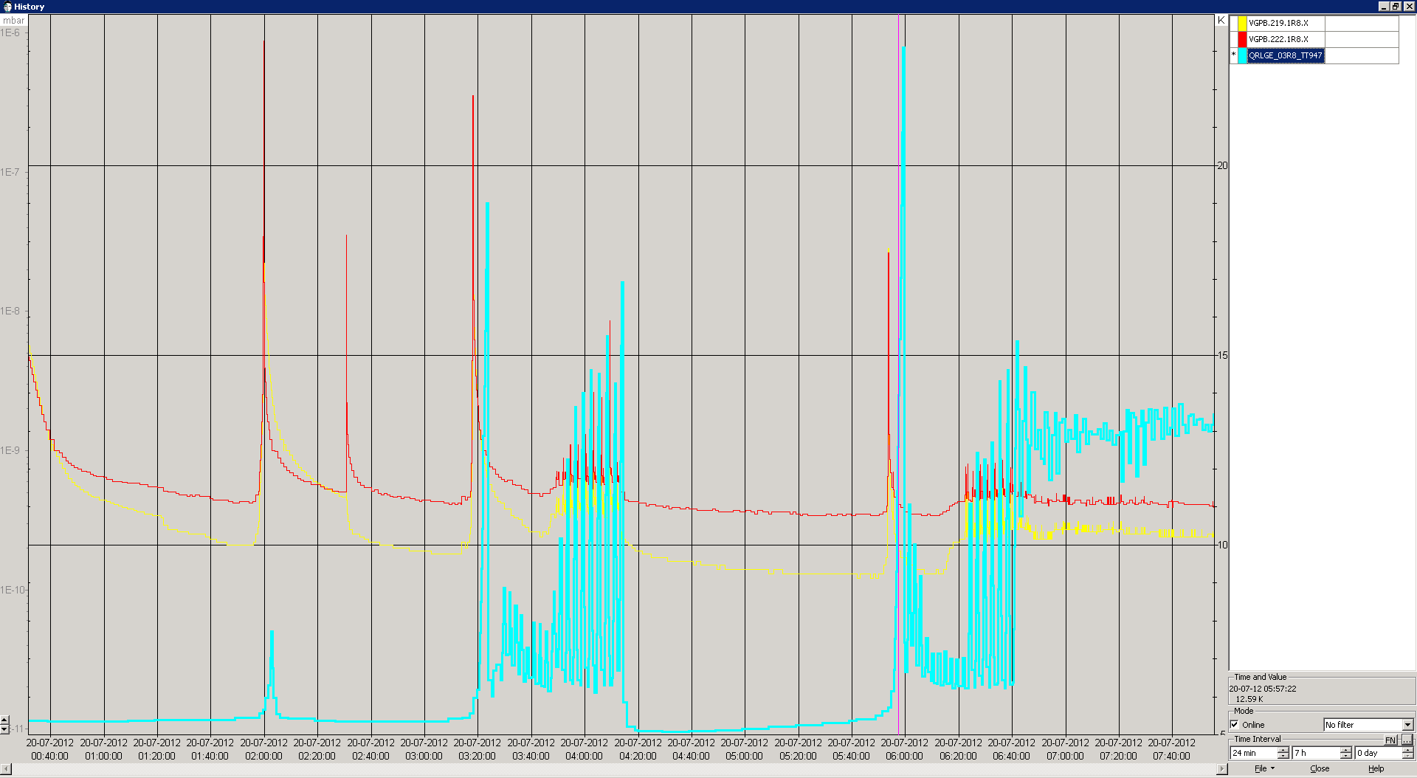
Q1R8
Vacuum Dump
Temperature BS
1 Temperature sensor in ITR8 is not working

Slide 2
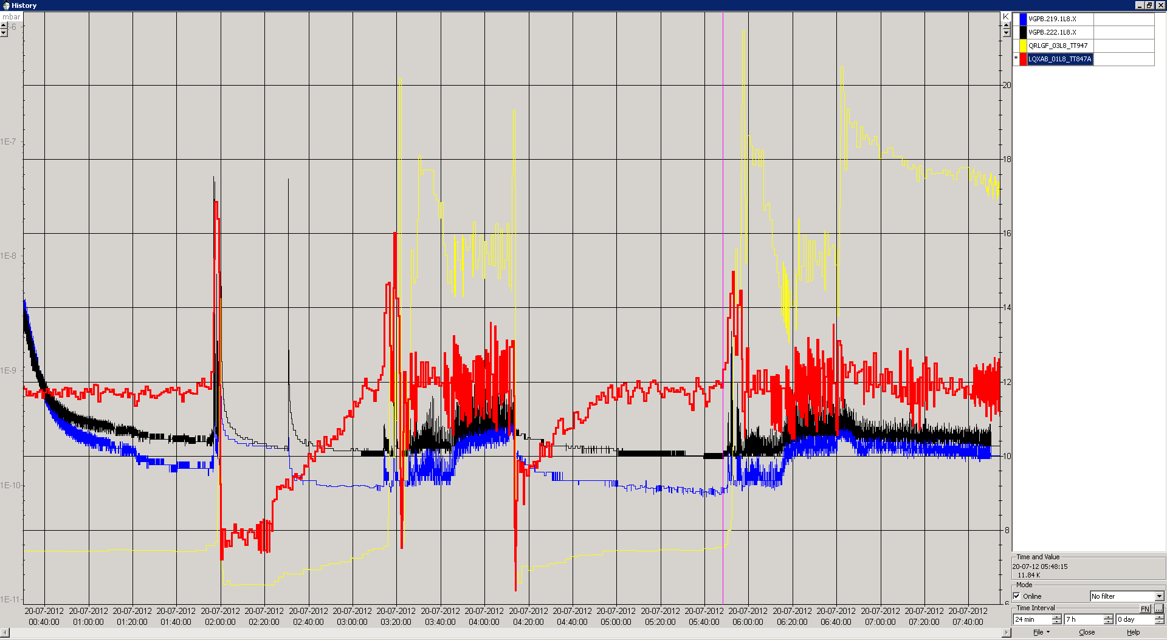
Q1L8
Temperature BS

