Slide 1
Wednesday 18.7.2012 - Morning
Cryo recovery → giving access for:
ODH sensor in pt 3 and 2
EPC: RQTL11.L1B2 in pt 1, RQS.A78 water level in pt 8, RD1 in pt2, putting a 600A spare in pt 4
LDM in pt 4
QPS board changes in pt 4
Alice, ATLAS, CMS
Cryo: WorldFIP repeater in pt 6
Ventilation door checking in pt 2
CV in pt 5

Slide 2
Afternoon and Night
13:00 cryo filter clogged → access needed pt 1
13:45 RF crowbar M2B1
RF power piquet: “The latest trip is due to an arc that developed because of bad vacuum on klystron 8b1. We can reset it and carry on. Anyway they will go in and have a look at the scope that they had installed, should be in the shadow of the cryo recovery.”
Confirmed after the access
16:00 access for power converter RCBV19.R5B2
16:48 cryo is ready (19.5 hours)
17:27 power converter intervention finished – start pre-cycle
Short loss of cryo maintain tripped S12 → pre-cycle again
21:32 stable beams: VdM scans of LHCb
5:30 LHCb finished – beam dump
Now: fill foe VdM scan for Atlas and CMS

Slide 3
Orbit in the squeeze – from Joerg
In May we performed one squeeze using a higher bandwidth for the orbit FB → resulting corrections were fed-forward.
The squeeze functions of the orbit corrected have not been touched since the feed-forward May 16th !
Comparison of the orbit at the TCPs for a fill just after the feed-forward (2621) in May and for the last fill on Sunday (2848).
Look at the relative change with respect to start of squeeze.
Same thing for 2 fills from last WE, 2843 and 2848.

Slide 4
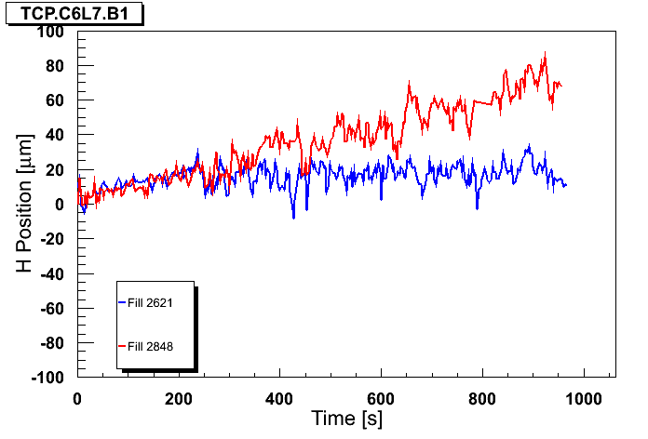
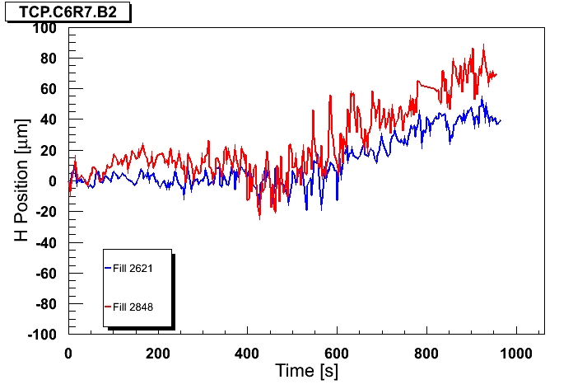
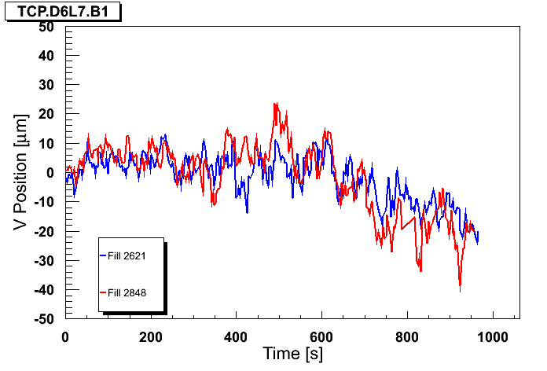
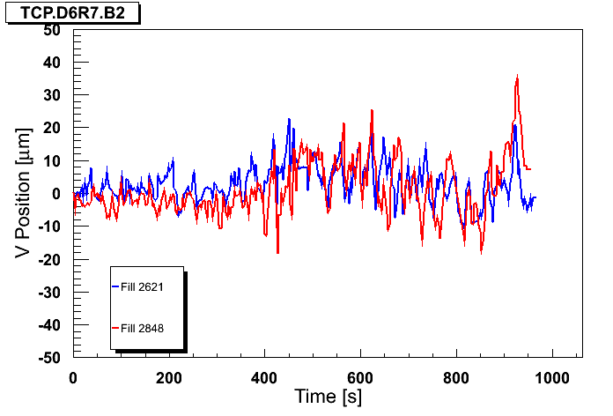
Comparison of fills 2621 (May) and 2848 (now)
B2H
B1H
B2V
B1V

Slide 5
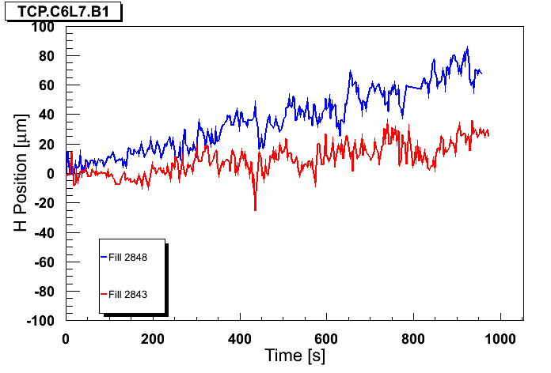
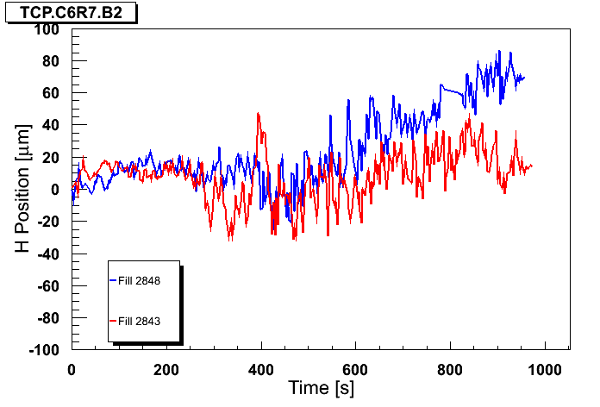
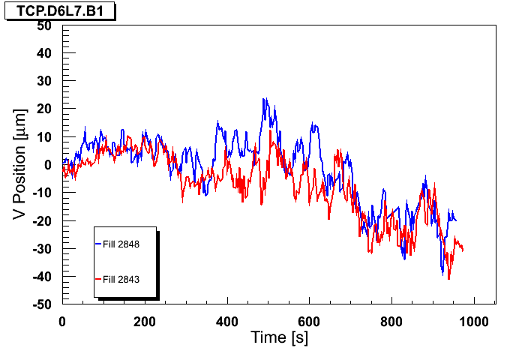
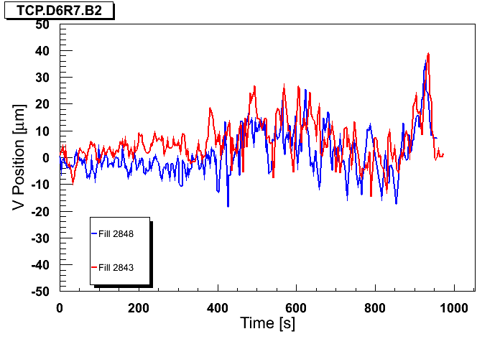
Comparison of fills 2843 and 2848
B2H
B1H
B2V
B1V

Slide 6
Relative orbit change
The quality is still impressive, orbit fluctuation have not degraded too much.
The 2 recent fills differ more for B2 than for B1.
But the differences are at the level of 20-30 um.

Slide 7
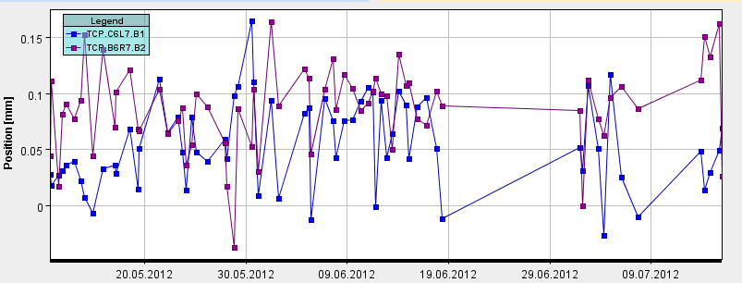
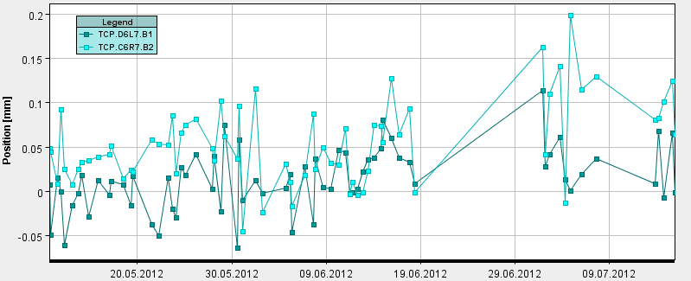
Long term stability
Orbit @ TCP from May to now.
15 mins after start of stable beams.
Horizontal
Shift for B2V?
Vertical

