Slide 1
Tuesday 17.7.
7:53 start VdM scans LHCb
8:18 beam dump: RF M2B1 crowbar (3rd time within 24 hours)
Access for RF
Changed thyratron – but problem with crowbar came back (15:15) – access again
LHCb, Atlas and CMS, Alice access in the shadow
Cryo access in the shadow to investigate a noisy sensor on a DFB right of point 6, UJ67: faulty static relay was identified and fixed
Access to P8: vacuum interlock for MKI is not received (but correctly generated) – found a lose cable on vacuum crate

Slide 2
Thursday evening
20:00 after hardware intervention of the RF, the low level needs to be adjusted
20:34 OK from RF (duration of the fault: 12:16)
Philippe: Following the series of crowbars, and after the intervention of the RF power, the tuning system of cavities 4B1 and 6B1 were not working. Loss of communication between the Low Level and the PLC controlling the step motors. The problem is known: crowbars create transients on the groundings, that occasionally perturb this link. The problem was cured by resetting these two links.
20:50 communication problem RCBV14.L5B2. EPC piquet: he cannot communicate with the FGC of RCBV14.L5B2. An access to exchange that FGC needs to be organized at the next occasion. The ramp, squeeze and collision settings of this COD are negligible.

Slide 3
Summary of RF status by Olivier Brunner
Yesterday morning we started by replacing the suspected thyratron of M2B1. Note that the validation tests took a little bit longer than expected due to a faulty attenuator that is used to measure the response signal of the system. At around one o'clock this was done. Unfortunately it turned out not to be the whole story.
The system tripped on a crowbar fault soon after having being restarted. The unusual signals that were observed on the scope as well as the noise that we could hear from inside the HV bunker seem to indicate that there was a real arc occurring somewhere in there (i.e. not a thyratron faulty shot, nor a faulty klystron). For different reasons we finally suspected the smoothing capacitor and replaced it.
Although I'm not certain at all that we have definitively cured the problem, 2B1 was still up and running 1 or 2 hours after we left P4 and also after Philippe solved the cavity 6B1 cavity problem.

Slide 4
Thursday evening cont.
21:12 cryogenics problem at P2 (QURC in PM18 tripped on oil detection); lost CS and CM in sector 12.
22:00 restarting the cryoplant at PM18
Access for the DFB's in sector 1-2 by the cryo piquets
Biometric iris scanner not working at UJ16, delaying the access by ~1 hour; bypassing the biometry reading.
An access to repair the faulty ODH sensor at P3 to be organized Wednesday morning.

Slide 5
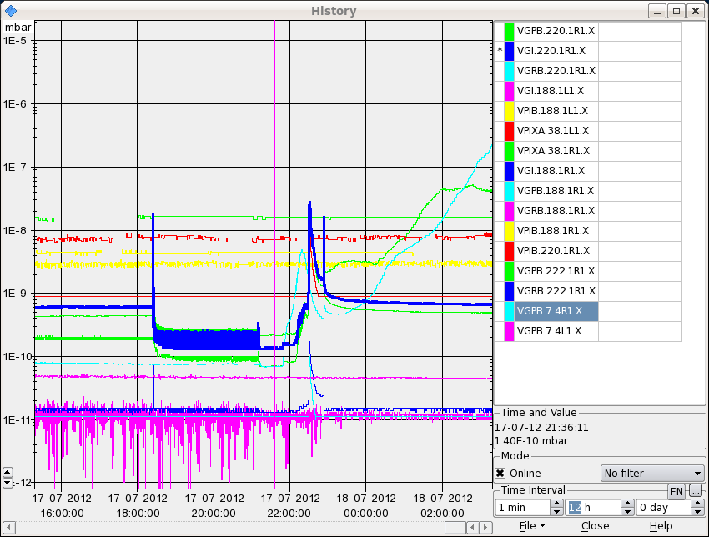
Pressure rising in the IP1 triplets. The valves of the sector are closed. ATLAS called to say that they see a vacuum gauge on the Jura side (60m from the IP) rising.

Slide 6
Cryo recovery – no beam before 14:00

