Slide 1
Summary week 29 VdM scans Luminosity production
Eva Barbara Holzer, Jorg Wenninger

Slide 2
Brief overview of the weekend
A rather good restart on Friday with fill 2858 – peak L ~6.2 cm⁻²s⁻¹ – was followed by 24+ rocky hours with 1 short fill and 6 fills dumped due to losses in squeeze and adjust.
Losses on B2, with coherent activity (BBQ, ADT) in the H plane. B1 rock stable – no losses.
Even rolling back all changes, including re-increasing octupoles on B2 to pre-TS2 value, did not seem to help.
Saturday evening we decided to drop the intensity at injection to 1.35E11 ppb.
Since that moment we have been able to bring all injections to stable beams with good performance given the reduced intensity.
Emittances ~ 2.2 um in collision.
No changes made to the settings since Saturday evening.

Slide 3
Present settings – Q’ and octupoles
B1 : same settings than last weekend.
Octupoles at 417 A.
B2 : octupoles back at 450 A.
Q’ H had been temporarily increased by +1.8 at end of squeeze and in collision (see later). Rolled back during the period of instability.

Slide 4
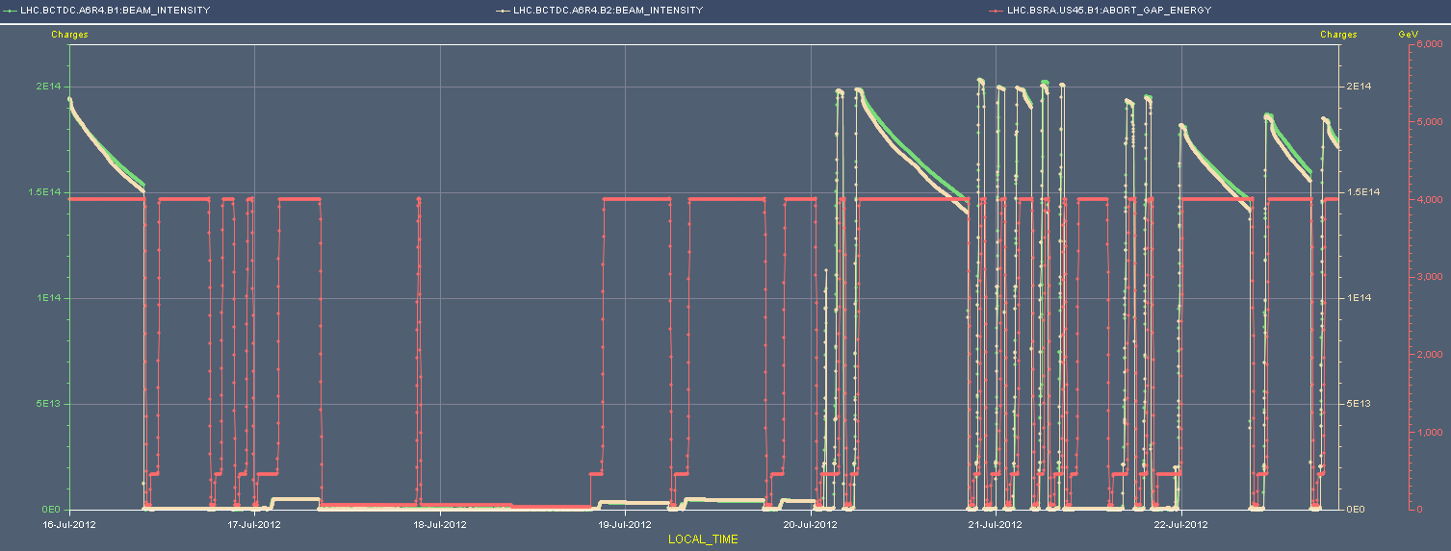
Week overview
VdM scans: setup and 4 fills.
Physics operation: reduced intensity to 1.35E11 ppb.
Instabilities on B2 at end of squeeze.
Intensities and energy
VdM
setup
VdM
fills
RF
Cryo P18
VdM
fills

Slide 5
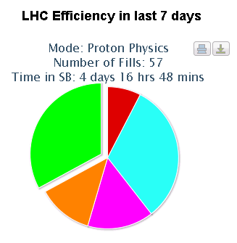
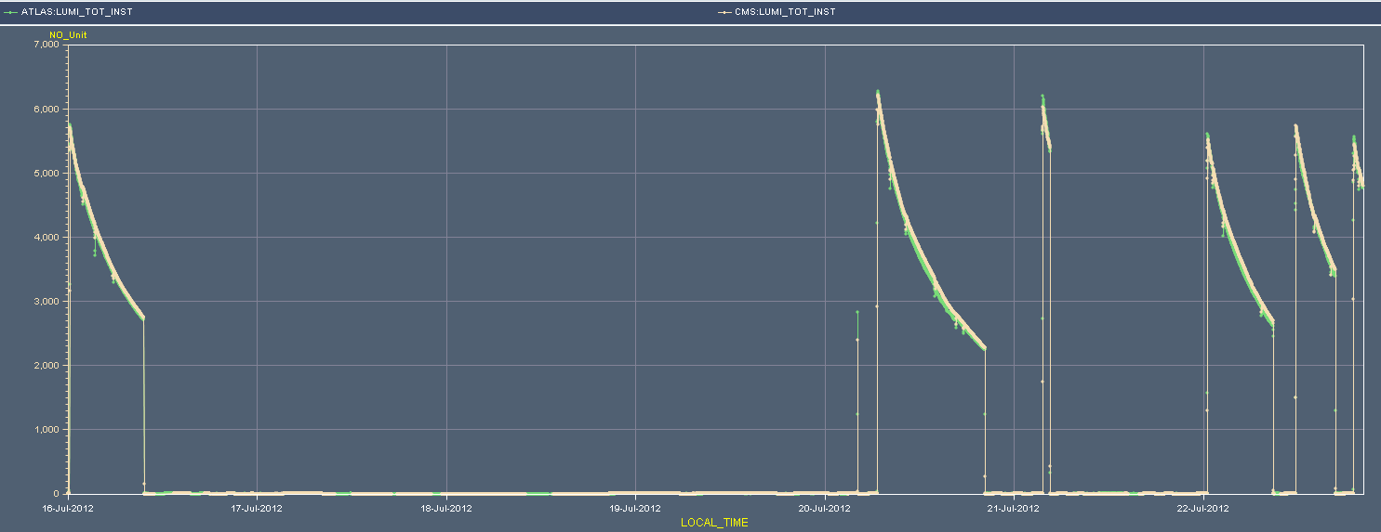
Overview of lumi production
Peak initial L : 6.2x10³³ cm⁻²s⁻¹
33%
Luminosity
6x10³³ cm-2s-1

Slide 6
Downtimes
This week had only one, but long, downtime period from Tu 08:00 to We 17:00 – 35 hours.
The period started with a crowbar on RF module M2B1.
Repaired in iterations on Tuesday.
Smoothing capacitor replaced.
Tuesday evening at 21:00 cryo plant P18 switched off.
QURC in PM18 tripped on oil detection.
Recovered We 17:00.
There is a clogged filter at P18 – stable but should be fixed between 2 fills (~ 2hours) this week.

Slide 7
Fills of the week
Fill | Day | L (h) | Nb | Int L (pb-1) | Dump
2852 | Tu | 4:40 | 50 | VdM 2/8 | RF – crowbar M2B1
2853 | We | 8:10 | 35 | VdM 8 | OP
2855 | Th | 9:10 | 48 | VdM 1/5 | SIS – systematic BPM drift (IR6, TCSG)
2856 | Th | 3:40 | 48 | VdM 1/5 | OP
2858 | Fr | 13:35 | 1374 | 175 | OP
2861 | Sa | 0:57 | 1374 | 19 | IR7 BLM false trigger
2870 | Sa | 8:20 | 1374 | 112 | FCG communication to RCBV lost (SEU candidate) – SIS dump on orbit excursion.
2871 | Su | 5:00 | 1374 | 77 | CMS BCM – faulty channel.
2872 | Su | >12:00 | 1374 | >150
Integrated luminosity 533 pb⁻¹ in a ½ week.

Slide 8
Fills lost before stable beams
Fill | Day | Phase | Comment
2857 | Fr | Adjust | RQ6.R7 trip (QPS) SUE?
2859 | Fr | Adjust | Heavy losses on selected B2 bunches.
2860 | Sa | Adjust | Same as before…
2862 | Sa | Adjust | And again…
2863 | Sa | Flat top | QFB dragged B2H tune away.
2865 | Sa | Adjust | Heavy losses on selected B2 bunches.
2866 | Sa | Adjust | Ditto.
In most cases the losses in ADJUST already started in SQUEEZE (below 2 m).
Losses came with activity on B2 H plane.
After fill 2866 (4th lost in a row) → intensity down to 1.35E11 ppb.

Slide 9
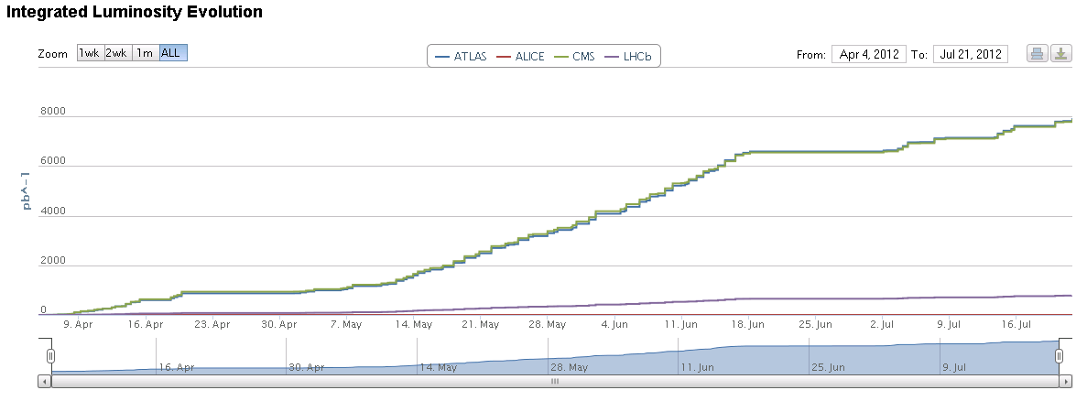
Integrated luminosity – >8 fb⁻¹
Add 150 pb-1 for the last fill

Slide 10
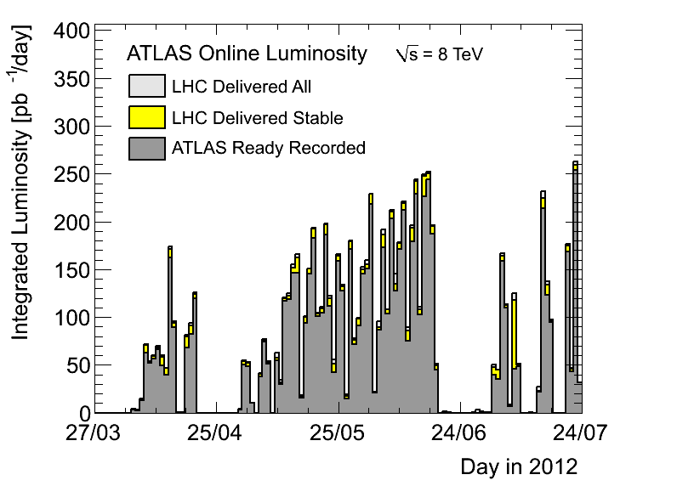
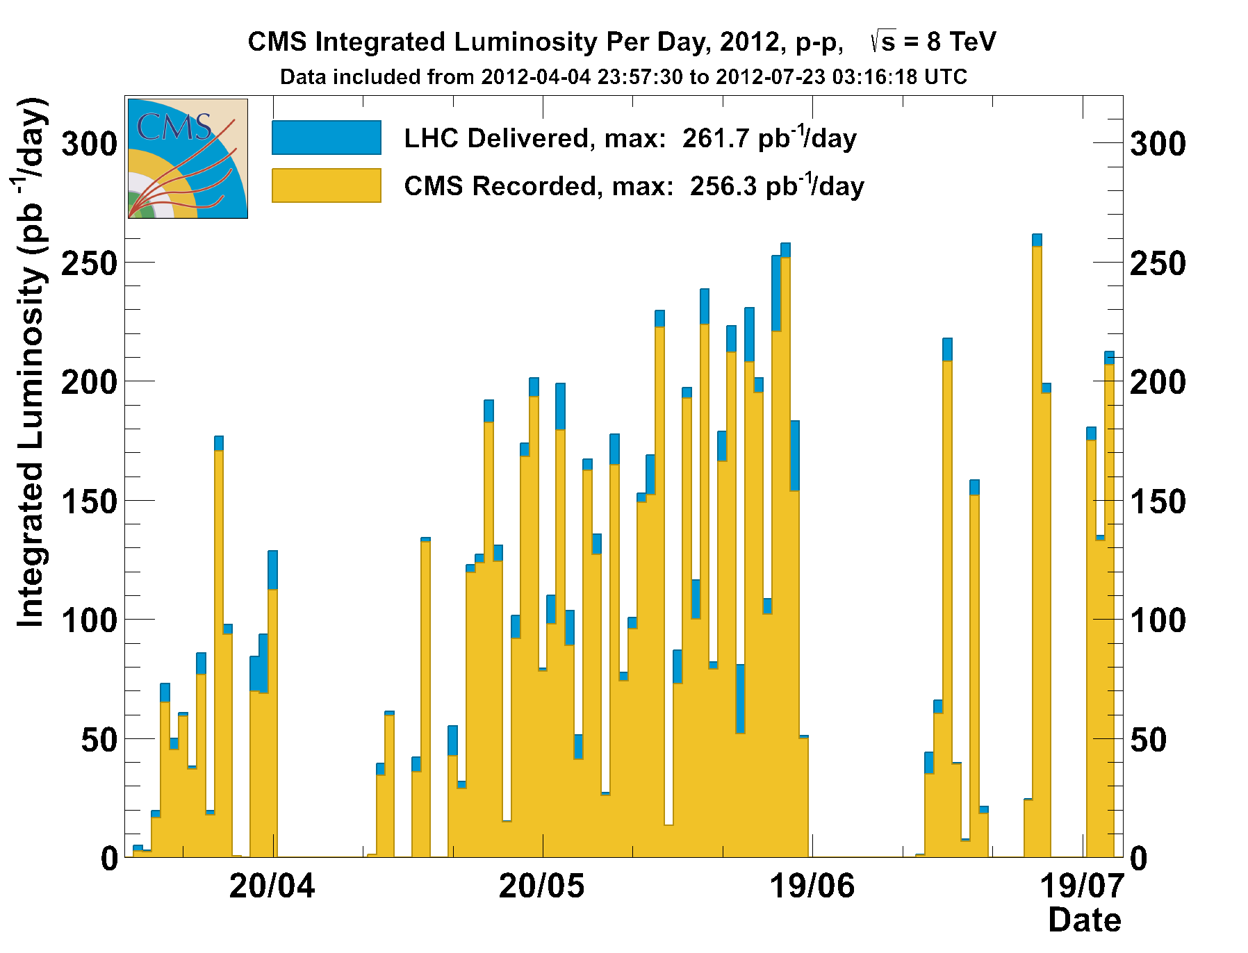
In the end a good week-end
Good efficiency compensated loss in peak performance…
Sunday achieved the highest int. luminosity per day of 260 pb-1 for ATLAS
CMS has a different way of assigning integrated luminosity to days

Slide 11
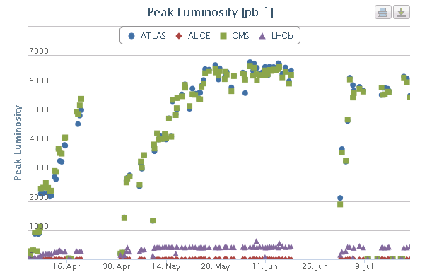
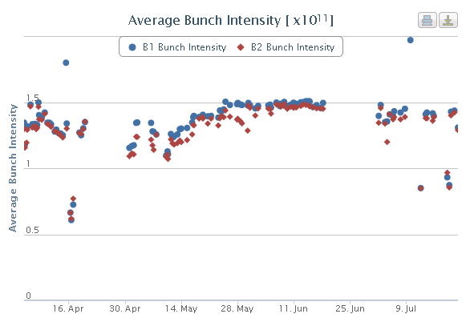
Performance evolution
We still haven’t recovered pre-TS2 peak performance.
Emittance in collision rather small in the past few days ~ 2.2 um.

Slide 12
VdM scan configuration
Beams: 30-50 individual bunches, ~1E11 ppb.
Emittances 3-3.2 um, blow up by screen in TT10.
Collisions with injection optics (but with collision tunes).
External crossing angles (in microrad).
IR1 and IR5 : 0 FT default : ± 145
IR2 : -90 -90
IR8 : +200 -220
IR8 crossing bump in horizontal plane.
ADT @ ½ standard gain for physics, octupoles @ 300 A.
TCPs at 5.3 σ, TCTs at 30 σ, other collimators at standard settings.
Loss-free ramps even with large emittances.

Slide 13
VdM scans
Efficient setup and validation on Monday.
Begin ~10:00, finished ~24:00. Followed by first VdM fill in the night of Mo-Tu.
Loss map on B1V shows some hierarchy problem, but acceptable for the low intensities.
Scans were spread over 4 fills, with a 36 hours long intermezzo due to the RF/cryo problems.

Slide 14
Emittances
SPS wire scan analysis by Verena seemed to indicate presence of vertical tails since TS2 (similar to post TS1).
More scrapping in V plane at the SPS.
Scrapping ~ 3 % / plane.
Studies of the emittance at the SPS indicate that longitudinal blowup increases vertical emittance.
Blowup needed to stabilize beams longitudinally, required above ~1.45E11 ppb (depends on quality criteria).
By accident the longitudinal blowup was switched off for the first fills on Thursday – Friday.
Seemed to reduce losses in squeeze for B2.
Back to standard settings for longitudinal blowup for the moment.

Slide 15
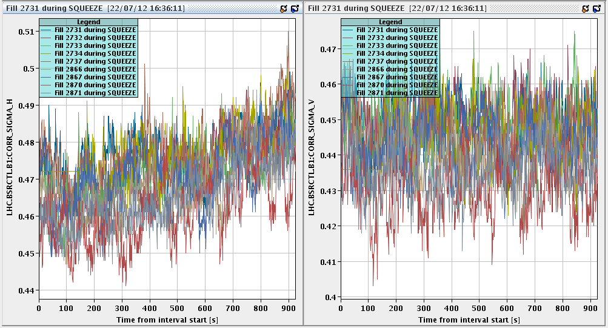
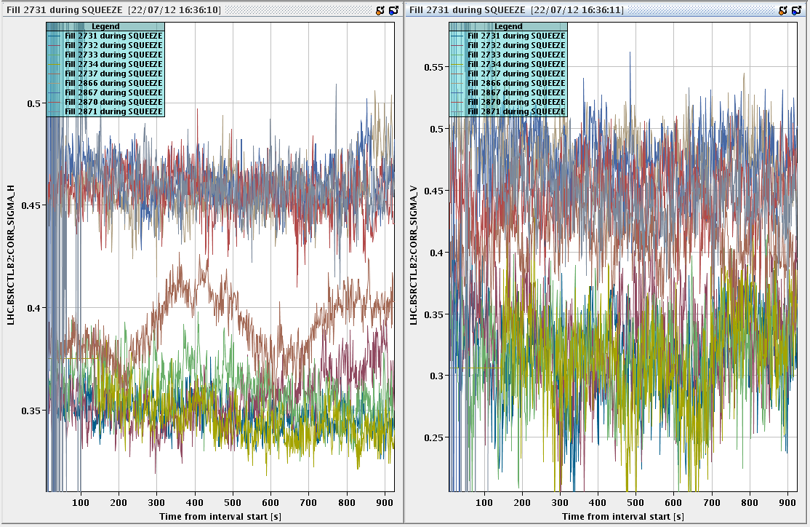
Emittances
With intensities of 1.35E11 ppb at injection we have emittances of 1.4-1.6 um in the LHC – very good !
Are the B2 emittances in squeeze larger than before TS2, or is it a systematic effect?
Not seen at injection. Not consistent with luminosity?
B2 – sigmas ~30% larger than before TS2
B1 – no change

Slide 16
Main loss categories at 4 TeV
Phase | Type | Affected bunches | Comment
Squeeze | incoherent | ~ all | Dominant problem after TS1. Tail losses with tight collimators. Also from bad tune at end of ramp.
Squeeze | coherent oscillations | subset | Rather rare events, but frequent loss cause during past week-end.
Adjust | coherent oscillations | subset | Occurs frequently in the phase where LHCb V crossing is ramped up. => Idea to change and split up way we go into collisions (not done yet)
There are obviously exceptions…
This weekend’s issues dominated by second category.

Slide 17
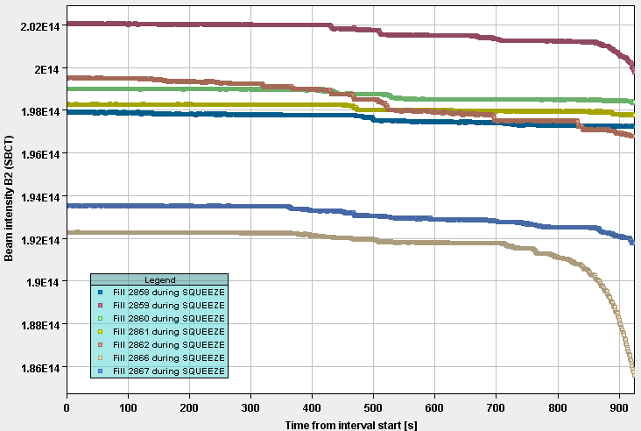
B2 DC BCT in squeezes 2858-2867
2858 and 2861 made in into stable beams.
The best squeezes in terms of BCT losses,
Both without long. blowup in SPS.
2861
2858

Slide 18
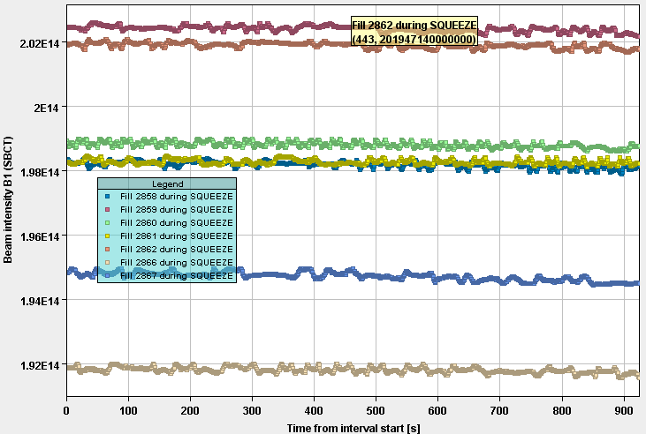
B1 DC BCT in squeezes 2858-2867
B1 stable and happy in all cases.
Could indicate that there is no fundamental problem for present intensities.

Slide 19
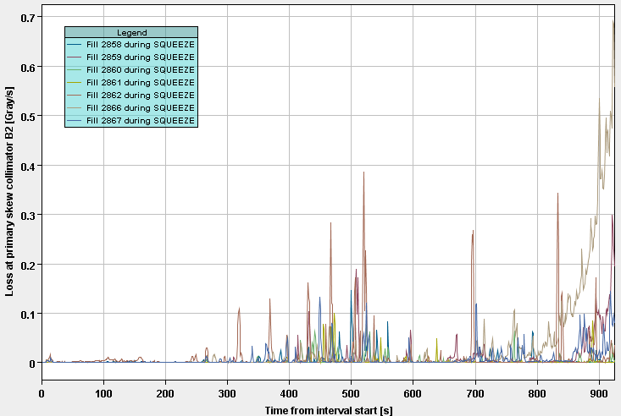
TCP losses B2
Losses on B2 H and skew collimators dominate

Slide 20
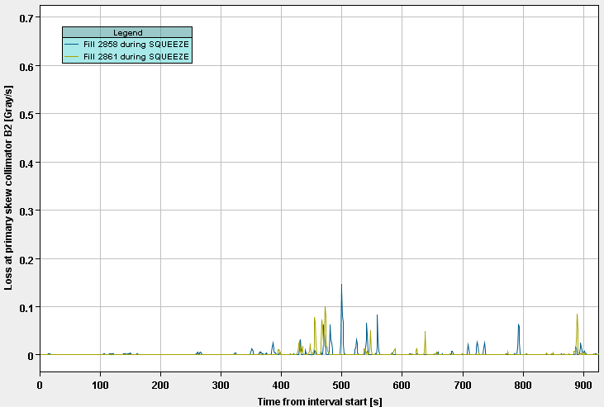
TCP losses B2
Same plot as before for fills 2858 and 2861.

Slide 21
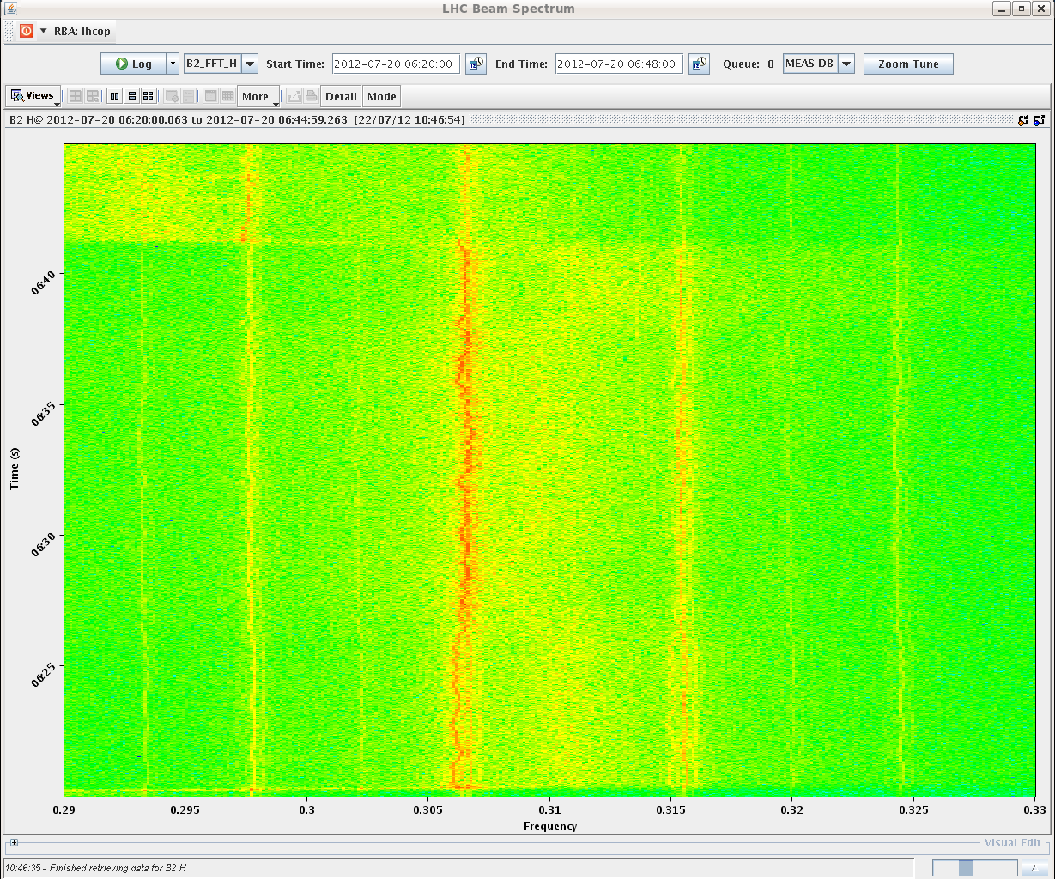
Tune in squeeze – good fill 2858
B2 H tune barely visible between mains lines.
Beams colliding
Q change @ start of collision BP
Q change @ start of squeeze

Slide 22
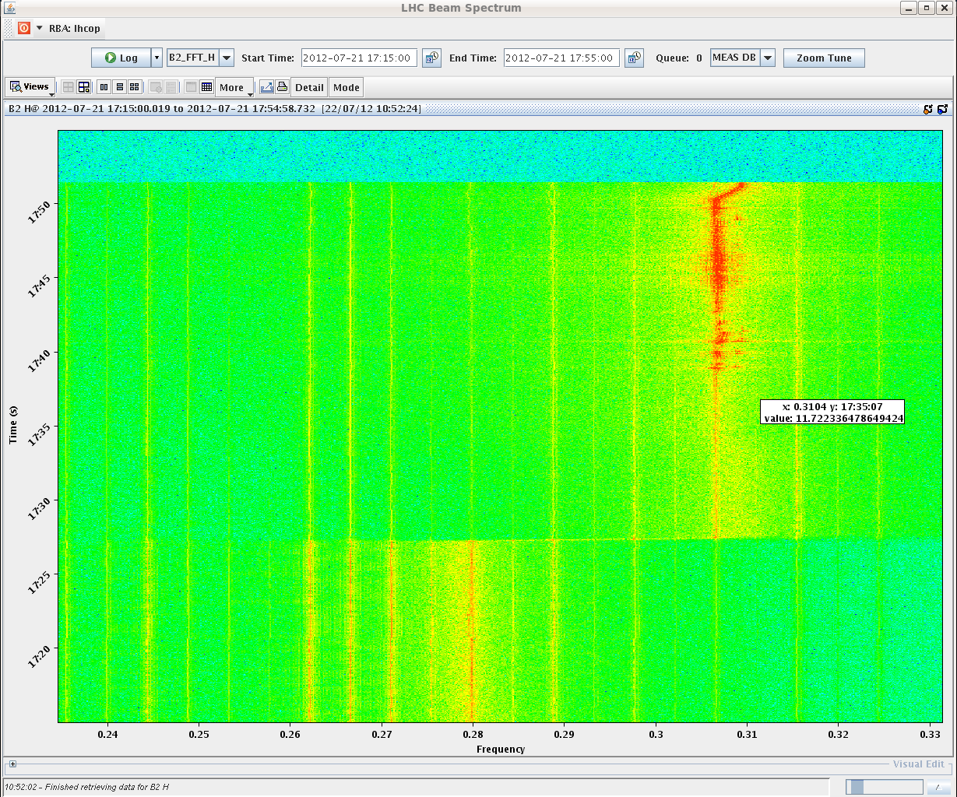
Tune in squeeze – bad fill 2866
m-1 mode (?) excited, sitting on top of mains harmonic.
Mains harmonic exciting -1 mode ??
Q change @ start of collision BP
Tune?
Q change @ start of squeeze

Slide 23
What’s different for B2?
LSA settings were checked and searched for trims during MD or TS2 – nothing found (except known changes).
No changes at the level of ADT (Daniel dixit).
But B2H has the highest gain – coincidence or …?
We considered lowering B2H gain on Sunday, but eventually opted for trying to reproduce what we had.
What else could explain the recurrent problems of B2 – with a happy B1 – and the difference wrt pre-TS2 ?

Slide 24
Chromaticity measurements
Saturday morning a test cycle with 3 nominal bunches was used to check Q and Q’ in squeeze and collision BP.
ADT gain halved for better Q signals. B2 H quality remained poor.
On flat top Q’ is close to 0 in H, ~ 2 in V.
Left it there as no problems observed.
At the end of the squeeze Q’ was ~ 2 for all beams/planes.
Performed manual measurement (see later). Reasonable agreement with online Q’ from radial modulation.
Non-linear chromaticity measurement repeated for 4 octupole settings, including inverted signs.
Exploration – just in case we end up changing the octupoles…
Beams did not case much about octupole settings !

Slide 25
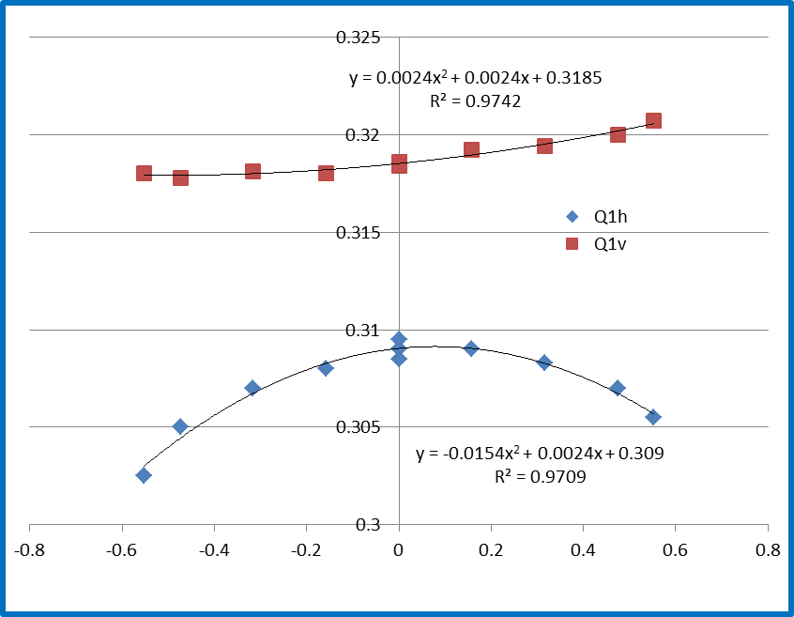
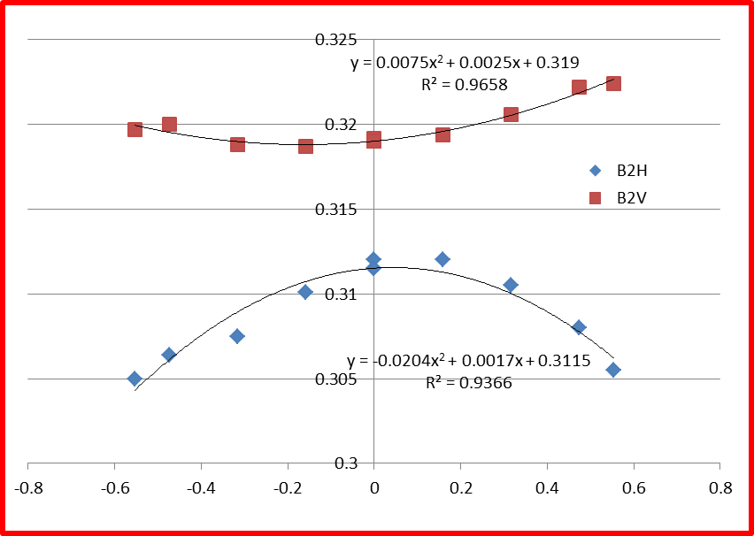
Standard octupoles +417 A ROD
Beam | Plane | Q’
1 | H | 2.4
1 | V | 2.4
2 | H | 1.7
2 | V | 2.5
To note – present situation:
B2 octupoles back at 450 A,
B2 Q’ H lowered by 1.8.

Slide 26
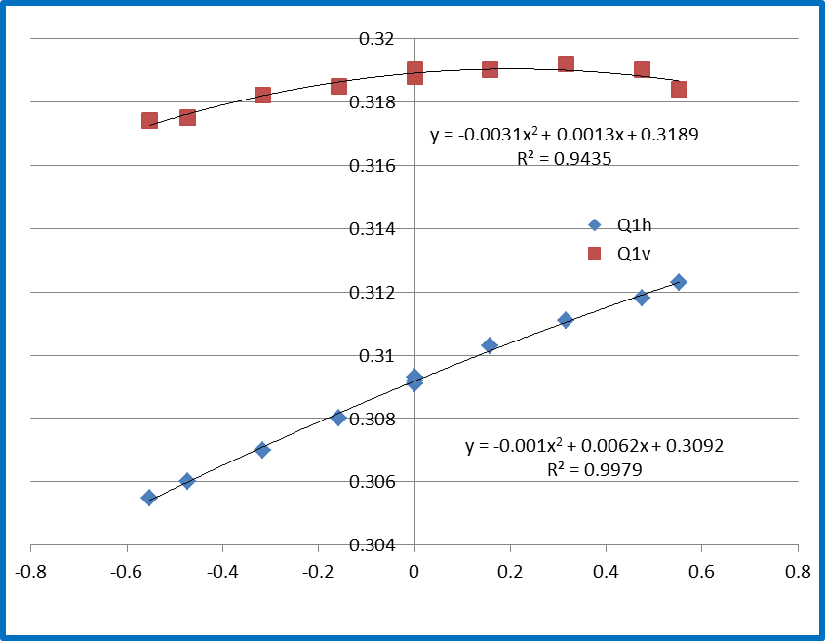
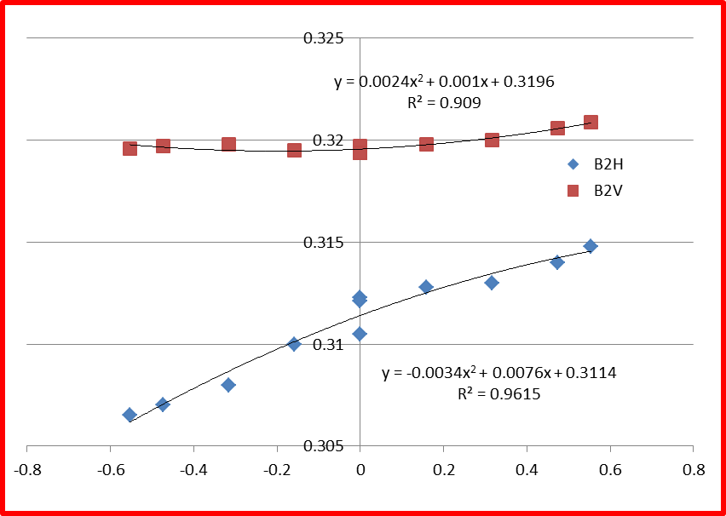
Octupoles +70 A ROD
Beam | Plane | Q’
1 | H | 6.2
1 | V | 1.3
2 | H | 7.6
2 | V | 1.0

Slide 27
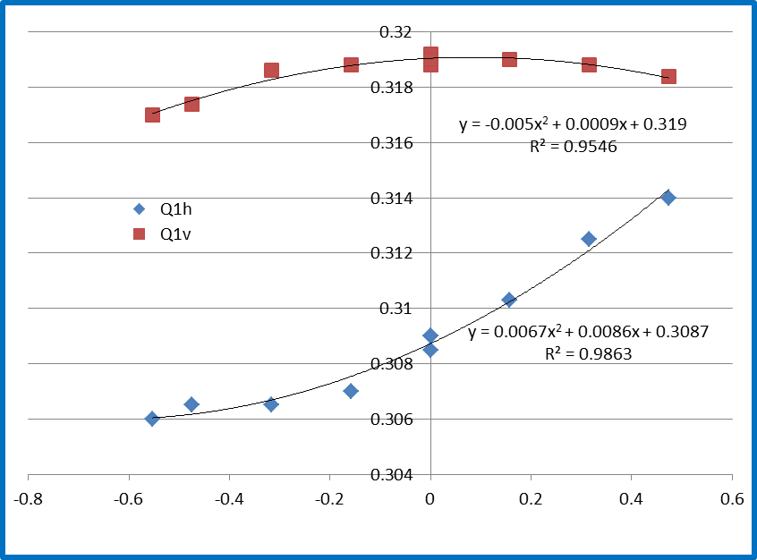
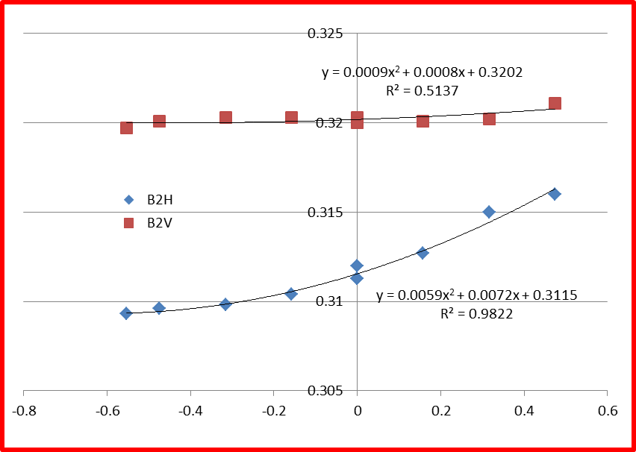
Octupoles -200 A ROD
Beam | Plane | Q’
1 | H | 8.6
1 | V | 0.9
2 | H | 7.2
2 | V | 0.8

Slide 28
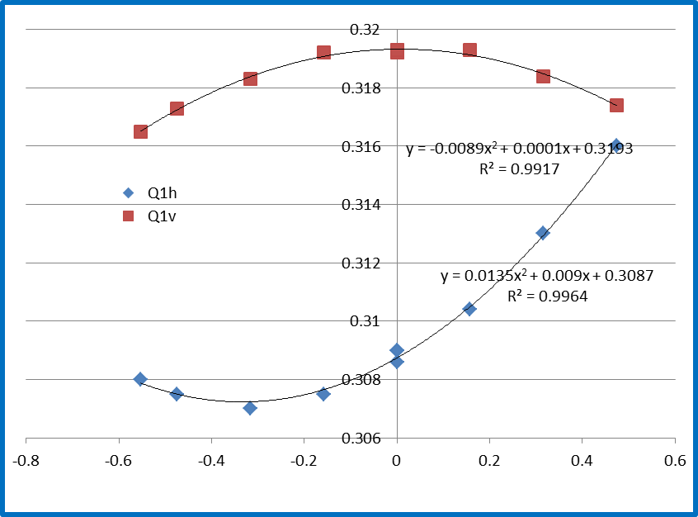
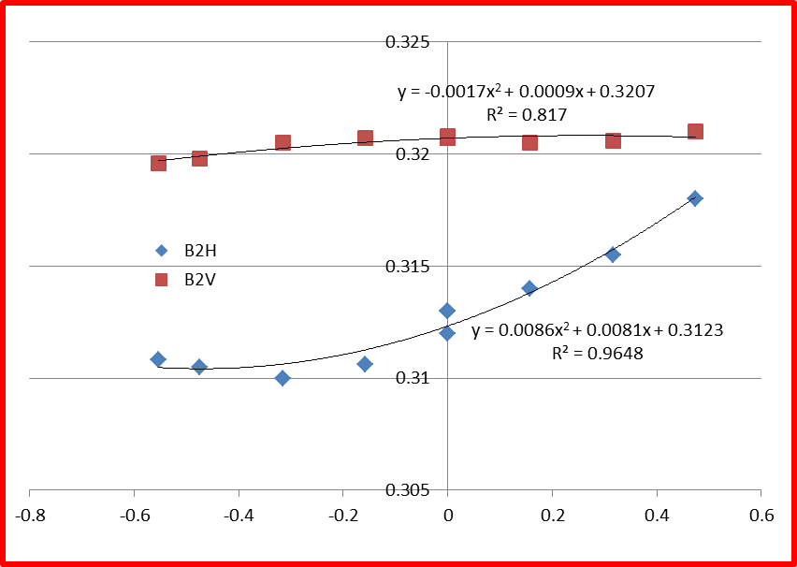
Octupoles -417 A ROD
Beam | Plane | Q’
1 | H | 9.0
1 | V | 0.1
2 | H | 8.1
2 | V | 0.9

Slide 29
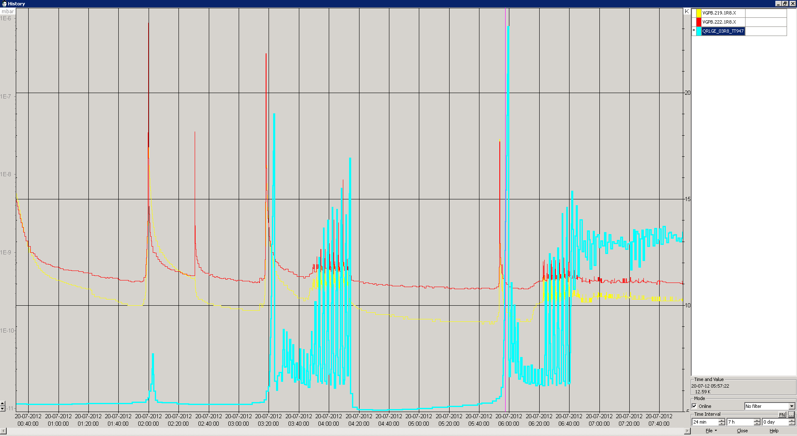
Vacuum dumps after VdMs
Beam was dumped at injection when vacuum valves closed during first high intensity filling after VdM scans and Ne injection from SMOG system.
Calmed down.
Q1R8
Vacuum Dump
Temperature BS
1 Temperature sensor in ITR8 is not working

Slide 30
This week
Production.
LHCb polarity change (to ‘good’ polarity).
Interventions.
Clogged filter cryo P18 – 2 hours between fills..
UPS repair at Pt5 (surface) Friday morning. Should be transparent.
Pending LHCb access request .

