Slide 1
Saturday morning
10:00 Diagnostics fill with 3 bunches for Q and Q’ along the squeeze.
Squeeze measurements of Q’ for 4 octupoles settings (end of squeeze).
No problems to flip sign of the octupoles.
B1 measurements cleaner than B2 measurements.
Bunches did not really care, lifetimes looked a bit better with standard settings, but Q’ rather large with inverted polarity.
For default octupole settings (+417 A):
At start of squeeze Q’ H close to 0, Q’ V around +2. Leave it.
Along the squeeze Q’ is ~ Ok.
At end of squeeze Q’ is around +2 for all planes.

Slide 2
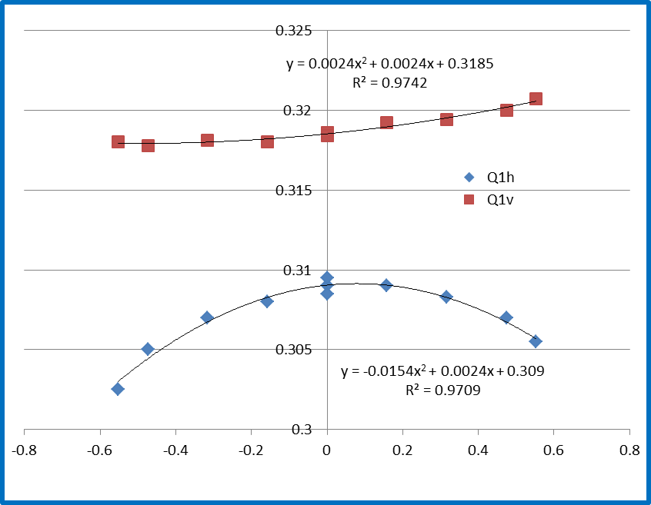
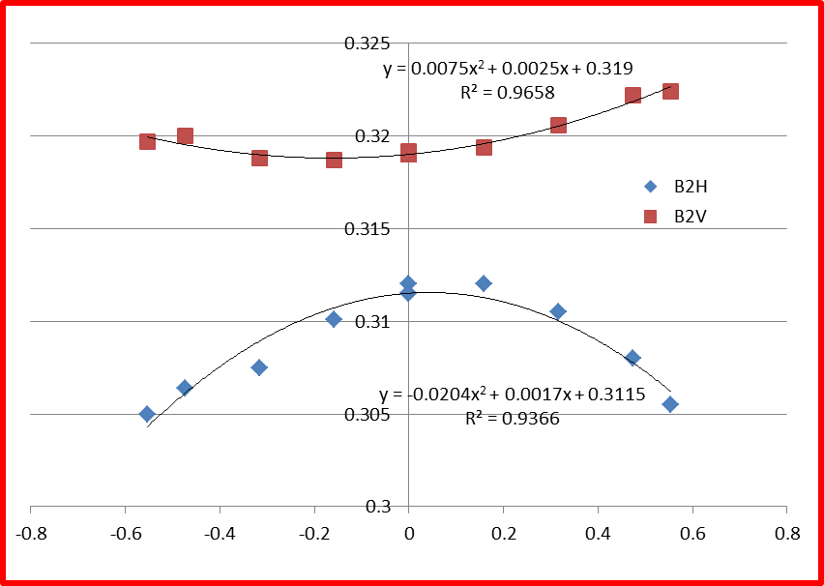
Standard octupoles +417 A ROD
Beam | Plane | Q’
1 | H | 2.4
1 | V | 2.4
2 | H | 1.7
2 | V | 2.5

Slide 3
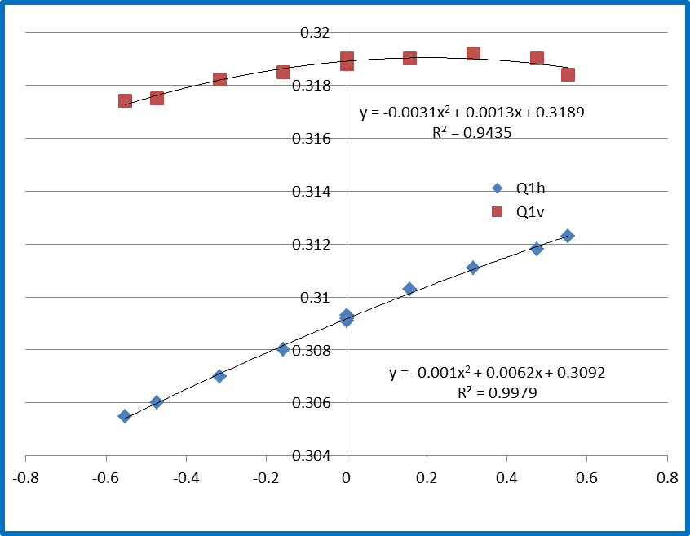
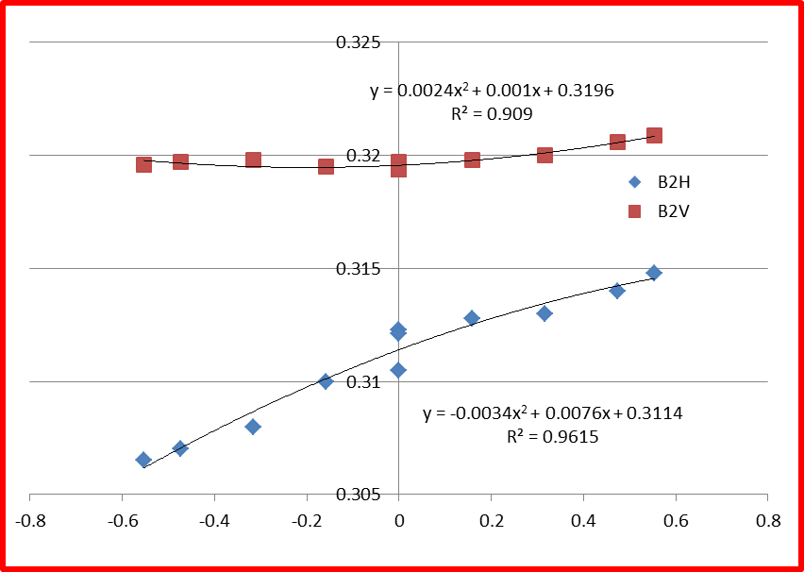
Octupoles +70 A ROD
Beam | Plane | Q’
1 | H | 6.2
1 | V | 1.3
2 | H | 7.6
2 | V | 1.0

Slide 4
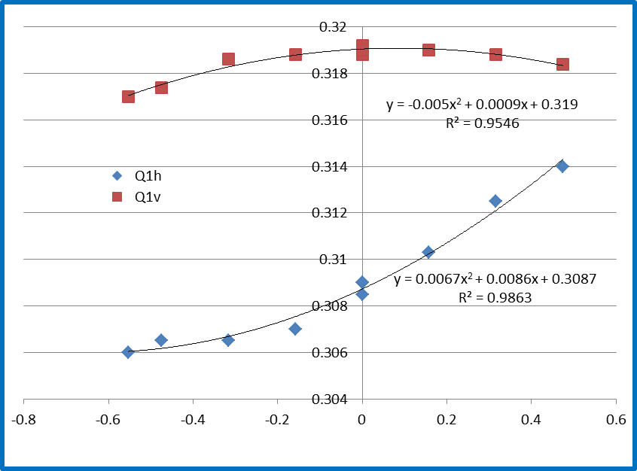
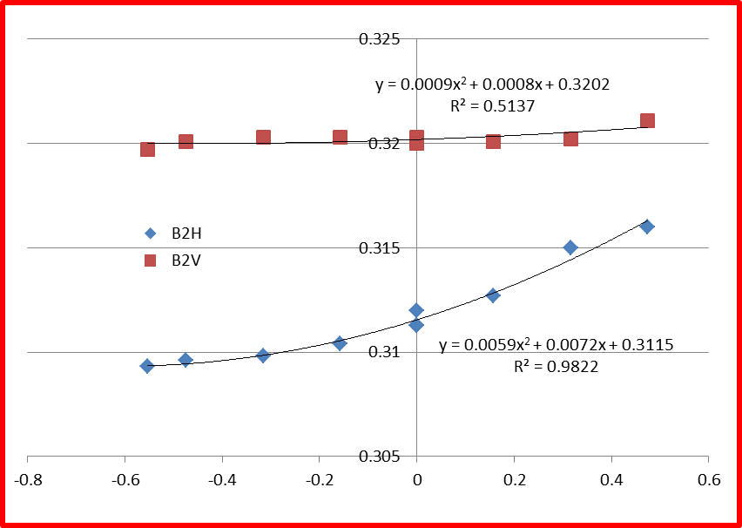
Octupoles -200 A ROD
Beam | Plane | Q’
1 | H | 8.6
1 | V | 0.9
2 | H | 7.2
2 | V | 0.8

Slide 5
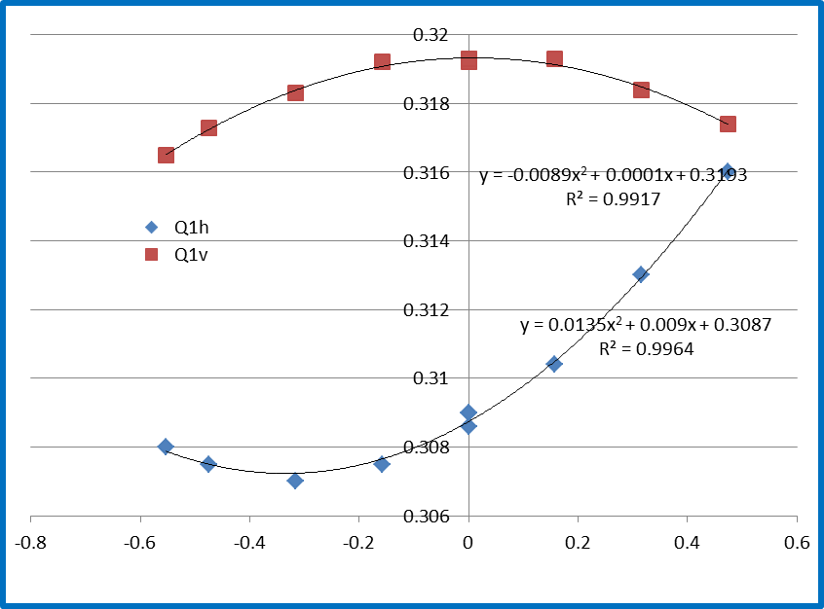
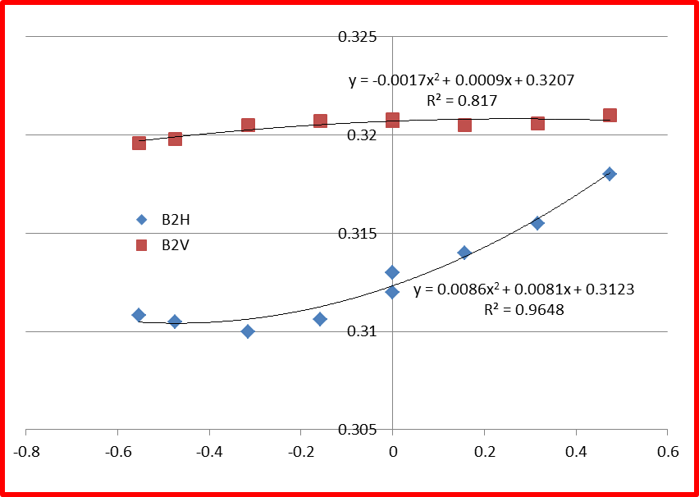
Octupoles -417 A ROD
Beam | Plane | Q’
1 | H | 9.0
1 | V | 0.1
2 | H | 8.1
2 | V | 0.9

Slide 6
Saturday afternoon
16:00 Another attempt, put back on longitudinal blowup in SPS (50%) – beams too bright? Drop intensity.
17:50 Again losses at end of squeeze from B2… dump.
Large losses new Pt5 in ramp, well above Pt7. Vacuum?
18:50 Trying again, octupoles back to pre-TS2 settings (revert last weekends trims) for B2.
20:00 Again dump - same signature.
21:30 Trying again, undo Q’ H trim of ~ +2 done last Thursday for B2 at last point of squeeze.
Q’ H now ~0 at that point – according to measurements…
OFC crash during filling - cs-ccr-ofc had to be rebooted,
Problems with XPOC blocked (and experts ‘busy’).

Slide 7
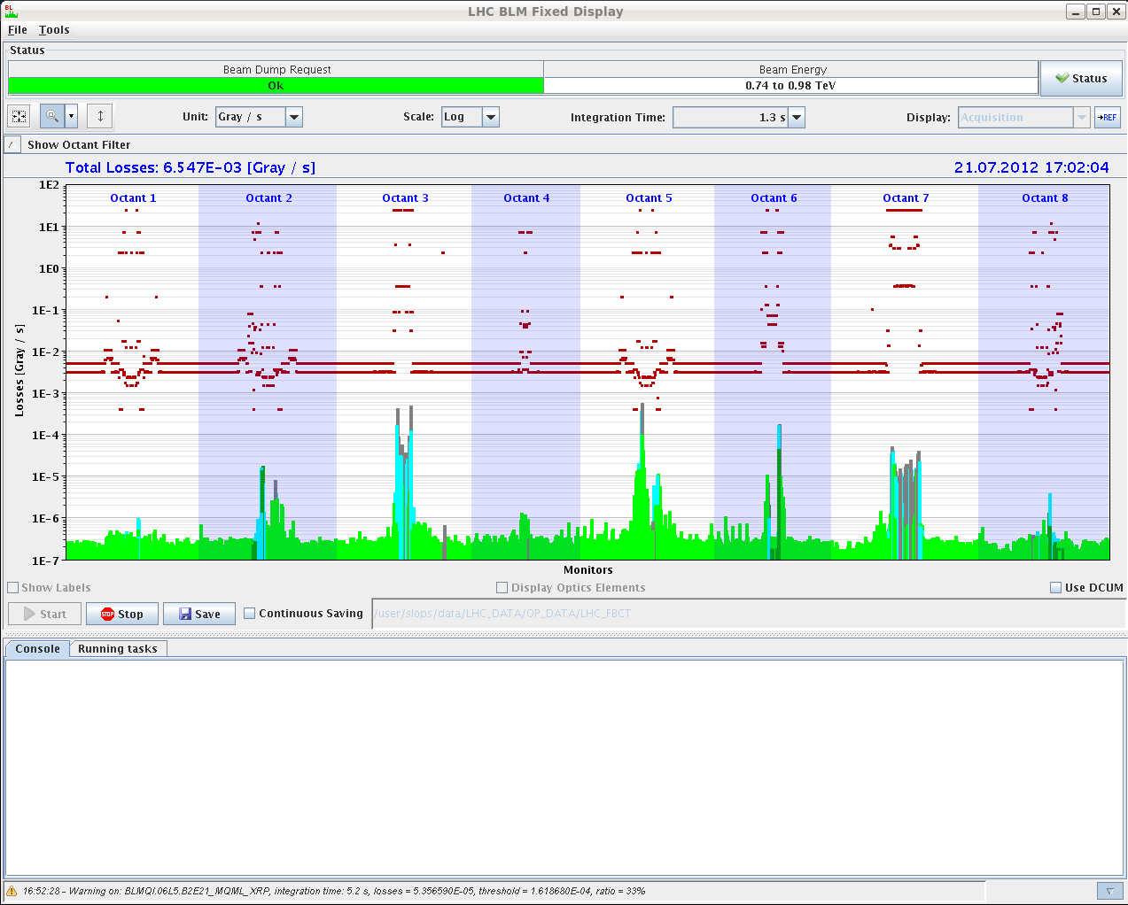
Losses fill 2866 in ramp
Losses up to warning level on 83s RS towards end of ramp. Looks like local loss from vacuum.

Slide 8
Night
Decide to drop the intensity further to reach a ‘stable’ situation → 1.35E11 ppb.
00:30 Stable beams fill 2870, 5.4E33 cm-2s-1.
Conditions:
B1 settings same as last weekend, octupoles at 417 A.
B2 Q’H back to last weekend setting,
B2 octupoles back to highest values (~450 A),
SPS longitudinal blowup ~nominal.
What’s the next step?

Slide 9
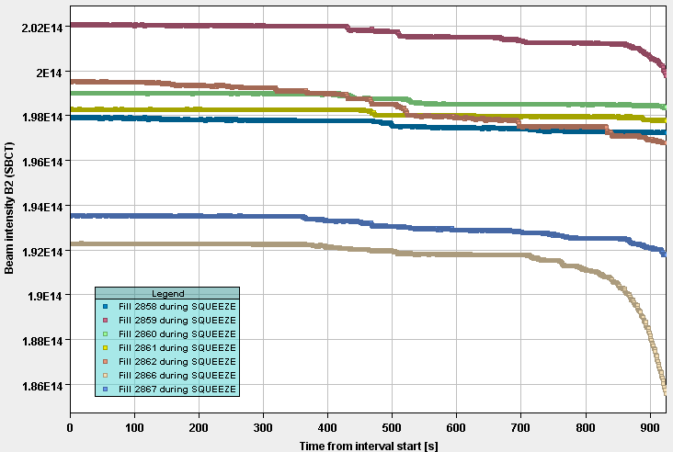
B2 DC BCT in squeezes 2858-2867
2858 and 2861 made in into stable beams.
The best squeezes in terms of BCT losses,
Both without long. blowup in SPS.
2861
2858

Slide 10
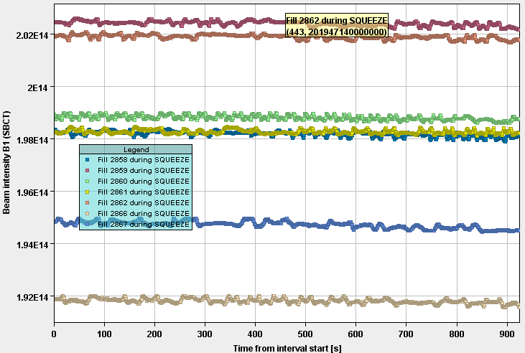
B1 DC BCT in squeezes 2858-2867
B1 completely insensitive to scraping and long. blowup in SPS (but BCT a bit noisy).

Slide 11
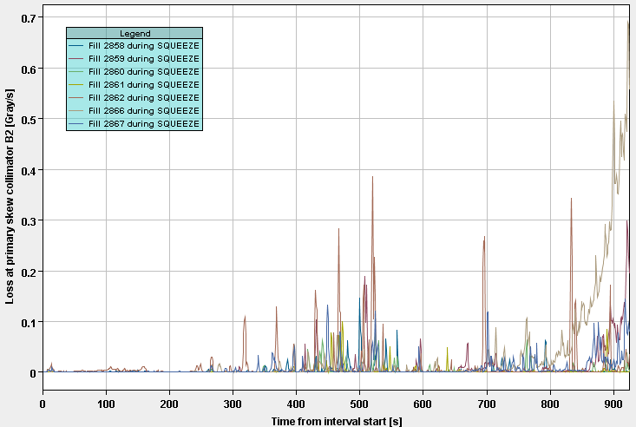
TCP losses B2
Losses on B2 H and skew collimators dominate

Slide 12
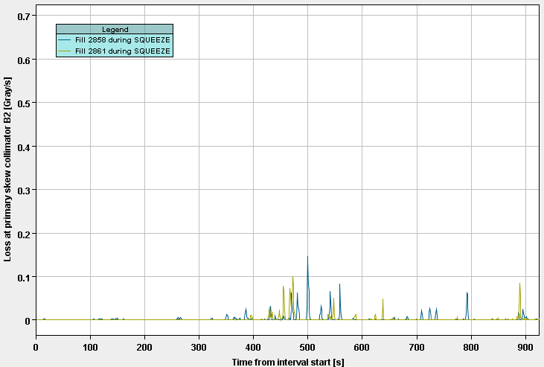
TCP losses B2
Same plot as before for fills 2858 and 2861.

Slide 13
Excluding the last lower intensity fill, the 2 fills that made it into stable beams since Thursday:
Had no longitudinal blowup in the SPS,
Small B2 losses in squeeze,
Bright beams,
Octupoles at 417 A.
But we also lost more fills in ~same conditions.

