Slide 1
LHC Status Mon Morning 16-July
Bernhard Holzer, Jan Uythoven

Slide 2
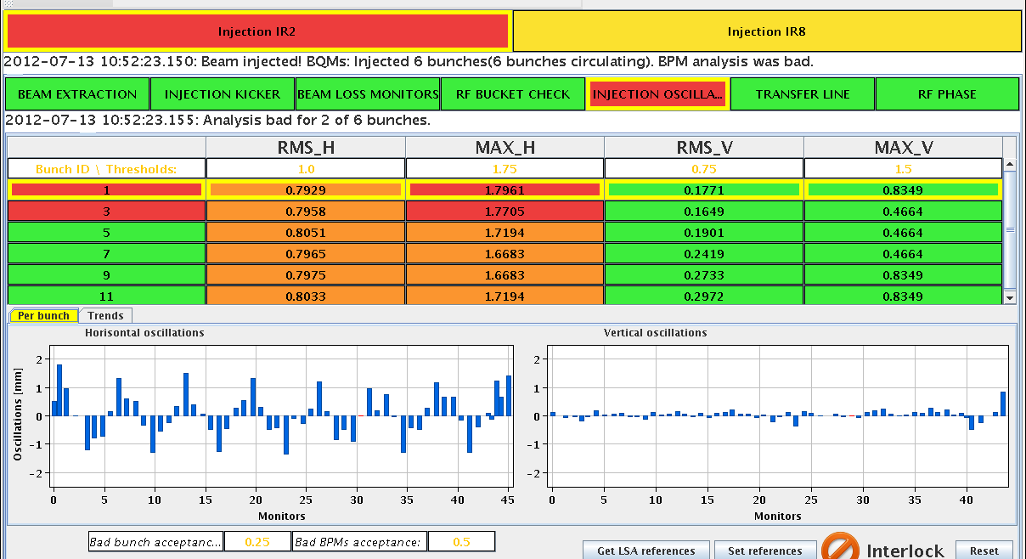
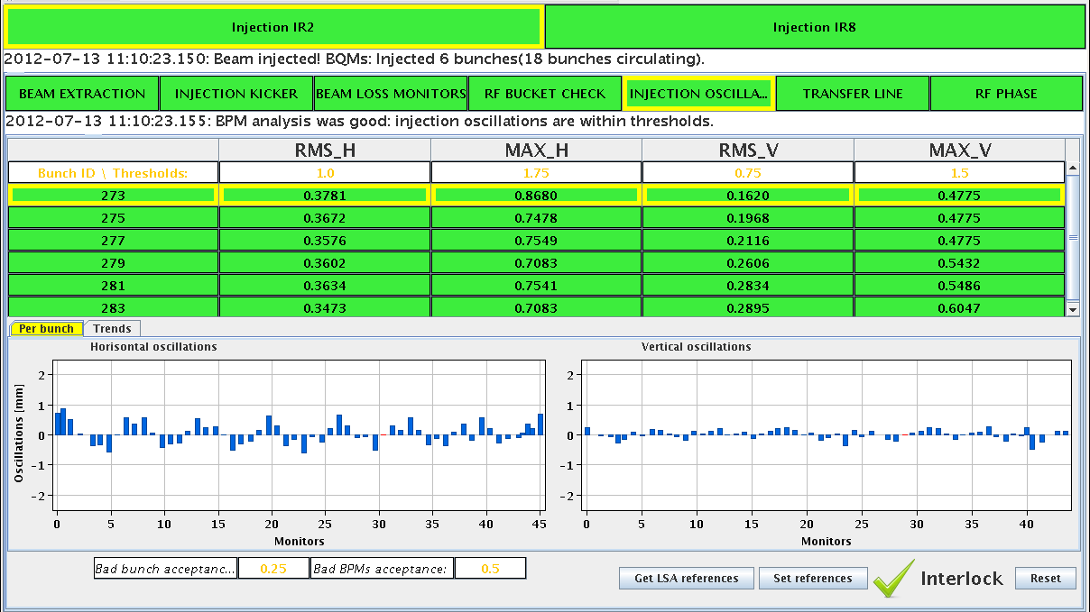
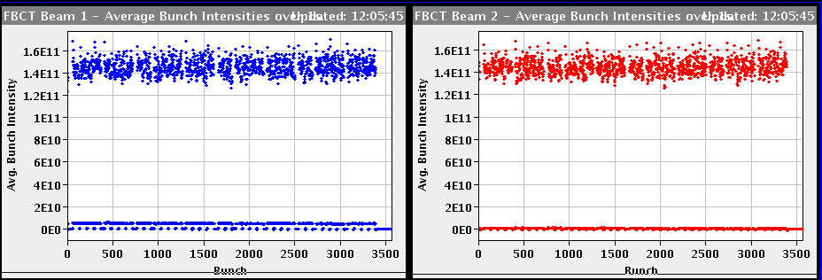
Fri Morning
... back to standard after 90m run
07:14h power converter fault IT 56 (RQTX1.R5 overcurrent)
09:22h probe beam & injection optimisation
11:21h injection physics beam

Slide 3
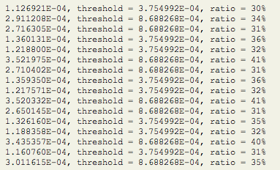
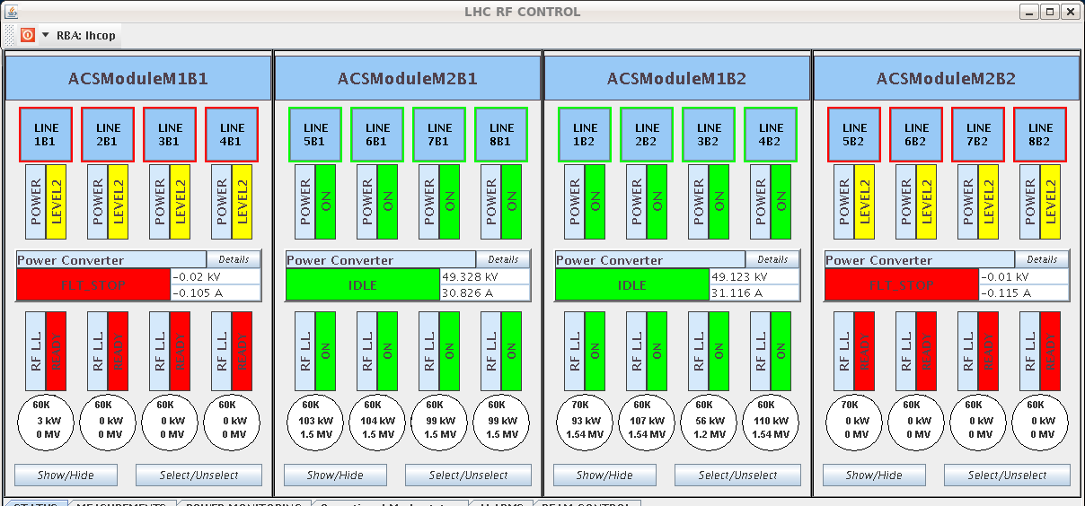
Fri Morning
12:12h Ramp & squeeze
12:58h beam dump during adjust:
Trip of IT.R5 again
and some minutes later: RF modules M1B1 and M2B2 tripped
(fault in control rack ... broken fuse)
→ access
β* = 2.2m

Slide 4
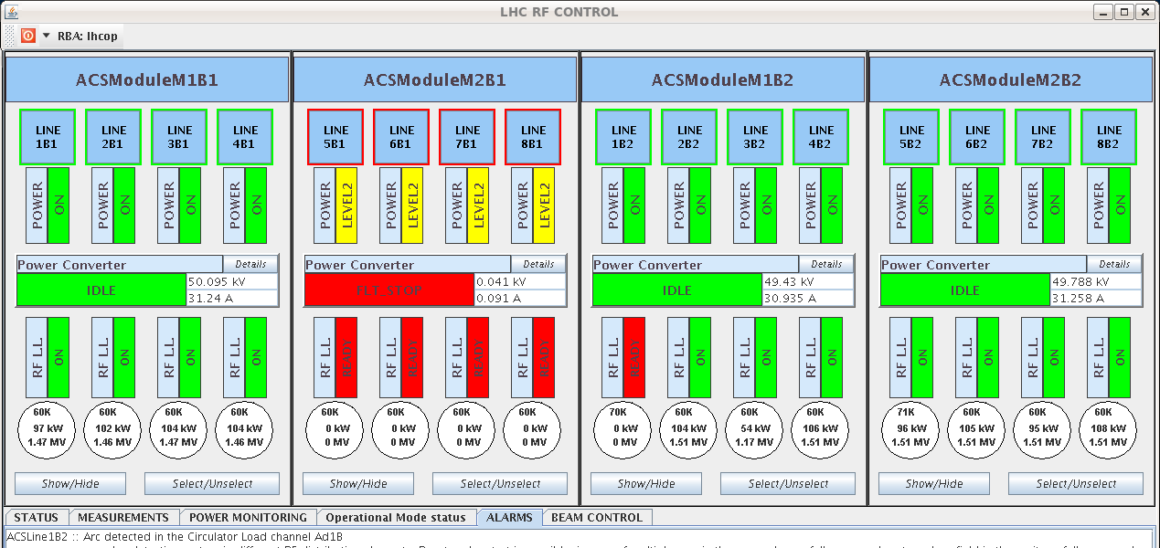
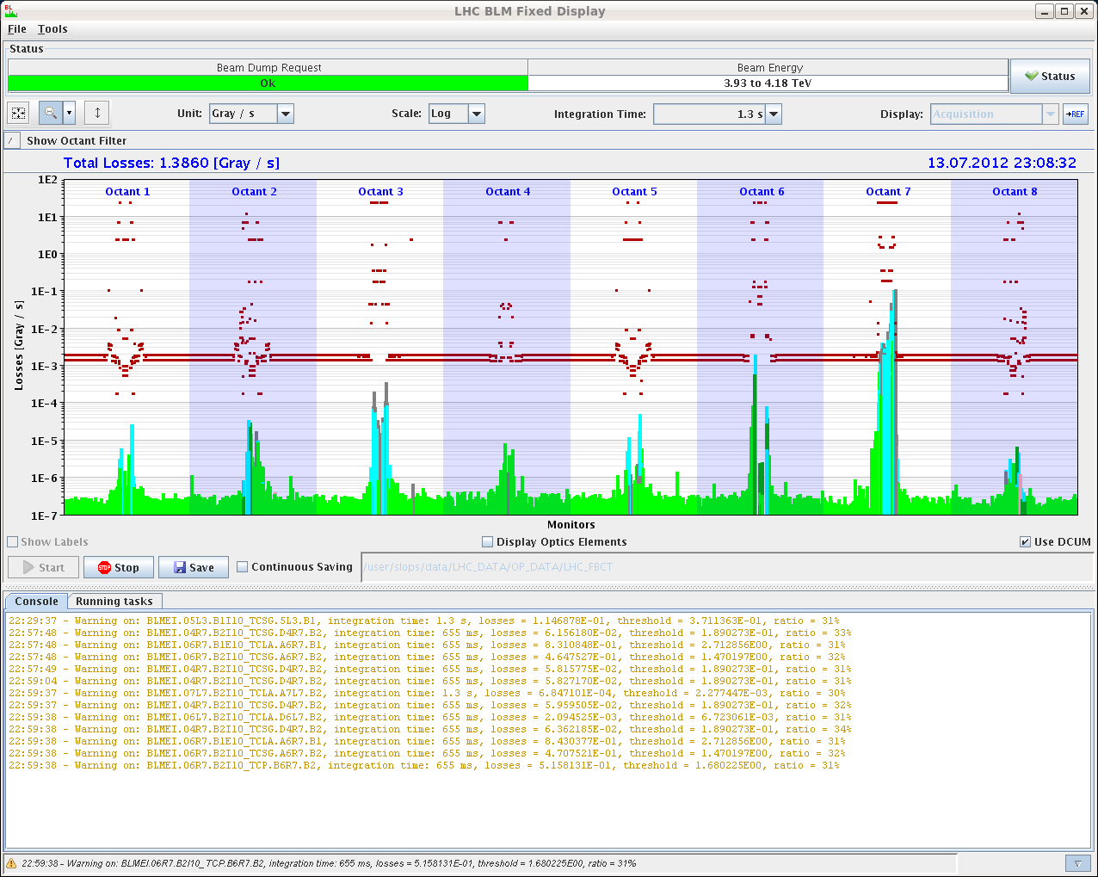
Fri Late
15:31h restart, pre-cycle
18:03h injection probes & waiting for SPS
19:05h injection for physics
20:00h ramp
... and beam dump: RF problem
spurious trigger on crowbar
21:27h new injection, ramp, squeeze, adjust

Slide 5
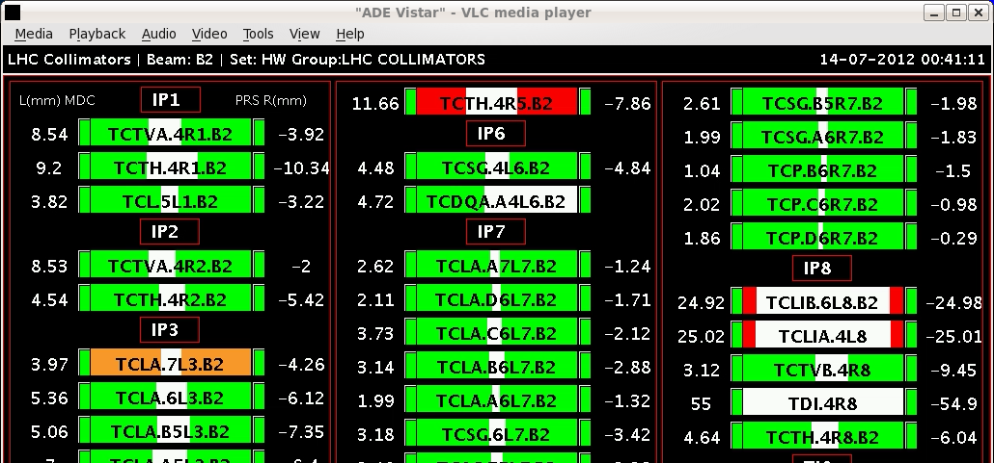
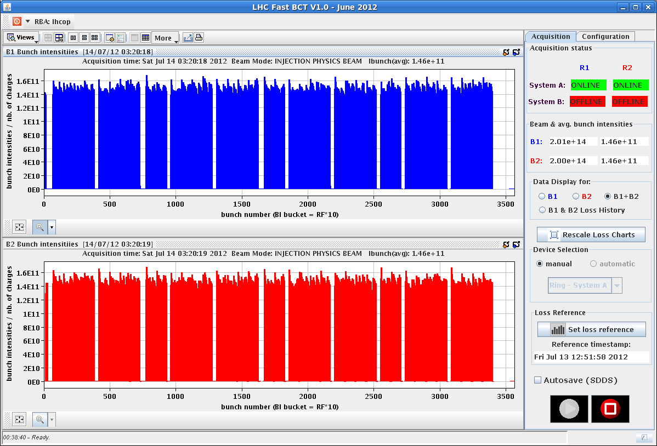
Fri Night
23:23h stable beams
00:38h beam dump: spurious rigger from collimators
interlock from collimator motor on TCTH.4R5.B2
02:54h precycle & new injection
Emittances
B1H = 1.98 B2H = 1.67
B1V = 1.73 B2V = 1.9

Slide 6
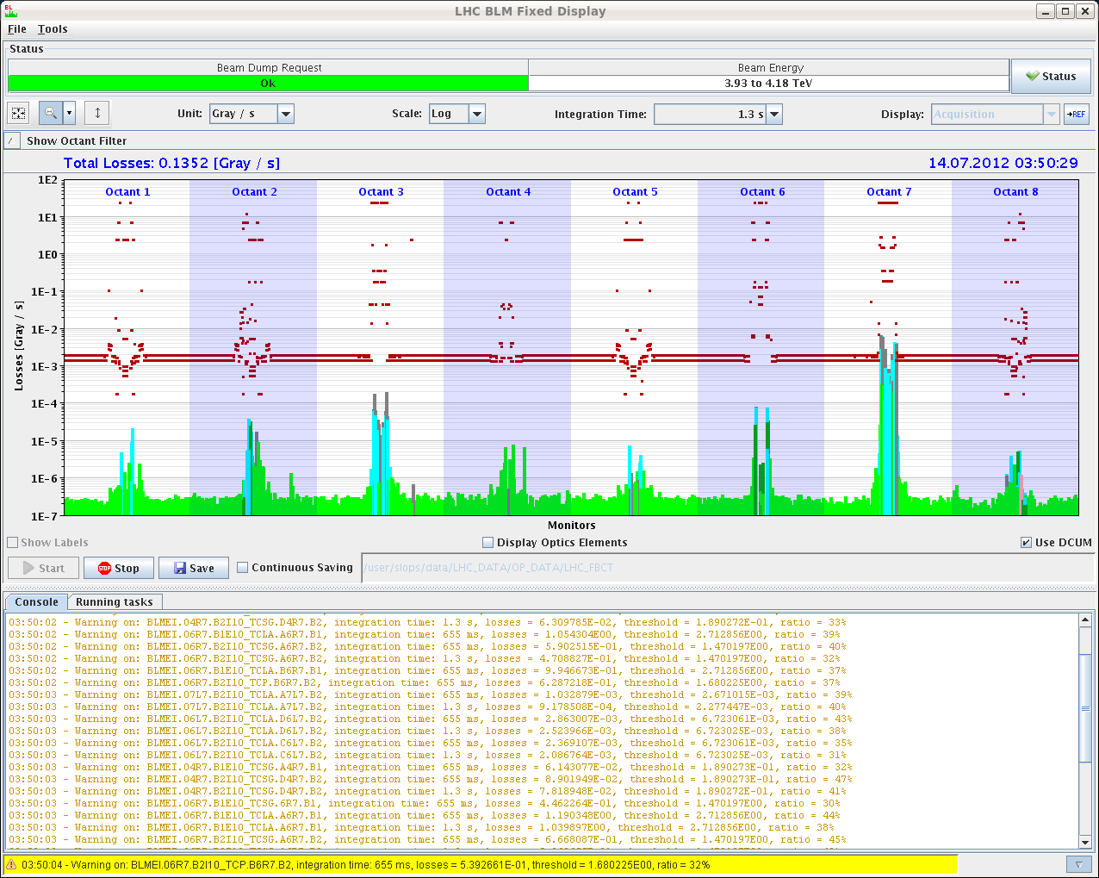
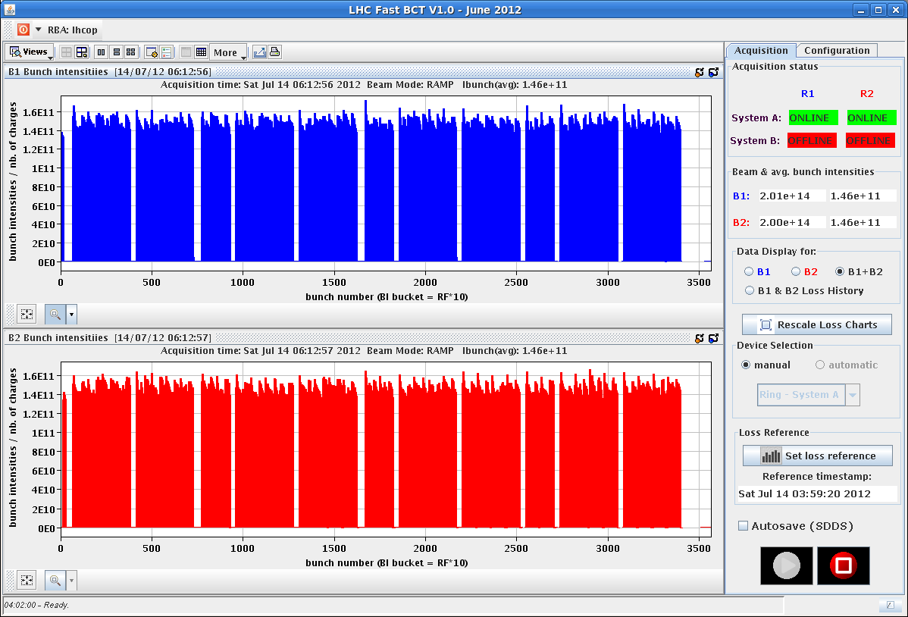
Fri Night
ramp & squeeze: ok
Losses up to 47% in IP7 around 2 m beta*
04:01h beam dump:
High losses on RS9 on TCTH.4R5.B2
going into collisions.
05:34h ... once again ... injection
06:23h ramp ... ok
carefully checking the Q trim currents

Slide 7
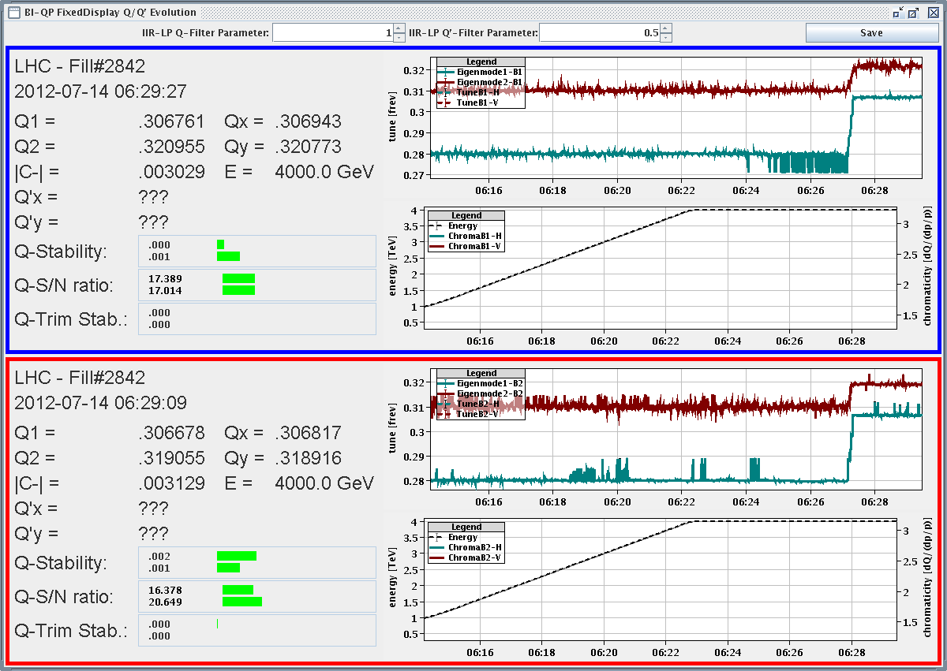
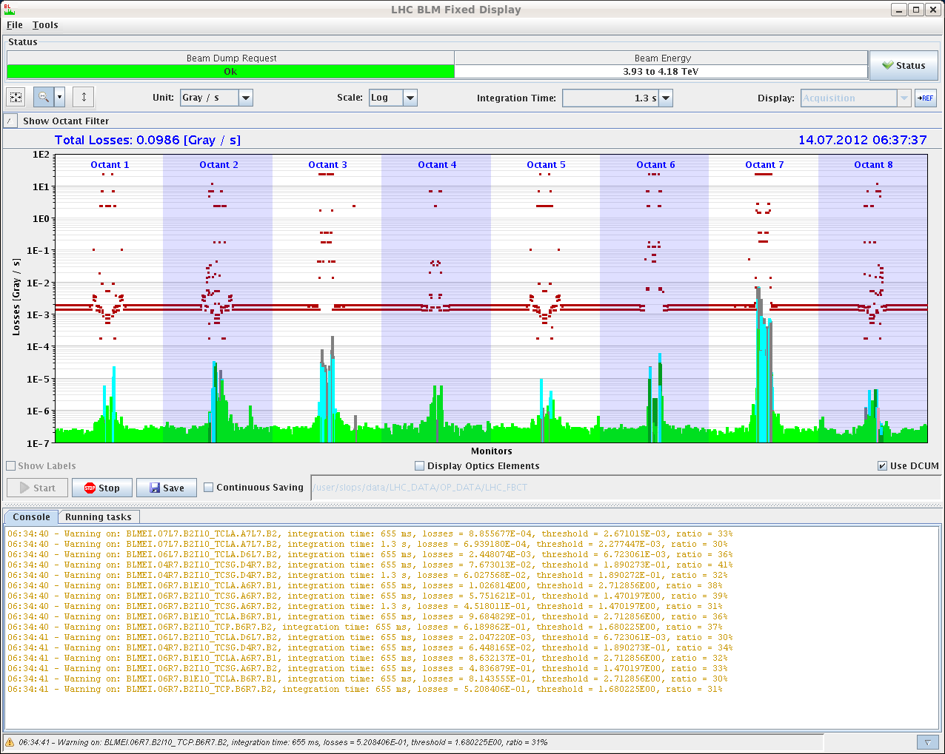
Fri Night
06:27h squeeze: “much cleaner tune signals than in the
previous fill”
again: some losses around β*=2m, 41 %
06:58h stable beams

Slide 8
Sat Morning / Late
06:58 Stable beams fill #2842
18:30 Operator Dump, Int. Lumi 147 pb-1
21:17 Stable beams, fill #2843, initial lumi 5.9/5.6e33 cm-2s-1
05:04 beam dump due to RQTL11.L1B2 trip. Int. Lumi 113 pb-1

Slide 9
Fill #2843
Some small changes – which might have an effect:
SPS some stronger scraping in the H-plane and relax a bit on the V-plane scraping
Octupole knob from 3.7 to 3.6, current now to 415 A in the squeeze
Dropped QH increase during collision beam process from 5e-3 to 3e-3 based on BBQ measurements
Still lowish bunch intensities of 1.44e11resulting in low initial lumi’s: 5.9/5.6e33 cm-2s-1
Only BLM warning from UFO at 1 TeV
83 % on TCDQM.4L6.B2, ouf!
Turnaround of 2h45min!

Slide 10
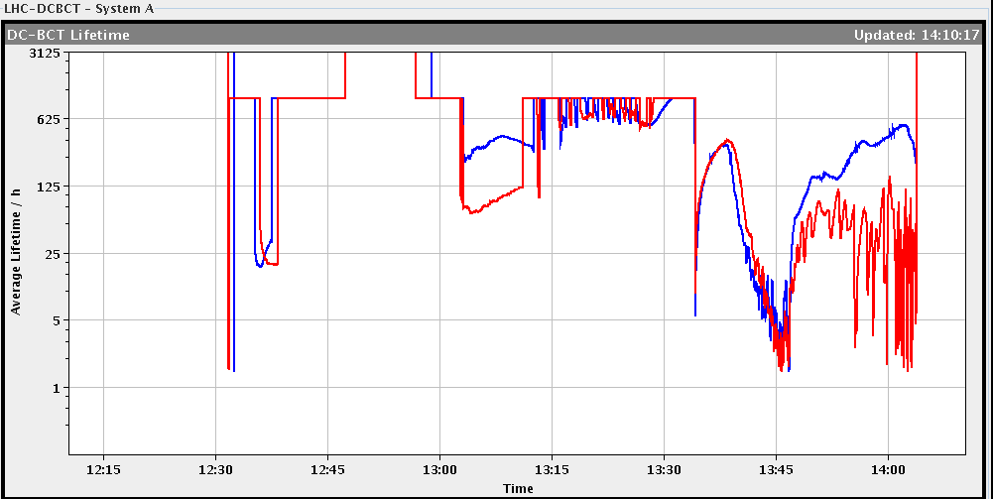
Sun Morning
07:13h beam dump during squeeze: cryo loss
faulty crate that controls the valves on the DFBMH.
access in UJ33 to repair a faulty ODH detector
10:00h injection / ramp ...
beam dump due to PC fault: RQTL10.L7B1
“... smells like SEU on QPS...”
10:00h injection / ramp / squeeze
14:03h beam dump during squeeze at β*=1.6m
15:07h during pre-cycle:
Trip of RSD1.A67B2 triggered by QPS,
DCCT signal wrong, not understood

Slide 11
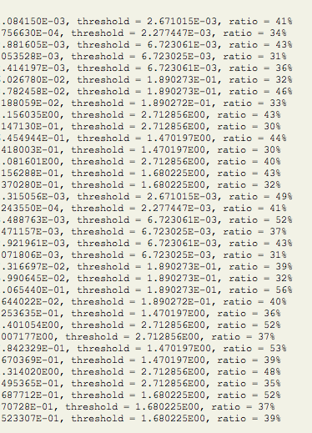
Sun Late
16:07h injection physics beam
ramp /squeeze / adjust /
17:44h stable beams
low luminosity in ATLAS due to the
incorporation of yesterday,
losses in squeeze
21:40h beam dump
Trip of RCBXV2.R1 due to false QPS trigger (suspected SEU)

Slide 12
Sun Night
Emittances (144) B1H = 1.86
B1V = 1.79
B2H = 1.83
B2V = 1.97
22:37h injection physics beam
ramp /squeeze / adjust /
00:18h stable beams
06:00h still ... stable beams :-)

Slide 13
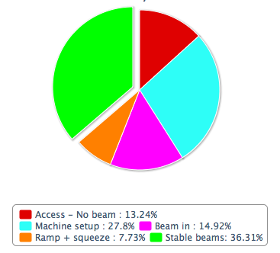
Resume of the Week:
fill # | date | int Lumi | length | dump
2836 | 12-July | 0.058 (90m) | 13:03 | OP/RQX R5
2840 | 13-July | 24 | 1:14 | Colli moving
2842 | 14-July | 147 | 11:32 | OP
2843 | 14-July | 114 | 7:46 | Power Converter
2847 | 15-July | 66 | 3:55 | QPS

Slide 14
Resume of the Week / Plan
Floating MD’s
90m Run set up, loss maps & physics
back to Standard Operation
Plan VdM Scans
Routine Runs for Physics
New Procedure for Adjust
Octupoles ?

Slide 15
VdM scan configuration (court Joerg)
Beams : ~ 50 individual bunches.
Collisions with injection optics (but with collision tunes).
Beta* 10 m in IR2/IR8, beta* 11 m in IR1/IR5.
No SQUEEZE !
External crossing angles (in microrad).
IR1 and IR5 : 0 FT default : ± 145
IR2 : -90 -90
IR8 : +200 -220
IR8 crossing bump in horizontal plane.
Dedicated hypercycle : 4TeV_10Aps_0.6m_VdM
Standard injection and ramp.
Collimation with 2011-style settings (TCP @ 5.7 sigma).

Slide 16
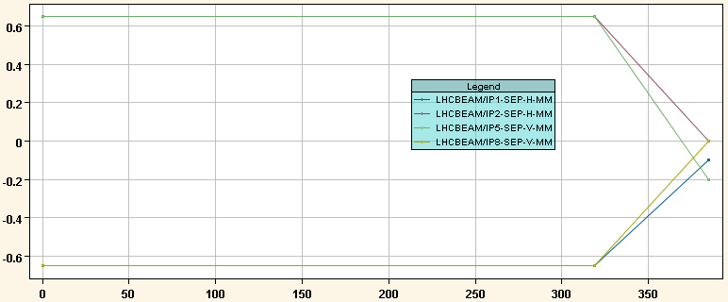
VdM collision beam process
(1) Tune change
(2) Xing bumps
(3) Separation bumps
(+ lumi scan corrections)

Slide 17
VdM setup
Commissioning with beam of the collision BP.
With 3 nominal bunches.
Find collisions, optimize, incorporate corrections.
Align TCTs around orbit.
Estimate ~4 hours.
Collimation & protection validation in collision.
H and V betatron loss maps,
Off-momentum loss maps (+/-),
Asynchronous dump test.
Estimate ~ 1 shift.

