Slide 1
Thursday 12th July
06:04 injection & ramp: beam dump QPS trigger RSD1.A45.B2
09:25 another ramp for 90 m optics run: beam dump due to collimator energy threshold function interpolation
10:39 RSF2.A34B1 tripped at injection settings: access for EPC to fix. In parallel access for QPS
12:41 Phantom of the ventilation doors passed by in Pt 2 (UL26)
13:11 Door closed
13:56 No beam from SPS, RF problem needing an access.
15:46 Injecting again.
17:09 Ramp for 90 m physics run started.
18:10 Stable beams fill #2836
18:30 Roman Pots in
07:14 Trip of IT-R5 just before programmed dump
Preparing for nominal production fill

Slide 2
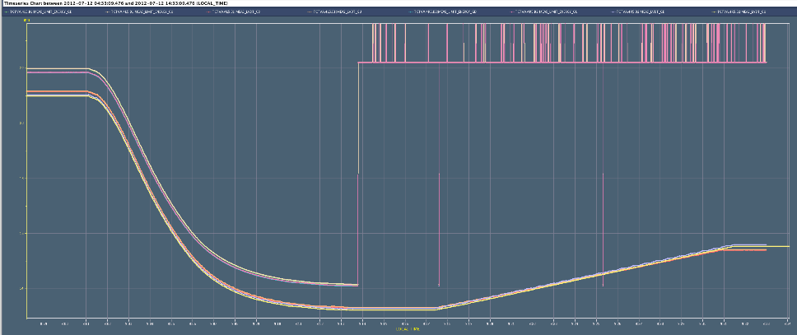
9:25 Dump during Squeeze at 30 m b*
Beam dump due to collimator energy threshold function interpolation

Slide 3
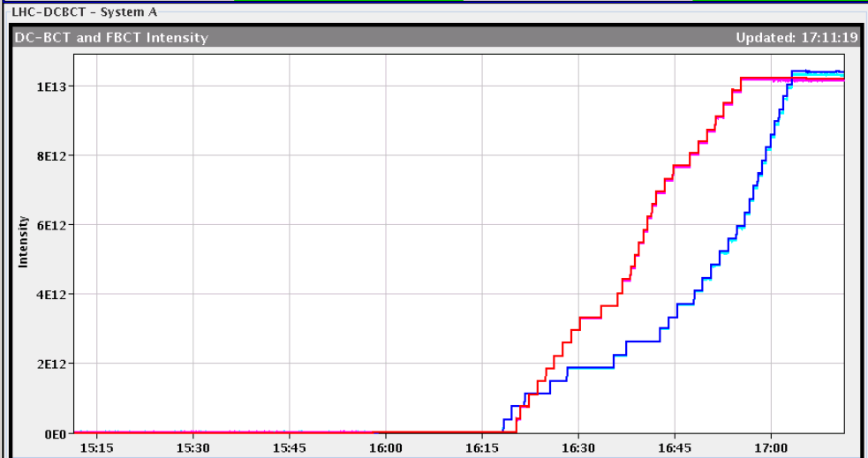
Fill #2836 finally made it
Injection rather smooth, but takes about 45 minutes

Slide 4
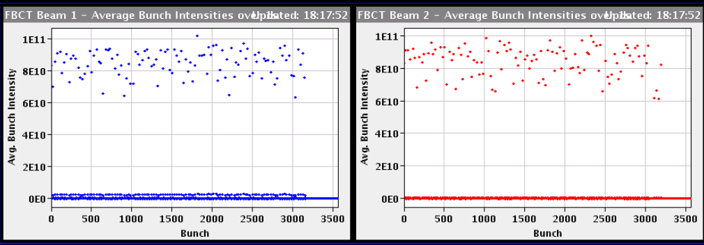
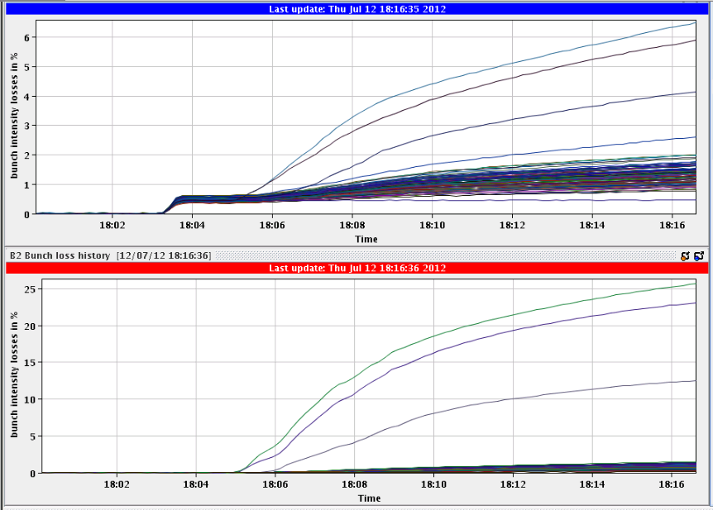
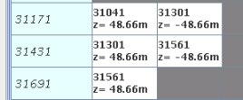
Non colliding bunches (again)
Long range causing loss of 3 non colliding bunches
B2, 2 bunches 25 losses in 15 minutes
Should ‘collide’ > 60 m (after D1)

Slide 5
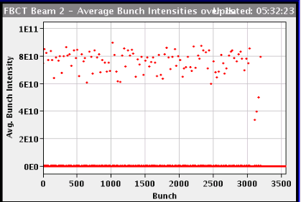
Bunch intensity decay, still ok this morning...
‘Normal’ collisions
Only long range at 48 m
Dump limit

Slide 6
The Plan
90 m physics run until 7 am this morning
Back to ‘standard’ physics production
Develop additional break point for going in collision in parallel. Will need about three test fills, spread out over the coming days
Fill with 3 bunches or so to do first test
Fill with 36 bunches (trains of 50 ns) to correct leakage
Intermediate intensity fill (something like 480 bunches)
Octupole polarity change postponed for the moment
Need to define the strategy

