Slide 1
Friday
Access for QPS in the morning.
12:00 Injection for 90 m setup.
Ramp and squeeze reasonably smooth, but indiv emittances somewhat large on LHC side.
2.5 um or so, 1.3 um in the SPS.
14:00 Going into collision. Beams colliding a bit right away – some lumi signals clearly observable.
The only corrections taken over from 60 cm were trims on the separation knobs (H IR1, V IR5).
After about 2 minutes, large losses on B2 for the bunches colliding in IR1 and IR5.
Octupoles were at ~200 A, ADT on at reasonable gain (not max).

Slide 2
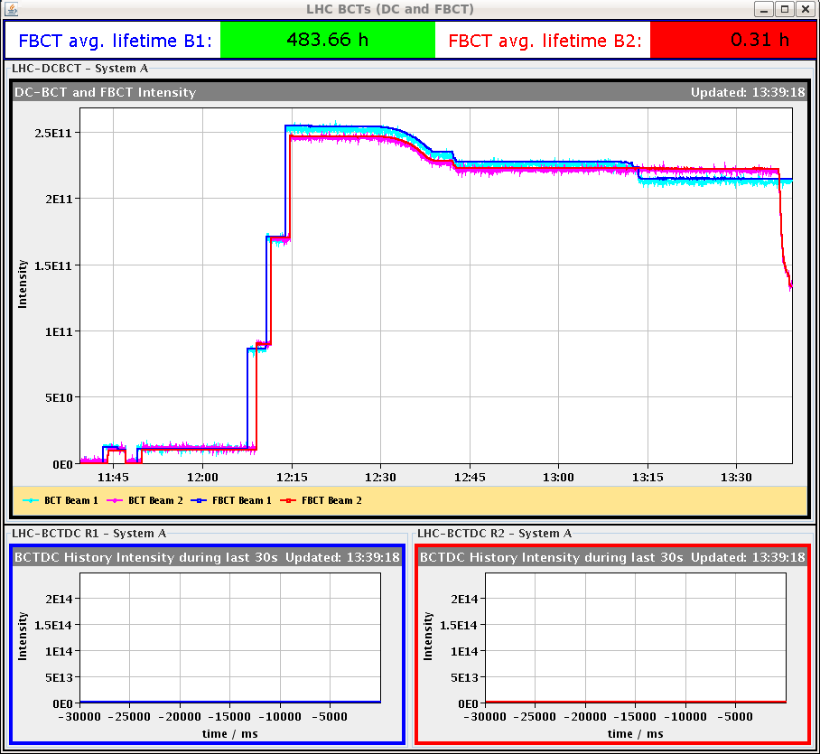
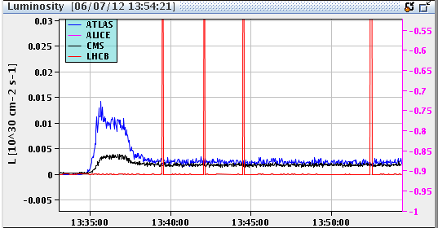
Luminosity and losses
B2 instability after ~2 minutes in collision
Luminosity in IR1/5

Slide 3
Friday afternoon
Killed the 2 bunches of B2 that had heavy losses with the ADT, to be able to measure orbit correctly on B2.
Saw a funny structures that seemed related to the separation knobs in IR1/5. Finally understood that the knob shape for the OFB at 90 m had been accidentally calculated from the 900 m optics. Can carry on like this, just a small shape mismatch between Q4-Q6.
Checked and corrected Q’ (small upward trim on B2H).
Trimmed octupoles to 300 A and checked Q’ – OK.
15:00 Ramp down
16:00 Access in US15 – major water leak. Vacuum crate and ATLAS safety system (sniffers) affected.
In the shadow A. Bland fixed the SPS SIS server (thanks' a lot).

Slide 4
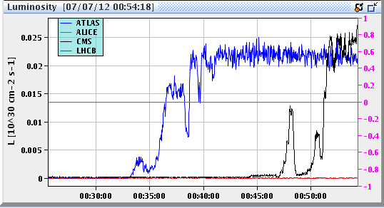
Friday night
21:45 Pre-cycle.
23:00 Filling again for 90 m.
00:30 Going into collisions again. This time:
Octupoles at 300 A.
First collide only at ATLAS → get some Q spread from head-on BB.
Once ATLAS optimized, collide at CMS.
00:50 Both IPs optimized. No problems this time.

Slide 5
Q in R & S
With lower ADT gain can keep QFB on in squeeze. Very smooth - ~no corrections, very good feed-forward.
But also here some issues with B2H Q trim in the ramp. Looks familiar…

Slide 6
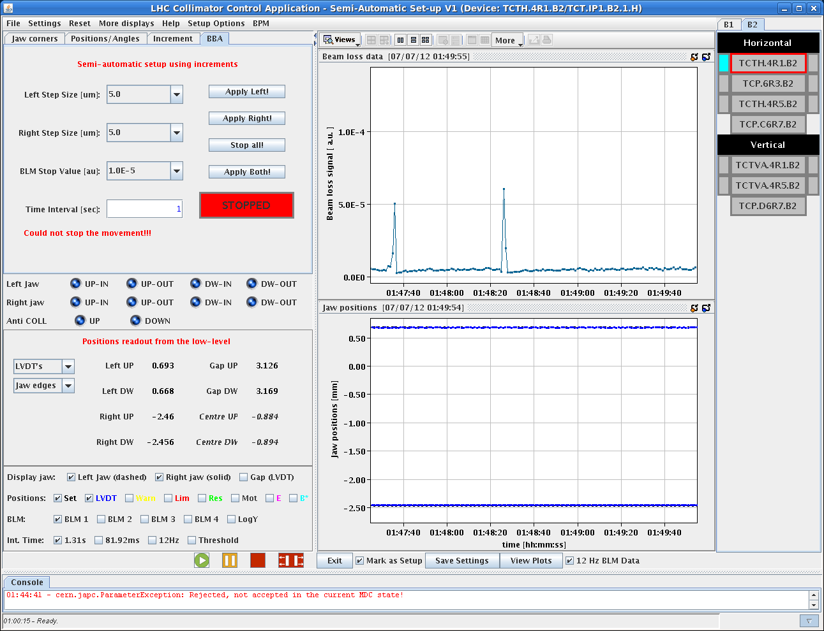
Night continued
01:15 Start of collimator setup.
When the TCPs were close to the beam, started to observe loss spikes with the period of the SPS super-cycle. Correlated to the LHC probe cycle (probably TI2/8) – removed from the SPS super-cycle.

Slide 7
Night continued / Sat morning
02:20 TCTs aligned. Start of RP setup.
05:20 Beam dump during setup –BLMs in IR5.
06:30 Refill for 90m (actually a mis-understanding).
08:00 Start of unsqueeze.
08:45 ATLAS magnets start to ramp down.
Today
Use this fill for TOTEM elastic run, H RP alignment, loss maps. Until ~12:00-13:00.
Then access for ATLAS until ~ 15:00.
Refill for physics, hopefully with ATLAS magnets on.

