Slide 1
LHC Status Mon Morning 2-July
Bernhard Holzer, Jan Uythoven
Plan for restart after Technical Stop
Machine closed. Ramp for powering tests & pre-cycle
Pilots through nominal cycle up to collisions. Measure chroma during squeeze. Check dump of pilots
If time left over night: second ramp with pilots. Open primary collimators at flat top for manual chroma measure at collision
Check BPMS.
3 nominals. Interlocking with bump and scraping
BPMS – TCSG. Measure beam position w 12 nominals. Call Jorg. If position changed, check TCSG alignment
Ramp into collision 2 – 3 nominals (< 3e11) for Roman Pot alignment. In principle only Totem alignment, max 5 hours alignment. Finish fill with
Betatron loss maps with resonance crossing
Asynch dump tests

Slide 2
Plan for start-up with beam
Fill with 3 nominal bunches for loss maps (<3e11 p)
Betatron loss maps at the end of the squeeze with separated beams (using the ADT on bunch 1 and 2)
Possibly repeat betatron loss maps in physics (resonance) if not enough beam was left in the alignment fill.
Negative off-momentum in physics (Roman pots IN)
Sunday
02:00 No beam in the machines for the leap second
Repeat another fill for asynch dump tests with Roman Pots in if there was not enough beam left after RP set-up
injection loss maps with ADT method at injection – can also be done during the intensity ramp up
If things go extremely well already start the intensity ramp up

Slide 3
Intensity ramp-up
84 bunches: 2 hours Stable Beams
480 bunches: 6 hours Stable Beams for ATLAS (but don’t refill)
840 bunches + 12 non colliding: Production fill
1380 bunches: Production fill
✔
✔

Slide 4
Fri Late / Night
19:50h starting a test-cycle ramp and squeeze
ALFA movement tests ... -> problematic station A7L1
20:00h trip of RQX.L8 at about 1500 A
20:25h switch closure problem on RCS.A23B2. Access needed
21:44h repeating the ramp on RQX.L8 -> trip at 1100 A
... problem of temperature on the current lead ... (Quench ! )
investigating on site (i.e. in tunnel)
exchannging cards ... error moves with the card
error located at a cable
23:03h problem in trimming the RF frequency -> fixed by Greg
04:43h RQX.L8circuit back in business
04:44h ice on a He valve ... checked by cryo ... to be followed up

Slide 5
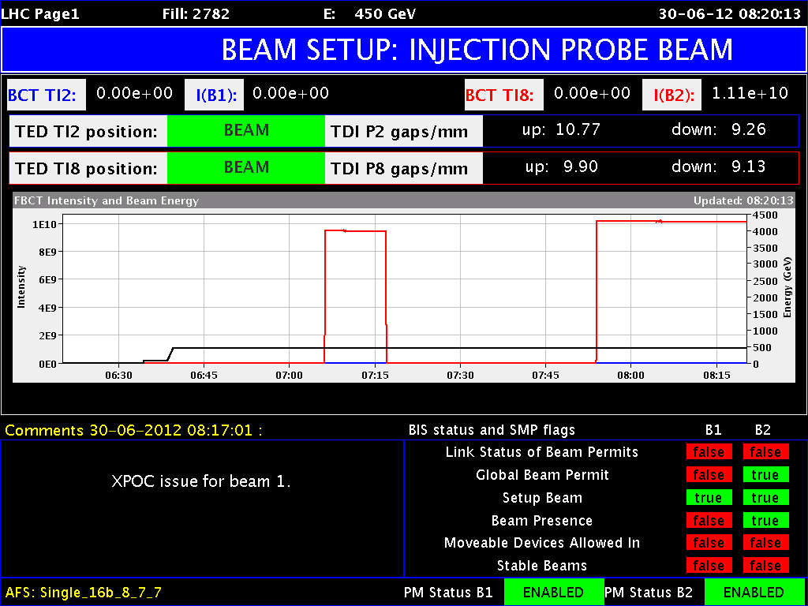
Sat Morning
06:09h Unable to change the beam mode;
“With Greg's help via telephone (he was at the airport) we managed
to fix the problem which prevented us from changing the beam mode
(the library junit.jar was missing in the LSA library folder).”
06:54h injection probe beam !!
at present: XPOC latched for
beam 1 and beam 2
after programmed dump.

Slide 6
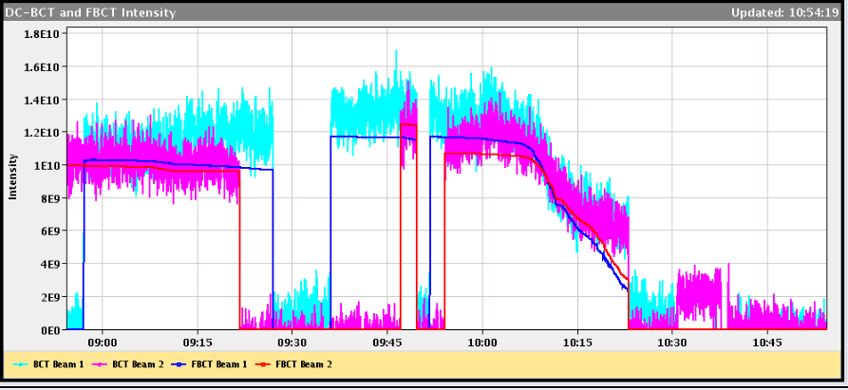
Sat Morning
10:00 First Ramp with 2 probes: loosing most of the beam on the ramp
Decide to call the RF, as more losses when freq. modulation on
Themis (RF)
Beam Phase Loop: A subset of the beam phase loop persistent settings were apparently set to zero when the module was re-initialized after the technical stop. We are suspecting that some controls changes during the week had adverse consequences. As a result we were effectively running with the beam phase loop open. This explains the debunching issues at flat bottom and during the ramp.

Slide 7
Two pilot ramps with large losses
Themis (RF)
Beam Phase Loop: A subset of the beam phase loop persistent settings were apparently set to zero when the module was re-initialized after the technical stop. We are suspecting that some controls changes during the week had adverse consequences. As a result we were effectively running with the beam phase loop open. This explains the debunching issues at flat bottom and during the ramp.

Slide 8
Themis (RF) Continued
Since the settings were lost, Daniel inserted temporary settings so that the LHC program could continue. These settings are NOT optimal for high bunch intensity operation, but should not interfere with the initial intensity ramp-up. We are hoping that the controls experts will be able to recover the persistent data. Otherwise, some time will be necessary to reset the beam phase loop on Sunday/Monday. No debunching was observed in the next injection.
Shortly before the above steps were completed, all four cavities of module 1B1 started oscillating. After our investigation, we once again found that even though the settings that had been adjusted during the RF startup yesterday were correct in FESA, they had been overwritten in the actual hardware. This is a bit concerning since it seems that running the sequencer was sufficient to introduce this error. We will also follow this up with the controls experts.
Everything seemed a lot better afterwards. Ramp 3 bunches for RP alignment was OK
Optimised settings put back Sunday morning

Slide 9
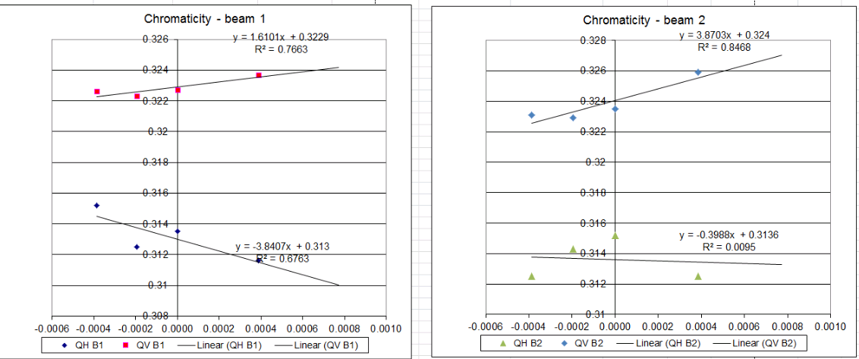
Manual chroma in second pilot ramp
Vertical chroma seems ok
Horizontal (close to) negative
Better repeat some time with better tune signals

Slide 10
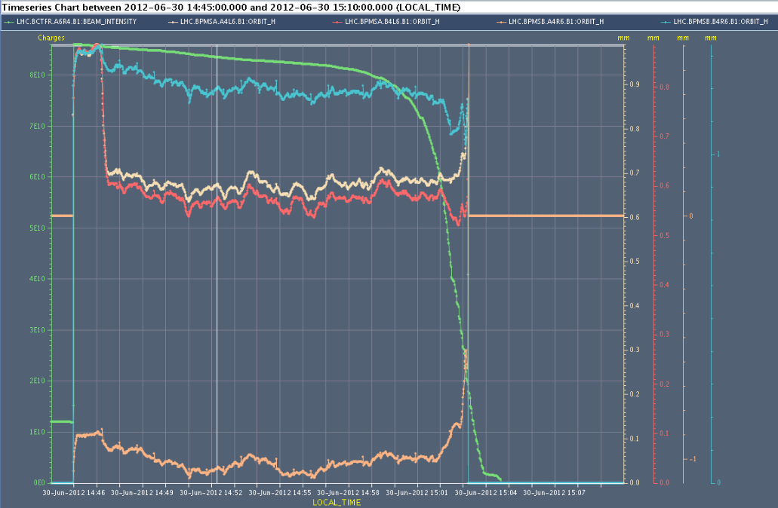
Sat Late
16:30h Check of interlock BPMS in IP6
Checks required after interventions during TS
Scrape bunch and check when reading lost = IL triggered:
At 2e10: perfect
Bump the beam and check when interlock triggers
At 3.0 +/- 0.1 mm: perfect
Check orbit reading with 50 ns trains, done with 12 bunches, relative to TCSG / TCDQ retraction
OK
...but dumped beam on first 12 bunch
injection and first pilot injection
OK afterwards ... Seems like a bad reading

Slide 11
Sat Late
20:03 Start ramp 3 bunches for Totem alignment
23:10 Totem starting alignment ... needed 2 hours.
Also moved Alpha in
Moved RP out for dump for leap second at 02:00
04:00 Ramped for loss maps with Roman Pots in
Collisions to perform loss maps. We carried out betatron loss maps in both planes, both beams (B1V lost very much intensity when crossing the resonance). We then did the OFF momentum loss maps (with very low intensity left in B1) and the beams were dumped by the unmaskable BLMs
One more ramp this morning for loss maps (see later)

Slide 12
Sat Night
02:00 Leap second
The recovery took about 2h as the communication with many systems was affected and we had to reboot the consoles and many control systems
A few minutes before 2am all the accelerators were stopped. At 1 second before 2am the leap second was inserted. The 1400 or so Linux Servers, Consoles and Front Ends + the LynxOS Front Ends correctly inserted it.
Some problems coming back – finally all worked out

Slide 13
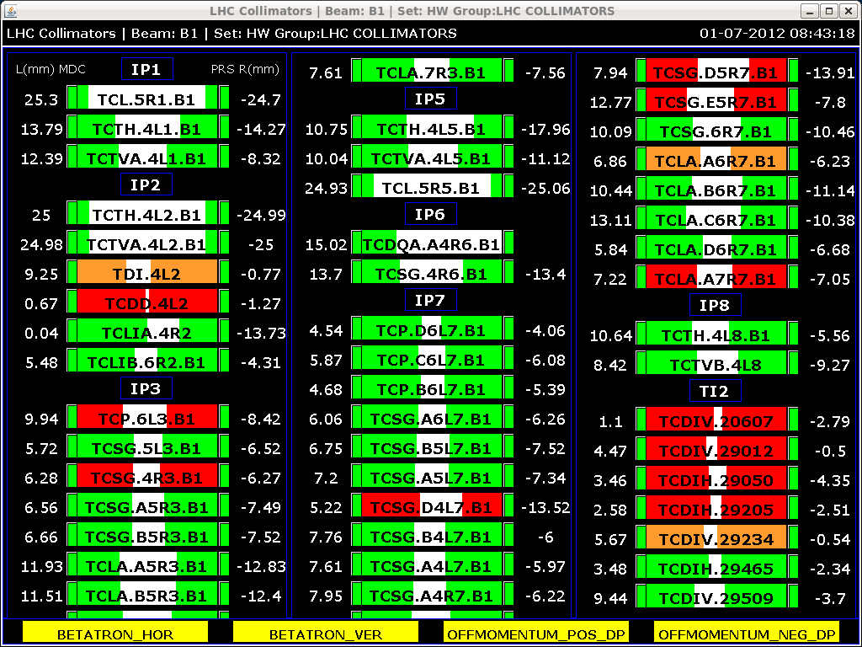
Sun Morning
07:00h EDF problem, 2 RF modules,
5 sectors (S12, S23, S67, S78, S81) and dipoles of ALICE and LHCb.
08:40h injection delayed: As a consequence of the electrical glitch
...many collimators seem to have steps lost.
10:09h Lost power converter RPTF.SR3.RQ4.LR3
(at injection) -> piquet
“short circuit on electronic”
10:09h Injection probe beam
16:32h cogging problem, cannot inject beam 2
-> re-synchronisation
17:05h finally: ramp

Slide 14
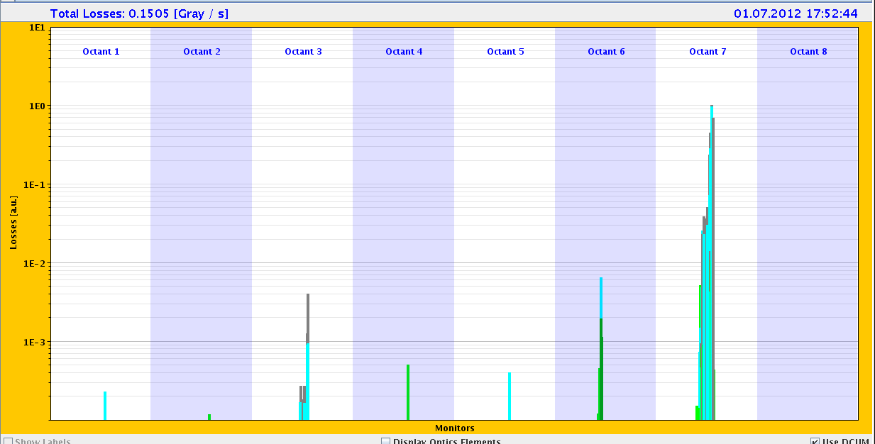
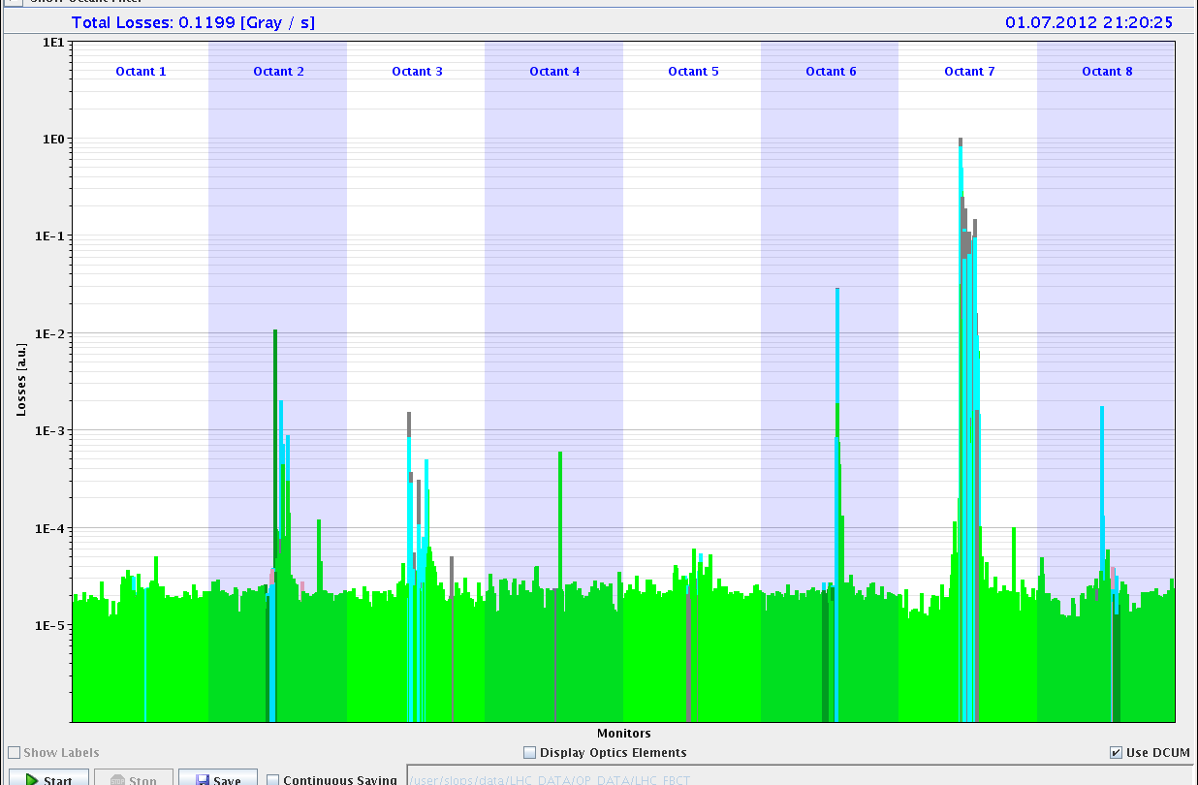
Sun Late
17:50h loss maps in Squeeze &
asynchronous dump with RP “in”
20:00h“again problem with the RF beam 2 cogging”
21:00h loss maps at injection ... with / without
injectio protection collimators

Slide 15
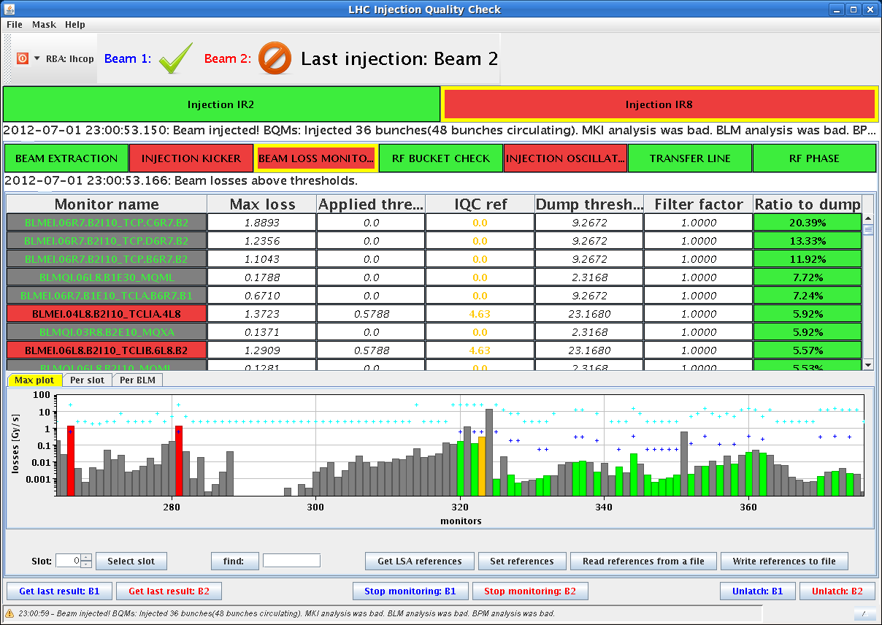
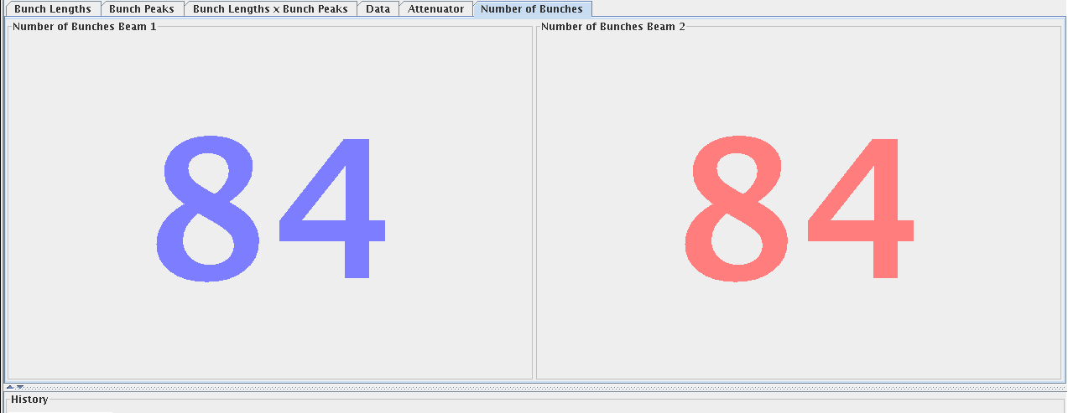
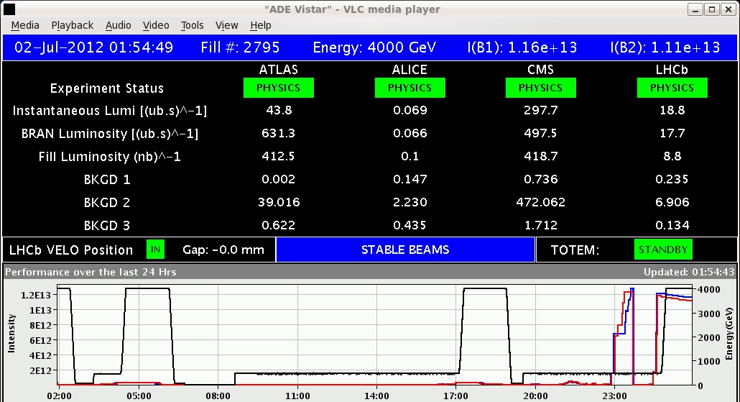
Sun Night
23:00h injection for first intensity step (84 bunches)
large inj. oscillations
23:42h “B2 dumped at injection due to problem on MKB.
fault was triggered by a wrong acquisition of 2 vacuum gauges”
00:25h injection physics beam
01:00h squeeze / adjust / collisions

Slide 16
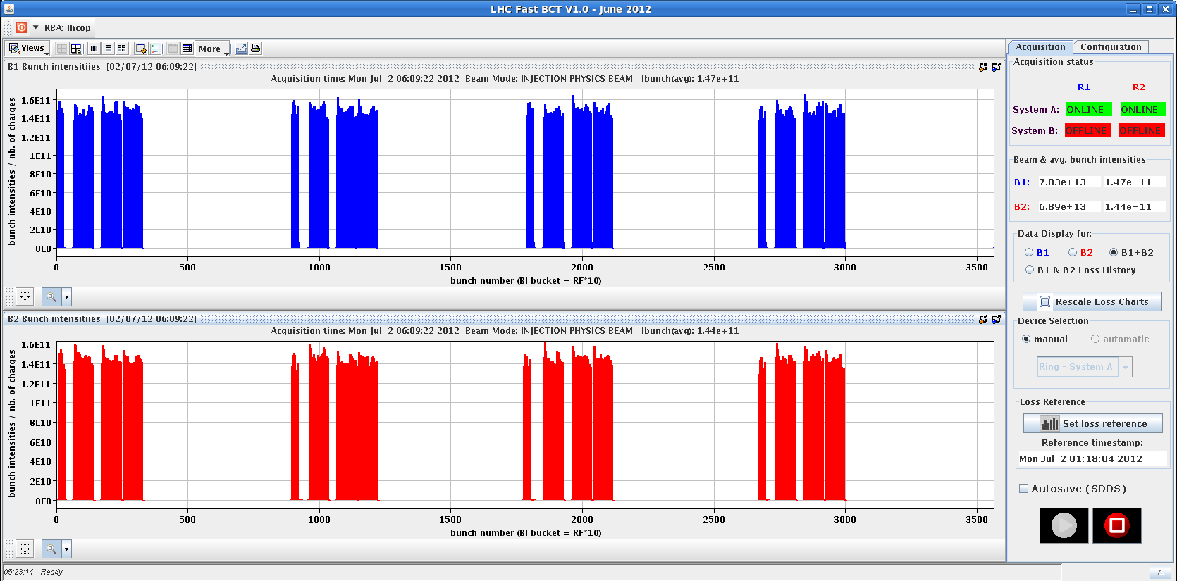
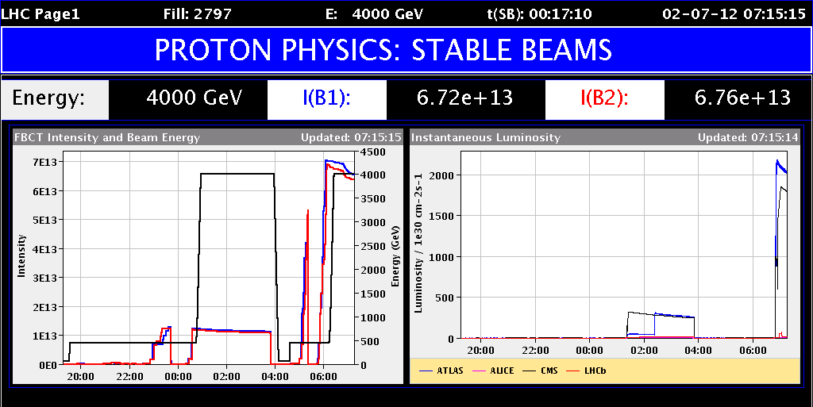
Sun Night
03:50h dump & pre-cycle
04:52h injection ... with some problems ...
filling scheme has not updated in DIP
Beams dumped by BPM in P6. It looks like a false trigger.
06:08h 480 bunches injected
ramp / squeeze / adjust & stable beams

