Slide 1
Saturday 30th June - Sunday: Rocky !
04:45 problem with RQX.L8 solved
07:00 injection probe beam
XPOC problems – wrong limits loaded after TS & new soft to create limits
10:00 Ramp with 2 probes: loosing most of the beam on the ramp
12:20 Ramp with 2 probes, again losses, attempt of chroma measurement in collision
14:45 Scraping nominal beam for BPMS checks: ok
16:30 BPMS interlock tests with bumps: ok
Recuperating RF settings
19:15 BPMS checks with 50 ns, 12 bunches: ok
20:03 Start ramp 3 bunches for Totem alignment
20:30 Dump in squeeze, electrical perturbation 400 kV line
22:09 Start second ramp for Totem alignment
23:10 Totem starting alignment
01:09 Totem alignment finished (fast!). Also move Alpha in.
01:56 Dump for the leap second.
04:18 Ramp for loss maps
05:53 OFF momentum loss maps in collisions with RP in
06:46 Electrical perturbation (EDF) switched OFF 2 RF modules, 5 sectors (S12, S23, S67, S78, S81) and the dipoles of ALICE and LHCb
07:30 pre-cycle – collimator steps to be recovered

Slide 2
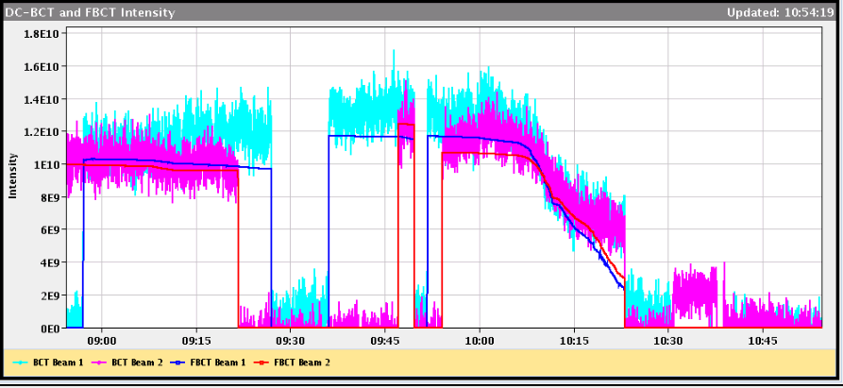
First energy ramp with pilots
Not so good...

Slide 3
Two pilot ramps with large losses
10:00 & 12:20
Second ramp reduced chirp and frequency modulation: not much better
Losses all through the ramp, nothing obviously wrong
Beam dump at 4 TeV ok
But not very good chroma measurements...
Decide to call the RF, as more losses when freq. modulation on
Themis (RF)
Beam Phase Loop: A subset of the beam phase loop persistent settings were apparently set to zero when the module was re-initialized after the technical stop. We are suspecting that some controls changes during the week had adverse consequences. As a result we were effectively running with the beam phase loop open. This explains the debunching issues at flat bottom and during the ramp.

Slide 4
Themis (RF) Continued
Since the settings were lost, Daniel inserted temporary settings so that the LHC program could continue. These settings are NOT optimal for high bunch intensity operation, but should not interfere with the initial intensity ramp-up. We are hoping that the controls experts will be able to recover the persistent data. Otherwise, some time will be necessary to reset the beam phase loop on Sunday/Monday. No debunching was observed in the next injection.
Shortly before the above steps were completed, all four cavities of module 1B1 started oscillating. After our investigation, we once again found that even though the settings that had been adjusted during the RF startup yesterday were correct in FESA, they had been overwritten in the actual hardware. This is a bit concerning since it seems that running the sequencer was sufficient to introduce this error. We will also follow this up with the controls experts.
Everything seemed a lot better afterwards. Ramp 3 bunches for RP alignment was OK
Optimised settings put back Sunday morning

Slide 5
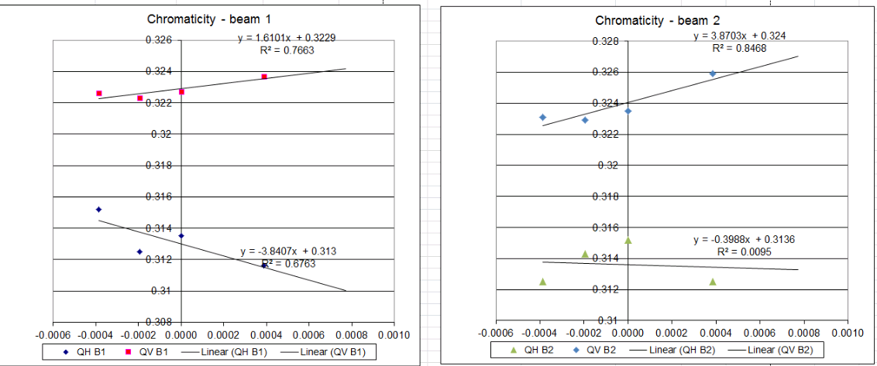
Manual chroma in second pilot ramp
Vertical chroma seems ok
Horizontal (close to) negative
Better repeat some time with better tune signals

Slide 6
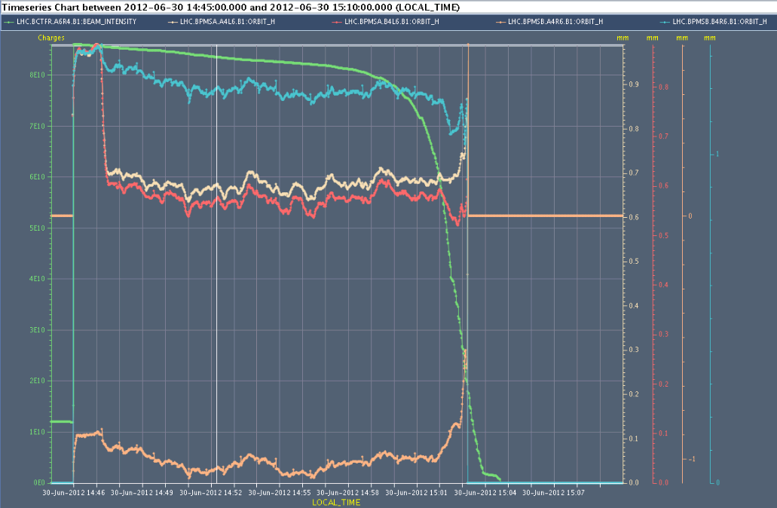
Check of interlock BPMS in IP6
Checks required after interventions during TS
Checks done
Scrape bunch and check when reading lost = IL triggered:
At 2e10: perfect
Bump the beam and check when interlock triggers
At 3.0 +/- 0.1 mm: perfect
Check orbit reading with 50 ns trains, done with 12 bunches, relative to TCSG / TCDQ retraction
OK

Slide 7
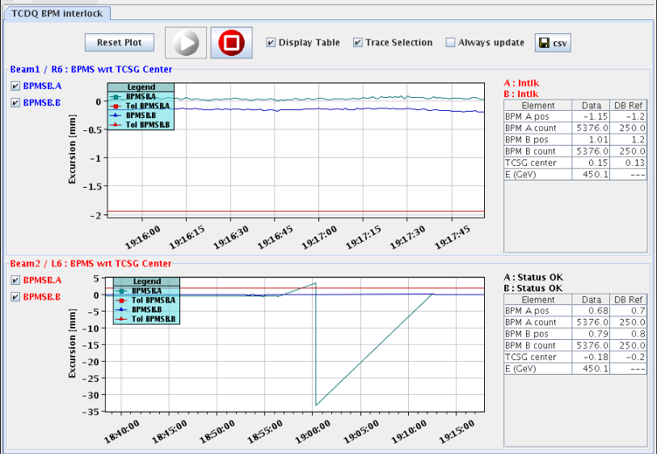
But BPMS not completely transparent...
...but dumped beam on first 12 bunch injection and first pilot injection
OK afterwards
Seems like a bad reading
To be followed up
But also some other BPM crates needed rebooting

Slide 8
Roman Pot set-up & loss maps
Totem very fast and efficient: needed 2 hours.
Also moved Alpha in
Moved RP out for dump for leap second at 02:00
04:00 Ramped for loss maps with Roman Pots in
Collisions to perform loss maps. We carried out betatron loss maps in both planes, both beams (B1V lost very much intensity when crossing the resonance). We then did the OFF momentum loss maps (with very low intensity left in B1) and the beams were dumped by the unmaskable BLMs
One more ramp this morning for loss maps (see later)

Slide 9
02:00 Leap second
The recovery took about 2h as the communication with many systems was affected and we had to reboot the consoles and many control systems
From Alastair
As planned during the previous week the following BE/CO staff arrived to handle the leap second insertion: - Jean-Claude Bau (to restart the LHC and Injector timing hardware) - Alastair Bland and Luigi Gallerani (to observe the time change in the 1400 or so computers) - Mark Buttner and Peter Jurcso (to restart parts of the LASER Alasrm system and/or Diamon) + Stefan Lueders (IT/CS) who volunteered to help communicate with IT
A few minutes before 2am all the accelerators were stopped. At 1 second before 2am the leap second was inserted. The 1400 or so Linux Servers, Consoles and Front Ends + the LynxOS Front Ends correctly inserted it.
Some problems coming back – finally all worked out

Slide 10
Plan
Already put back the optimised RF settings
Sort out lost steps in collimators after power cut
One ramp for loss maps
Betatron end of squeeze with ADT
In collision move in RP and asynch dump
Injection loss maps (1 h)
If all OK can start intensity ramp up

Slide 11
Intensity ramp-up
Sunday afternoon:
84 bunches: 2 hours Stable Beams
480 bunches: 6 hours Stable Beams for ATLAS (but don’t refill)
840 bunches + 12 non colliding: Production fill
1380 bunches: Production fill

