Slide 1
MD#2 News & Plan Tue – Wed (19. – 20.6.)
Day | Time | MD | EiC | MP
Tue | 06:00 | 450 GeV → 4 TeV: Ramp for chromaticity (done later) |  | A
 | 08:00 | Ramp down
 | 10:00 | 450 GeV: Large Piwinski Angle MD + precycle 2 bunches 2.4e11 – started with 3:30 h delay |  | A
 | 18:00 | 450 GeV → 4 TeV: Octupole instability threshold Single full physics beams – successful Ramp for chromaticity + octupole effect |  | C
Wed | 02:00 | Ramp down
 | 04:00 | 450 GeV → 4 TeV: Longitudinal dynamics studies– successful |  | B
 | 10:00 | Ramp down
 | 12:00 | 450 GeV → 4 TeV: Beta* leveling 2 nominal bunches – successful |  | C
 | 20:00 | Ramp down
 | 22:00 | 450 GeV → 4 TeV: Long-range beam-beam with high bunch intensity 84b 50 ns 1.7e11 – successful |  | C
Giulia
Alick
Ghislain
Giulia
Mirko
Alick
Ghislain

Slide 2
Draft MD Planning Thu – Fri (21. – 22.6.)
Day | Time | MD | EiC | MP
Thu | 06:00 | Ramp down
 | 08:00 | 450 GeV → 4 TeV: High beta* (1) – successful |  | A
 | 16:00 | Ramp down
 | 18:00 | 450 GeV: MKI UFO studies |  | C
Fri | 04:00 | 450 GeV → 4 TeV: Scraping, diffusion and Repopulation Study and fast losses (with ADT) |  | C+C
 | 12:00 | Ramp down
 | 14:00 | 450 GeV: Injection and Q20 optics |  | A
 | 22:00 | 450 GeV: RF cavity phase modulation for 25ns |  | B
Ghislain
Mirko
Alick
Ghislain
Verena
Mirko

Slide 3
Draft MD Planning Sat – Mon (23. – 25.6.)
Day | Time | MD | EiC | MP
Sat | 06:00 | 450 GeV → 4 TeV: High beta* (2) |  | A
 | 14:00 | Ramp down
 | 16:00 | 450 GeV: Transverse Damper studies - cancelled
 | 22:00 | Ramp down
Sun | 00:00 | 450 GeV → 4 TeV: Collimation (impedance, nominal settings) |  | C
 | 06:00 | Ramp down
 | 08:00 | 450 GeV: Beam Instrumentation (BSRT, BGI, wire scan, BPM nonlinearities) |  | A/B/C
 | 16:00 | 450 GeV → 4 TeV: Test ramp for emittance calibration |  | B/C
 | 20:00 | Ramp down
 | 22:00 | 450 GeV: Dynamic Aperture MD |  | D
Mon | 06:00 | Technical Stop
Alick
Enrico
Mirko
Alick
Enrico
Mirko
Alick

Slide 4
High beta* (1)
Aim: beta* = 500 m in IP1&5; measure & correct optics
3 probe bunches per beam, initial intensity ~3e10 per beam
First 3 hours: re-commissioning of the 90 m optics with parallel separation on, Q’ measured and corrected in several steps to 90 m
Collimators opened up at 90 m for the de-squeeze
The de-squeeze from 90 to 500 m worked very well without any significant losses.
The second half of MD: optics measurements and corrections at 500 m. AC dipole beam 1 horizontal plane faulty and requires access to reset.
Measured optics B1 V and B2 H/V. Beta-beat without correction mostly within +/- 20 %. Corrections were calculated online and implemented and optics quickly re-measured.
H. Burkhardt, J. Wenninger, M. Pojer, M. Solfaroli, S, Redaelli, L. Ponce, beta-measurement team et al.

Slide 5
Optics Measurements at 500 m
Beam1
The AC dipole malfunctioned in the H-plane of Beam1.
A global correction for beam1 was calculated using data from the 90 m commissioning on Monday night where some initial measurements at 500 m had been made.
Optics was re-measured with the global correction implemented, kicking only in the V-plane with the AC dipole. There is no usable data for the B1 H-plane from the MD
Beam2
Optics measurements were performed on and off momentum with no correction applied. Local corrections were calculated for IP1, IP5 and IP6.
Optics was re-measured on-momentum with local corrections implemented. A global correction was calculated on the phase.
Optics was re-measured with local and global corrections implemented.

Slide 6
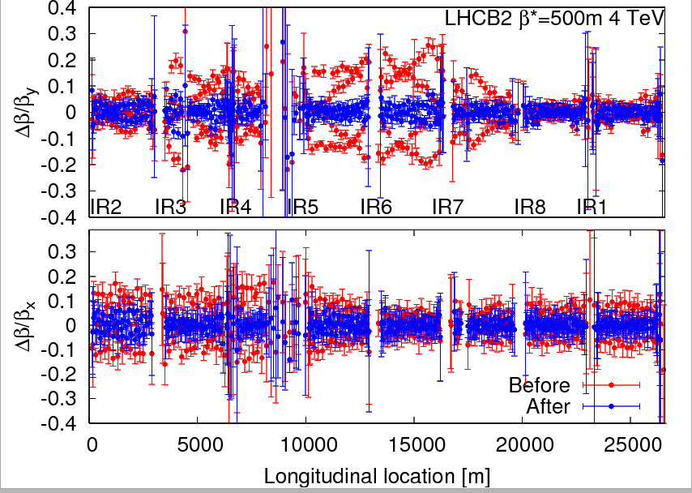
Optics Measurements at 500 m

Slide 7
MKI UFO studies
T. Baer, M. Barnes,
R. Giachino, G. Roy
access for BLM diamond sensors at Pt7, and for B1 MKQA (successfully repaired and tested by the piquet); started real MD at about 20:00
test procedure for non-standard MKI operation ~1.15 hours
PS cavity problem & beam losses when injecting 144 bunches with large emittance (beam dump), solved by TL steering
at ~0:50,1236 bunches were circulating for B1 and B2 with two different emittances of ~3, ~1.5 μrad (blow up by screens)
pulsed MKIs in gap alternating for B1 & B2 to produce UFOs; at 1:40 h switched off MKI e-cloud solenoids - 10 min later flashover at MKI.C5R8 with vacuum interlock
ventilation door opening in Pt.2, ended the MD
MKIs pulsed 48 times; several UFO events observed
1 conclusion: don’t operate MKIs without e-cloud solenoids

Slide 8
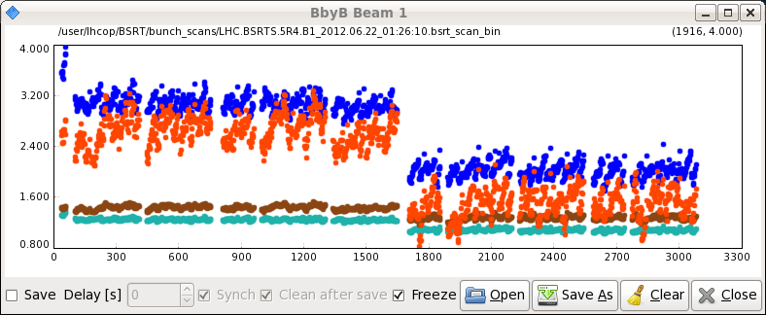
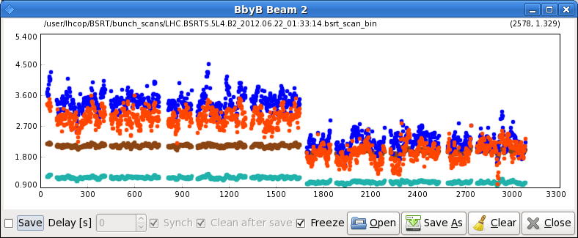
MKI UFO studies - emittances

Slide 9
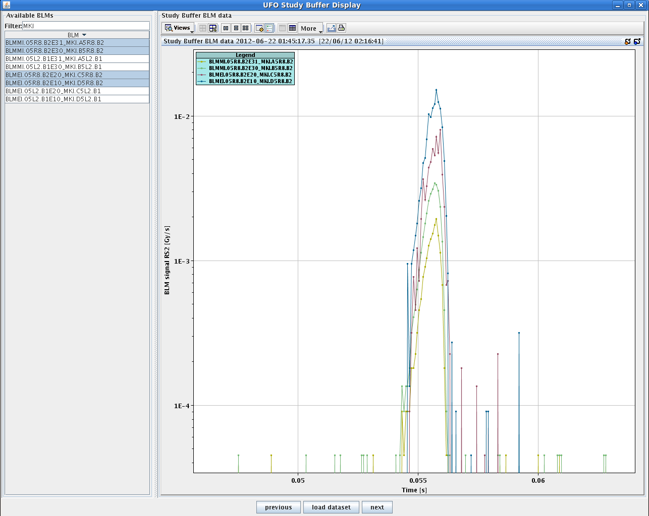
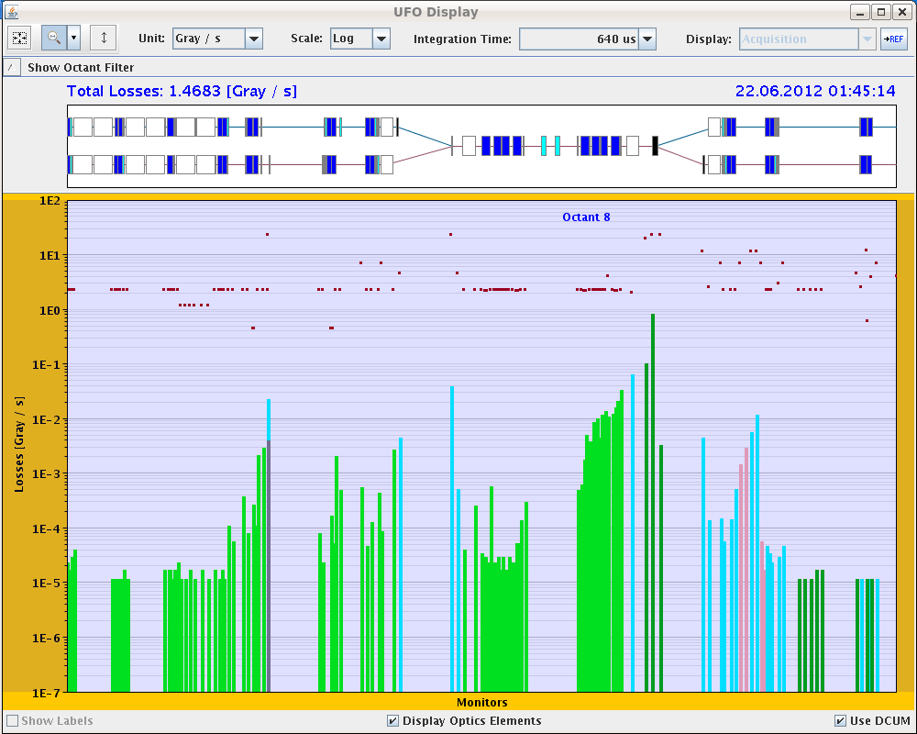
UFO event about 30 ms after MKI pulse

Slide 10
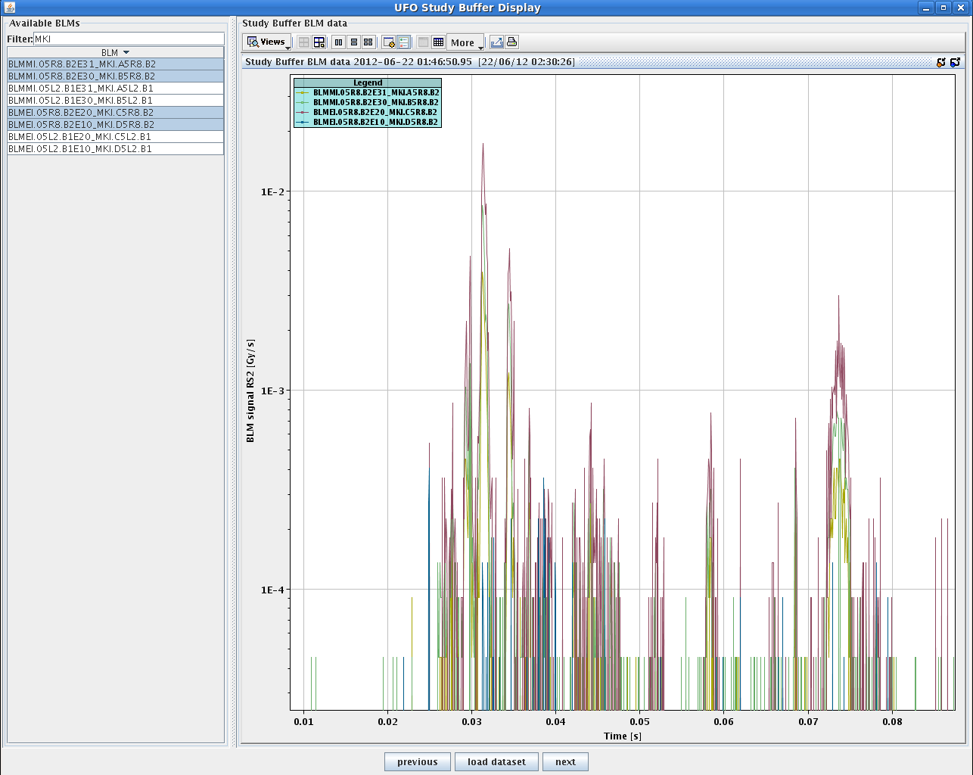
loss spikes after MKI pulse

Slide 11
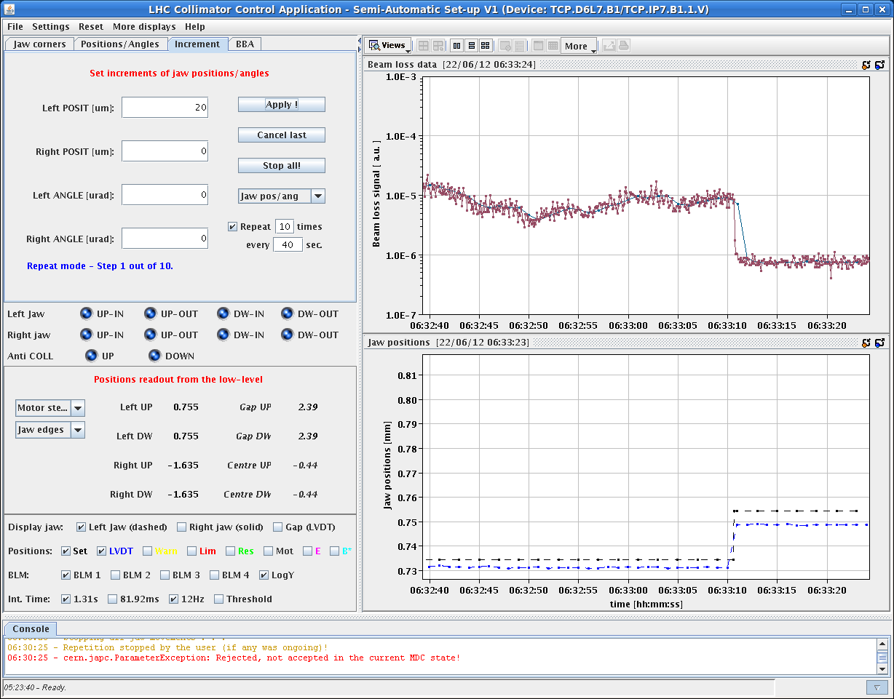
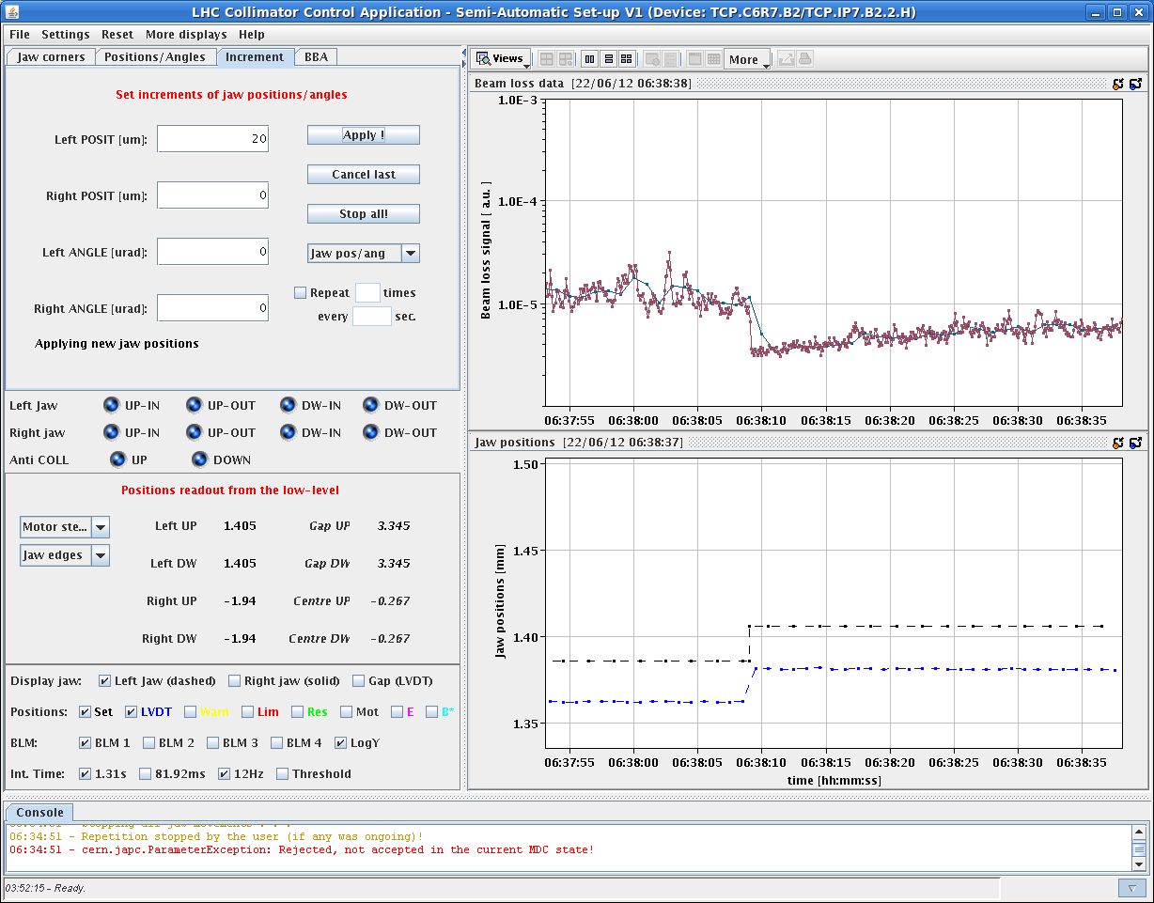
Scraping, diffusion & repopulation study
F. Burkart, G. Valentino, S. Redaelli et al ++
scraping & collimator retraction at top energy in squeeze
w/o collision
with collision
Asynchronous dump test
next: ADT fast losses

