Slide 1
Tie me kangaroo down sport
Monday 18th June
10:30 Stable beams
Fill 2739 Initial luminosity 6.48e33 cm-2s-1
13:00 Beams dumped (~50 pb⁻¹)
Off to Oz with:
Atlas: 6.6/6.3 fb⁻¹ delivered/recorded
CMS: 6.8/6.3 fb⁻¹ delivered/recorded
LHCb: 0.65/0.62 fb⁻¹ delivered/recorded
Alice: a little over 1 pb⁻¹

Slide 2
Access Monday afternoon
Access for:
LBDS Check/repair Ethernet connection on FEC cfc-ua63-mkdtspm. N. Magnin.
Collimator cooling check TCT IR8 – Oliver Aberle
BI: UA43 – BBQ remote communication BBQ with a controls front-end
BI: Q7R4 (RF zone) - install attenuator and temperature probes on the HT- monitor (Ralph Steinhagen)
ATLAS
Christos Z intervention on BLM card at IP1

Slide 3
Coming out of access
16:45 Problems getting RF module 2 beam 2 back on
Broken crowbar
17:30 Starting study of the impact of TETRA on the hump/beam.
We could do the measurements with one pilot per beam but due mix-up on the SPS side we could not get the INDIV beam
ADT set-up (Daniel Valuch) on hold until Tuesday morning
18:20 Access UX45 for RF
The broken crowbar could not be fixed because the spare part could not be found in UX45. There is a spare in the lab on Meyrin site and the change will be organised first time tomorrow morning. For the night we will stick with pilots.

Slide 4
TETRA
The tetra system was on from 17:09 to 17:18 while there was no beam. On 17:38 and 17:40 a pilot was injected in ring 1 and 2 respectively. The tetra system was on from 17:47 to 17:57. Around 17:58, 18:05, 18:10 the system was switched off-on-off within few seconds.
In this interval there were few attempts to inject a nominal bunch in beam 1 (beam 2 had RF problems) without success in order improve the SNR of the BBQ.
Ralph Steinhagen recommended to repeat the measurement with a nominal bunch since the sensitivity of the BBQ will be greatly enhanced.
The damper was setup with pilot settings (excluding b2h) and switched off about one minute after injection.
BBQ data is stored in timber and few averaged ffts with the tuneviewer are stored in /nfs/cs-ccr-nfs4/lhc_data/OP_DATA/FILL_DATA/2740.
A first analysis without and with beam did not show any effect.
Tomorrow I will analyse the data in detail for more subtle effects.
Riccardo De Maria

Slide 5
Monday evening
20:15 Three pilots in for beta* = 90 m re-commissioning
20:25 Start ramp
(Without RF M2B2)
21:00 Start unsqueeze
22:15 90 m
With the exception of B2 (issue with RF) the un-squeeze to 90 m was smooth
Optics measurements
00:35 start squeeze to 500 m
01:25 beta* 1 & 5 = 500 m
Orbit correction, optics measurements
02:15 beams dumped

Slide 6
Early this morning
03:30 Ramp 3 probes again
04:15 S12+S23 trip, vacuum valves closed.
Electrical problem, PIC detects loss of UPS.
fault of a 400 V electrical distributor affected some systems
90 m decommissioning – detailed report in logbook
Conclusion :Overall the commissioning went well given the HW issues (RF, El). Next time we should be able to get to 90 m with separated beams, and push to 500 m with both beams for further optics etc measurements.
Matteo, GHH and Jorg for the high-beta team.

Slide 7
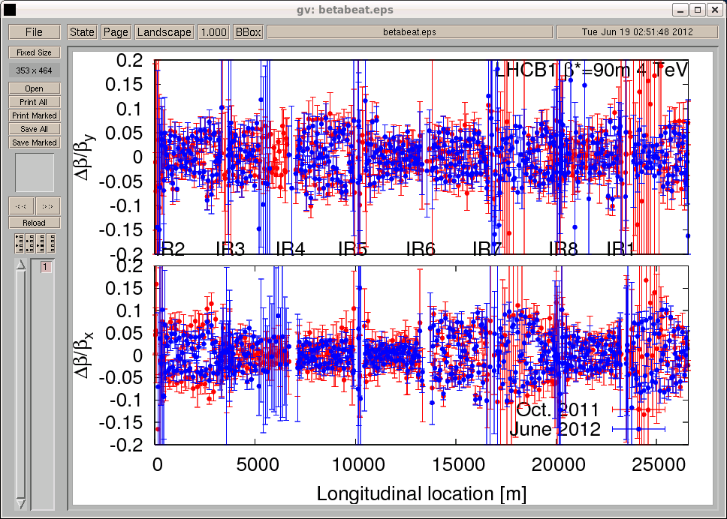
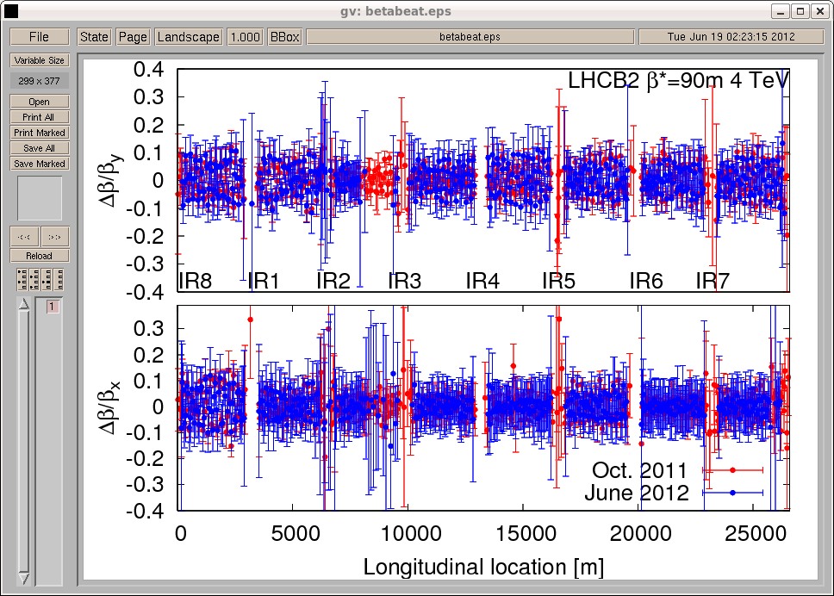
Beating 90 m

Slide 8
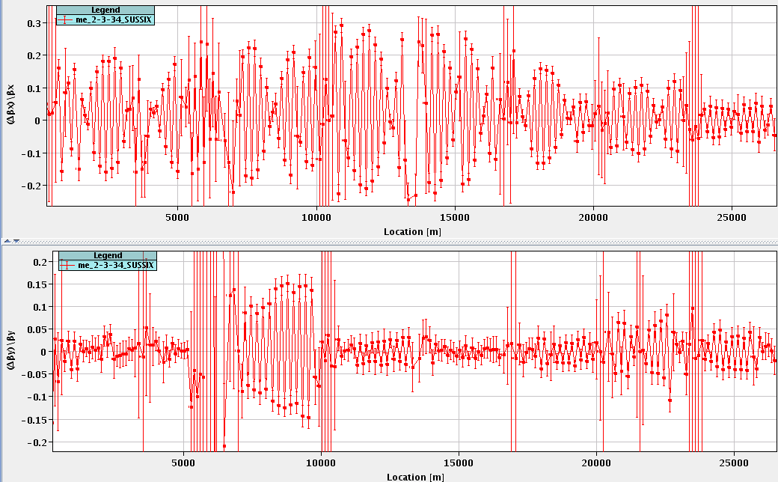
Beating 500 m – beam 1

Slide 9
This morning
06:00 CMS solenoid ramping down
08:00 Access
Intervention PM18
Defaut sur pompe n°2 Eau Mixte en PM18 alimentant la QURC-B de la CRYO
09:00 RF repair
Access PX45
~10:30 Start large Piwinski angle MD
First up ~15 minutes for ADT - Daniel Valuch
[Experiments’ magnets not required after Piwinski]

Slide 10
Draft MD Planning Tue – Wed (19. – 20.6.)
Day | Time | MD | EiC | MP
Tue | 06:00 | 450 GeV → 4 TeV: Ramp for chromaticity - missed |  | A
 | 08:00 | Ramp down
 | 10:00 | 450 GeV: Large Piwinski Angle MD + precycle 2 bunches 2.4e11 |  | A
 | 18:00 | 450 GeV → 4 TeV: Octupole instability threshold Single full physics beams |  | C
Wed | 02:00 | Ramp down
 | 04:00 | 450 GeV → 4 TeV: Longitudinal dynamics studies |  | B
 | 10:00 | Ramp down
 | 12:00 | 450 GeV → 4 TeV: Beta* leveling 2 nominal bunches |  | C
 | 20:00 | Ramp down
 | 22:00 | 450 GeV → 4 TeV: Long-range beam-beam with high bunch intensity 84b 50 ns 1.7e11 |  | C
Giulia
Alick
Ghislain
Giulia
Mirko
Alick
Ghislain

Slide 11
Outstanding accesses
Still to do:
TCLIB.6R2.B1 electronics and LVDT sensor.
MAD PM15: motors of inner doors not working (at least 4 hours).
BI in Pt4 wall current monitor: postponed to after TS – R. Steinhagen (3-4 hours, working hours).
TOTEM vacuum gauge (3 hours).
MCBV18.L4B1 and RCO.A12.B1 to be repaired / changed.
Pt.7 (IMPACT: 18638) to exchange two amplifiers for the diamond BLMs. 1-2 hours both sides of the IP (Ewald). – after cool down of the collimator region (before Thursday UFO MD)
BI: Q7R4 (RF zone) - install temperature probes on the HT- monitor to be retrieved during the next TS. ½ hour: but needs one more short access to install temperature probes (before the MD on Tuesday 18:00 ideally).

