Slide 1
Sat 17.06.12
13:20 ALICE trip
14:24 Beam dump by OP. Integrated lumi 204 pb-1.
14:59 MKI8 at 105% of interlock level. Need to wait…
17:33 Injection.
Transfer line steering TI8.
Filling was again slowed down by the poor beam quality (both for intensity and longitudinal parameters spread, despite a slight release by the SPS experts of the BQMSPS thresholds).
.

Slide 2
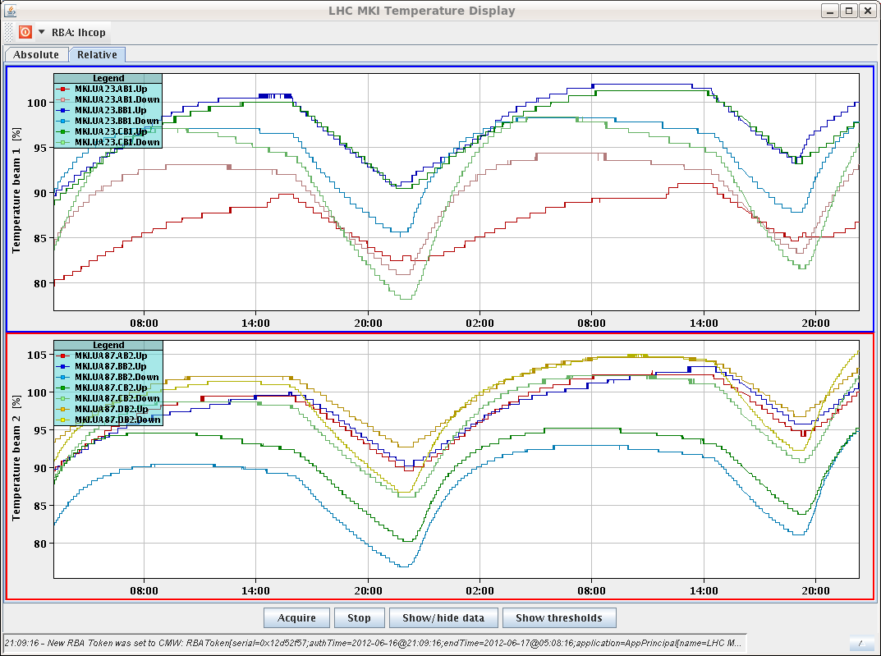
MKI Heating Issue

Slide 3
Sat/Sun 17/18.06.12
19:18 Start ramp.
B2H tune jumps between 2 peaks... RT trims are wavy. Trimmed the tune manually down by -0.003 in B2H. What the feedback was locked on did not move with the trims.
20:07 Losses at the start of the collision beam process, beam 2 up to ~50% dump threshold
20:10 Stable beams #. Initial lumi: 6.5e33cm-2s-1.
b1 lifetime was worse than that of beam 2, so trimmed Q1H up by 0.002.
Sunday morning:
Most productive day (Sat): 0.251 fb-1
Int. lumi last 7 days (Sun – Sat): 1.35 fb-1 (2/3 of ideal potential)
Longest time in SB per week: 90 h
Total reached: 6.46 fb-1
To improve further: Shorter fills, higher peak L, MKI8 heating

Slide 4
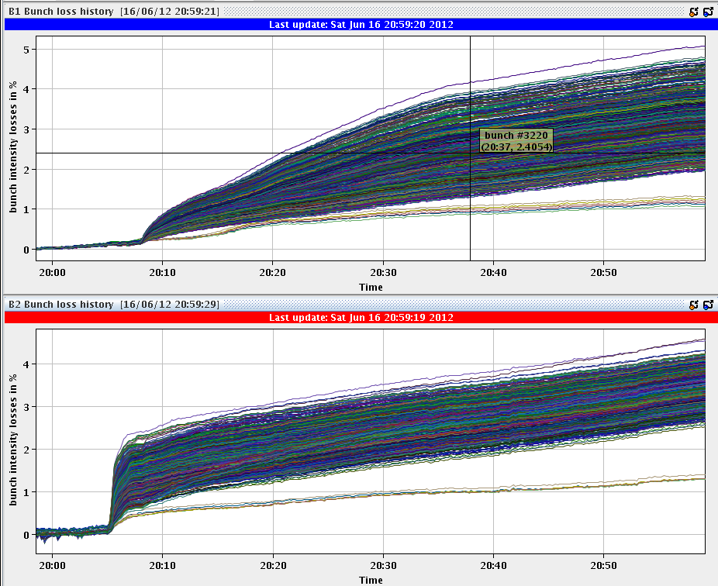
Losses over 1h

Slide 5
Planning Ahead
Delivering luminosity…
To be done…
RF: Long. blow-up at injection: tried it, to be re-visited after TS
New filling scheme (6 non colliding bunches for ATLAS/CMS): Ready for usage
ADT: Pilot for 15min. 6b for 15min.
Impact of TETRA on hump / beam: 30 mins at injection with probe bunches.
Access:
TCLIB.6R2.B1 electronics and LVDT sensor.
MAD PM15: motors of inner doors not working (at least 4 hours).
BI in Pt4 (3-4 hours, working hours).
TOTEM vacuum gauge (3 hours).
MCBV18.L4B1 and RCO.A12.B1 to be repaired.
LBDS Check/repair Ethernet connection on FEC cfc-ua63-mkdtspm. 1 hour during working hours, N. Magnin.
Collimator cooling check TCT IR8 – Oliver Aberle
Pt.7 (IMPACT: 18638) to exchange two amplifiers for the diamond BLMs. 2 hours (Ewald).
BI: UA43 - lost remote communication with one of our controls front-ends. ½ hour.
BI: Q7R4 (RF zone) - install attenuator and temperature probes on the HT- monitor to be retrieved during the next TS. ½ hour.

