Slide 1
Thu 14.06.12
04:00 Fill #2729 Stable Beams. Initial lumi 6.5e33 cm-2 s-1.
07:29 Beams dumped by BLM self trigger. Integrated lumi 68 pb⁻¹.
09:51 BLM card replaced, kickers cooled down. Injecting probes.
10:55 Different BLM problem, again in point 1:
One of the two fibres coming up from the tunnel is 'broken' and gives continuous faults.
An access of at least 2 hours would be needed to fix it (they don't know where the fault is exactly).
They prefer to postpone the access to a later moment, probably the next technical stop.
As there are two redundant fibres, they will split the signal from the good one. The system will still be safe (and failsafe) but it will lose the redundancy.
12:02 Injecting again - some problems with beam from SPS.

Slide 2
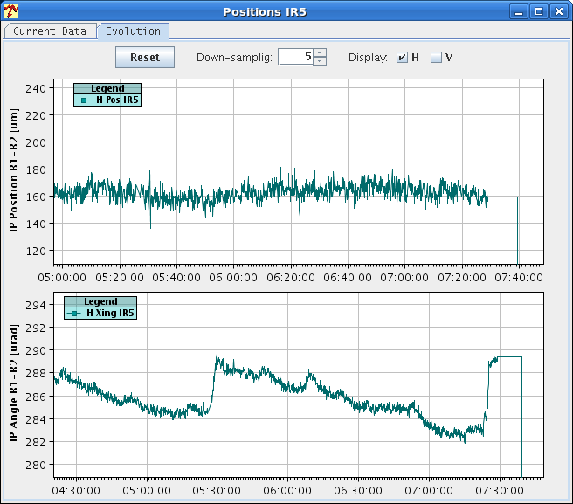
Fill 2729: Crossing Angle Drift

Slide 3
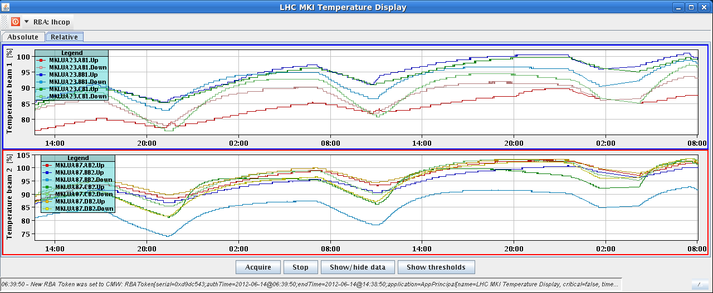
MKI Temperature after Fill 2729
Recovery of MKI temperature in shadow of BLM card problem.
Would have otherwise delayed injection…

Slide 4
Thu 14.06.12
12:02 Injecting again
Some problems with beam from SPS: Lost a 80 MHz PS cavity, bad capture at the SPS.
BQMSPS latching on peak and with faults on analysis at injection which (so far) is not interlocked.
We need only 2 more injections (we let one bad 72 one in intentionally to check on our side).
13:58 Beams dumped at beginning of mode “Adjust” due to high losses in IP7:
Losses appeared already at the end of the squeeze.
B2 only. Betatron losses.
14:50 Injection. Bunch length problems in the injectors. Injector chain tuning.

Slide 5
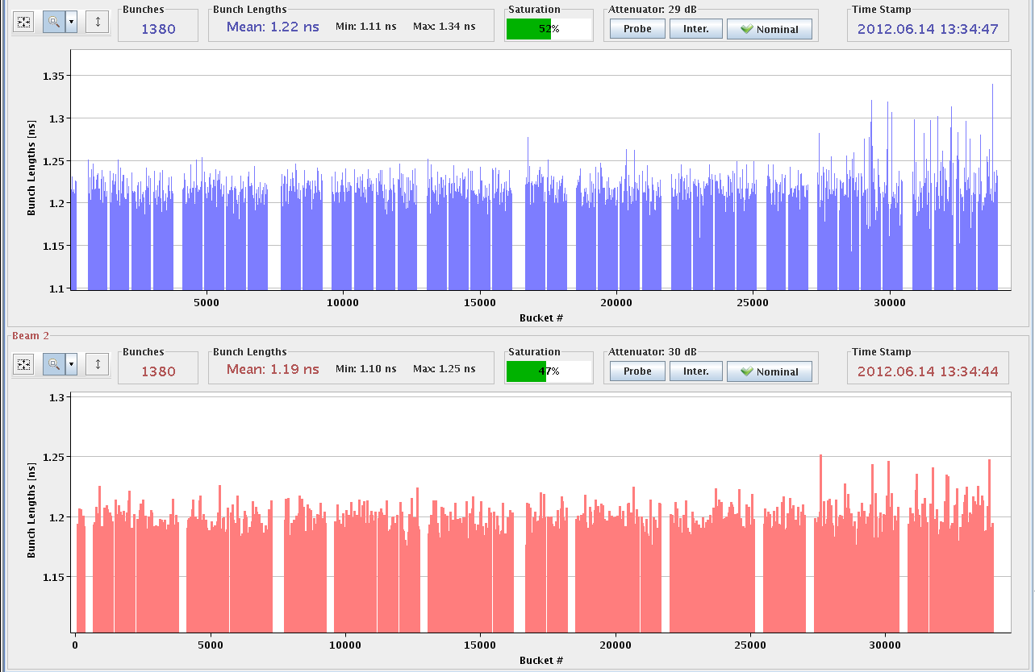
Bunch Length B1 and B2

Slide 6
Beam Dump at Start of Adjust
Losses show that this was a beam 2 problem only…
Also: All losses in IR7 → Betatronic, no longitudinal problem!

Slide 7
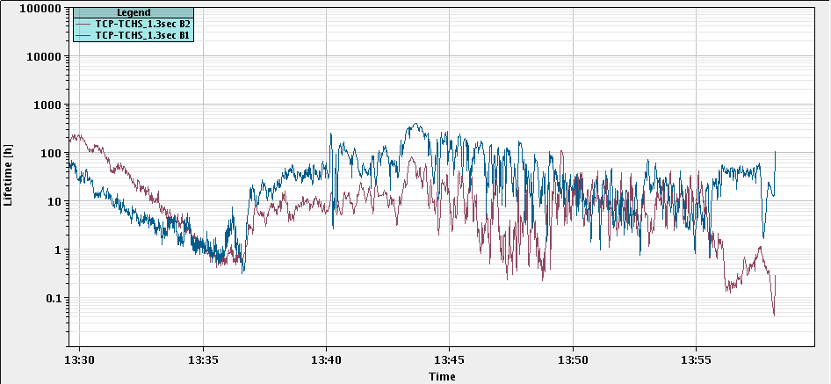
Lifetime for Lost Fill

Slide 8
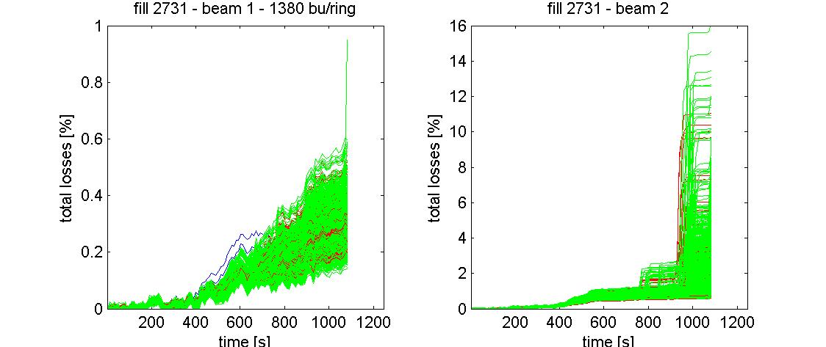
Time Evolution of Bunch by Bunch Losses
B1
B2
0.6%
16%

Slide 9
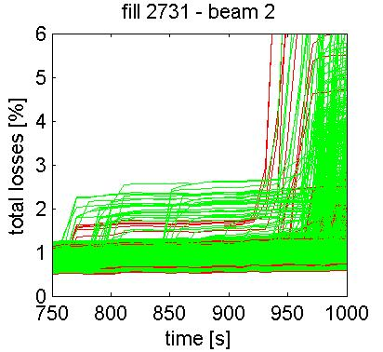
Zoom into B2 Bunch-by-Bunch Losses

Slide 10
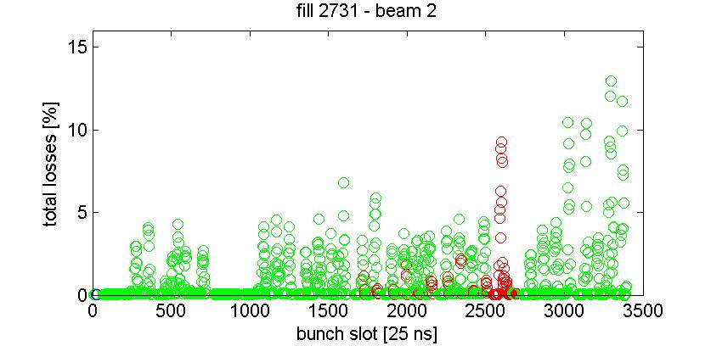
Location of Unstable B2 Bunches

Slide 11
Tune Feedback Trims: Seems OK
However, B1 and B2 very close to each other: Can it be that B2 tune peak was in fact B1? → NO
However, started with an unusually large initial trim (offset)!

Slide 12
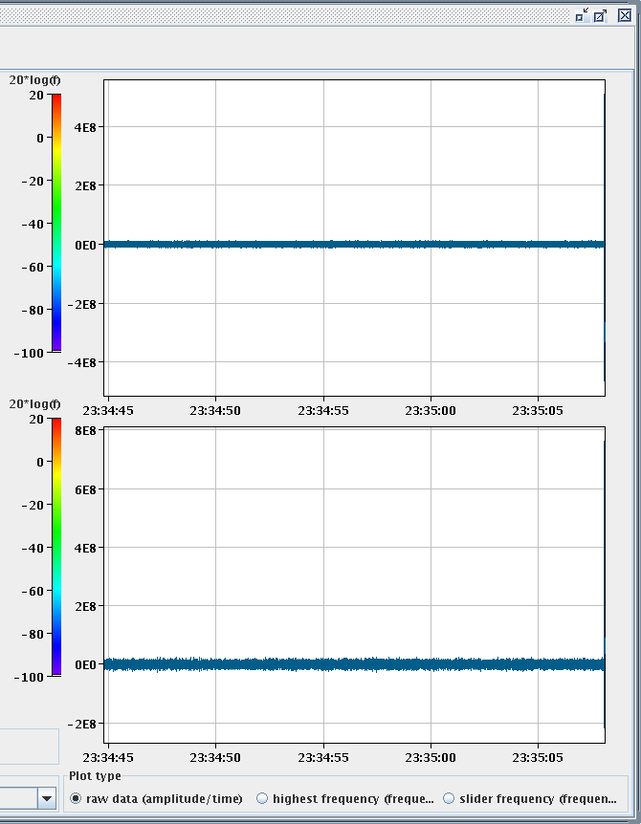
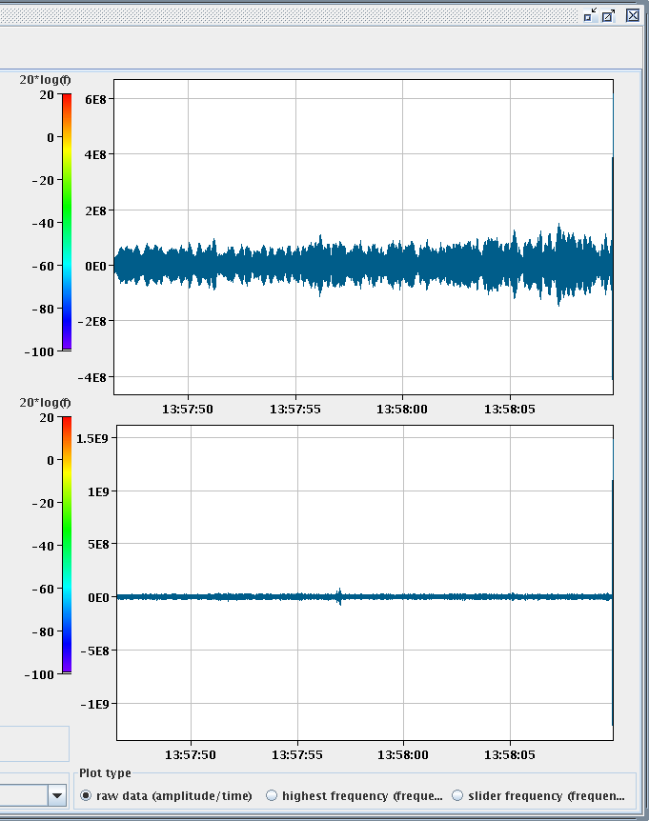
B2 Excitation: Maybe or maybe not?
Previous fill
Lost fill

Slide 13
Thu 14.06.12
14:50 Injection. Bunch length problems in the injectors.
Injector chain tuning.
17:44: Extraction kicker problem in the PS (controls problem).
18:25 Injection probe beam.
19:00 Injection physics beam
Quite long and unstable injection.
Many injections inhibited due to bunch length!
19:46 Ramp.
Injector tuning continuing after end of LHC injection.
19:59 At 4 TeV.
MKI2 faulty after start the ramp.
20:29 Stable Beams #2732. Initial lumi: 6.6e33.
22:20 Beam dumped. Integrated 40pb-1.
QPS triggered on RQX.R1, fire heaters discharged, vacuum valves closed. SEU?

Slide 14
Bunch Length Problem in the SPS
abnormal
12b normal

Slide 15
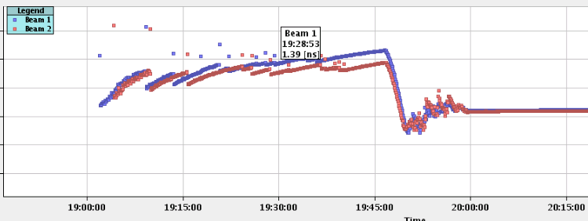
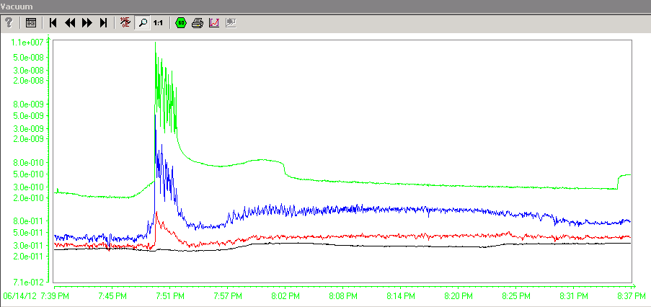
MKI Kicker Problem
MKI vacuum interlock from 19:49:54 is understood:
it just happened when we had the shortest bunch length at the start of the ramp and the vacuum signals look as e-cloud as well.
Reset the vacuum interlock and soft start when we need to reinject.

Slide 16
Fri 15.06.12
01:11 Injection.
02:42 Stable beams #2733. Initial lumi: 7e33cm-2s-1.
Ongoing…
Essentially reached 6fb-1.
At 8:17: 5.976/6.042 fb-1 (ATLAS/CMS)

Slide 17
Planning Ahead
Delivering luminosity…
To be done…
RF: Long. blow-up at injection: tried it, to be re-visited after TS
New filling scheme (6 non colliding bunches for ATLAS/CMS): Ready for usage
ADT: Pilot for 15min. 6b for 15min.
Impact of TETRA on hump / beam: 30 mins at injection with probe bunches.
Access:
TCLIB.6R2.B1 electronics and LVDT sensor.
MAD PM15: motors of inner doors not working (at least 4 hours).
BI in Pt4 (3-4 hours, working hours).
TOTEM vacuum gauge (3 hours).
MCBV18.L4B1 and RCO.A12.B1 to be repaired.
LBDS Check/repair Ethernet connection on FEC cfc-ua63-mkdtspm. 1 hour during working hours, N. Magnin.
Collimator cooling check TCT IR8 – Oliver Aberle
Pt.7 (IMPACT: 18638) to exchange two amplifiers for the diamond BLMs. 2 hours (Ewald).
BI: UA43 - lost remote communication with one of our controls front-ends. ½ hour.
BI: Q7R4 (RF zone) - install attenuator and temperature probes on the HT- monitor to be retrieved during the next TS. ½ hour.

