Slide 1
Fri 15th – Sun 16th June
Friday
  02:42 Stable beams #2733. Initial lumi: 6.7e33 cm-2s-1
  15:54 Beam dumped, triplet RQX.L2 tripped. Delivered lumi 183 pb-1
  17:30 MKI temperatures ok, waiting on EPC and precycle RQX.L2
  19:45 Injection septum is misbehaving, getting FMCM RMSI.R8B2
  Injection problems, longitudinal and transverse
  22:50 Stable beams #2734. Initial lumi 6.3e33 cm-2s-1
Saturday
  14:24 Beam dump by OP. Integrated lumi 204 pb-1
  14:59 MKI8 at 105% of interlock level. Need to wait…
  20:10 Stable beams #2736. Initial lumi: 6.5e33cm-2s-1
Sunday
  13:40 Dump fill #2736. Integrated lumi 233 pb-1.
  14:30 Waiting for injection kickers to cool down.
  Integrated lumi for 2012: 6.5 fb-1
  20:57 Stable beams #2737. Intial lumi 6.1e33 cm-2s-1
  22:30 Holland dumped. Germany and Portugal inj. into quarter finals.
Monday
  00:34 Beam lost RF line 2B2. Lumi 66 pb-1
  Kickers cooling down. ATLAS water leak, access.
  05:15 Injecting again. MKI B2 vacuum interlock, looks like e-cloud again.

Slide 2
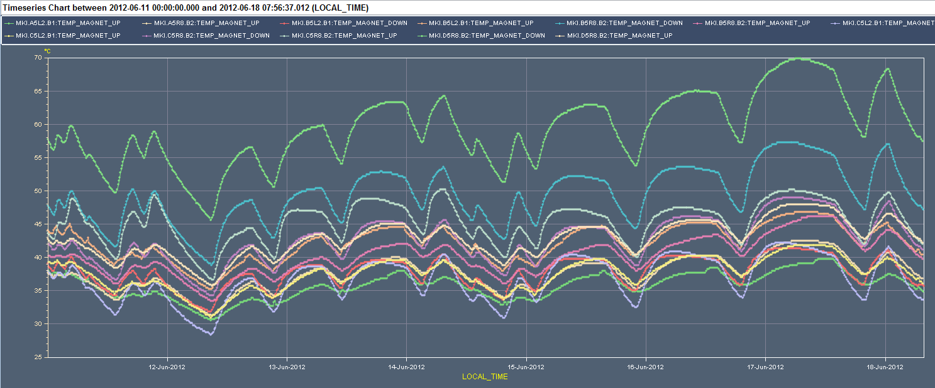
Integrated performance and main ‘worry’
Injection kicker temperature over the week
All time high in temperature = All time high in performance = All time record in waiting for cool down between fills
70° C
60° C

Slide 3
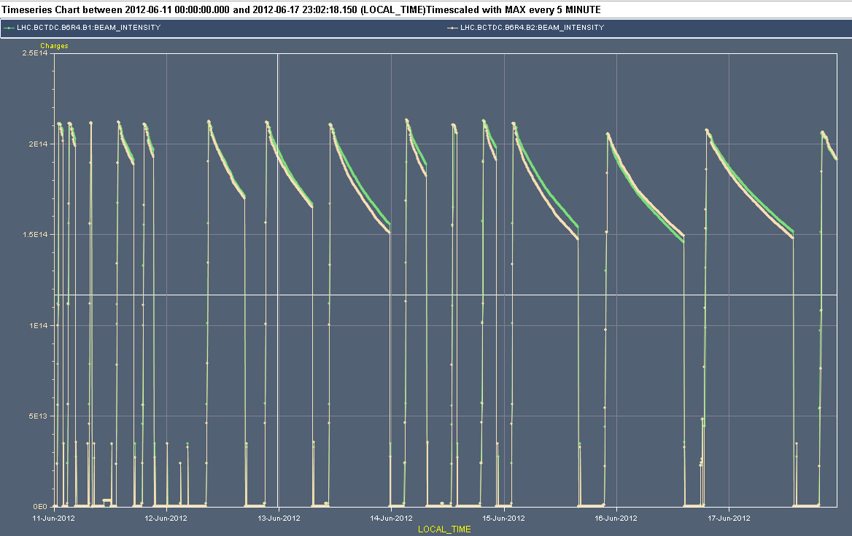
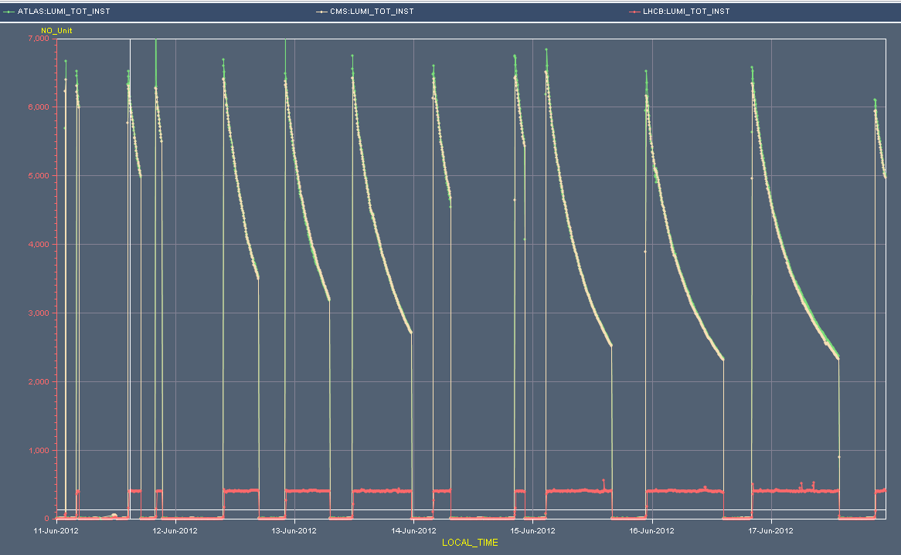
Beam Intensities and Lumi over the week
Stable performance
2e14
Mixed bag
Stable performance
6e33

Slide 4
Overview of fills
Fill | Duration | Ibeam | Lpeak [e30 cm-2s-1] | Lint [pb-1] | Dump
2723 | 2:26 | 2.03E+14 | 6406 | 46.06 | Trip of ROD.A81B1, SEU?
2724 | 1:13 | 2.03E+14 | 6329 | 25.905 | Electrical perturbation
2725 | 7:04 | 2.05E+14 | 6520 | 115.5 | Trip of S81
2726 | 8:58 | 2.05E+14 | 6499 | 142.5 | Elecitrical perturbation, FMCM
2728 | 11:41 | 2.06E+14 | 6525 | 171.5 | Operator dump
2729 | 3:28 | 2.06E+14 | 6502 | 67.7 | BLM self trigger
2732 | 1:52 | 2.06E+14 | 6592.5 | 40 | QPS trigger RQX.R1, SEU?
2733 | 12:34 | 2.06E+14 | 6674 | 183 | Triplet RQX.L2 tripped.
2734 | 15:33 | 2.01E+14 | 6257.5 | 203.5 | Operator dump
2736 | 17:29 | 2.02E+14 | 6465.5 | 233 | Operator dump
2737 | 3:36 | 1.99E+14 | 6021 | 66.1 | RF Trip 2B2
Tot | 51.1% |  |  | 1301
51 % of time in stable beams; total of 1.3 fb-1 in one week !

Slide 5
Overview of main ‘down time’
MKI waiting for cool down 13 h 40 min
Injectors 6 h 30 min
Waiting for experiments 3 h 28 min
Others (> 1h) 7 h 51 min
Total 18.7 % ‘down time’

Slide 6
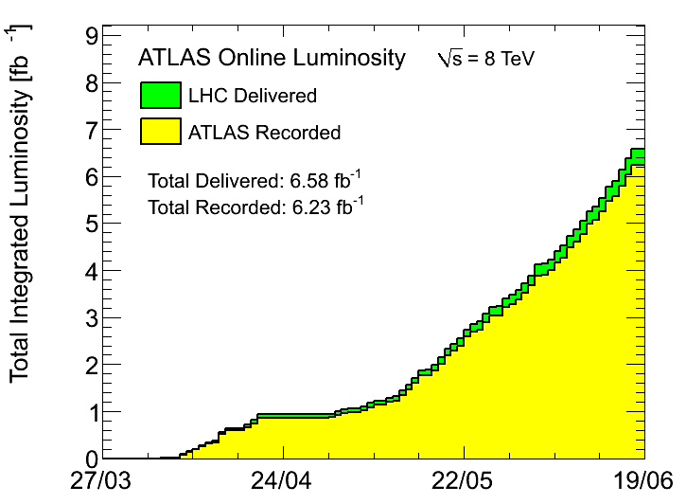
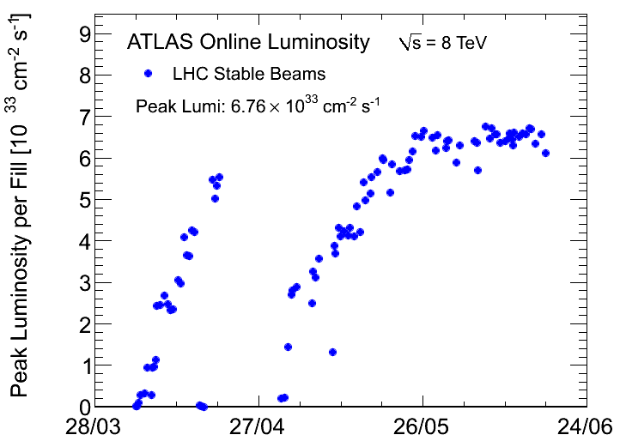
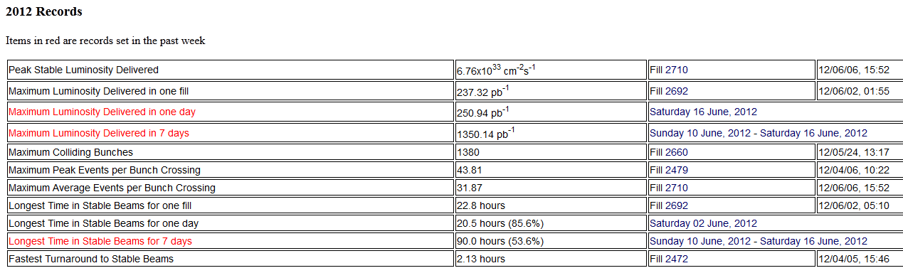
Total lumi: > 6.5 fb-1 (ATLAS)
Could not access the CMS plots….

Slide 7
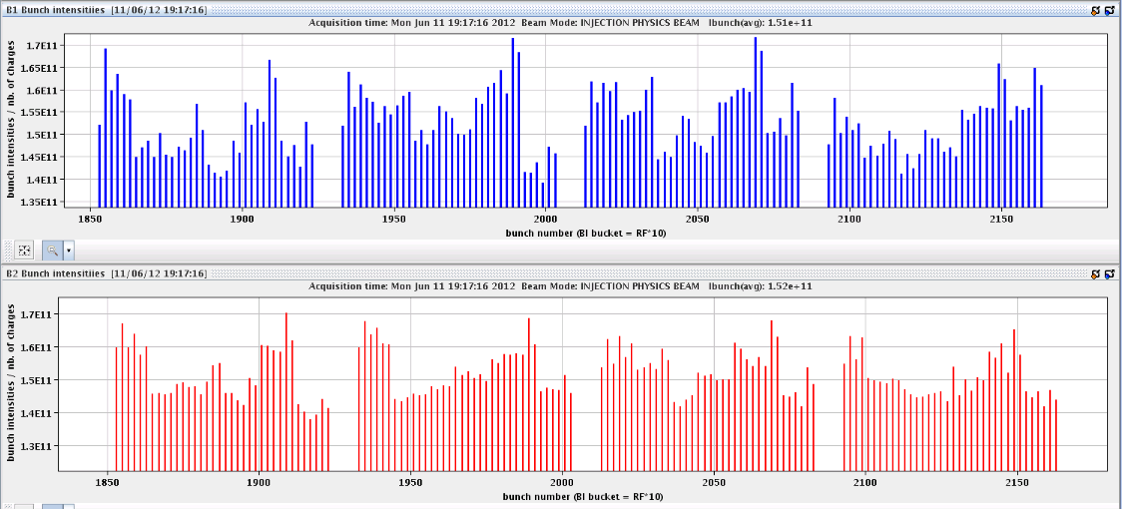
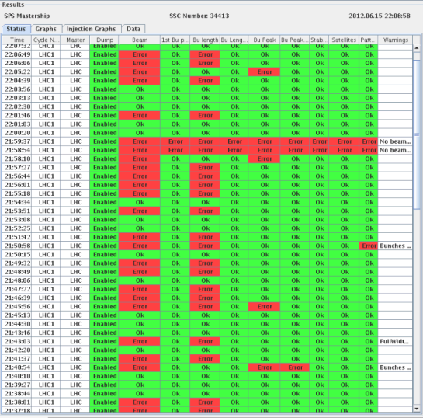
Start of the week Monday 11th June
LHCb Polarity
  Monday morning first thing – Polarity back to negative
    Test ramp to centre collisions with 24 bunches
    Results very reproducible
  Could consider skipping the test ramp…
  No problems due to LHCb polarity change
SPS beam quality
  Already on Monday problems with SPS beam quality
    Filling not smooth due to various BQM interlocks in SPS (bunch length, bunch peak, satellites, pattern)
    Problems with SPS beam quality continued throughout the week
  Only minor effect on LHC peak luminosity
Bunch intensities
1.70
1.35

Slide 8
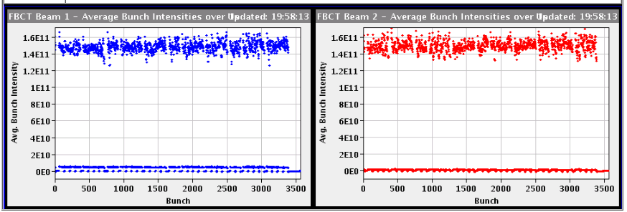
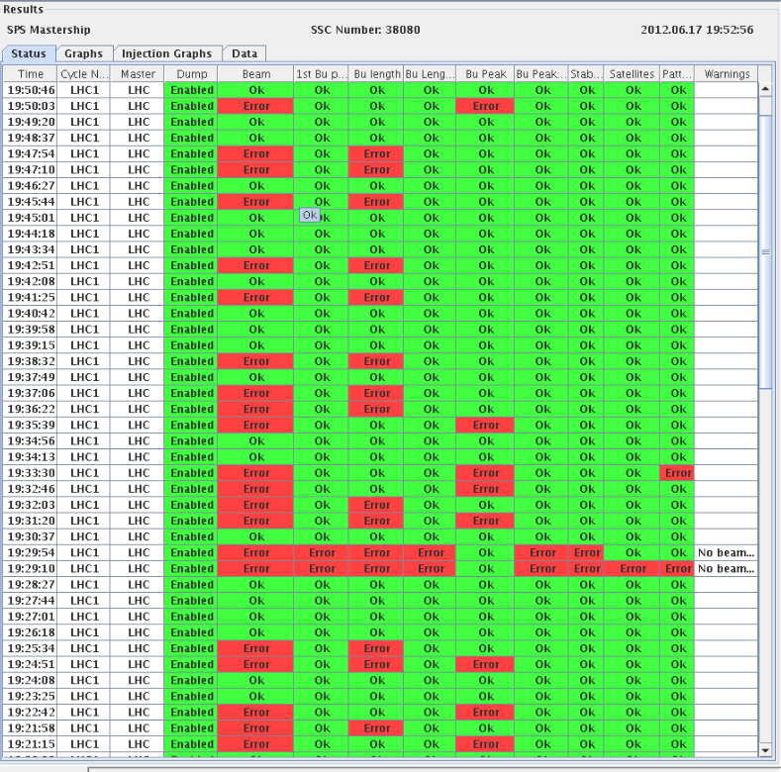
Injection from SPS still difficult Sunday eve
Same problems still at end of the week
Reduced intensities leading to lower initial lumi last fill

Slide 9
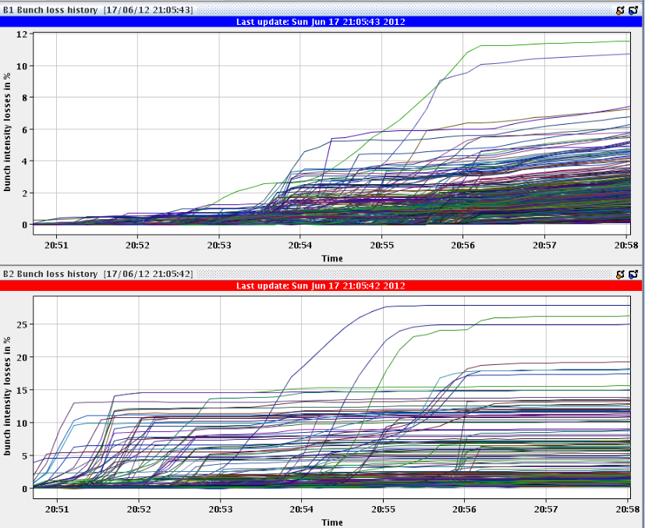
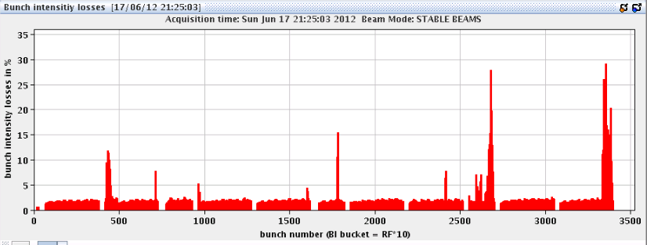
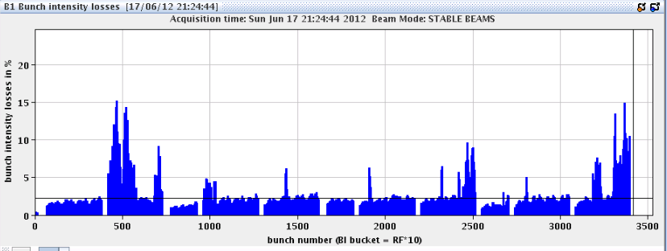
Fill from Sunday evening
Losses back beginning of fill, both beams, several manual tune trims to improve lifetime

Slide 10
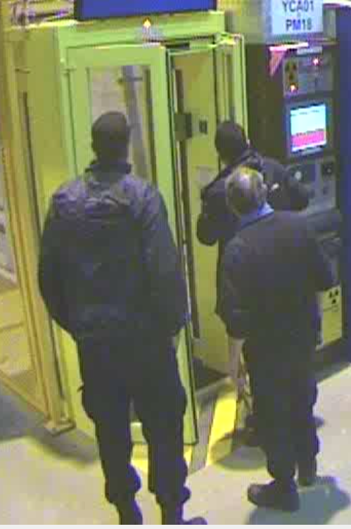
Fill #2725: Tuesday morning 3:02 am
Dumped during injection for physics
Beam dump caused by a wrong manipulation of the access door. CSR forced the PAD in PM18 to add a missing "plombage" on the internal handle.
This caused the loss of beams and of S12 and S81 as foreseen.
Security guard team opened the PAD, using their key. Apparently there was a "plombage" missing on the inside of the PAD, and they wanted to repair it!!! They tell us that CSA told them he had called the CCC and it was ok to touch the PAD. We did not know anything about the intervention.
Forcing a door at 03:02 in the morning…

Slide 11
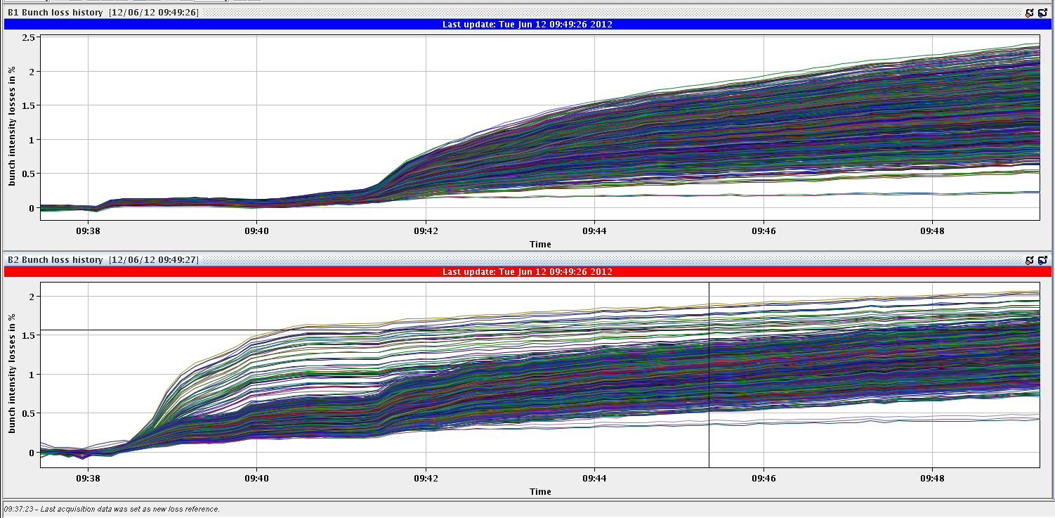
Bunch-by-bunch losses #2725
Low for both beams
B2: some bunches additional losses in squeeze
  This disappeared on later fills…and came back again…

Slide 12
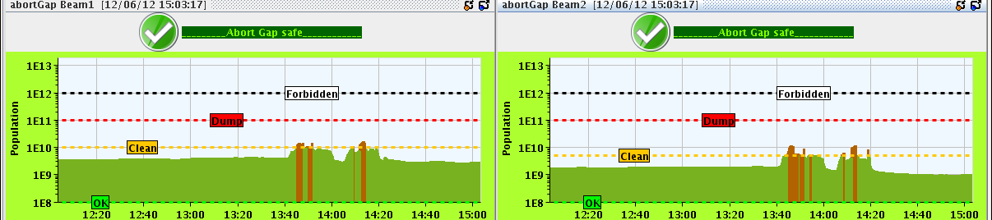
Abort gap population #2725
Around 13:45 the abort gap filled suddenly above cleaning threshold and kept filling.
The abort gap cleaning was switched on at LOW.
After about 15 min the abort gap population went back to a normal level.
10 min later the same thing happened again.
Since then the however abort gap is calm.
Abort gap cleaning is off. The RF experts have not found any explanation yet
  However, it did not come back after regenerating the RF functions which had a ‘funny’ in it, see next slide

Slide 13
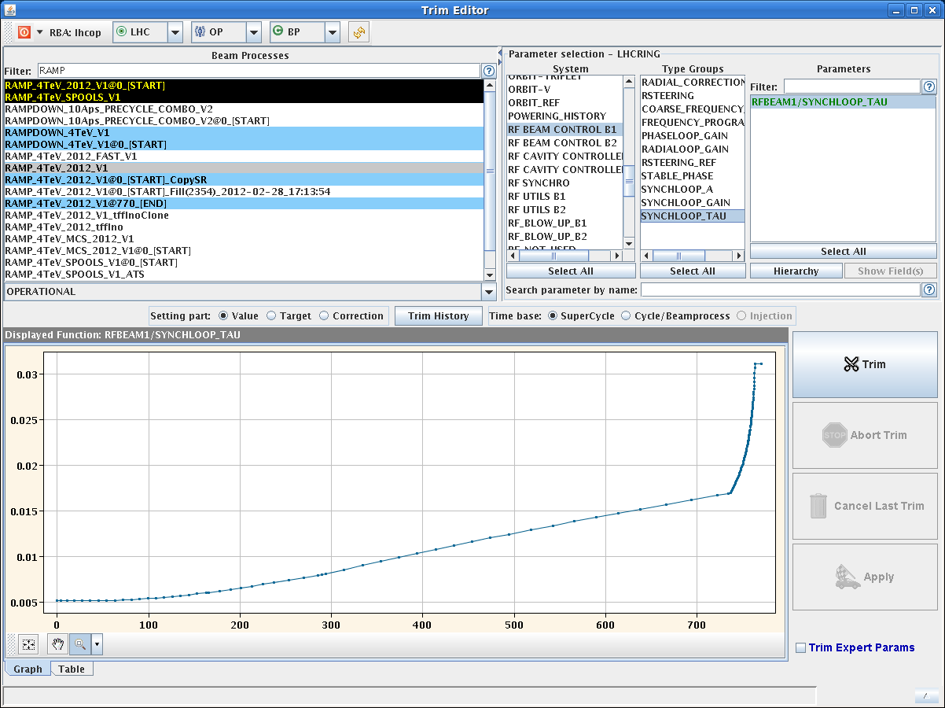
RF function (Synchro Loop)
The two functions had never been trimmed. The errors were present in 2011, and probably there since 2009...
With the new (correct) settings, the Synchro Loop should be more stable at high energy

Slide 14
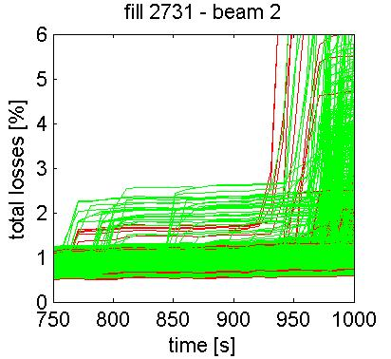
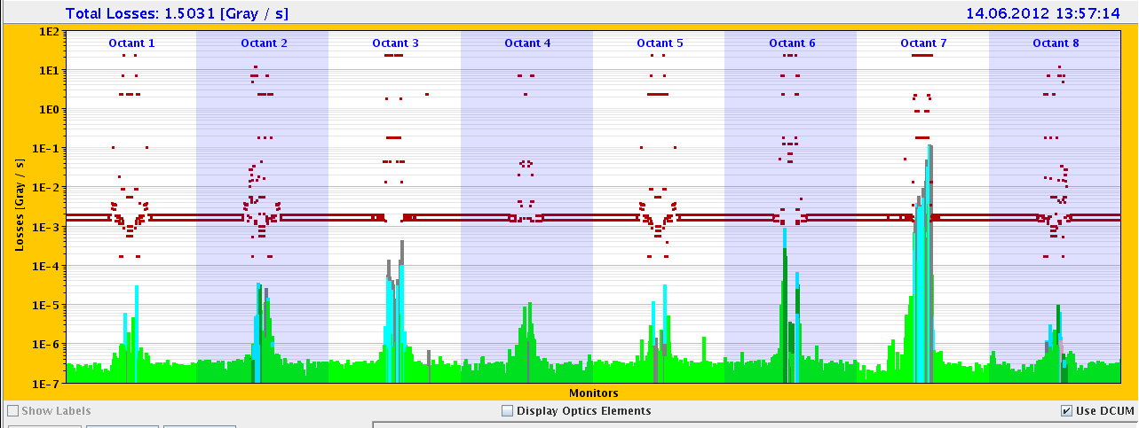
Beam Dump at Start of Adjust, Thursday PM
Losses show that this was a beam 2 problem only…
Also: All losses in IR7 → Betatronic, no longitudinal problem!
Losses on many bunches
Problem did not come back…

Slide 15
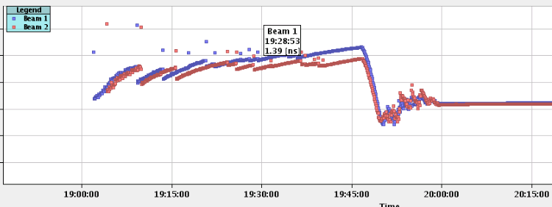
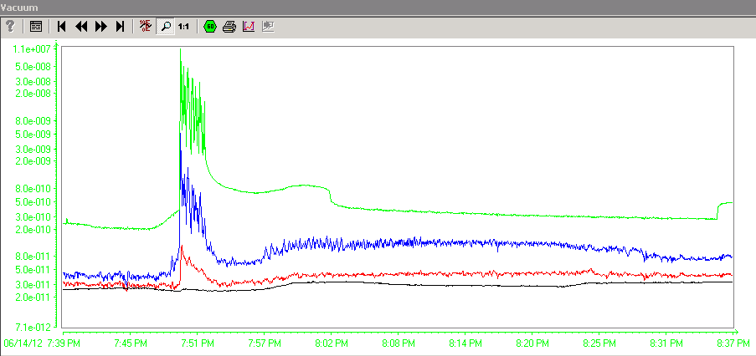
MKI Kicker Vacuum IL on Thursday
MKI vacuum interlock from 19:49:54 is understood:
  It just happened when we had the shortest bunch length at the start of the ramp and the vacuum signals look as e-cloud as well.
  Reset the vacuum interlock and soft start when we need to reinject.
Happened second time Sunday evening,
Similar this morning

Slide 16
Fri15:54 triplet RQX.L2 tripped
[ms]
[ms]
R.Schmidt / I.Romera

Slide 17
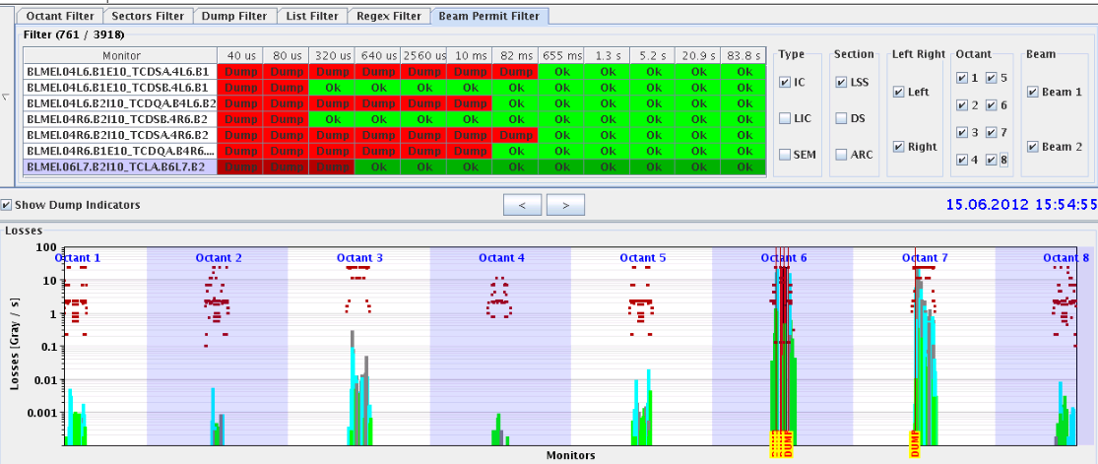
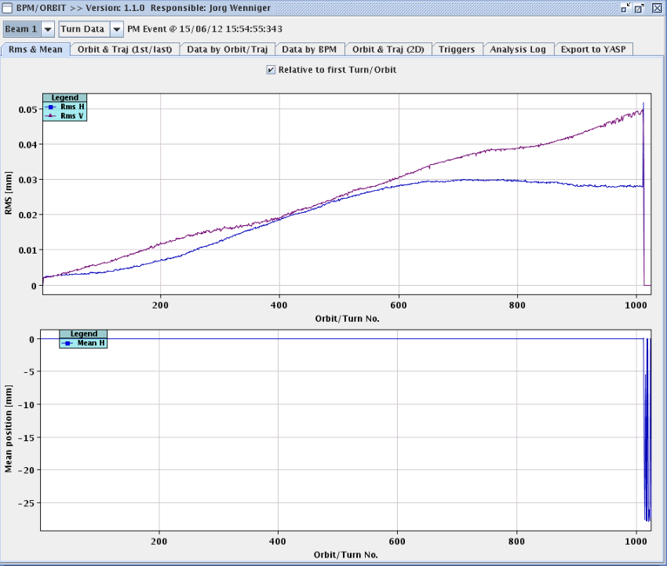
Fri15:54 triplet RQX.L2 tripped
The fault was originated by an internal problem on RTQX2.L2, which generated voltage oscillations of the three nested converters.
  I_ref had a sudden jump; that was probably due to the change of current of RQX2.L2 by -5 A
  This resulted in orbit oscillations
  Beam was dumped by fast losses on TCLA.B6L7.B2
  The pc tripped by overcurrent inside the RTQX1.L2, after 300 ms
    N.B. Behaviour of the PC (and protections) correct, apart for the initial current change (which is not clear whether is coming from the PC.)
    the subconverter 3 of RTQX2.L2 went probably in short-circuit
OK to continue, but check if improvement of protection on the longer term

Slide 18
Fri15:54 triplet RQX.L2 tripped
This has been one of the standard cases during the design of the MP system, and the reason for the diverse redundancy in the systems
We would not have dared to test such case with high intensity beams
MP worked as expected…..
EPC should investigate how to send out a Powering Failure event in such case
In order to no only rely on the BLMs, the Fast Beam Current Change Monitor is required …
R.Schmidt / I.Romera

Slide 19
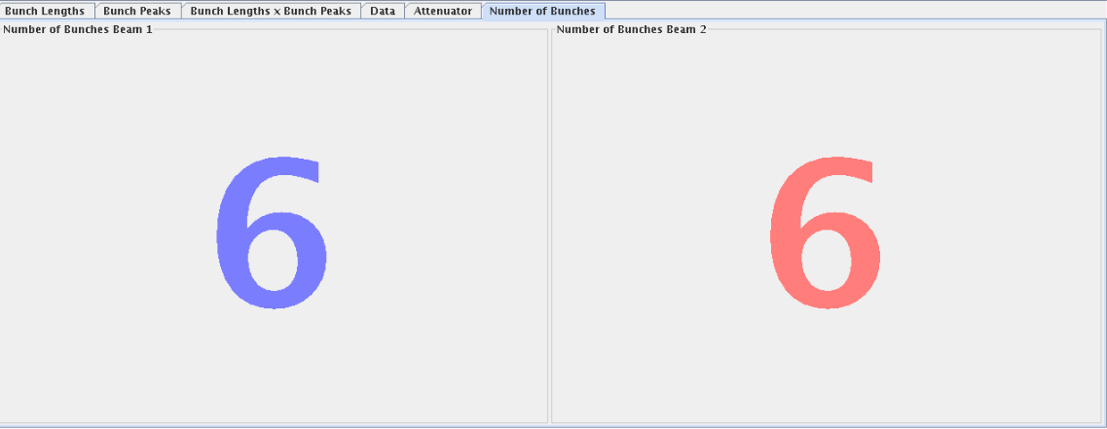
New Filling Scheme from Friday onwards
No problems

Slide 20
Injection kicker MKI temperatures
70° C
60° C
All time record temperatures

Slide 21
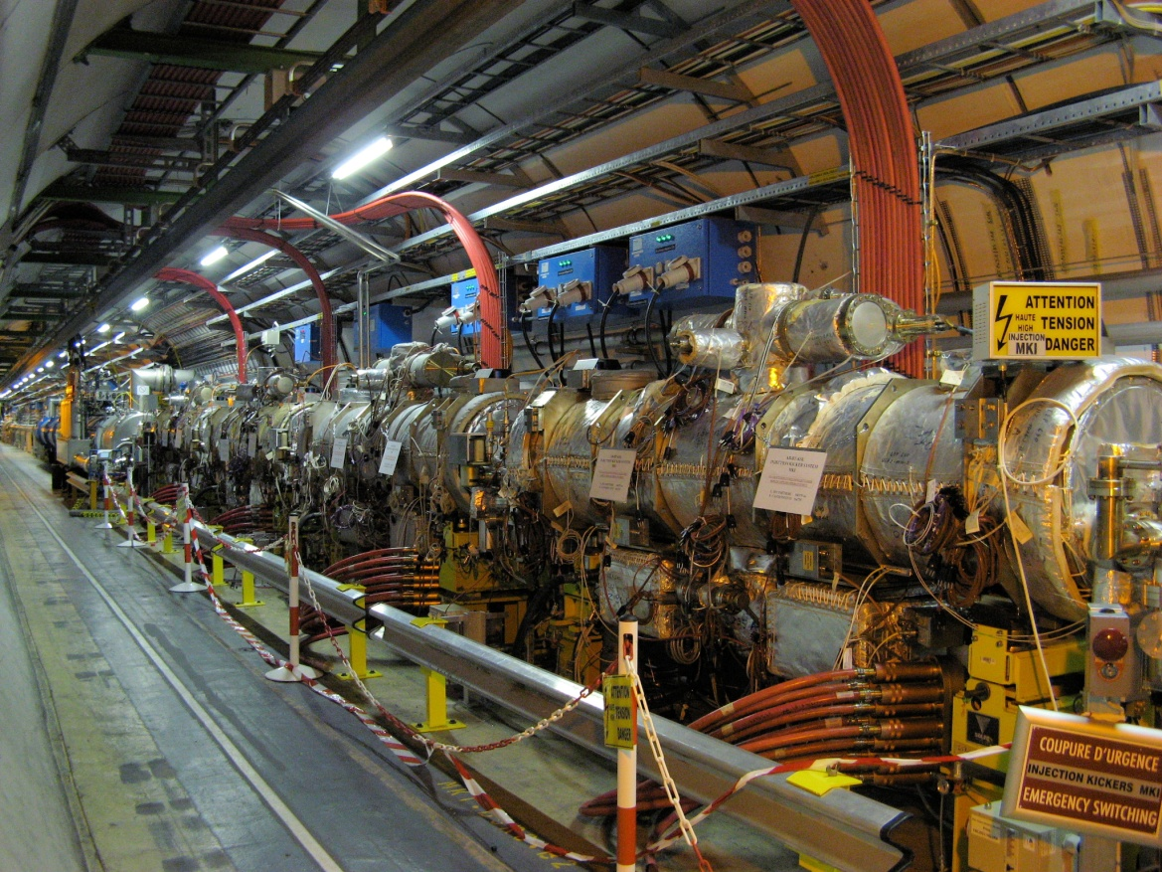
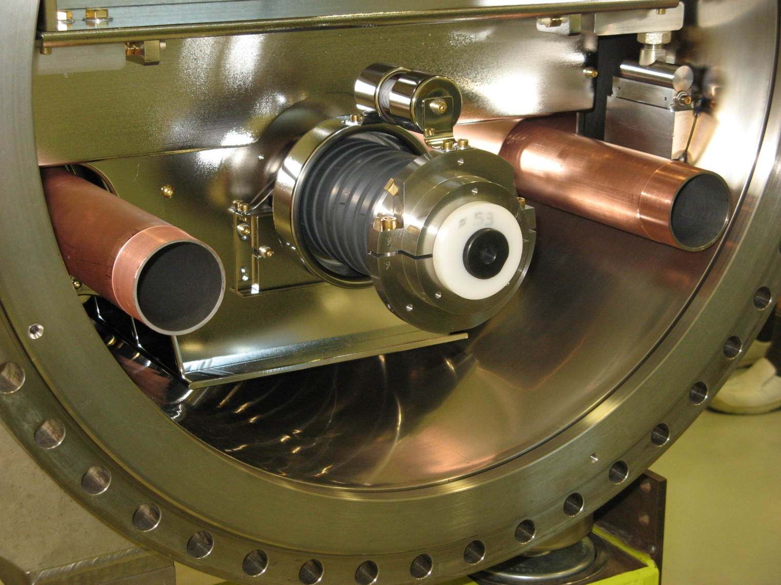
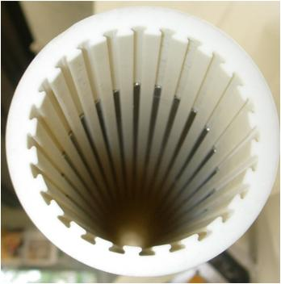
Injection Kicker MKI
Bake-out jackets to be removed in coming TS
Will (only) give a 5° C gain in measured temperature
Possibly new MKI-8D with more stripes in TS3
M.Barnes

Slide 22
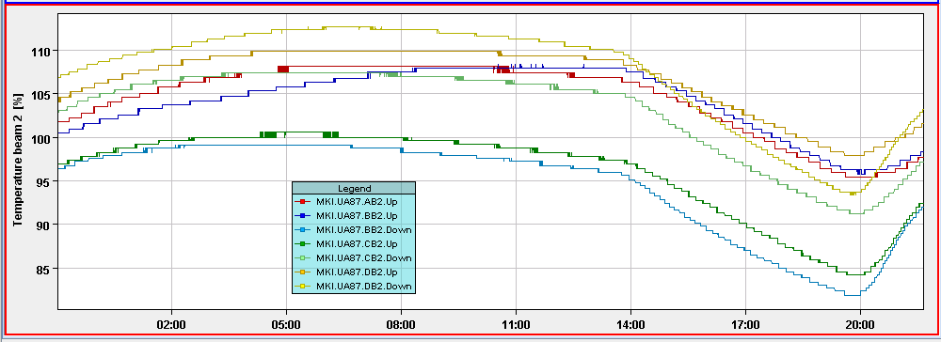
MKI cool down Sunday afternoon
For critical temperature MKI.DB2.UP
  07:00 Max temperature reached: 10 % above interlock
  13:40 Beams dumped, still 9 % above interlock
  18:35 Below interlock threshold
  Spent 1h25 minutes below threshold
Optimisation difficult…
18:35 OK
13:40 beams dumped
21:00 >IL

Slide 23
Planning Ahead (tbc by M.Lamont, Barbara Holzer)
Aim: Delivering lumi until start of the MD
  Dump early afternoon to allow for injection kicker cool-down
Clear majority of access list while MKI cooling down (depends on temp)
  Access:
    TCLIB.6R2.B1 electronics and LVDT sensor.
    MAD PM15: motors of inner doors not working (at least 4 hours).
    BI in Pt4 (3-4 hours, working hours).
    TOTEM vacuum gauge (3 hours).
    MCBV18.L4B1 and RCO.A12.B1 to be repaired / changed.
    LBDS Check/repair Ethernet connection on FEC cfc-ua63-mkdtspm. 1 hour during working hours, N. Magnin.
    Collimator cooling check TCT IR8 – Oliver Aberle
    Pt.7 (IMPACT: 18638) to exchange two amplifiers for the diamond BLMs. 2 hours (Ewald).
    BI: UA43 - lost remote communication with one of our controls front-ends. ½ hour.
    BI: Q7R4 (RF zone) - install attenuator and temperature probes on the HT- monitor to be retrieved during the next TS. ½ hour.
16:30 Impact of TETRA on hump / beam: 30 min. at injection with probe bunches.
  17:00 ADT: Pilot for 15min. 6b nominal for 15min.
18:00 Start of 90 m pre-MD
Tue 06:00 Start of MD block

