Slide 1
Wednesday 13th June
07:06 Beam dump fill #2746. Produced 142 pb-1. Electrical perturbation. ALICE and LHCb tripped. 3 PC on FMCM.
09:00 Update of RF synchro loop functions. Test of RF blow-up at injection.
10:16 re-injecting probes and injection for physics
11:41 Fill # 2728 Stable Beams. Inital lumi's 6.5e33 cm-2s-1
23:35 Beams dumped by operator. Integrated lumi about 170 pb-1
01:30 MKI temperatures OK again. About one hours wait.
Some problems with PM.
04:00 Fill #2729 Stable Beams. Initial lumi 6.5e33 cm-2s-1.
07:29 Beams dumped by BLM self trigger. Integrated lumi 68 pb-1

Slide 2
RF (Philippe & Team)
RF functions corrected
Two RF functions piloting the RF Synchro Loop (slow loop making the RF track the ramping frequency and keeping collision in the centre of detectors in physics) were not programmed correctly during the ramp (and in physics as this is extrapolated from end-ramp).
The problem was solved by "re-generating" the functions. The change is minimal at injection but large at 4 TeV.
The two functions had never been trimmed. The errors were present in 2011, and probably there since 2009... With the new (correct) settings, the Synchro Loop should be more stable at high energy.
Worked well in the next ramp
Batch by batch blow-up at injection
Did not work
RBAC privileges issues, so that phase noise excitation could not be started on the first 12b batches injected. Cannot be solved in the allocated time -> revert for physics fill

Slide 3
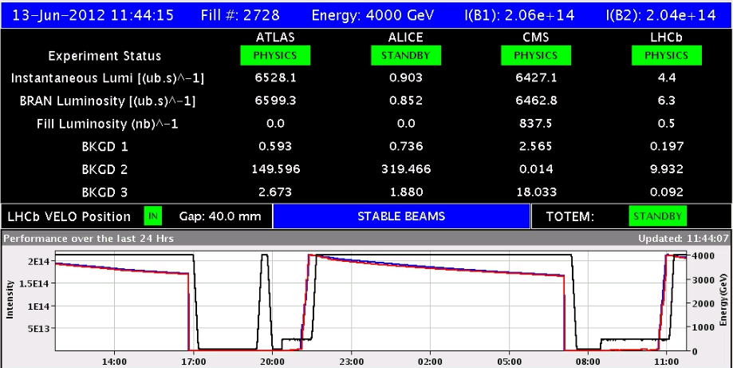
Fill #2728 – anything more to say?
Twice good turnaround, despite ‘special tasks’
Good initial lumi
Fill lasted…
Access
RF

Slide 4
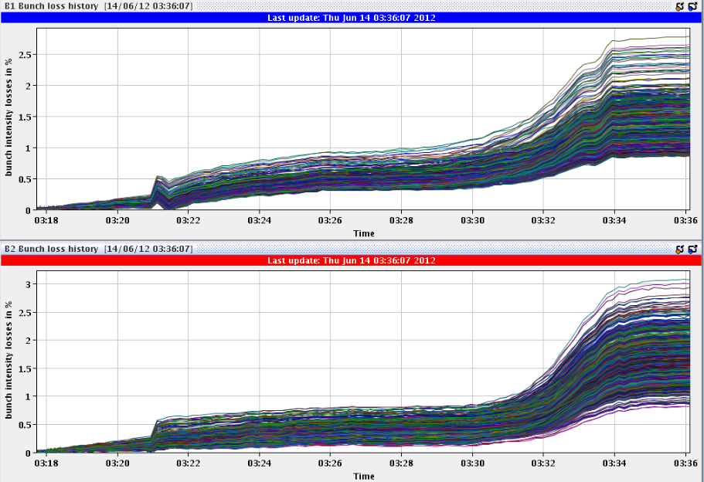
Fill #2729
Losses on B2 only at start of squeeze, seen on previous fills, were not there on the last fill.

Slide 5
MKI temperatures
Relative plot
Five temperatures just above threshold, including MKI.8D.Down
Absolute plot
MKI.8D.Down hottest and cannot increase limit

Slide 6
Planning ahead
Delivering luminosity…
To be done…
RF:
Synchro loop control functions: corrected
Long. blow-up at injection: tried it, to be re-visited after TS
New filling scheme: 6 non colliding bunches for ATLAS/CMS
Under discussion
Impact of TETRA on hump / beam.
30 mins at injection with probe bunches.
Access:
TCLIB.6R2.B1 electronics and LVDT sensor.
MAD PM15: motors of inner doors not working (at least 4 hours).
BI in Pt4 (3-4 hours, working hours).
TOTEM vacuum gauge (3 hours).
MCBV18.L4B1 and RCO.A12.B1 to be repaired.
LBDS Check/repair Ethernet connection on FEC cfc-ua63-mkdtspm. 1 hour during working hours, N. Magnin.
Collimator cooling check TCT IR8 – Oliver Aberle.

