Slide 1
LHC Status Tue Morning 5-June
Bernhard Holzer, Joerg Wenninger
Status yesterday morning
Plan:
TCSG alignment verification in point 6 (B2) (1 hour)
Physics
Pending:
Scan up to 3 sigma (CMS). Propose to do that with reduced damper gain at the end of the fill.
Verification of impact of TETRA and GSM transmission on the tunnel (30 mins with pilot beam at injection)
Accesses:
TCLIB.6R2.B1 electronics and LVDT sensor
MAD PM15: motors of inner doors not working
RQTL11.R7B2 temp DFBAN spikes affecting cryo start but not CM (~3 to 5 hours)

Slide 2
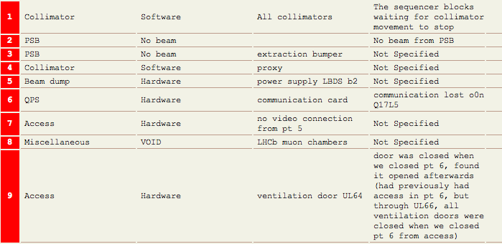
Mon Morning
08:06h no beam, power supply is down, access needed for LBDS beam 2.
QPS team needs an access
... and for LHCb / and...
12:46h start precycle
13:49h LHC closed
14:29h injection probe beam

Slide 3
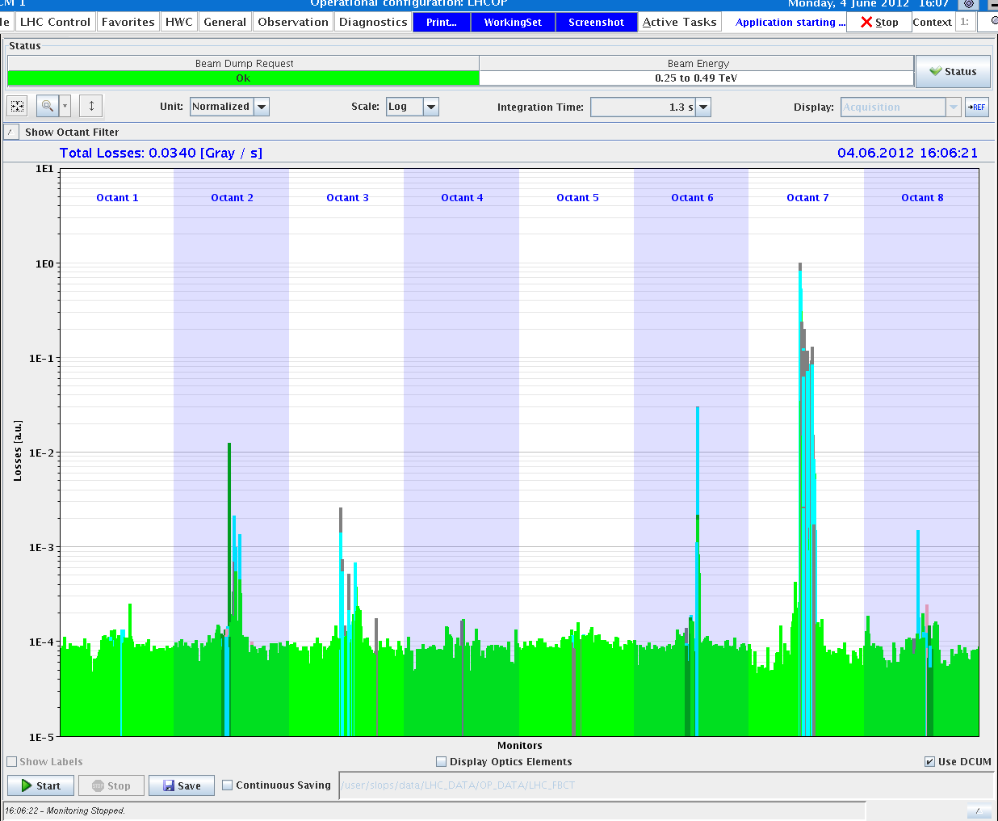
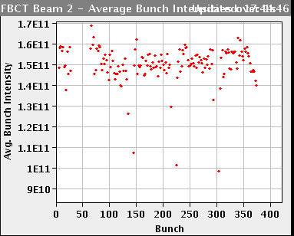
Mon Late
14:29h Starting alignment of IR6 TCSGs in B1 and B2
including a number of Loss maps in b1 & 2, h & v
references for the SIS beam position interlock in IR6
(wrt center of the TCSG) have been updated
with the current orbit
16:43h waiting for (good) beam
SPS problem: first bunch of each
train is not well injected:
investigating the kickers
-> replacing a switch

Slide 4
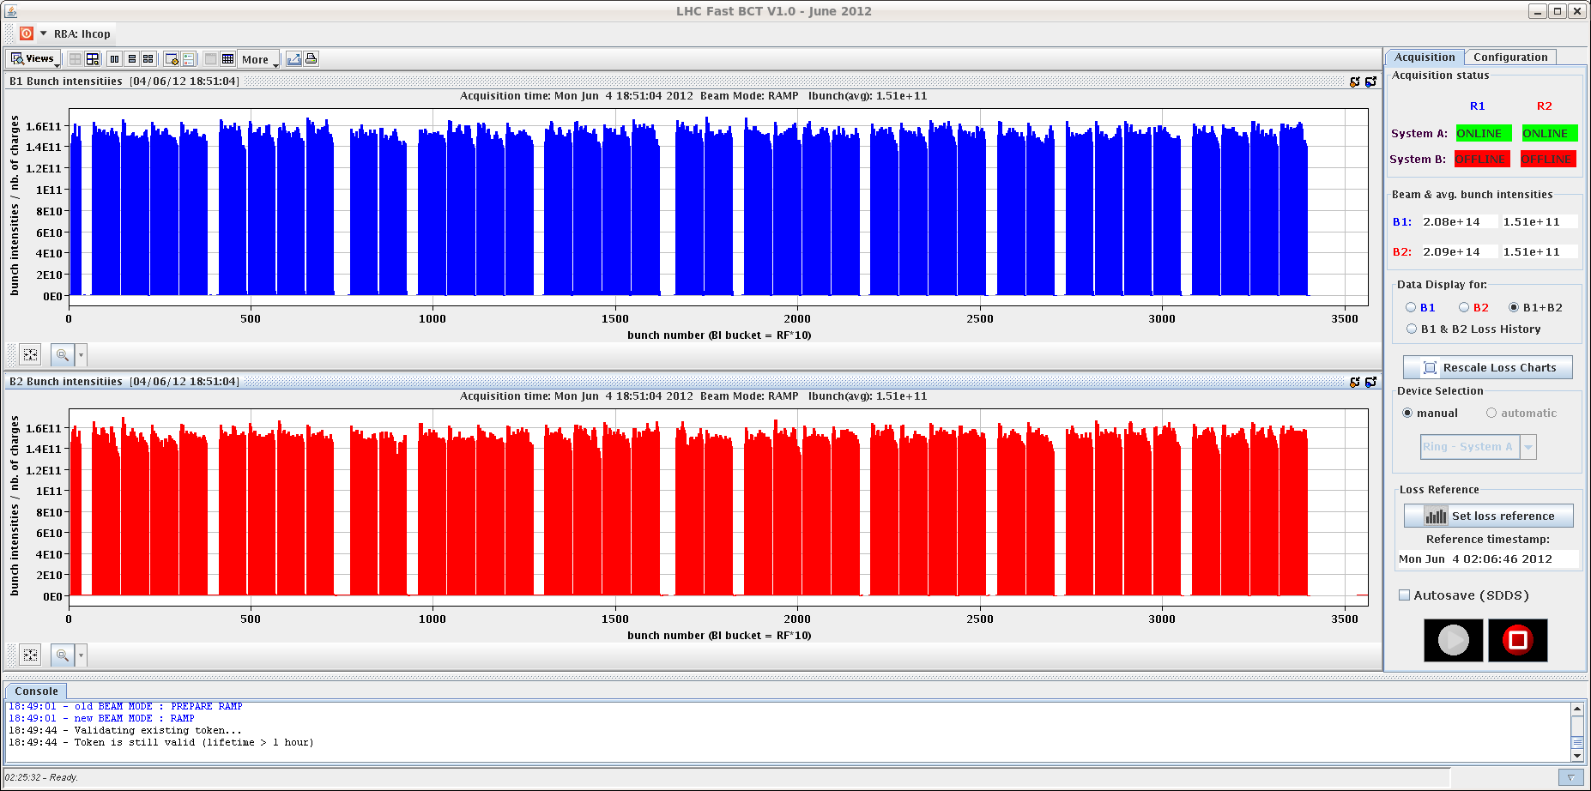
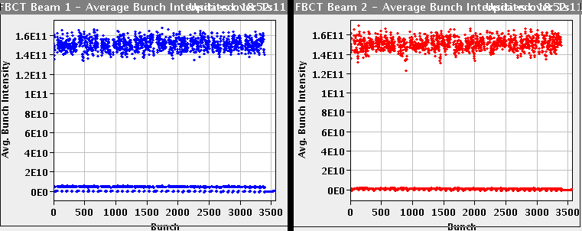
Mon Late
18:18h injection for physics
clean injection !
19:26h stable beams
in 5 hours
00:25h beam dump: Vacuum system trigger
Vacuum communication problem UX451 access needed

Slide 5
Mon Night
A chassis had a short circuit that caused a local power cut to a set of vacuum pumps and gauges in the D4R4 area, and as a result of the short circuit, the VGI.1025.5R4.B electronics burned
02:50h injection probes
03:55h injection for physics .. a bit problematic in beam 1
05:52h new fill in, start ramp

Slide 6
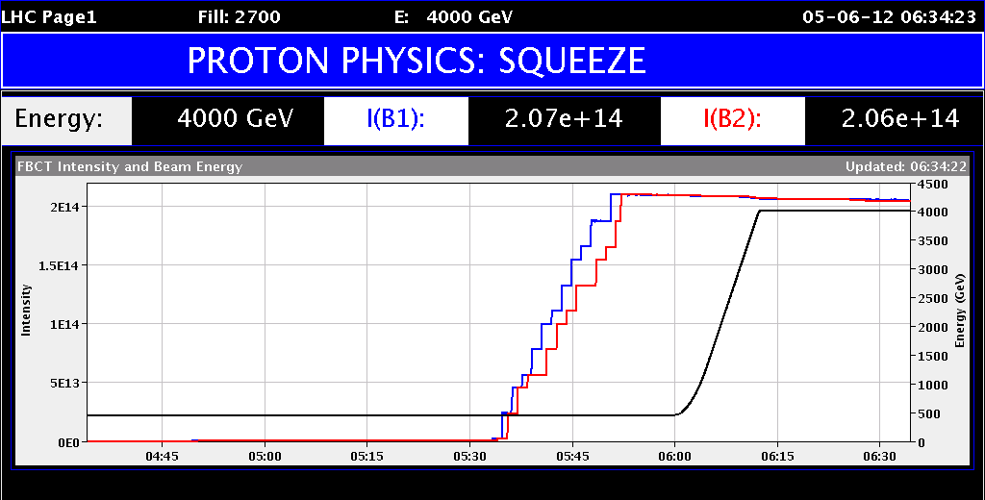
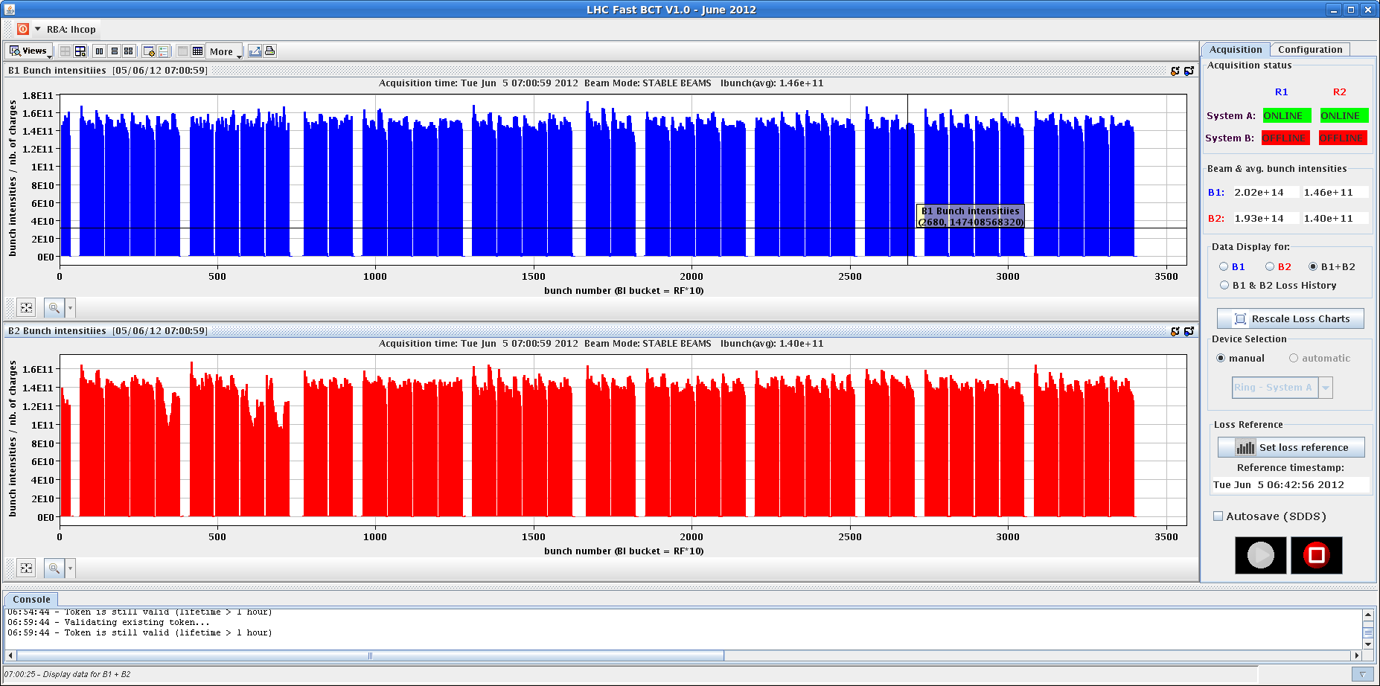
Tue Morning
06:30h stable beams
Nota bene: Beam losses going into collision ... with LHCb POSITIVE

Slide 7
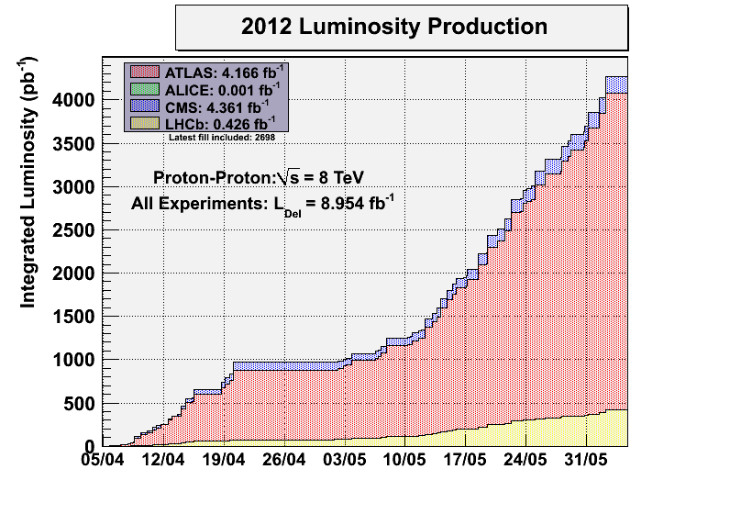
Tue Morning
06:30h stable beams
07:34h unfortunately ...
ATLAS' solenoid tripped...to be discussed
my goal: 150 pb ⁻¹ per day

Slide 8
Plan:
TCSG alignment verification in point 6 (B2) (1 hour)
Physics
Pending:
Scan up to 3 sigma (CMS). Propose to do that with reduced damper gain at the end of the fill.
Verification of impact of TETRA and GSM transmission on the tunnel (30 mins with pilot beam at injection)
Accesses:
TCLIB.6R2.B1 electronics and LVDT sensor
MAD PM15: motors of inner doors not working
RQTL11.R7B2 temp DFBAN spikes affecting cryo start but not CM (~3 to 5 hours)
✔
✔

