Slide 1
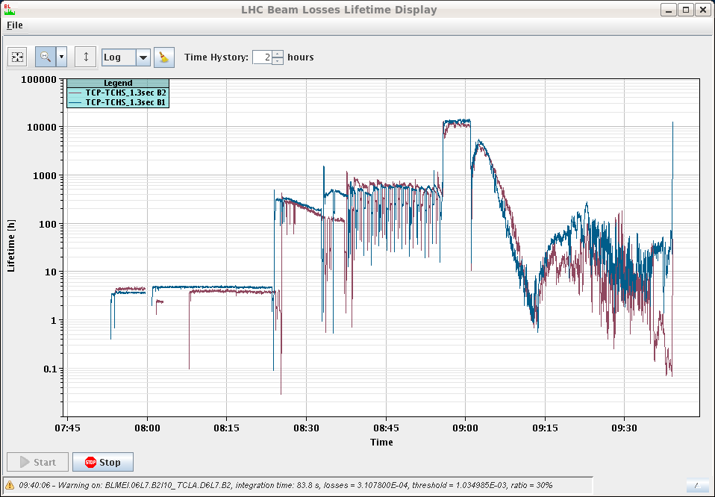
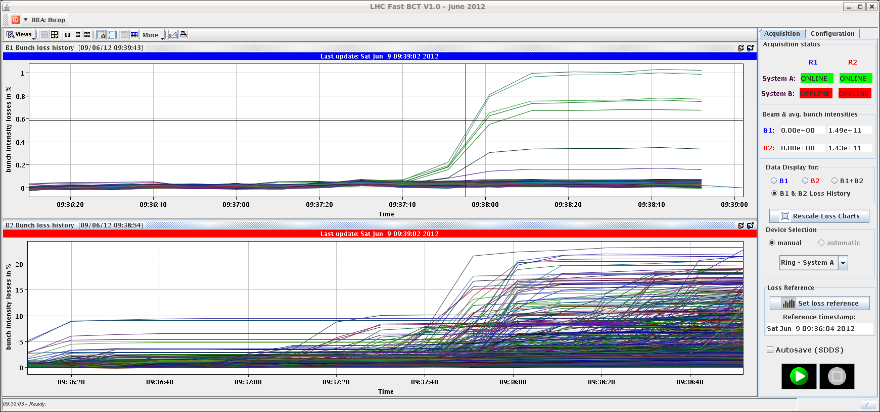
Saturday
09:40 Fille 2716 lost when going into collisions.
Heavy losses on B2, starting already before colliding.
Large(r) bunch int. spread.

Slide 2
Saturday-Sunday
Between fills trimmed Q’ H up by +2 in squeeze / collision to reach +1 (from night’s measurement).
11:30 Refilling – still rather large bunch spread, but emittances are OK.
Again some OFSU problems.
13:00 Stable beams fill 2717, 6.3E33 cm-2s-1.
B2 loosing 2-3 more than B1 (not un-common).
Some DIP communication hick-ups.
04:45 Beam dumped, RF B2 (M1) klystron fault, circuit breaker.
Integrated L 199 pb-1.
06:00 Access for RF and EL piquet.

Slide 3
Sunday
07:30 Injecting again.

Slide 4
For discussion – Leap second
Saturday 30th June at 23:59:59 a leap second will be added to the UTC time.
This will shift NTP time distributed over the network from the UTC time distributed by the timing systems (all machines).
Question from timing team:
Can the re-synch be done Mo 2nd July (all machines) or does it have to be done in the night of 30th June?
Clearly the logging from difference source will be out of step.

Slide 5
Pending
Impact of TETRA on hump / beam.
30 mins at injection with probe bunches.
SPS Q20 extraction tests to TI2/8 downstream TED.
During LHC downtime – would need Pt2/8 closed, injection OK from ALICE/LHCb.
Accesses:
TCLIB.6R2.B1 electronics and LVDT sensor
MAD PM15: motors of inner doors not working
RQTL11.R7B2 temp DFBAN spikes affecting cryo start but not CM (~3 to 5 hours).
BI in Pt4 (3-4 hours, working hours).
MKA test in Pt4 (1-2 hours).
TOTEM vacuum gauge (3 hours).
MCBV18.L4B1 to repair.
RCO.A12.B? to repair.

