Slide 1
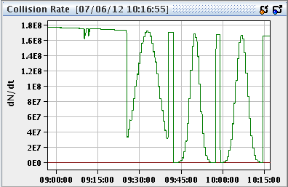
Thursday
09:30 VdM scan for CMS, standard ADT gain.
First scan with +- 3 sigma TOTAL separation (we were not sure about the GUI).
Then 2 scans with +- 6 sigma TOTAL separation.
No problems, no losses.

Slide 2
Thursday
10:15 Test with reduced ADT H gain.
Separation in IR1 & IR5.
Increased activity on tune with reduced ADT gain and with separation.
Activity on the batches of 72 bunches (B1 &B2) on the ADT side, losses on a few isolated bunches of B1.

Slide 3
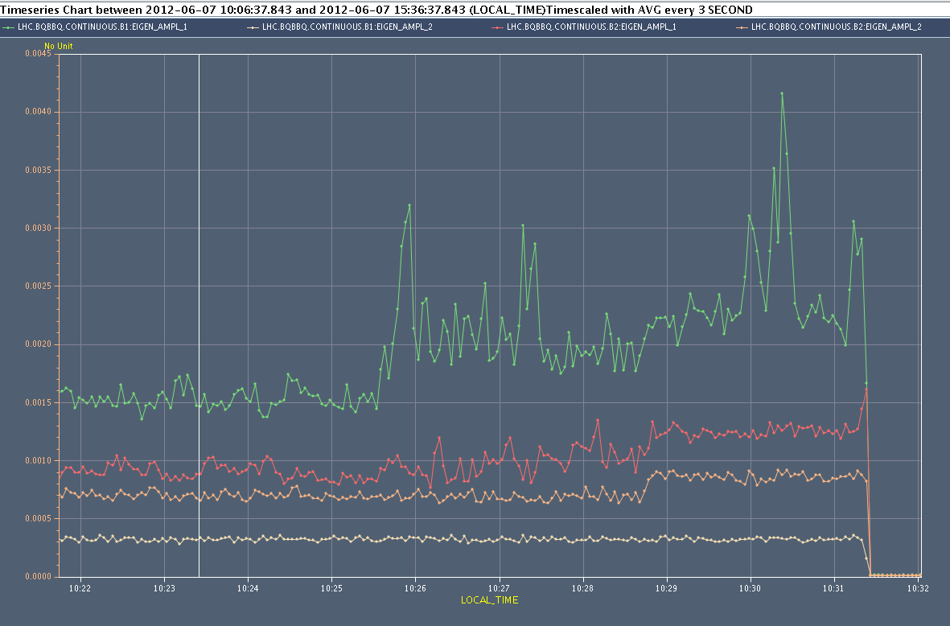
ADT test
BBQ activity
ADT gain
Separation

Slide 4
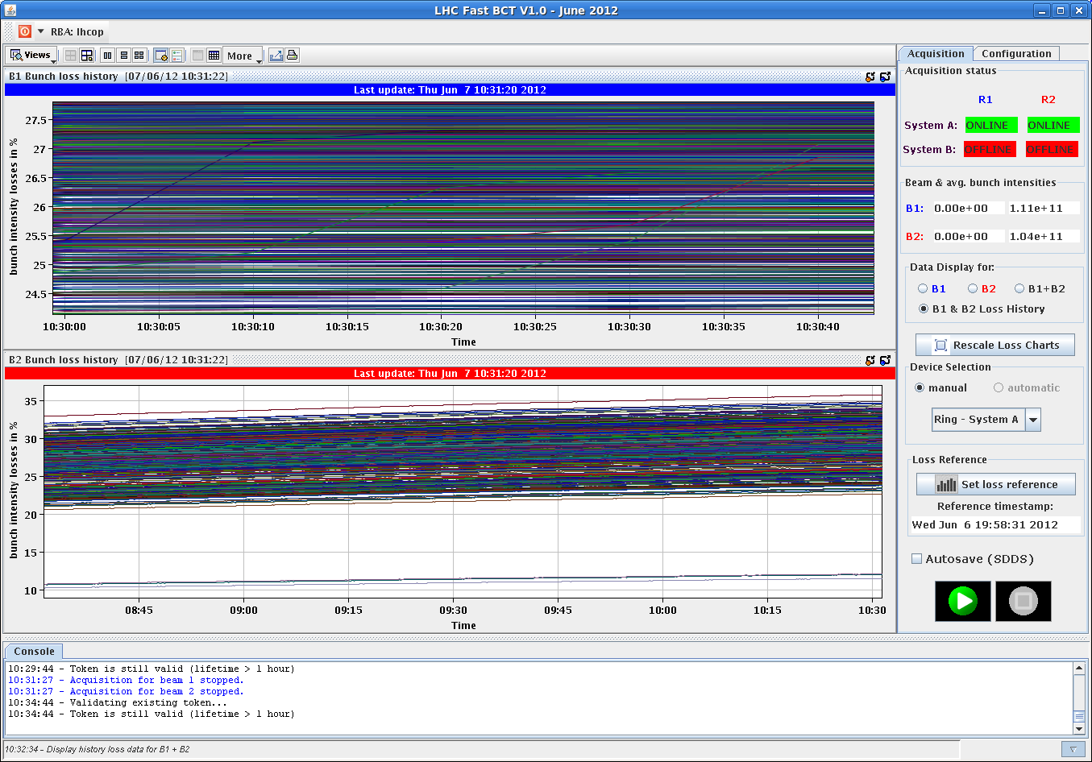
ADT test
Losses, B1

Slide 5
Thursday
Beam dump due to patrol loss/access door in PM56, with 200 pb-1 integrated in the fill.
The door (YCPS01=PM45) opened because it was not properly closed (but seen closed by the LASS contacts). Probably the effect of a pressure change…
This situation can actually be detected, but no info in the CCC.
Asked GS to get a simple view to detect such situations.
Another door in Pt2 was in the same state → went in to close it.
Patrol in PM56, access for ALICE, cryo in Pt8.
15:00 Filling again. ½ ADT modules trip during filling – vacuum.
Managed to switch on after a few minutes. Gauge trips after vacuum spikes. Recurrent problem → exchange in TS2.

Slide 6
Thursday evening
17:00 Stable beams fill 2710, 6.4E33 cm-2s-1.
19:45 Beam dump, electrical perturbation – FMCM and RQ4.L3 trip. 52 pb-1 integrated luminosity.
RQ6.R7B2 trip when moving to start of ramp-down.
Recovering some RF lines that had tripped required rebooting a number of crates.
Perturbation on D1 : 0.6 A / 380 A

Slide 7
Thursday evening+
Refill delayed to 21:00 due to PS mains problem.
22:50 Stable beams fill 2712, 6.6E33cm-2s-1.
Problem with the heating system of the current lead of RQ7.R1. Access required in RR17 today at the end of the fill.
Keep this fill until ~10:00-10:30, then access for cryo.
From a few minutes to 1-2 hours.

Slide 8
Pending
Impact of TETRA on hump / beam.
30 mins at injection with probe bunches.
SPS Q20 extraction tests to TI2/8 downstream TED.
During LHC downtime – would need Pt2/8 closed, injection OK from ALICE/LHCb.
Accesses:
RQ7.R1 lead heating.
TCLIB.6R2.B1 electronics and LVDT sensor
MAD PM15: motors of inner doors not working
RQTL11.R7B2 temp DFBAN spikes affecting cryo start but not CM (~3 to 5 hours).
BI in Pt4 (3-4 hours, working hours).
MKA test in Pt4 (1-2 hours).
TOTEM vacuum gauge (3 hours).
MCBV18.L4B1 to repair.

Slide 9
For discussion – Leap second
Saturday 30th June at 23:59:59 a leap second will be added to the UTC time.
This will shift NTP time distributed over the network from the UTC time distributed by the timing systems (all machines).
Question from timing team:
Can the re-synch be done Mo 2nd July (all machines) or does it have to be done in the night of 30th June?
Clearly the logging from difference source will be out of step.

